Slide 1

Unit 4: Holidays!
Lesson 4f: Skills
Page 80

Slide 2
Lesson Outline
Warm-up
Vocabulary
Reading
Consolidation
Wrap-up

Slide 3
Objectives
By the end of this lesson, students will be able to…
use words related to holiday: plant, resort, bottom, trek.
read the texts about holiday for main ideas and important details.

Slide 4

WARM-UP

Slide 5

Work in pairs.
Choose the word whose underlined part is
pronounced differently from that of the other words.
1. A. colour B. hotel C. mother D. lover
2. A. busy B. sunny C. lucky D. ugly
3. A. time B. night C. bike D. fish
/ˈkʌlə(r)/
/həʊˈtel/
/ˈmʌðə(r)/
/ˈlʌvə(r)/
/ˈbɪzi/
/ˈsʌni/
/ˈlʌki/
/ˈʌɡli/
/taɪm/
/naɪt/
/baɪk/
/fɪʃ/

Slide 6
Work in pairs.
Discuss the following questions:
Where do you often go on holiday?
Do you often share about your holiday with your friends? Why?
What are your favourite activities on holiday?
I often go to the beach on holiday.
Yes, I like sharing about my holiday with my friends because I want to share my happiness with them.
My favourite activities on holiday are swimming in the sea, eating seafood, and going sightseeing.

Slide 7

It’s time to learn …

Slide 8
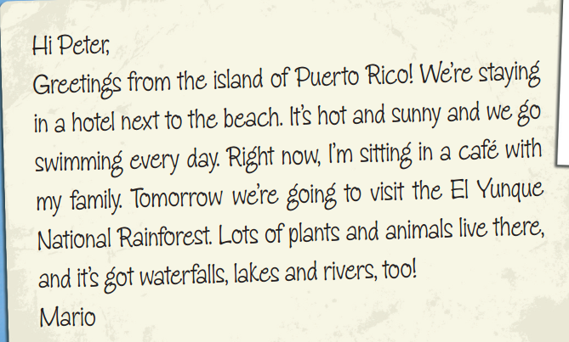
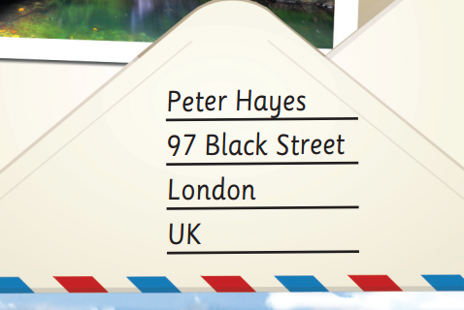
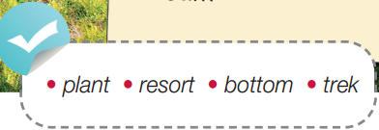
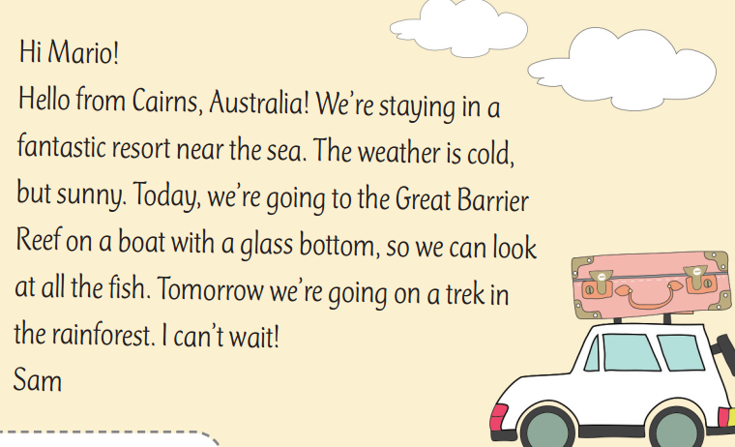
Pre-reading
Find these words in the text, try to guess their meanings.

Slide 9

Vocabulary
Listen and repeat.
plant /plɑːnt/ (n): thực vật
resort /rɪˈzɔːt/ (n): khu nghỉ dưỡng
bottom /ˈbɒtəm/ (n): phần dưới cùng, phần đáy
trek /trek/ (n): chuyến đi bộ đường dài (đường rừng/đồi núi)

Slide 10
Choose suitable words to complete each sentence:
Extra Practice
plants * resort * bottoms * trek
The _________ of your shoes are dirty.
They had a very long _________ from the mountain to our home yesterday.
There are many _________ growing in my garden.
We are going to stay in a very beautiful _________ for our next holiday.
bottoms
trek
plants
resort

Slide 11
Pre-Reading
Read the instruction quickly. Underline the key words. What are we going to do?
Look and choose

Slide 12
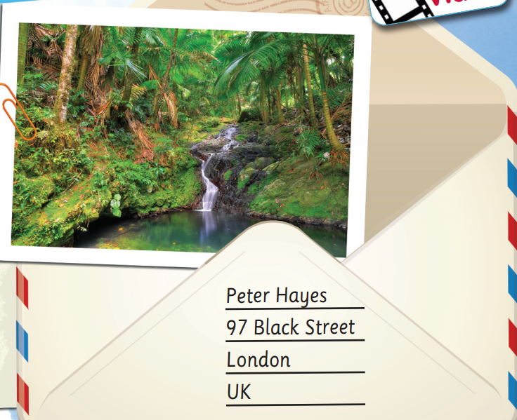
While-reading
Which is a letter? a postcard?
The first text is a postcard. The second is a letter.
Where is Mario? Sam?
=> Mario is in Puerto Rico. Sam is in Cairns, Australia

Slide 13
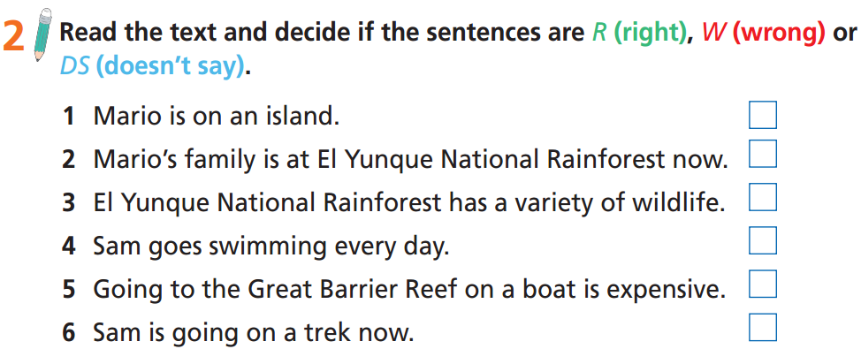
Read the instruction quickly. Underline the key words. What are we going to do?

Slide 14
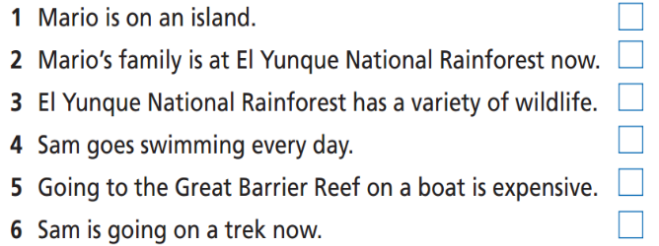
While-reading
R
W
R
DS
DS
W

Slide 15
Read the text and answer the following questions:
Extra Practice
Who is Mario going on holiday with?
What does Mario do every day on his holiday?
What’s the weather like on Sam’s holiday?
What is she going to do on the next day?

Slide 16
Read the text and answer the following questions:
Extra Practice
Read the task and underline the key words.
Who is Mario going on holiday with?
What does Mario do every day on his holiday?
What’s the weather like on Sam’s holiday?
What is she going to do on the next day?

Slide 17
Now, read again to check the answers.
Who is Mario going on holiday with?
Mario is going on holiday with
his family.

Slide 18
Now, read again to check the answers.
2. What does Mario do every day on his holiday?
He goes swimming every day
on his holiday.

Slide 19
Now, read again to check the answers.
3. What’s the weather like on Sam’s holiday?
It’s cold but sunny.

Slide 20
Now, read again to check the answers.
4. What is she going to do on the next day?
She is going on a trek in the
rainforest.

Slide 21
Discuss the following question:
Read texts about the two holidays on page 80 again. Which holiday would you choose? Why?
Post-reading
Work in pairs
I would choose the holiday to the island of Puerto Rico because I like hot and sunny weather. I like swimming in the sea and going to waterfalls.

Slide 22
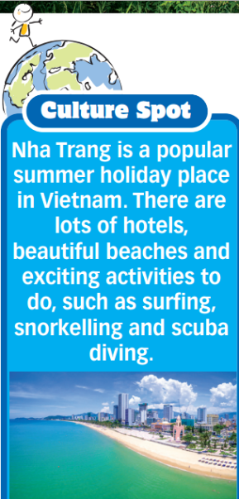
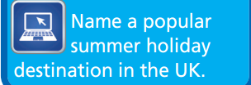
Work in groups
Think of a summer holiday destination in the UK, find pictures online, and make a poster with some short descriptions about that place (like in the poster about Nha Trang). Then present it to the class.
E.g.
Blackpool is a popular summer holiday destination in the UK. It's a fantastic resort.

Slide 23

CONSOLIDATION

Slide 24
Imagine you are going on holiday. Write a paragraph (50 – 70 words) about your holiday. You can use the following information:
• Where is your holiday destination? Why?
• Where are you staying (e.g. hotel, resort, homestay, etc.)?
• How do you feel about that hotel/resort/homestay/ etc.?
• What’s the weather like?
• What are you doing today?
• What are you going to do tomorrow?
• How do you feel about the holiday?

Slide 25
Imagine you are going on holiday. Write a letter (50 – 70 words) to your friend and share what you do on your holiday.
e.g.
I’m going on holiday to Vung Tau Beach. We only have a short holiday, so we choose a place near my house. We are staying in a hotel. It’s cheap and comfortable. The weather is hot and sunny. Today we are swimming, eating seafood, and walking along the beach. Tomorrow, we are also going to swim, go sightseeing, and try more local food. I love this holiday.

Slide 26

WRAP-UP

Slide 27
Today’s lesson
Vocabulary
plant
resort
bottom
trek
Reading
read the texts about holiday for main ideas and important details.

Slide 28
Homework
Practise the vocabulary and make sentences using them.
Do the exercises in TA 6 Right on WB (p. 43).
Prepare for the next lesson (p. 81 SB).
Do Unit 4 Test 1 in Bài Tập Bổ Trợ TA 6 Right on (pp. 34-35).

Slide 29
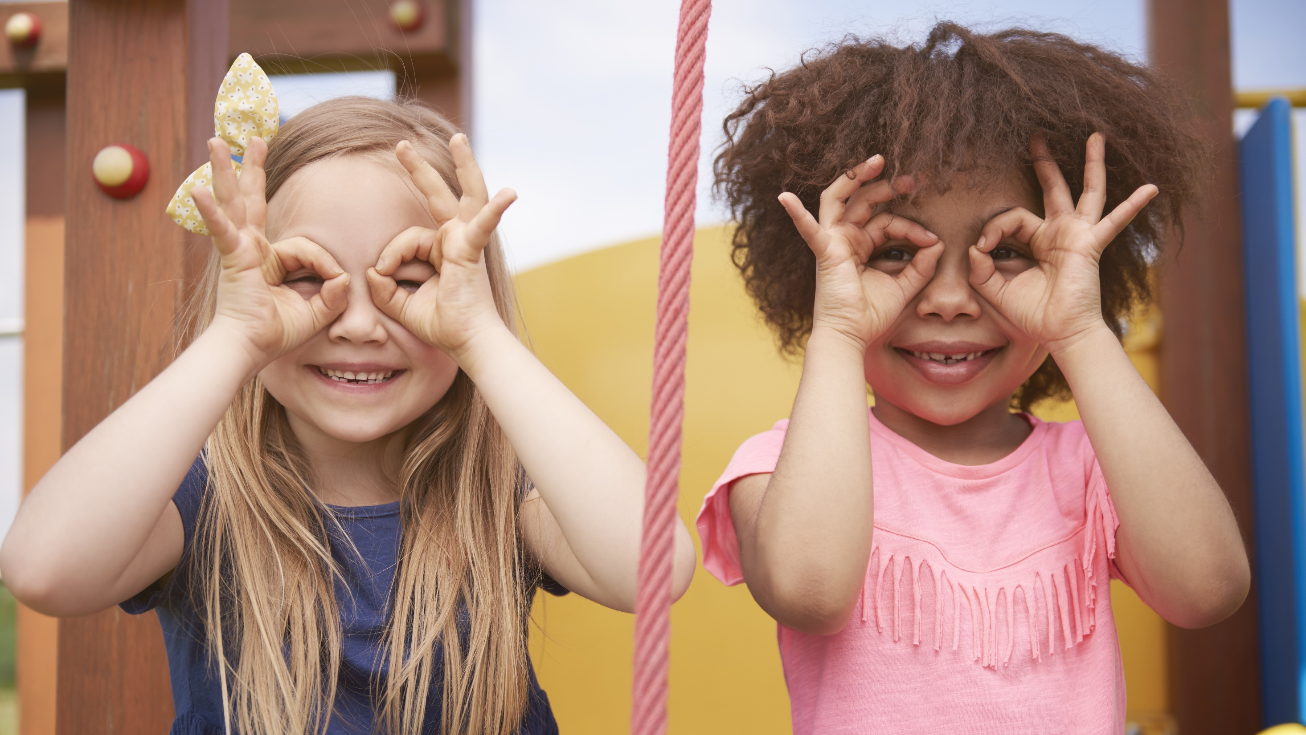
Enjoy your day!

