Slide 1


Slide 2
HUMAN ACTIVITIES AND GLOBAL WARMING
Unit
5
GLOBAL WARMING
Unit
FAMILY LIFE
LESSON 4
SPEAKING
Student Book – page 56

Slide 3
LESSON 4
SPEAKING
WARM-UP
Matching game
CONTROLLED PRACTICE
Task 1: Match the activities with their effects.
Task 2: Complete the conversation.
LESS CONTROLLED PRACTICE
Task 3: Talk about the other human activities that contribute to global warming.
FREE PRACTICE
Task 4: Decide which human activity contributes to global warming the most.
CONSOLIDATION
Wrap-up
Homework

Slide 4


WARM-UP
MATCHING GAME
Work in groups.
Match the cream (cause) with the correct bowl (effect) to make a perfect parfait.
Raise hands to take turns for your group.

Slide 5
WARM-UP
The snow fell all night.
It rained all week.
Lightning struck the tree.
Ice on the poles is melting.
Schools and factories are closed today.
It burned and blocked the road.
The town was flooded.
Sea level is rising.

Slide 6
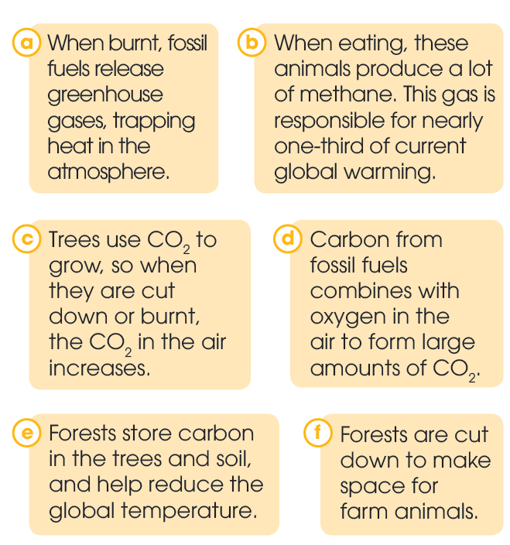
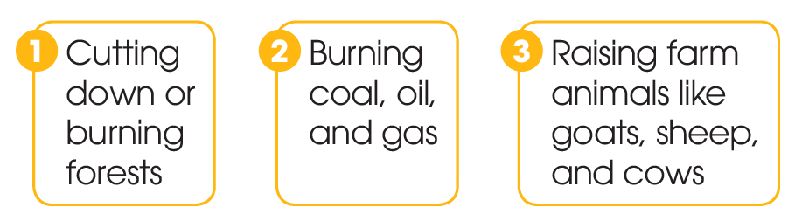
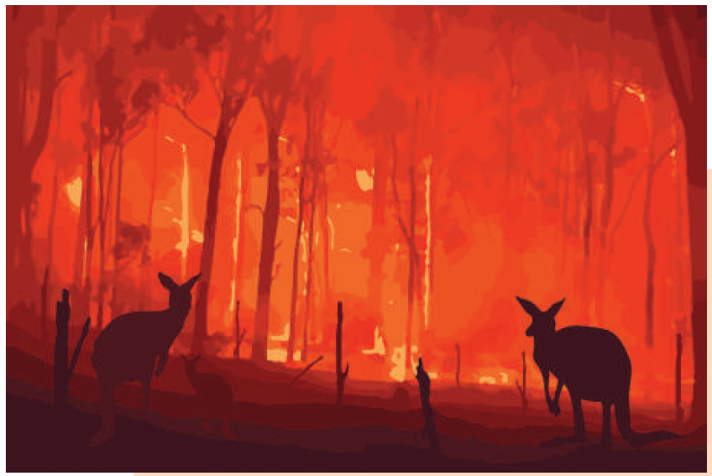
CONTROLLED PRACTICE
1
Match the activities (1–3) with their possible effects on the environment (a–f).
KEYS
1. c, e
2. a, d
3. b, f

Slide 7
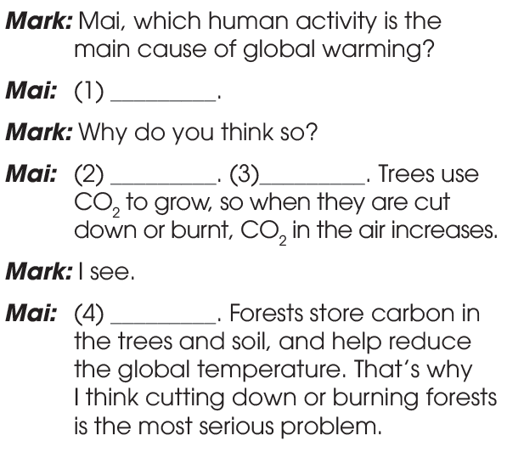
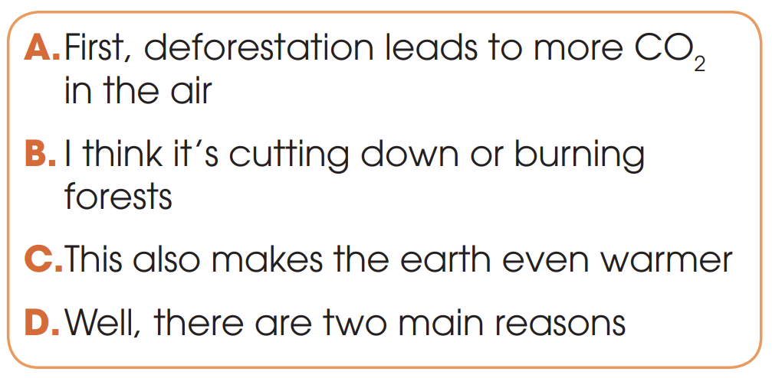
CONTROLLED PRACTICE
2
Use the sentences in the box to complete the conversation. Then practise it in pairs.
B
D
A
C

Slide 8
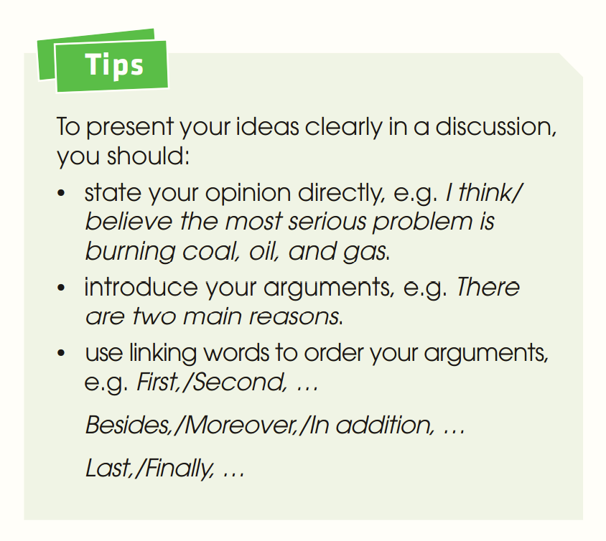
CONTROLLED PRACTICE

Slide 9
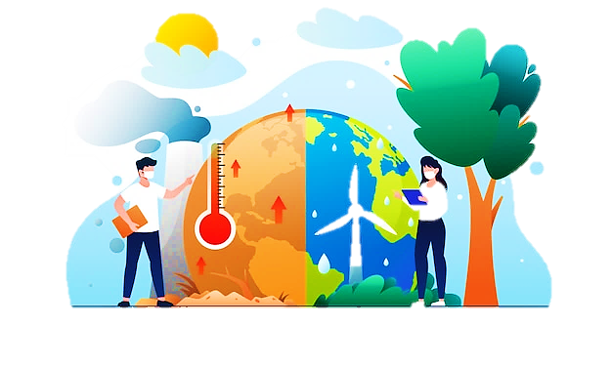
LESS CONTROLLED PRACTICE
3
Work in pairs. Talk about the other human activities that contribute to global warming. Use the ideas in 1, the model and the tips in 2 to help you.

Slide 10
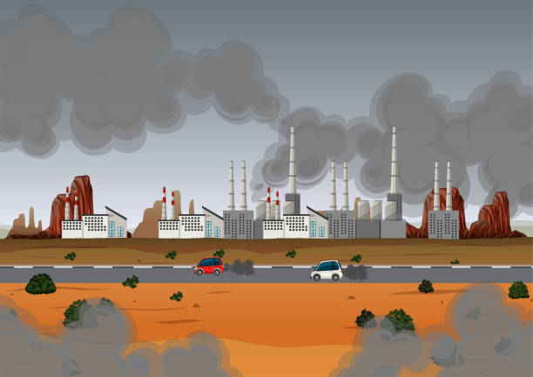
FREE PRACTICE
4
Work in groups. Decide which human activity contributes to global warming the most. Report to the whole class.

Slide 11
CONSOLIDATION
1
Wrap-up
What have you learnt today?
Talk about human activities and global warming
Present ideas clearly in a discussion
New vocabulary to talk about global warming

Slide 12
CONSOLIDATION
2
Homework
Do exercises in the workbook.
Prepare for Lesson 5 - Unit 5.

Slide 13

Website: hoclieu.vn
Fanpage: facebook.com/tienganhglobalsuccess.vn/

