Slide 1


Slide 2




Unit
2
HEALTHY LIVING
LESSON 6: SKILLS 2

Slide 3

OBJECTIVES
By the end of the lesson, students will be able to:
listen for specific information about some advice about healthy habits
write some advice to avoid viruses

Slide 4
LESSON 6: SKILLS 2
WARM-UP
Chatting
Task 1: Discuss and tick the habits you think are good for your health.
Task 2: Listen and tick the habits mentioned.
Task 3: Listen again and answer the questions with no more than THREE words.
LISTENING
Task 4: Discuss and make notes of the tips from the listening. Then share them with the class.
Task 5: Discuss and brainstorm ideas.
Task 6: Write a passage of about 70 words to give advice on how to avoid viruses.
WRITING
CONSOLIDATION
Wrap-up
Homework

Slide 5

LESSON 6: SKILLS 2
WARM-UP
Chatting
Aims of the stage:
to activate students’ prior knowledge and vocabulary related to the lesson

Slide 6
WARM-UP

Slide 7

LESSON 6: SKILLS 2
WARM-UP
Chatting
Task 1: Discuss and tick the habits you think are good for your health.
Task 2: Listen and tick the habits mentioned.
Task 3: Listen again and answer the questions with no more than THREE words.
LISTENING
Aims of the stage:
to help Ss brainstorm the topic and prepare for the listening text

Slide 8

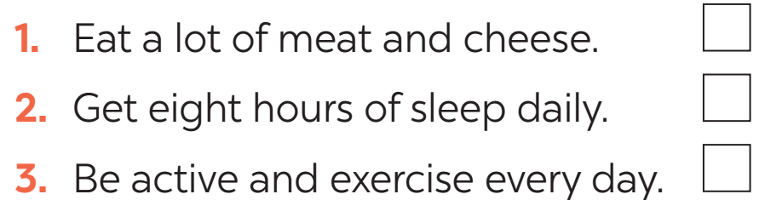
PRE-LISTENING
1
Discuss and tick the habits you think are good for your health.

Slide 9

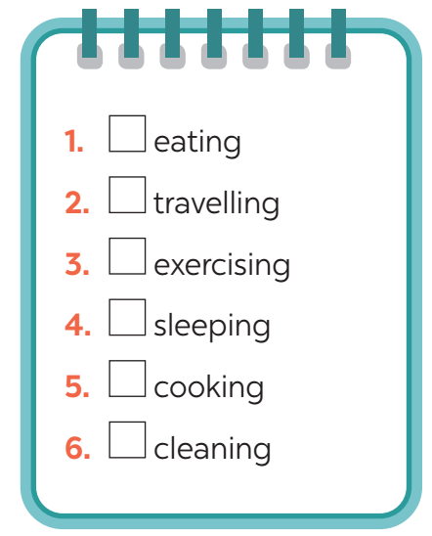

WHILE - LISTENING
2
Listen and tick the habits mentioned.

Slide 10
WHILE-LISTENING
3
Listen again and answer the questions with no more than THREE words.
1. What do healthy habits help you avoid?
2. What do fruit and vegetables provide you with?
3. How many hours do you need to sleep a day?
4. How should you keep your room?
disease
(lots of) vitamins
8 / eight hours
tidy and clean

Slide 11
LESSON 6: SKILLS 2
WARM-UP
Chatting
Task 1: Discuss and tick the habits you think are good for your health.
Task 2: Listen and tick the habits mentioned.
Task 3: Listen again and answer the questions with no more than THREE words.
LISTENING
Task 4: Discuss and make notes of the tips from the listening. Then share them with the class.
Task 5: Discuss and brainstorm ideas.
Task 6: Write a passage of about 70 words to give advice on how to avoid viruses.
WRITING

Slide 12
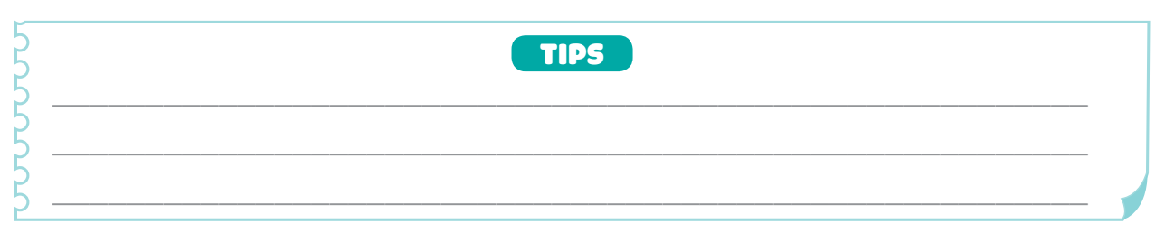
PRE-WRITING
4
Discuss and make notes of the tips from the listening. Then share them with the class.

Slide 13
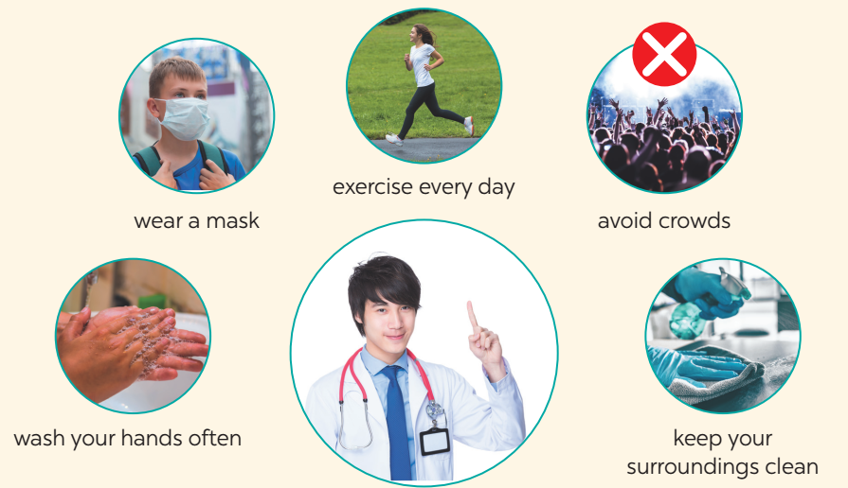

PRE-WRITING
5
Discuss and brainstorm ideas.
How to avoid viruses???

Slide 14
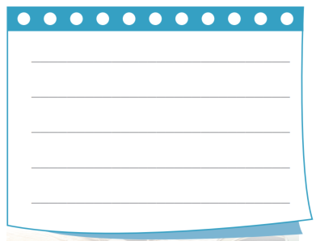
WHILE-WRITING
6
Write a passage of about 70 words to give advice on how to avoid viruses.

Slide 15

POST-WRITING
CLASS GALLERY
Students can:
go and see other’s work
give comments to each other

Slide 16

CONSOLIDATION
1
WRAP-UP
In this lesson, we have learnt to:
listen for special information about healthy habits.
write some advice to avoid viruses.

Slide 17

CONSOLIDATION
2
HOMEWORK
Rewrite the passage on the notebook.

Slide 18

Website: hoclieu.vn
Fanpage: facebook.com/www.tienganhglobalsuccess.vn/

