Slide 1

Hello 1
Pages 4 - 5 - 6

Slide 2
Lesson Outline
Warm-up
Vocabulary
Reading
Speaking
Consolidation
Wrap-up

Slide 3
Objectives
By the end of this lesson, students will be able to…
- Review vocabulary about countries and nationalities.
- Practise reading and speaking about countries and nationalities.

Slide 4

WARM-UP

Slide 5
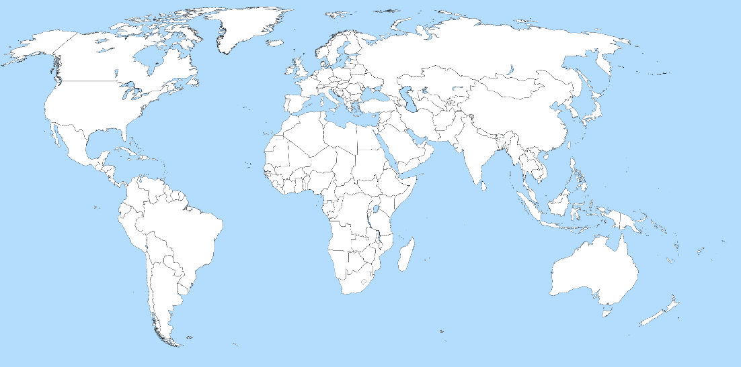






Look at the map. Find the countries: Vietnam, the USA, the UK, Australia, Spain and Brazil.

Slide 6

It’s time to learn …

Slide 7

Vocabulary

Slide 8
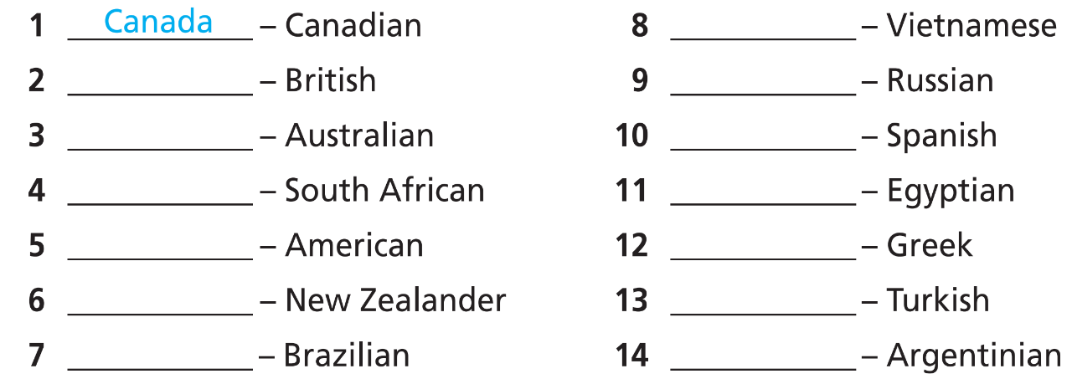
1 Look at the map. Match the countries on the map to the nationalities.
Vietnam
the UK
Russia
Australia
Spain
South Africa
Egypt
the USA
Greece
New Zealand
Turkey
Brazil
Argentina

Slide 9
NOTE!
We do not use the with most names of countries, e.g. Poland.
Countries with State, Kingdom or Republic in their name take the, e.g. the USA.

Slide 10

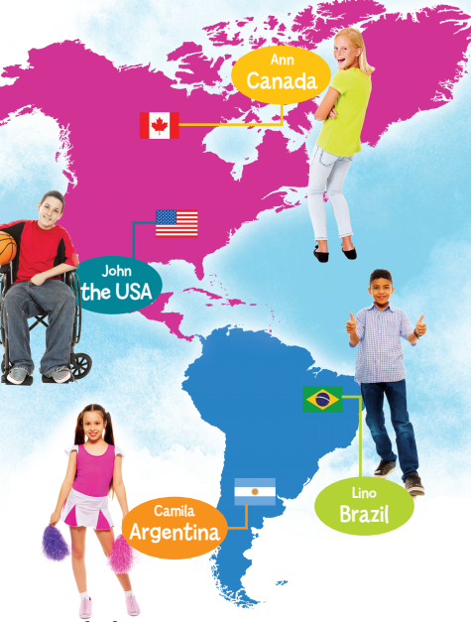
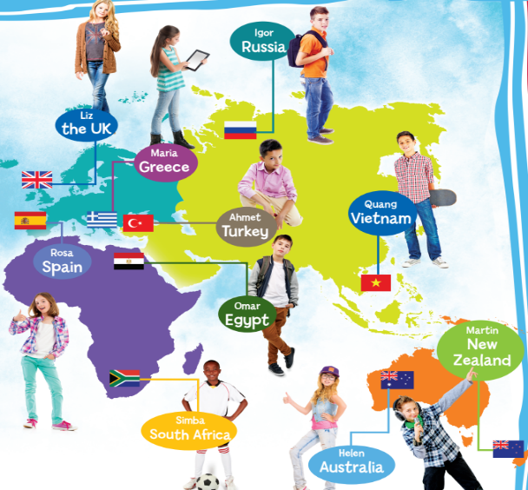
2 Look at Exercise 1. Listen and repeat.

Slide 11
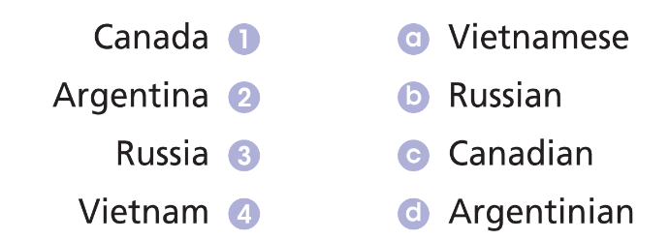
Further practice
Match the countries to the nationalities.

Slide 12
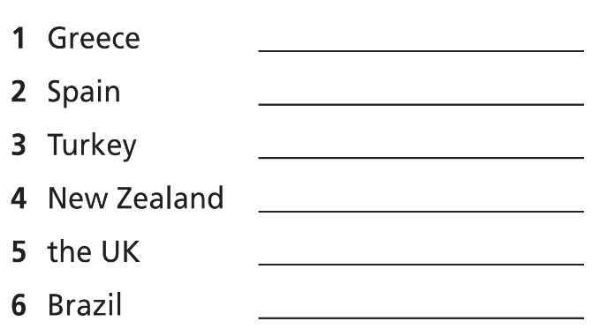
Further practice
Write the nationalities.
Greek
Spanish
Turkish
New Zealander
British
Brazilian

Slide 13

Speaking

Slide 14

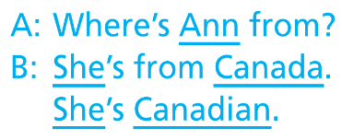
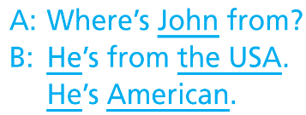
Pre-speaking
3 Act out dialogues as in the example.
First, find Ann and John on the map. Practise the sample dialogue with partners.

Slide 15
While-speaking
3 Act out dialogues as in the example.
Now, ask and answer about other people.

Slide 16
Post-speaking
4 Complete the sentences.
I’m from ___________ (country). I’m ___________ (nationality).
Example
I’m from Vietnam. I’m Vietnamese.

Slide 17

Reading

Slide 18
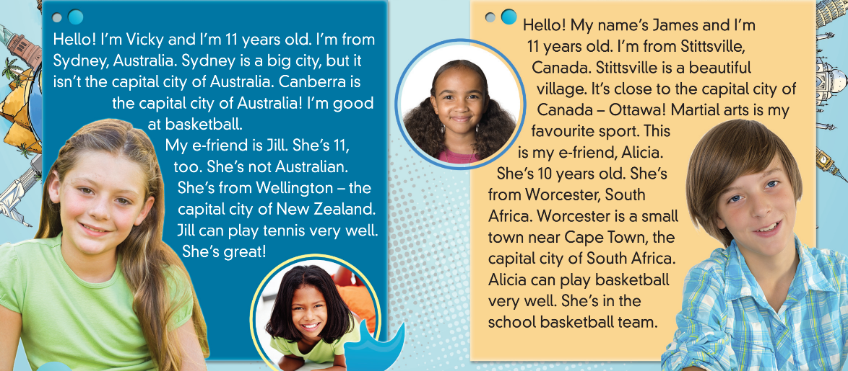
Pre-reading
1 Look at the pictures. Where is each person from?

Slide 19

Now, listen and read to find out.

Slide 20

While-reading
2 Read the text. Decide if the sentences are R (right) or W (wrong).
First, underline the keys words.
Now, read the text and do the task.

Slide 21
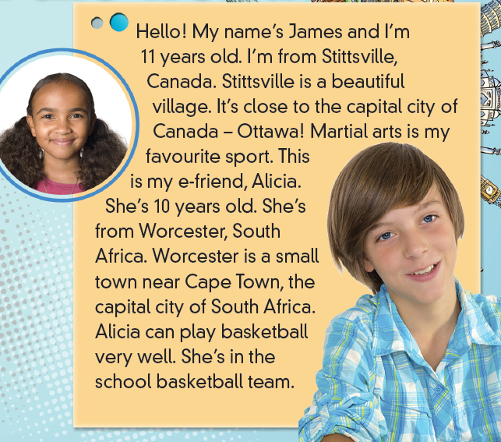
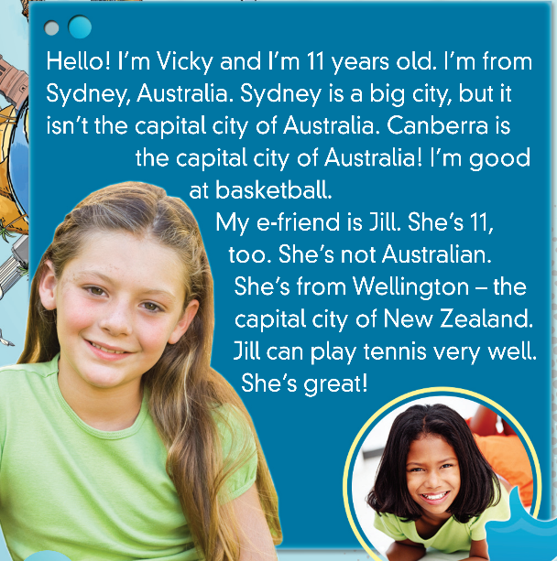


W
R
R
W

Slide 22
Post-reading
Work in pairs. Talk about yourself as examples in the text.

Slide 23

Speaking

Slide 24
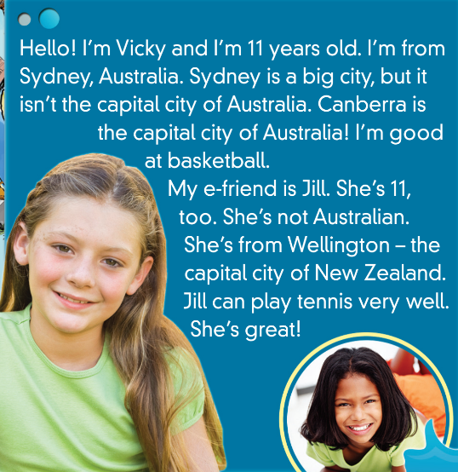
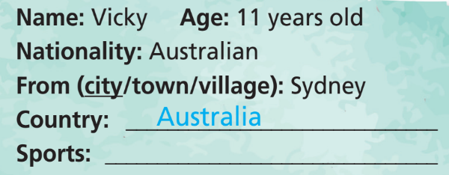
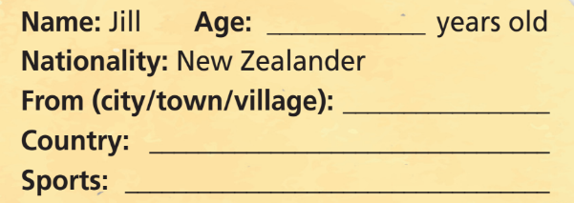
Pre-speaking
3 Complete the personal profiles.
basketball
11
Wellington
New Zealand
tennis

Slide 25
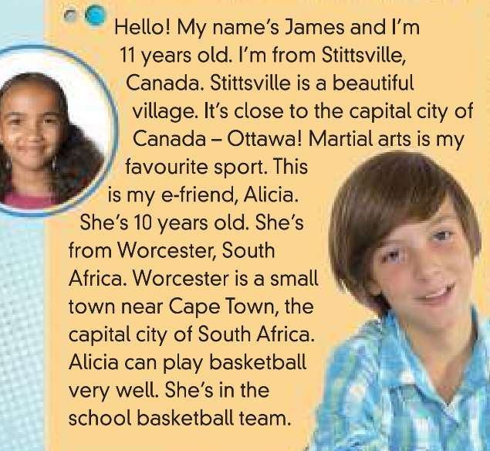
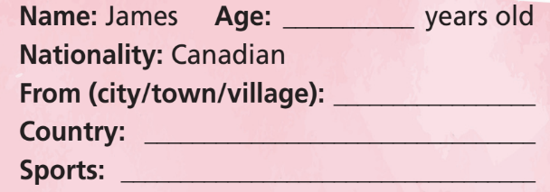
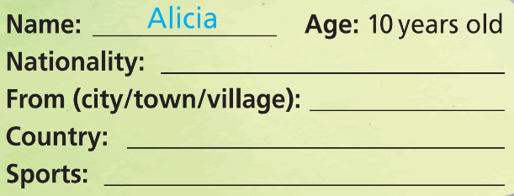
11
Stittsville
Canada
martial arts
South African
Worcester
South Africa
basketball

Slide 26
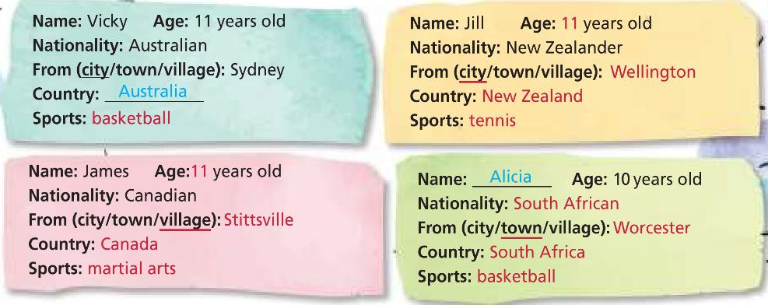
While-speaking
Choose a person and present him/her to the class.
… is … years old. He/She is … (nationality). He/She is from … . He/She can … .

Slide 27
Post-speaking
Work in pairs. Talk about your best friend.

Slide 28

CONSOLIDATION

Slide 29
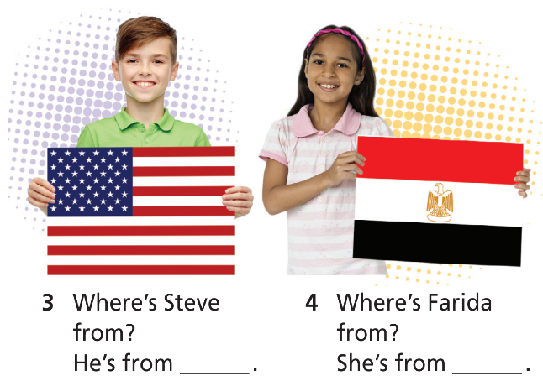
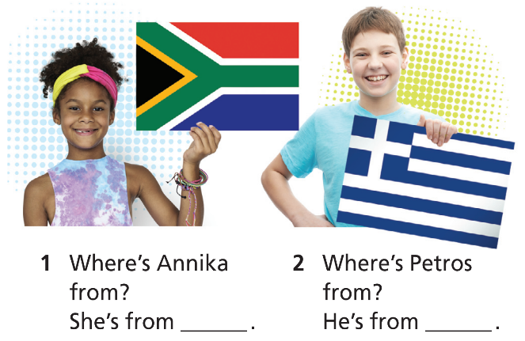
Work in pairs. Look at the pictures, ask and answer the questions.
South Africa
Greece
the USA
Egypt

Slide 30

WRAP-UP

Slide 31
Today’s lesson
Vocabularies
Countries
Nationalities
Structure
Structures to talk about countries and nationality

Slide 32
Homework
Practise the vocabularies and grammar and make sentences using them.
Do the exercises in TA 6 Right on WB (p. 4)
Do the exercises in TA 6 Right on Notebook (pp. 2-5)
Prepare the next lesson (pp. 7-9 SB)

Slide 33

Enjoy your day!

