Slide 1

Unit 1: Home & Places
Lesson 1b: Grammar (Cont.)
Page 25

Slide 2
Lesson Outline
Warm-up
Grammar
Consolidation
Wrap-up

Slide 3
Objectives
By the end of this lesson, students will be able to…
- Learn grammar: there is and there are.
- Ask and answer about the furniture in a situation.
- Remember the rules and use them in real situations.

Slide 4

WARM-UP

Slide 5
Write the plural forms of the following nouns
hat _____________
bus _____________
watch_____________
box _____________
lorry _____________
leaf _____________
car _____________
hats
buses
watches
boxes
lorries
leaves
cars

Slide 6

It’s time to learn …

Slide 7

Presentation

Slide 8
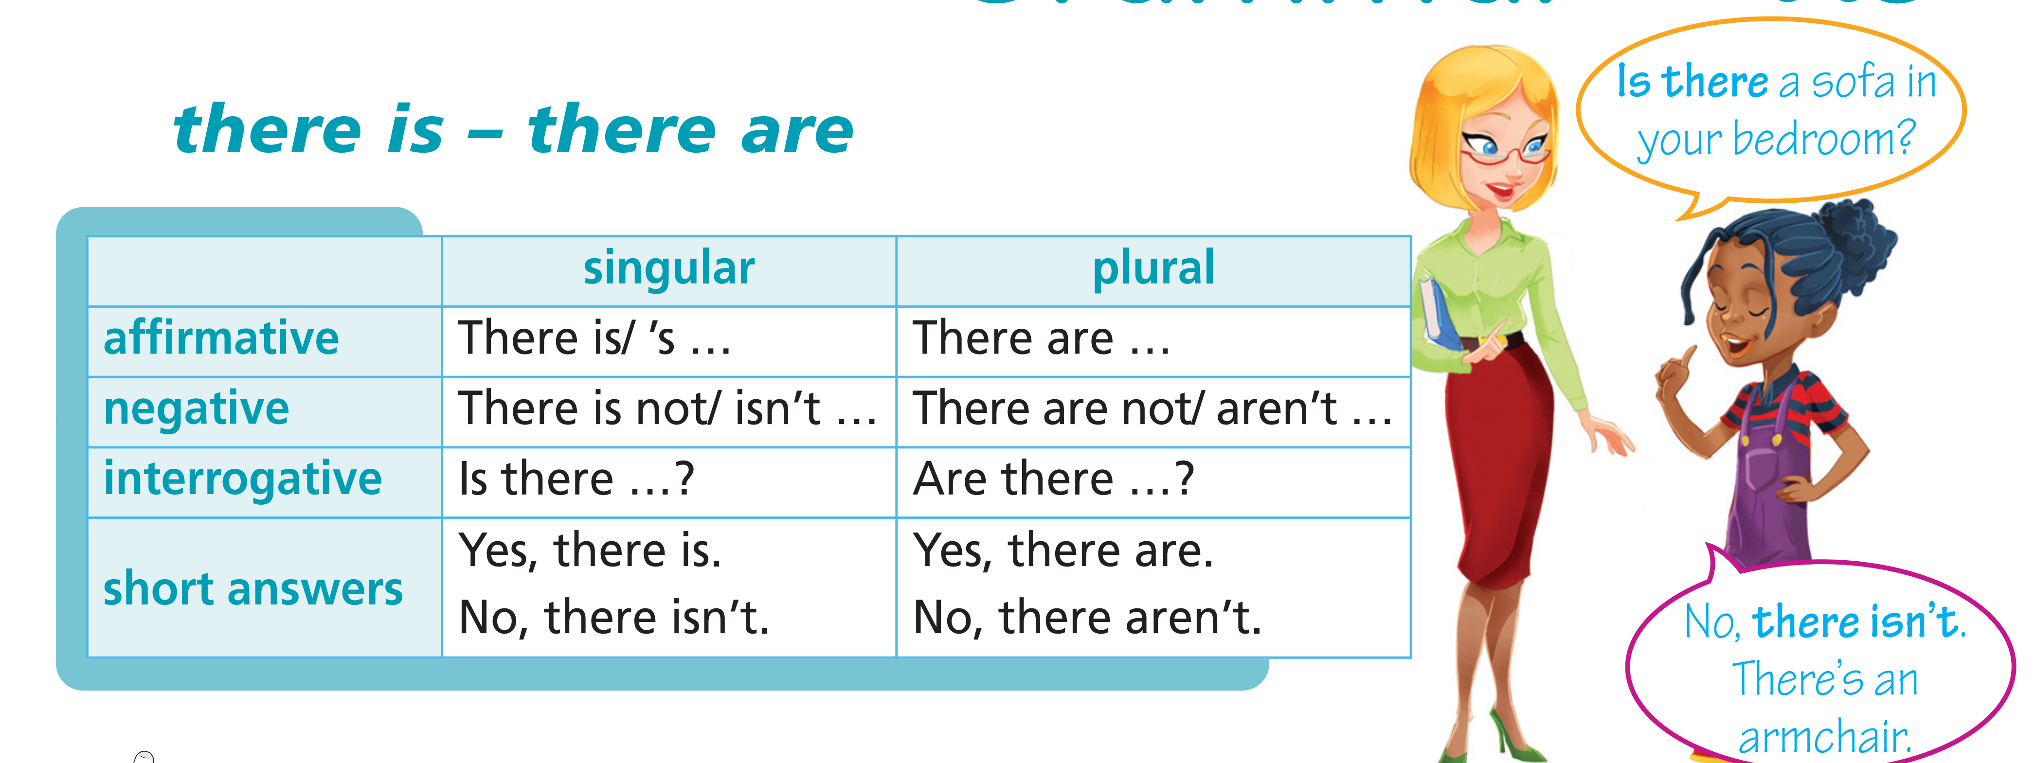

Slide 9

Practice

Slide 10
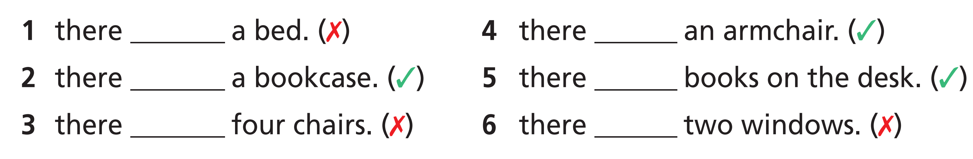
3 Complete the gaps with is, isn’t, are or aren’t. In the living room, ...
isn’t
is
is
are
aren’t
aren’t

Slide 11
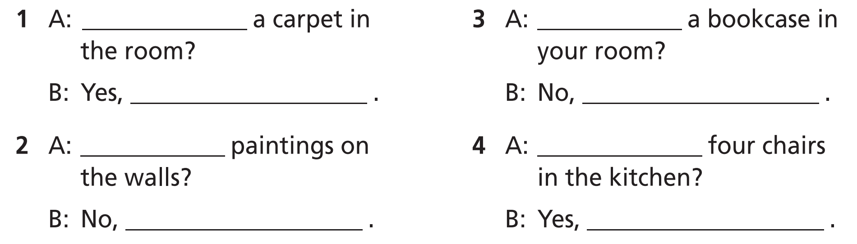
4 Complete the gaps with the correct form of there is or there are.
Is there
Is there
there is
there isn’t
Are there
Are there
there aren’t
there are

Slide 12
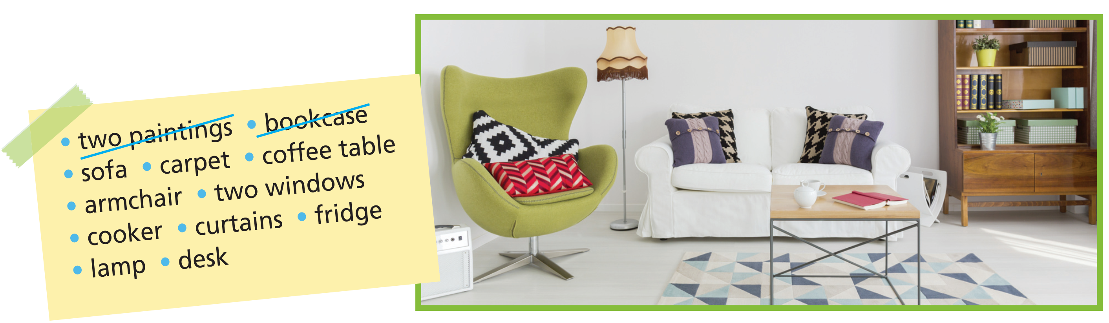
5 Look at Paul’s living room. Ask and answer questions as in the example.
example

Slide 13

Further Practice

Slide 14
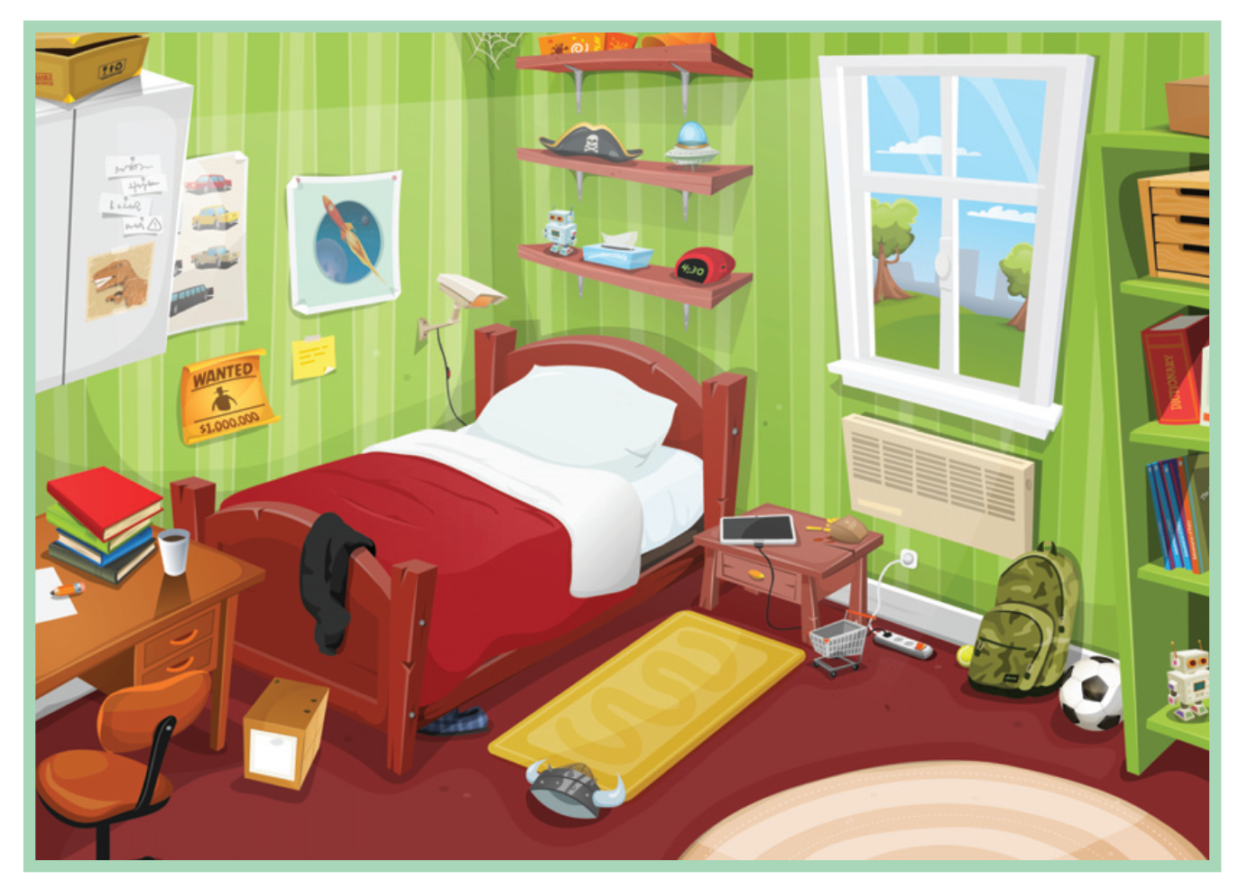
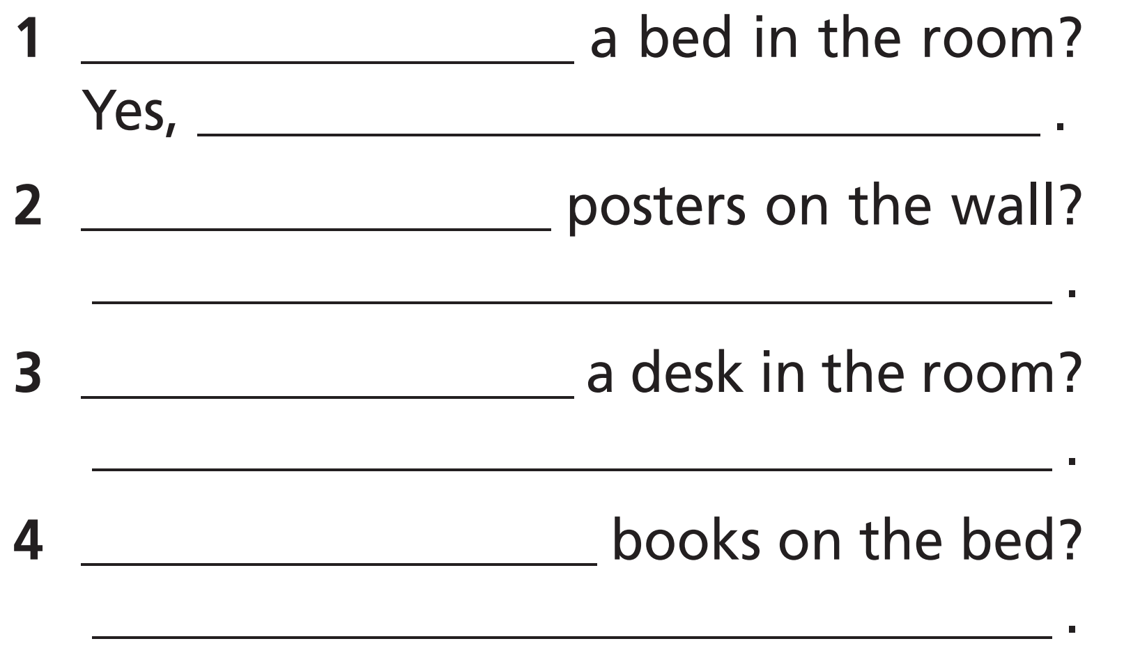
WB p. 13
Look at the picture and complete the sentences with the correct form of there is, there are.
Is there
there is
Are there
Yes, there are
Is there
Yes, there is
Are there
No, there aren’t

Slide 15

Production

Slide 16

6 Compare your living room to Paul’s.
Example
In my living room, there is a sofa. In Paul’s living room, there is a sofa, too. In my living room, there are three armchairs. In Paul’s living room, there is one armchair.

Slide 17

CONSOLIDATION

Slide 18
Form questions. Then answer them about yourself.
1 Are/your/living room/there/curtains/in/?
__________________________________________
2 there/carpet/Is/a/your/in/room/?
__________________________________________
3 in/posters/Are/your/there/bedroom/?
__________________________________________
4 desk/Is/your/in/bedroom/there/a/?
__________________________________________
=> Are there curtains in your living room?
=> Is there a carpet in your room?
=> Are there posters in your bedroom?
=> Is there a desk in your bedroom?

Slide 19

WRAP-UP

Slide 20
Today’s lesson
Vocabularies
Furniture
Grammar
There is / There are

Slide 21
Homework
Practise the vocabularies and grammar and make sentences using them.
Do the exercises in TA 6 Right on WB (p. 13)
Complete the grammar notes in TA 6 Right on Notebook (p. 14).
Prepare the next lesson (p. 26 SB)

Slide 22

Enjoy your day!

