Slide 1

Unit 6: Clothes
Lesson 3.1
Page 88

Slide 2
Lesson Outline
Warm-up
Vocabulary
Structure
Consolidation
Wrap-up

Slide 3
Objectives
By the end of this lesson, students will be able to ask and answer about their clothes.
Vocabulary: belt, scarf, sweater, pajamas, skiing.
Structure: Is that your belt? Yes, it is./No, it isn’t
Are those your pajamas? Yes, they are./No, they aren’t.

Slide 4

WARM UP

Slide 5
Let’s play!

Slide 6
Say
the clothes
Click on
the number
Say
the number

Slide 7


1
2

Slide 8
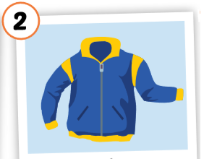
2
1
3

Slide 9
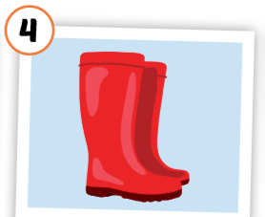
1
4
3
2

Slide 10
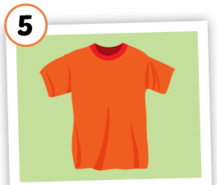
3
1
2
5
4

Slide 11
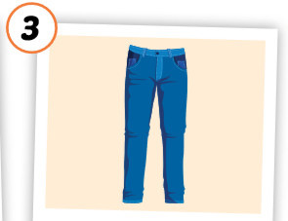
2
1
3

Slide 12

Good job!

Slide 13

It’s time to learn …

Slide 14
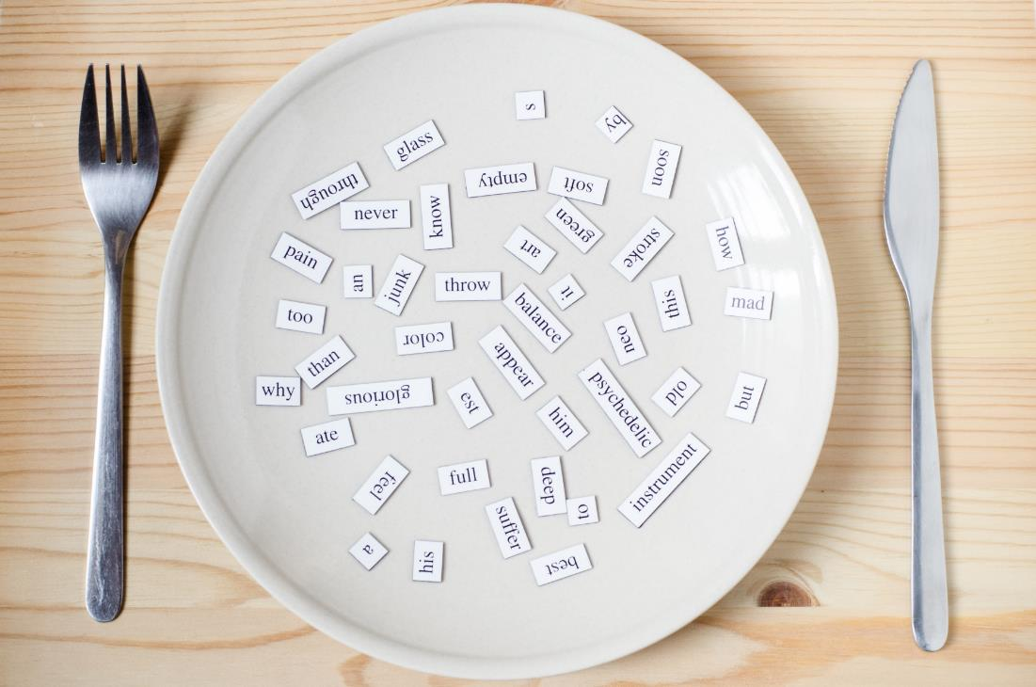
New words
belt,
scarf,
sweater,
pajamas,
skiing.

Slide 15

Presentation

Slide 16


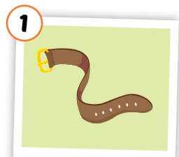
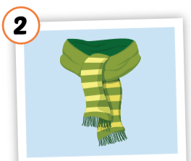
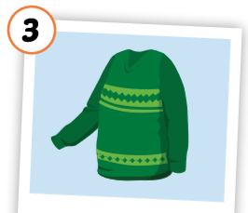
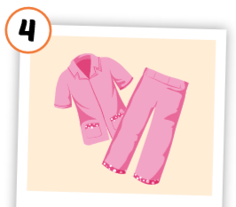
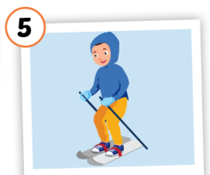
Click each English word to hear the sound.
belt
scarf
sweater
pajamas
skiing
/belt/
thắt lưng
/ skɑːrf /
khăn choàng
/ ˈswetər /
áo len
/ pəˈdʒæməz /
quần áo ngủ
/skiːɪŋ/
trượt tuyết
Notes:
GV giới thiệu từ vựng, CCQ

Slide 17
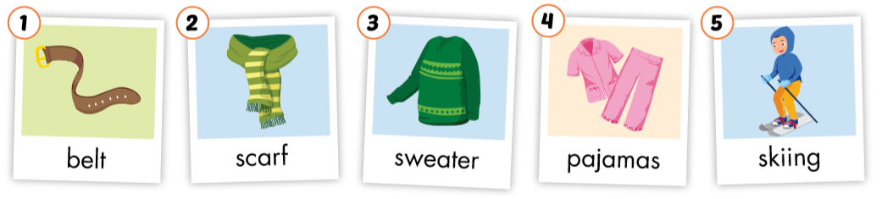

Slide 18
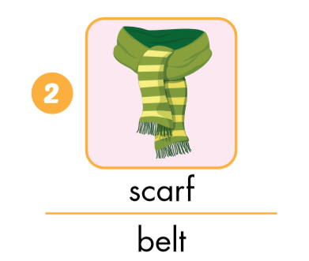
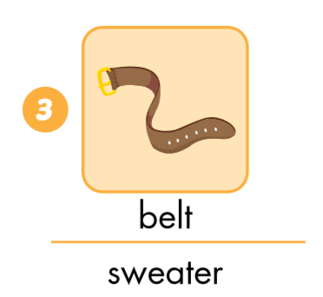
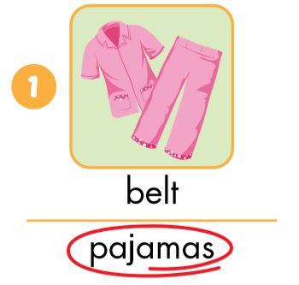
Look and circle.

Slide 19
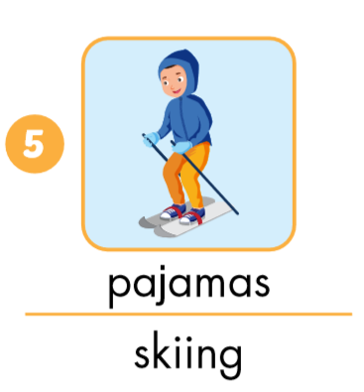
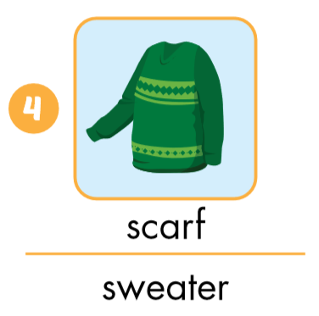
Look and circle.

Slide 20

Put the pictures in the right group.
◆
❖
is
are

Slide 21

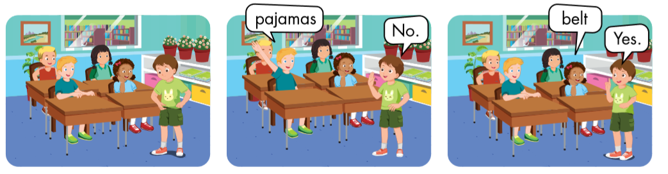

Slide 22

Practice

Slide 23
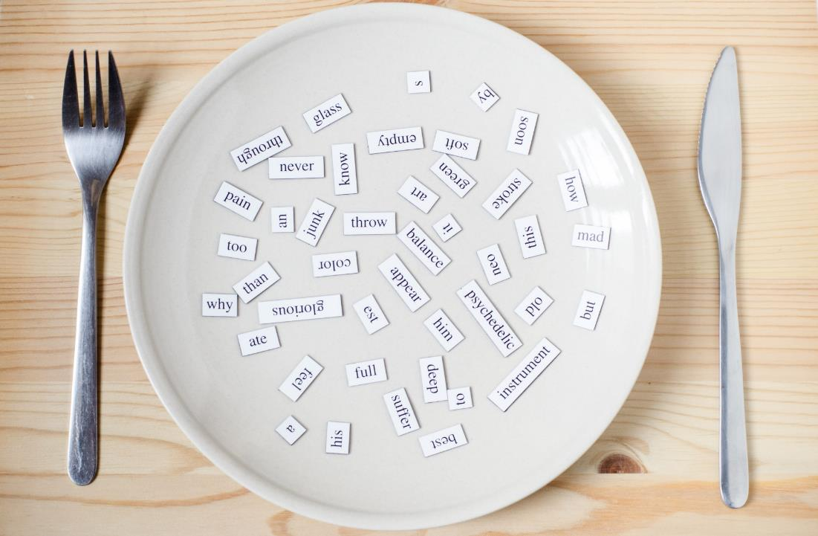
Structures
Is that your belt? Yes, it is./No, it isn’t
Are those your pajamas?
Yes, they are./
No, they aren’t.

Slide 24





Click on the earphone to hear the sound.
Is that your belt?
Yes, it is. /No, it isn’t.
Are those your pajamas?
Yes, they are./No, they aren’t.

Slide 25

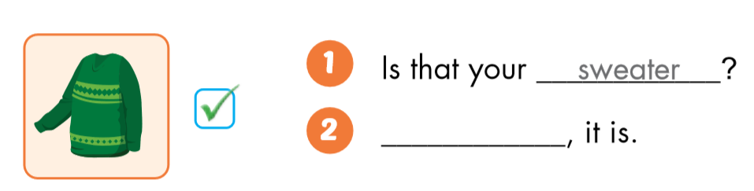
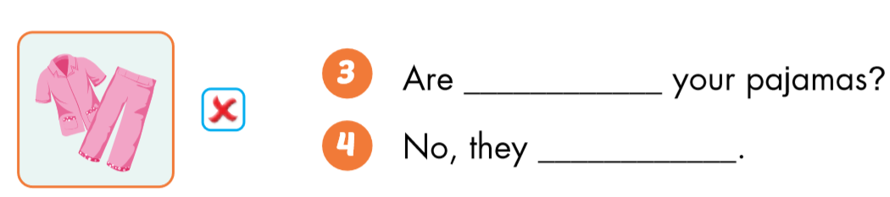
sweater
Yes
those
aren’t

Slide 26

Workbook
p. 59

Slide 27

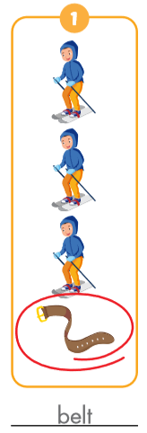
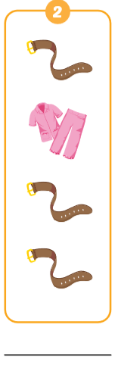
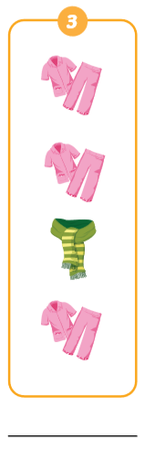
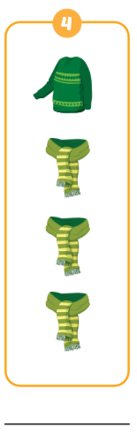
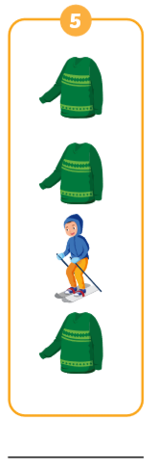
v
belt
pajamas
scarf
sweater
skiing

Slide 28

CONSOLIDATION

Slide 29
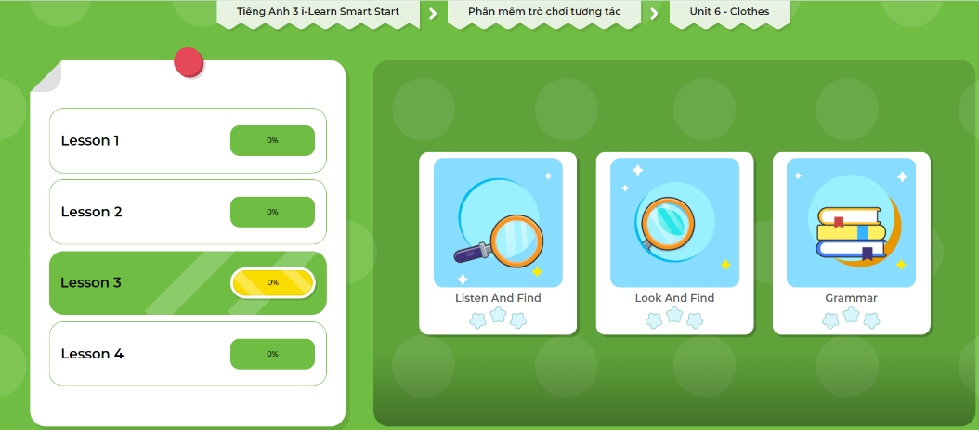
Click here to play the games!

Slide 30

Let’s draw!
Work in pairs.
Draw your clothes thing.
Tell your friend about your picture.
Notes:
134722862

Slide 31

WRAP-UP

Slide 32
Today’s lesson
Vocabularies
belt,
scarf,
Sweater,
pajamas,
skiing.
Structures/ Sentence patterns
Is that your belt?
Yes, it is./No, it isn’t
Are those your pajamas?
Yes, they are./No, they aren’t.

Slide 33
Homework
Practice the vocabularies and structure; and make sentences using them.
Do the exercises in Tiếng Anh 3 i-Learn Smart Start Workbook (page 62).
Prepare the next lesson (page 89 SB).
Play the consolidation games in Tiếng Anh 3 i-Learn Smart Start DHA App on www.eduhome.com.vn

Slide 34

Enjoy your day!

