Slide 1

UNIT 6: COMMUNITY LIFE
Lesson 1.1 – Vocabulary & Listening
Page 48

Slide 2




Lesson 1.1
LESSON OUTLINE
Consolidation

Slide 3

By the end of this lesson,
students will be able to …
- practice and learn vocab. for changes in the community.
- practice listening for specific information.
- practice functional English (Thanking someone politely).

Slide 4
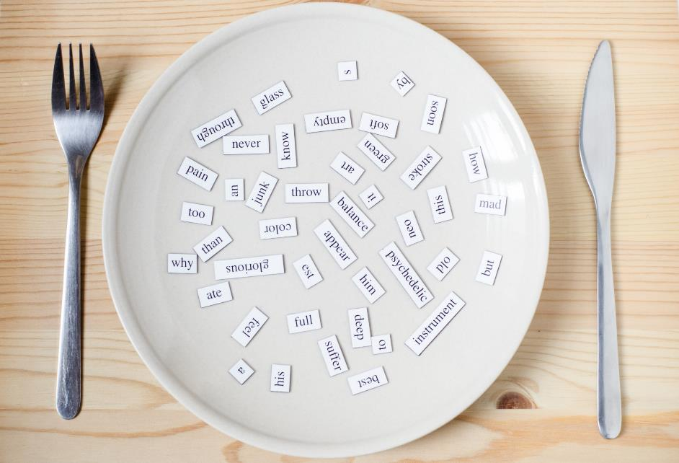
New words
increase
decrease
develop
move away
rebuild
change

Slide 5



Slide 6

Work in pairs.
What needs changing in your neighborhood?

Slide 7



Slide 8

Listen and repeat. Click each phrase to hear the sound.
increase (v) /ɪnˈkriːs/ tăng lên
decrease (v) /dɪˈkriːs/ giảm đi
develop (v) /dɪˈveləp/ phát triển
move away (v) /muːv əˈweɪ/ chuyển đi
rebuild (v) /ˌriːˈbɪld/ xây dựng lại
change (v) /tʃeɪndʒ/ thay đổi
Notes:
GV click vào từng cụm nghe âm thanh

Slide 9

a. Circle the correct definitions for the underlined words. Listen and repeat.
1. The population has increased from 1 million to 1.2 million.
a. become bigger in size, number, or amount
b. become smaller in size, number, or amount
2. The number of new students decreased from 750 to 650 this year.
a. become bigger in size, number, or amount
b. become smaller in size, number, or amount

Slide 10
3. The place has developed from a small fishing village into a famous tourist resort.
a. grow or become bigger or more advanced
b. get smaller or become less advanced
4. In the 1990s, many people moved away and went to live in bigger cities.
a. become different
b. go to a different place for work or to live

Slide 11
5. After the earthquake destroyed the town, it took ten years to rebuild the whole area.
a. make something for a second time
b. begin making something
6. The town has actually changed a lot in the last twenty years. Most small stores closed, and now we have big supermarkets.
a. stay the same
b. become different

Slide 12
b. In pairs: Make sentences using the words in Task a.
My friend moved
away last year.
The number of students in our school is increasing.

Slide 13
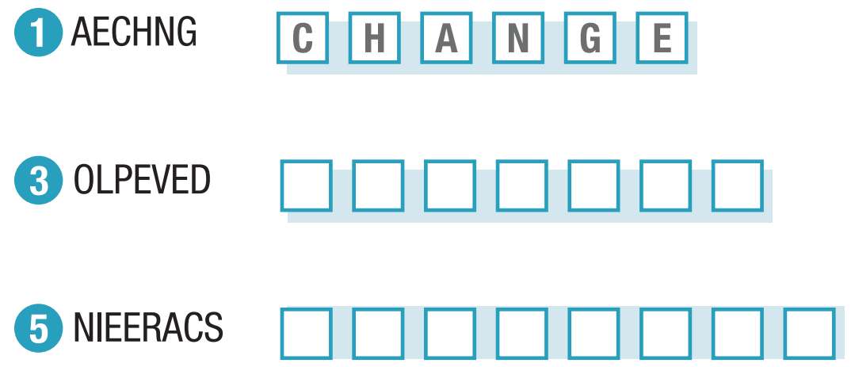
Extra Practice
WB, page 32
a. Unscramble the words
D E V E L O P
I N C R E A S E
Notes:
Taken from TA 10 i-Learn Smart World WB, page 2

Slide 14
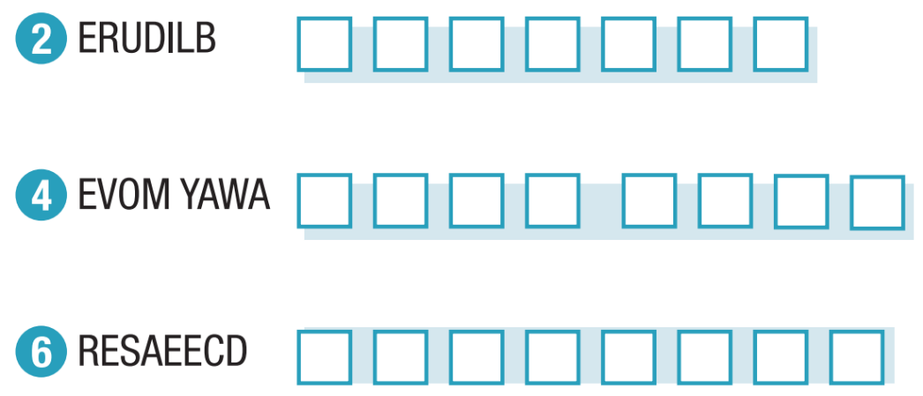
R E B U I L D
M O V E A W A Y
D E C R E A S E

Slide 15
b. Match the words in Task a. with their definitions.
develop
1. get better, or make something better over time
2. make something bigger, or become bigger in size, number, or amount
3. become different, or make someone or something different
4. go to a different place to live
5. make something smaller, or become smaller in size, number, or amount
6. make something again, especially if we want to improve what was there before
increase
change
move away
decrease
rebuild

Slide 16



Slide 17
a. Listen to Mr. Jones talking about how his town has changed in the last thirty years.
Tick (✓) the picture which best shows the town in the past.
Pre-Listening
Underline the key words/phrases.
1 Is the speaker a male or a female?
2 What’s he / she talking about?
3 What are we going to do?

Slide 18
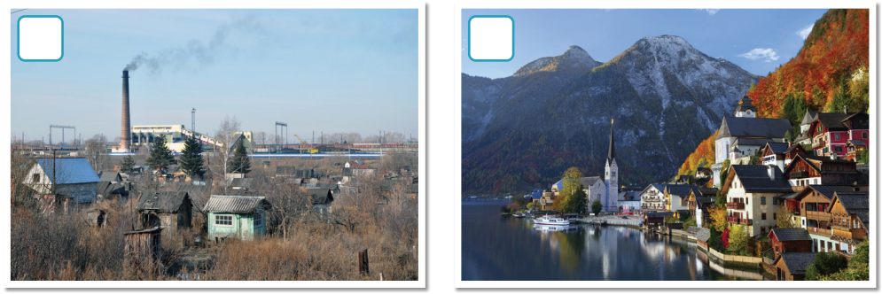
a. Listen to Mr. Jones talking about how his town has changed in the last thirty years.
Tick (✓) the picture which best shows the town in the past.
What can you see in each picture?
Guess the answer!

Slide 19
1. Where did people move to in the 1990s? ____________________________________
2. Why did a lot of people lose their jobs? ____________________________________
3. What was polluted in the town? ____________________________________
4. Is the town better for young or old people?
____________________________________
Underline the key words/phrases.
Guess the answers.

Slide 20

While-Listening
Listen once and Tick (✓)
Take notes the key words!
✓
Many factories / coal power plant / It’s much nicer now.

Slide 21
b. Now, listen and answer the questions.
1. Where did people move to in the 1990s? ____________________________________
2. Why did a lot of people lose their jobs? ____________________________________
3. What was polluted in the town? ____________________________________
4. Is the town better for young or old people?
____________________________________
Bigger cities
The factories and coal power plant were closed
The air
Young people

Slide 22

Scripts
Practice the conversation with a partner.
Claire: Hello, Mr. Jones. Thank you for helping with my project.
Mr. Jones: That's OK. What do you want to know?
Claire: How has the town changed in the last thirty years?
Mr. Jones: It's changed a lot. There used to be more people, but many people moved away to live in bigger cities in the 1990s.
Claire: Why?
Mr. Jones: Because many factories were closed. There was a coal power plant here, too. That closed too and lots of people lost their jobs. It was terrible for workers here.

Slide 23
Claire: I see. Has anything got better?
Mr. Jones: Well, when the power plant was here, the air was so polluted. Air quality has gotten a lot better since the power plant closed.
Claire: Anything else?
Mr. Jones: There's a lot more to do in the town than when I was young. We only had a movie theater when I was your age. That was rebuilt near the park five years ago. It's much nicer now.
Claire: Yes, I love the movie theater.

Slide 24
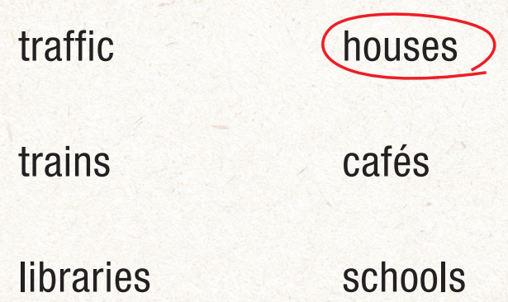
Extra Practice
WB, page 32
Pre-Listening
Underline the key words/phrases.
a. Listen to Emma talking to her grandfather about how their town has changed. Listen and circle all the topics they talk about.

Slide 25
The town used to be...
bigger. b. smaller. c. the same size.
2. People moved away from the...
city. b. nearby town. c. countryside.
3. The main road was...
built. b. rebuilt. c. developed.
4. Big restaurants and shopping malls were...
opened. b. closed. c. increased.
5. There used to be...
a. one school. b. two schools. c. three schools.

Slide 26

While-Listening
Listen once and circle

Slide 27
Listen twice and circle the correct options
The town used to be...
bigger. b. smaller. c. the same size.
2. People moved away from the...
city. b. nearby town. c. countryside.
3. The main road was...
built. b. rebuilt. c. developed.
4. Big restaurants and shopping malls were...
opened. b. closed. c. increased.
5. There used to be...
a. one school. b. two schools. c. three schools.

Slide 28
Scripts
Emma: Hi, Grandpa. Thanks for helping me with my geography project.
Grandpa: Sure, Emma. What do you want to know?
Emma: How has the town changed since you were young?
Grandpa: Well, it used to be smaller. New houses and apartments were built in the 1990s. There are also a lot more people.
Emma: Why?
Grandpa: Well, a lot of people moved away from the city to live here. Houses are cheaper and it's nicer for families. Most people drive to work in the city.
Emma: What else has changed?
Grandpa: There are a lot more cars now. We had a big traffic problem until the main road was rebuilt a few years ago.

Slide 29
Emma: I see. Do you think there are more things to do now than when you were young?
Grandpa: Yeah. Big restaurants and shopping malls were opened in the 1990s. Lots of cafés have opened recently, too. It's a much better place for young people.
Emma: Yeah, I guess so.
Grandpa: Oh, and one other thing. There used to be only one small school for the whole town. That was closed ten years ago and now all the children go to the two big new schools downtown.
Emma: OK. Thanks, Grandpa.
Grandpa: You're welcome. I might have some photos for your project. Let me see...

Slide 30

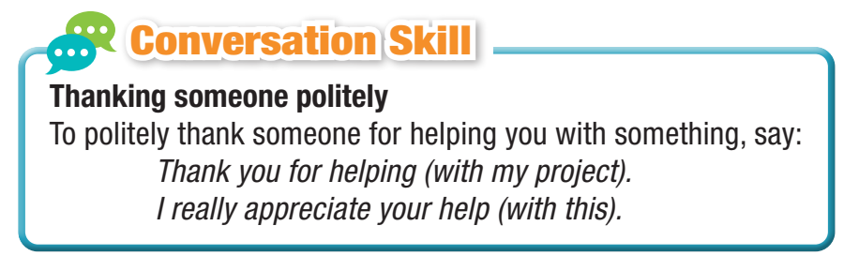
Listen and repeat

Slide 31


Post-Listening
Work in pairs.
1 How has your town changed in the last five years?
2 Why do you think it's changed?

Slide 32

Consolidation

Slide 33
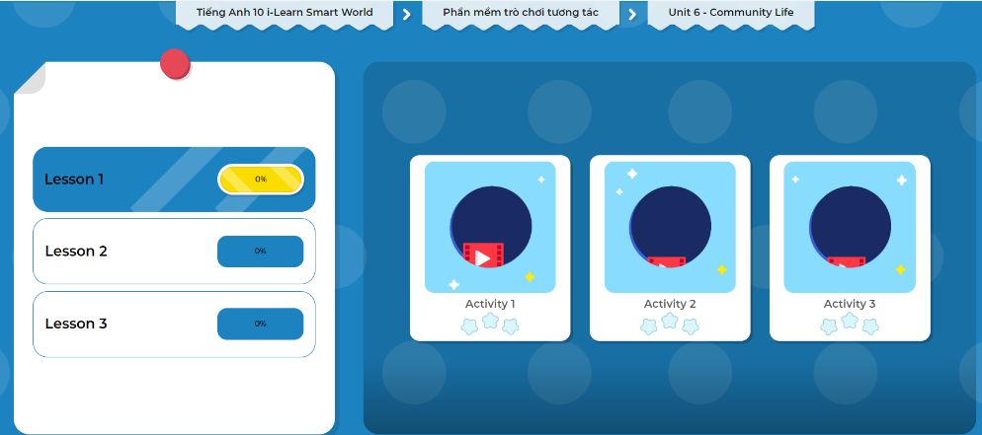
Extra Practice
DHA on Eduhome
Let’s Play!
Click here to play the games.

Slide 34

WRAP-UP

Slide 35
Today’s lesson
Vocabulary: Community life
Listening: for key information
Speaking: functional English
(Thanking someone politely)

Slide 36

Learn by heart vocabularies and make sentences using them.
Do the exercises in Tiếng Anh 10 i-Learn Smart World Notebook on page 32.
Prepare the next lesson - Grammar on page 49 in SB.
Play the consolidation games in Tiếng Anh 10 i-Learn Smart World DHA App on www.eduhome.com.vn

