Slide 1

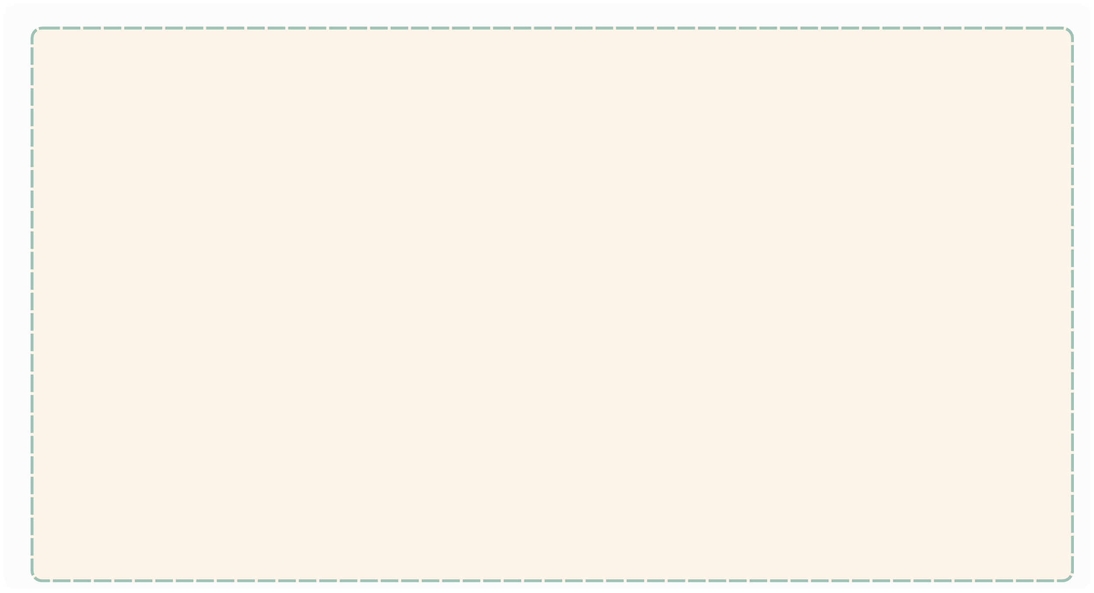
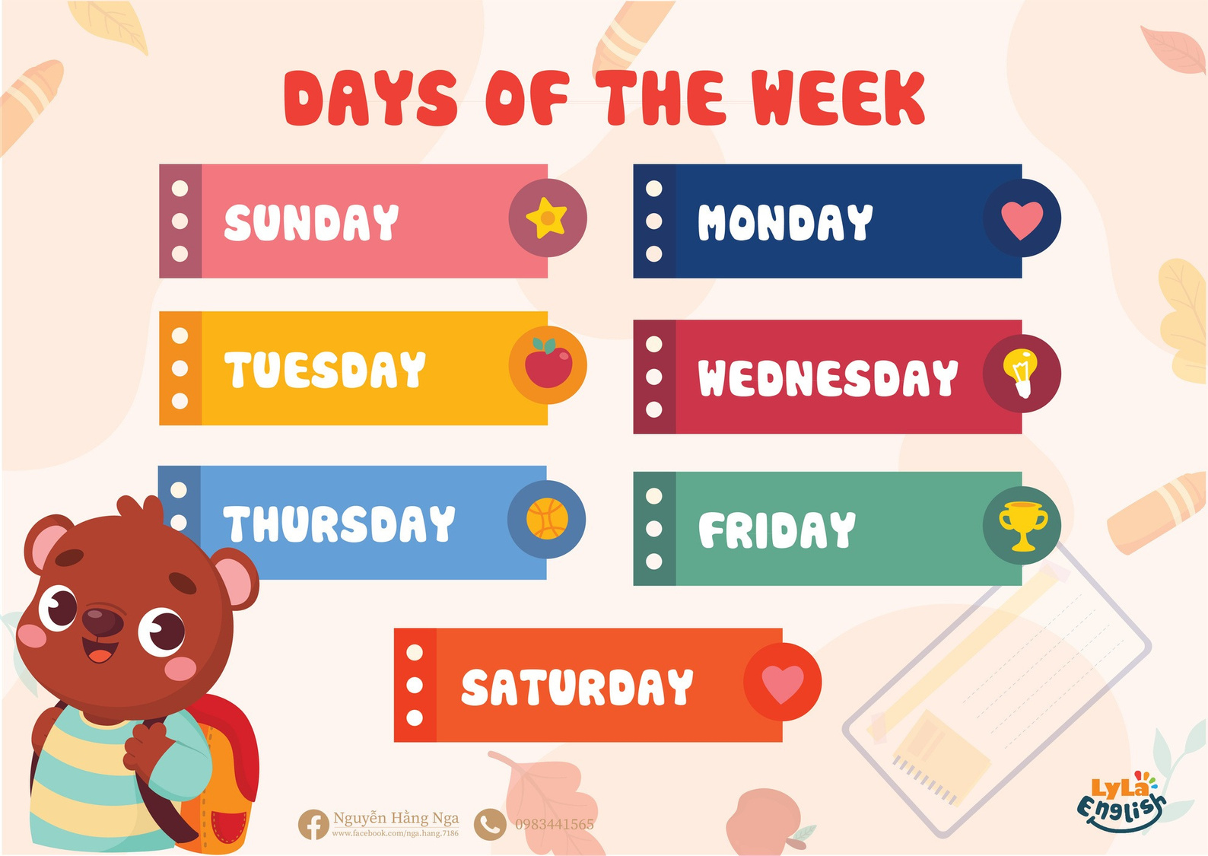


Slide 2
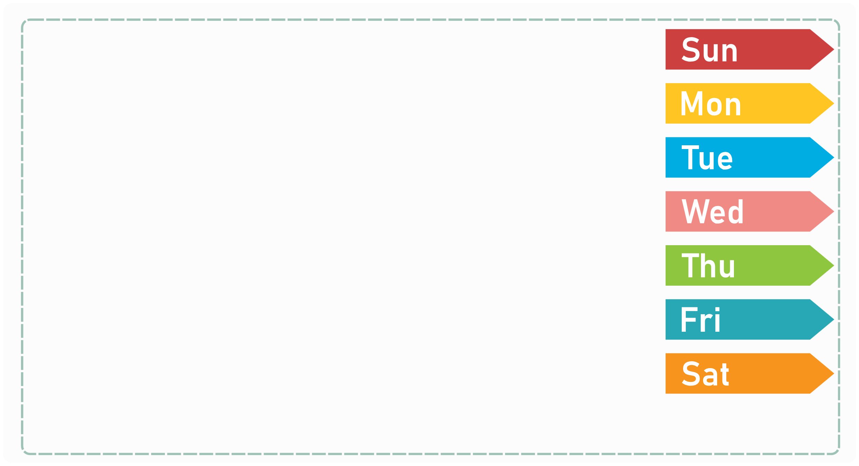

I. QUESTION
1. How many days are there in a week?
- There are ... days.
2. What day is it today?
- It’s ...
3. What day is it tomorrow?
- It’s ...
4. What day is it yesterday?
- It’s ...
5. How many days a week do you go to school?
- There are ...days.
6. How many days off do you have a week?
- ... days: ... and ...

Slide 3
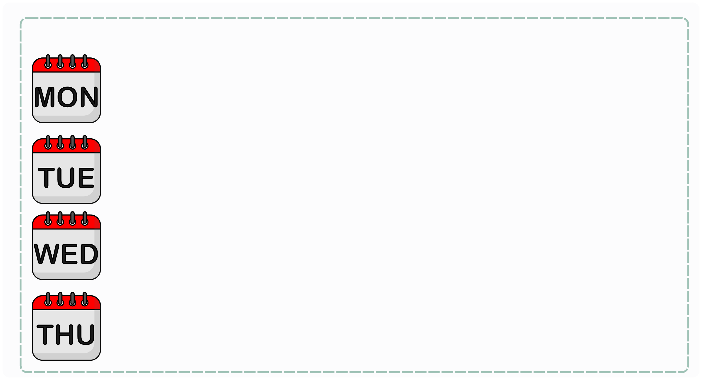
II. VOCABULARY
Monday:...........................................................
Tuesday:...........................................................
Wednesday:...........................................................
Thursday:...........................................................

Slide 4
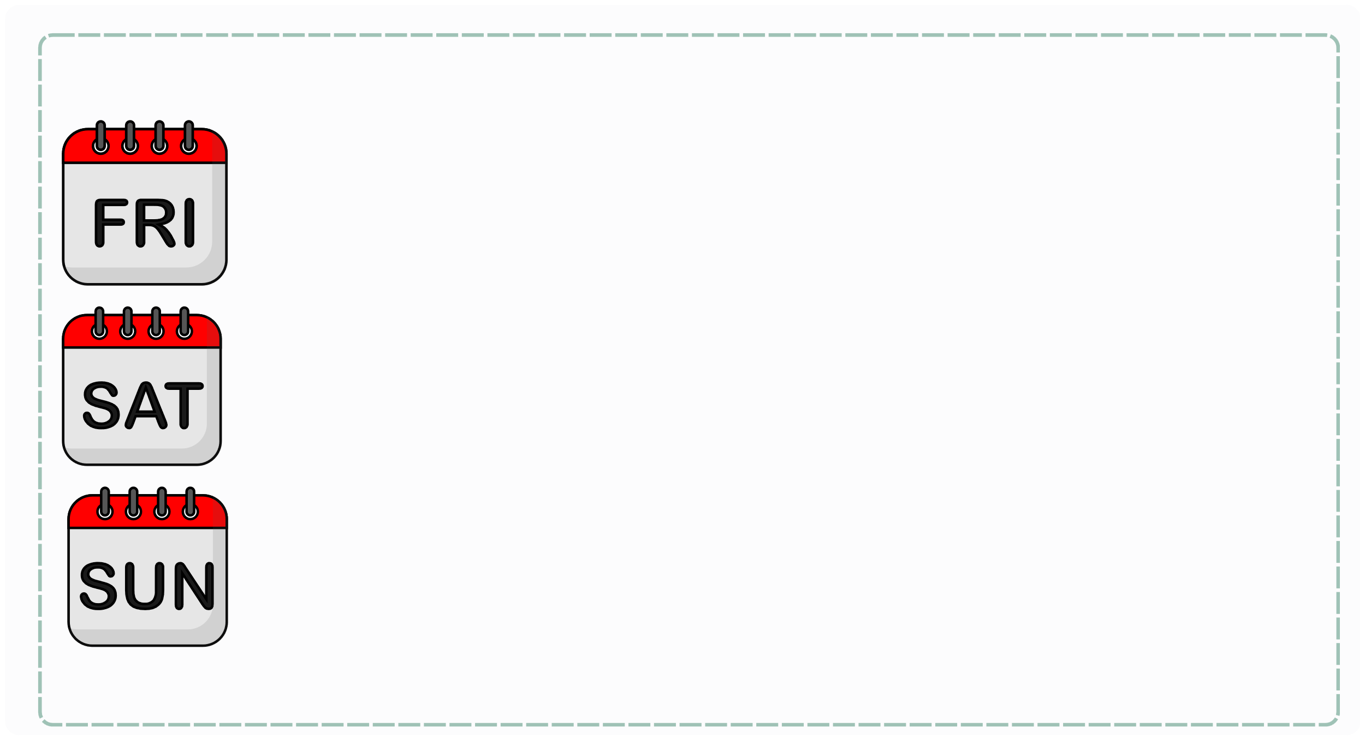
II. VOCABULARY
Friday:...........................................................
Saturday:...........................................................
Sunday:...........................................................

Slide 5

III. EXERCISES:
1.Trace the words:
Monday
Friday
Tuesday
Saturday
Sunday
Wednesday
Thursday

Slide 6
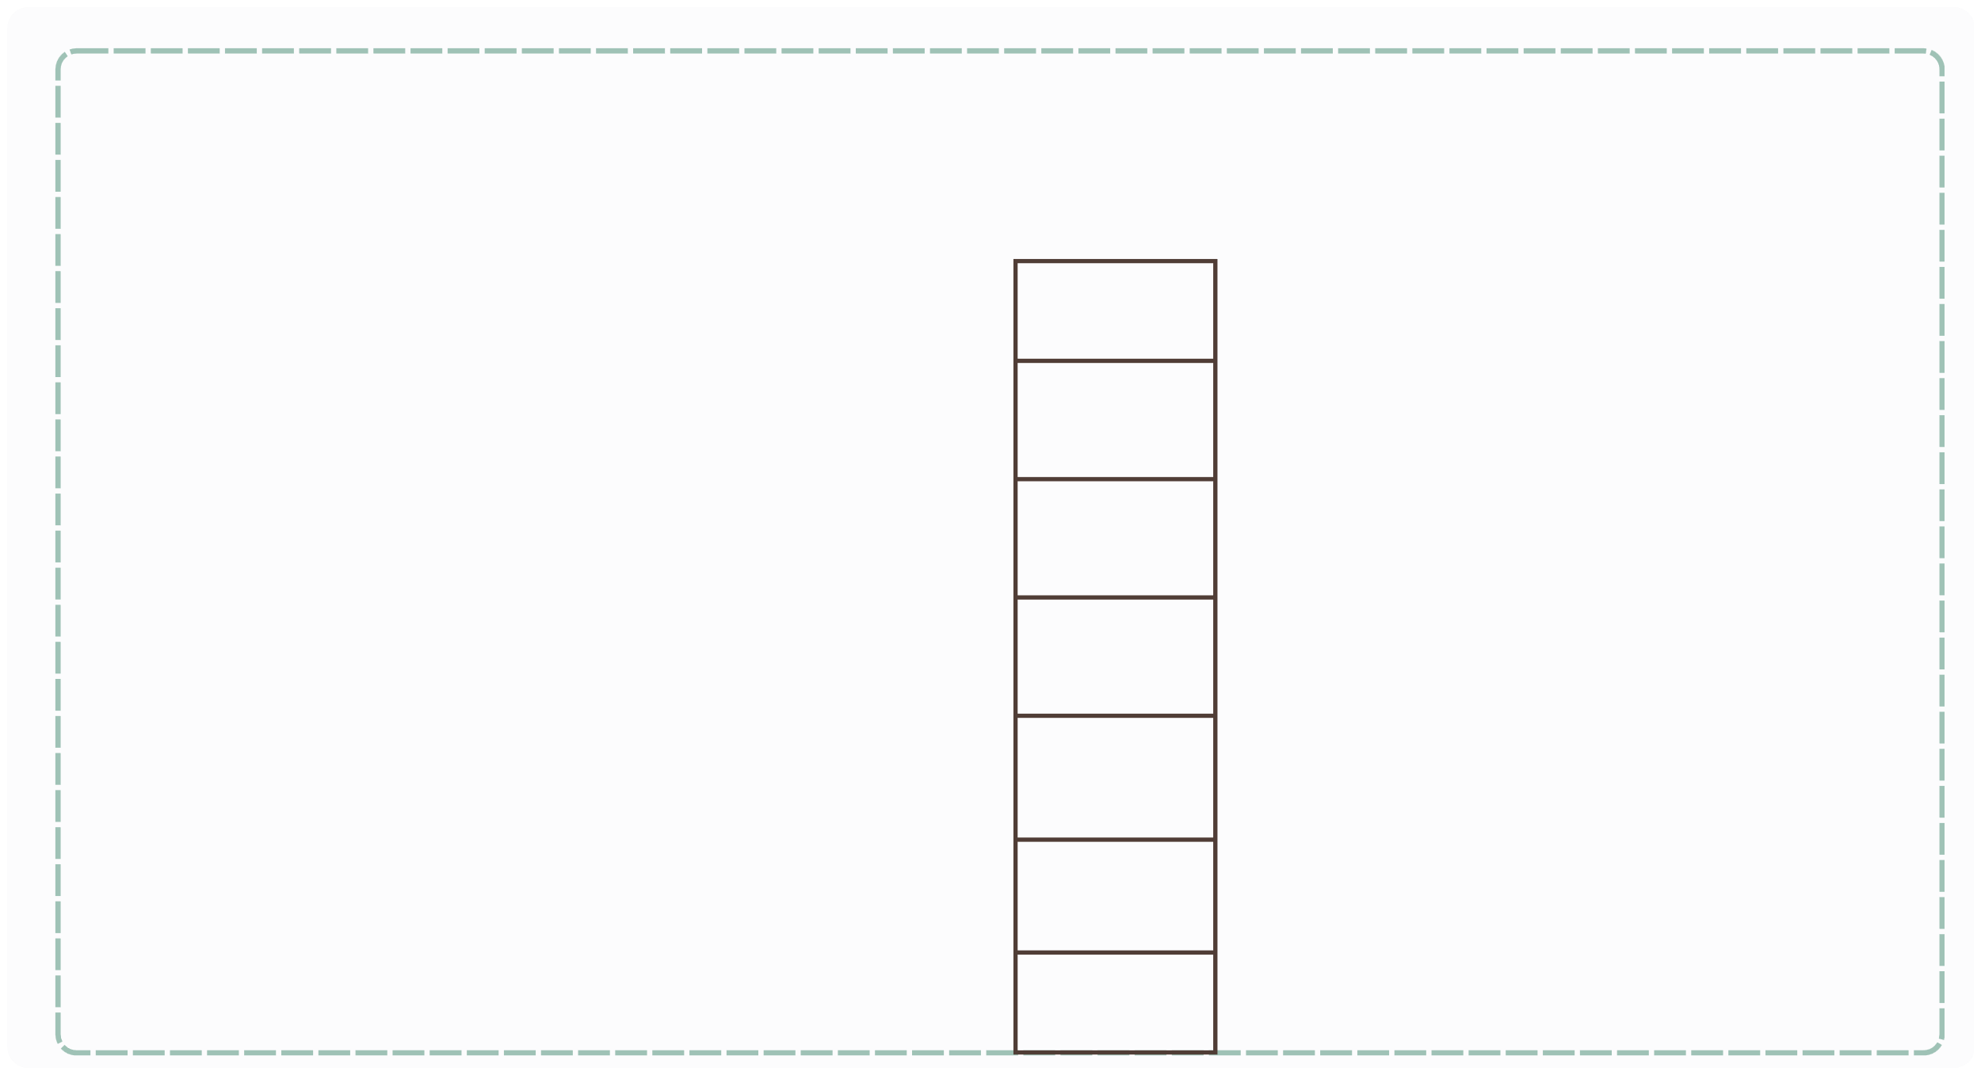
III. EXERCISES:
2. Put the days of the week in order:
saturday tuesday
wednesday
sunday
monday thursday friday
1

Slide 7
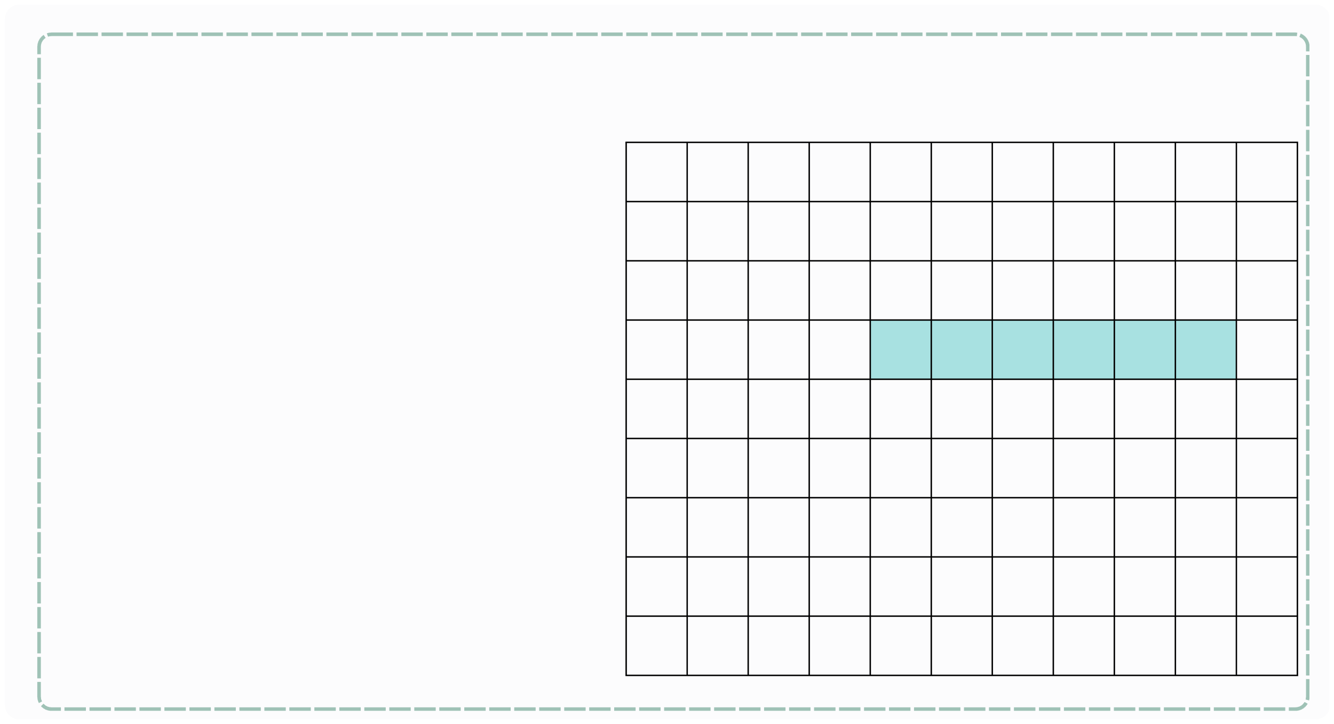
III. EXERCISES:
3. Find the days of the week:
S
A
T
U
R
D
A
Y
D
O
H
J
O
H
P
F
R
I
D
A
Y
L
M
A
U
T
H
T
A
R
I
N
S
N
I
R
M
S
U
N
D
A
Y
K
C
K
S
O
L
E
T
V
I
A
G
W
E
D
N
E
S
D
A
Y
Y
R
M
A
A
D
A
D
A
Y
A
Y
T
L
I
Y
A
N
A
O
U
P
S
D
L
O
M
Y
M
Y
T
U
S
D
F

Slide 8
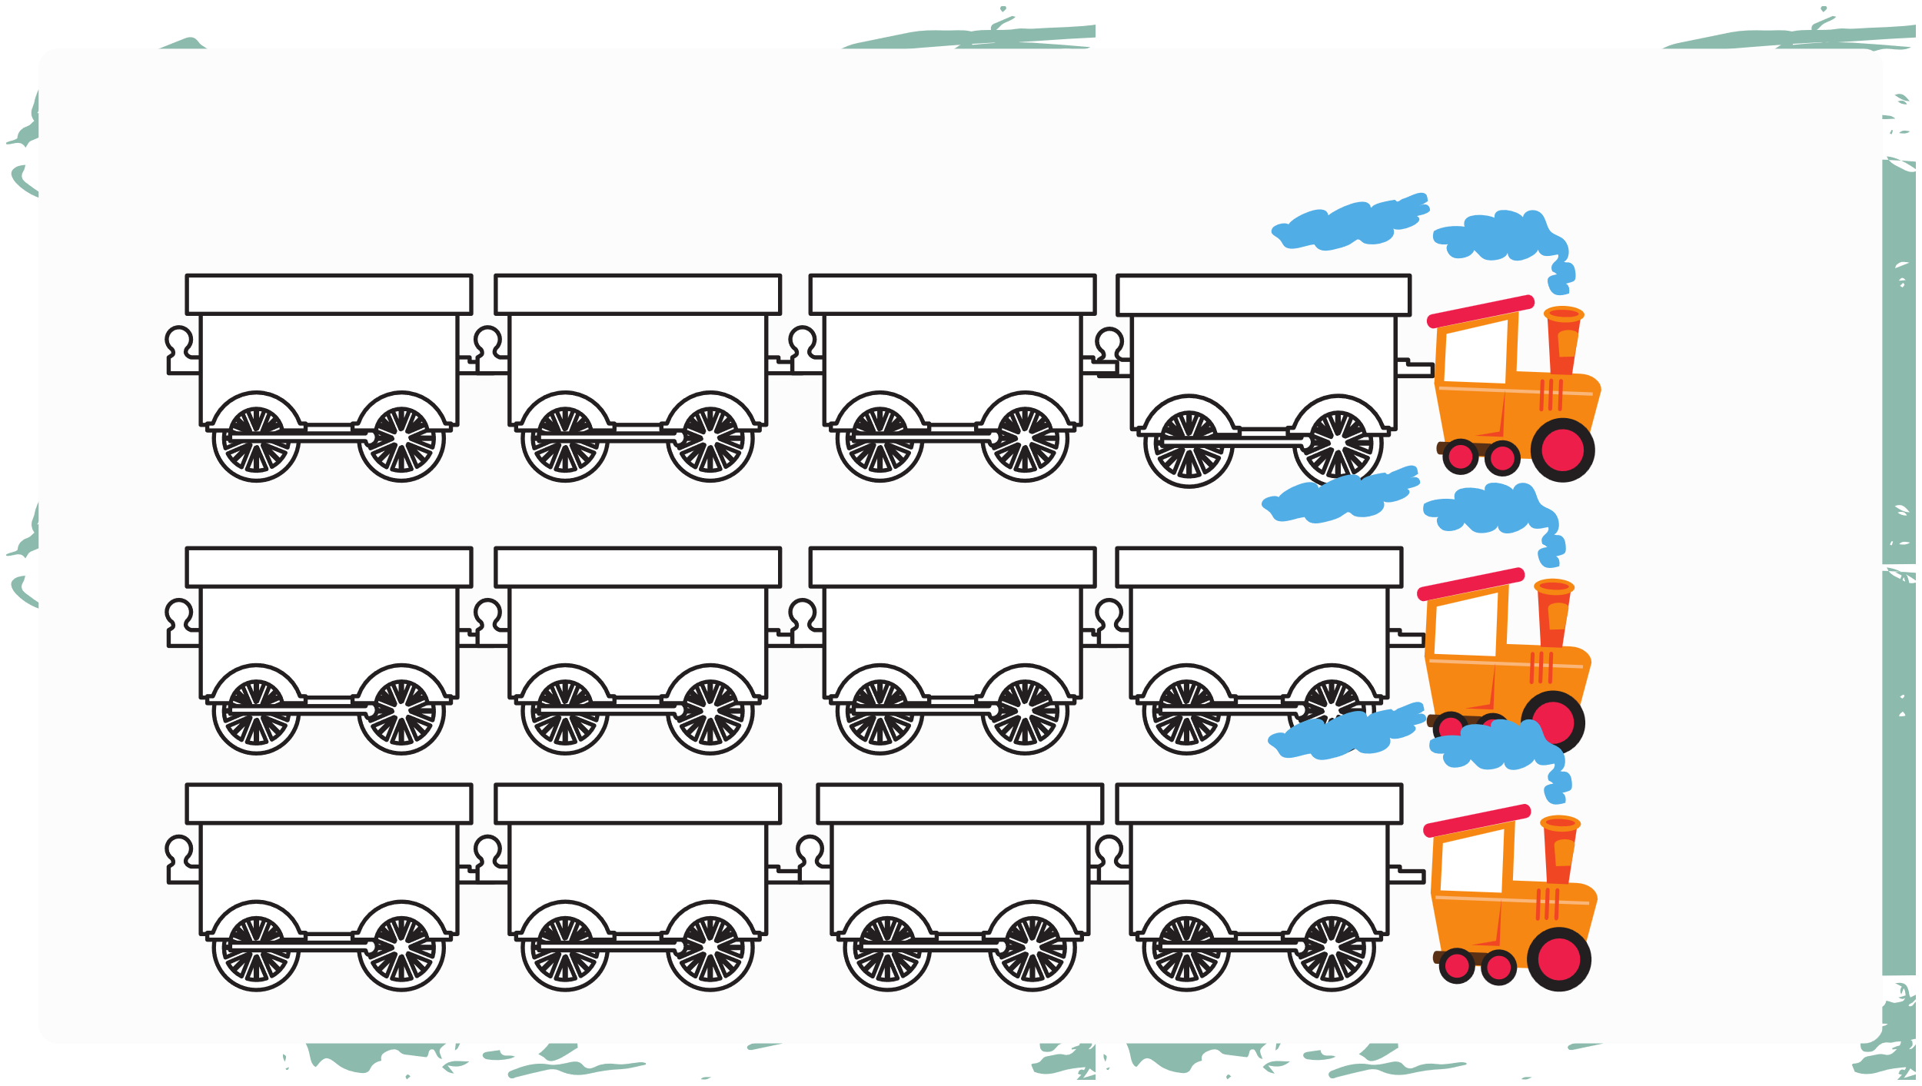
III. EXERCISES:
4. Fill the words:
Monday
....
Wednesday
Thursday
Thursday
Friday
Saturday
....
Tuesday
Wednesday
....
....

Slide 9

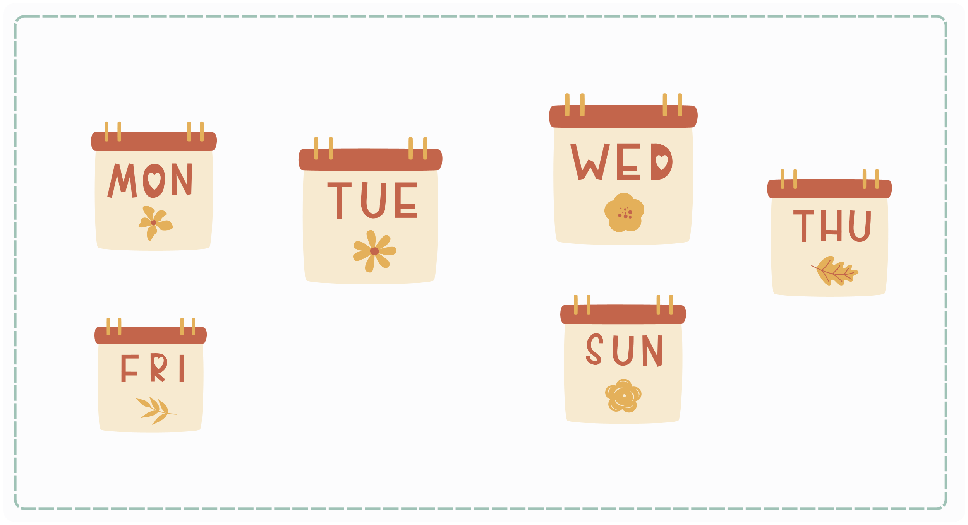
III. EXERCISES:
5. Unscramble the name of the days:
o/m/n/a/y/d .....
w/d/e/e/s/n/d/y/a .....
t/e/u/s/a/y/d .....
t/u/h/r/s/a/d/y.
....
f/r/d/y/i/a .....
s/u/d/n/y/a .....

Slide 10
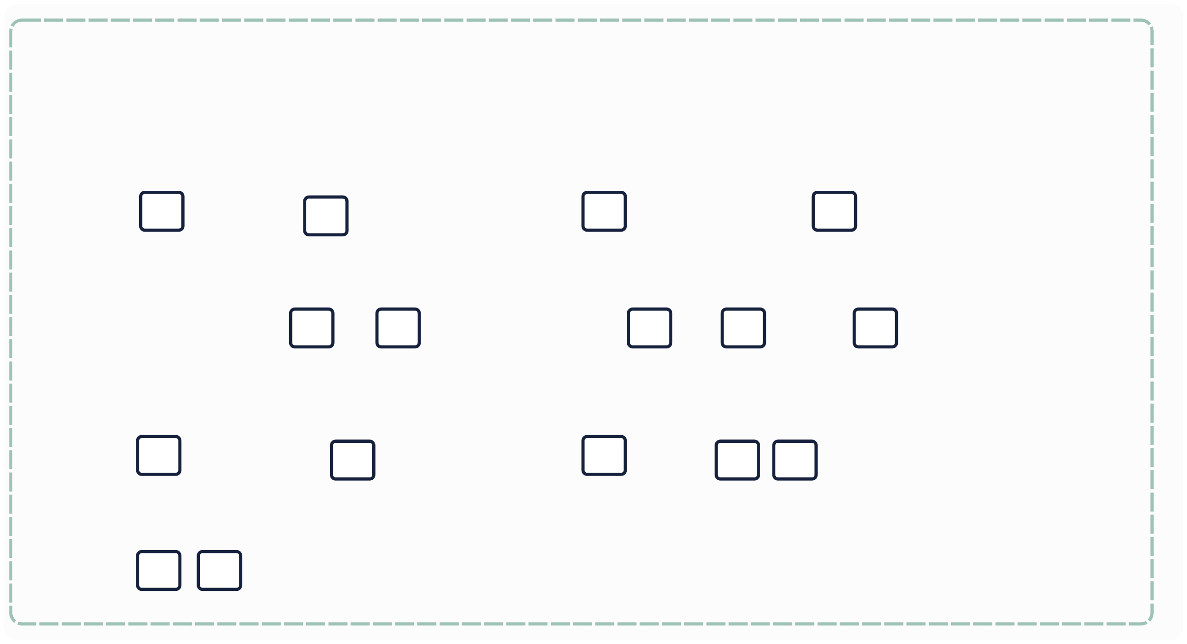
III. EXERCISES:
6. Write the missing letters:
M Wedn
n
d
y
u
e
s
a
y
s
ay
T
u
sd
y
F
id
a
at
d
a
y
S
d
a
y

Slide 11
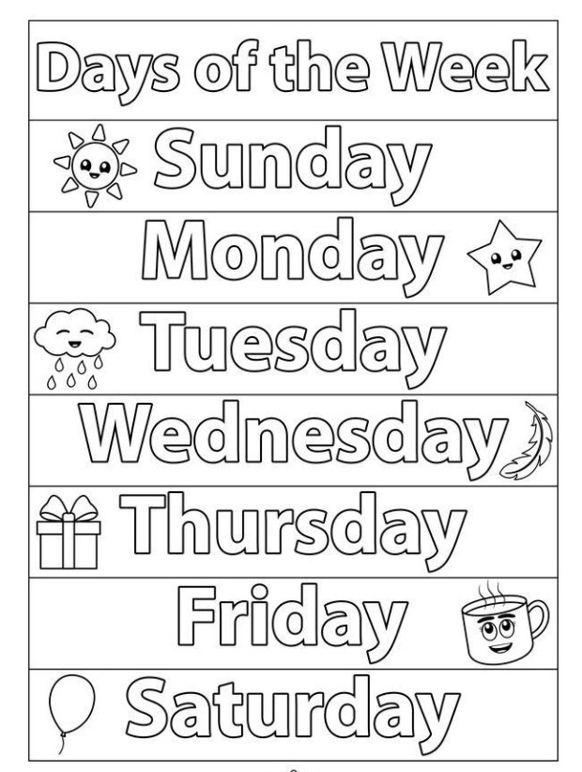
III. EXERCISES:
7. Color the days:

Slide 12
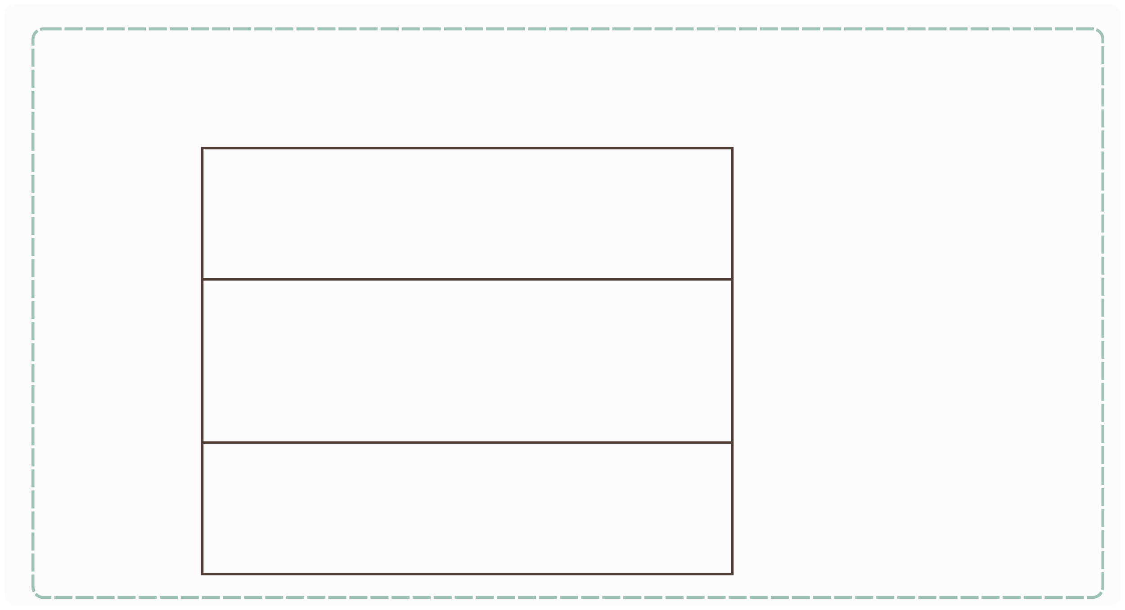







III. EXERCISES:
8. Fill the word:
Yesterday is
.....
Today is
Tomorrow is .....

