Slide 1
Unit 5: Science and Technology
Lesson 1.2: Grammar
Pages 45 & 46

Slide 2
Lesson Outline
Warm-up
Grammar
Consolidation
Wrap-up

Slide 3
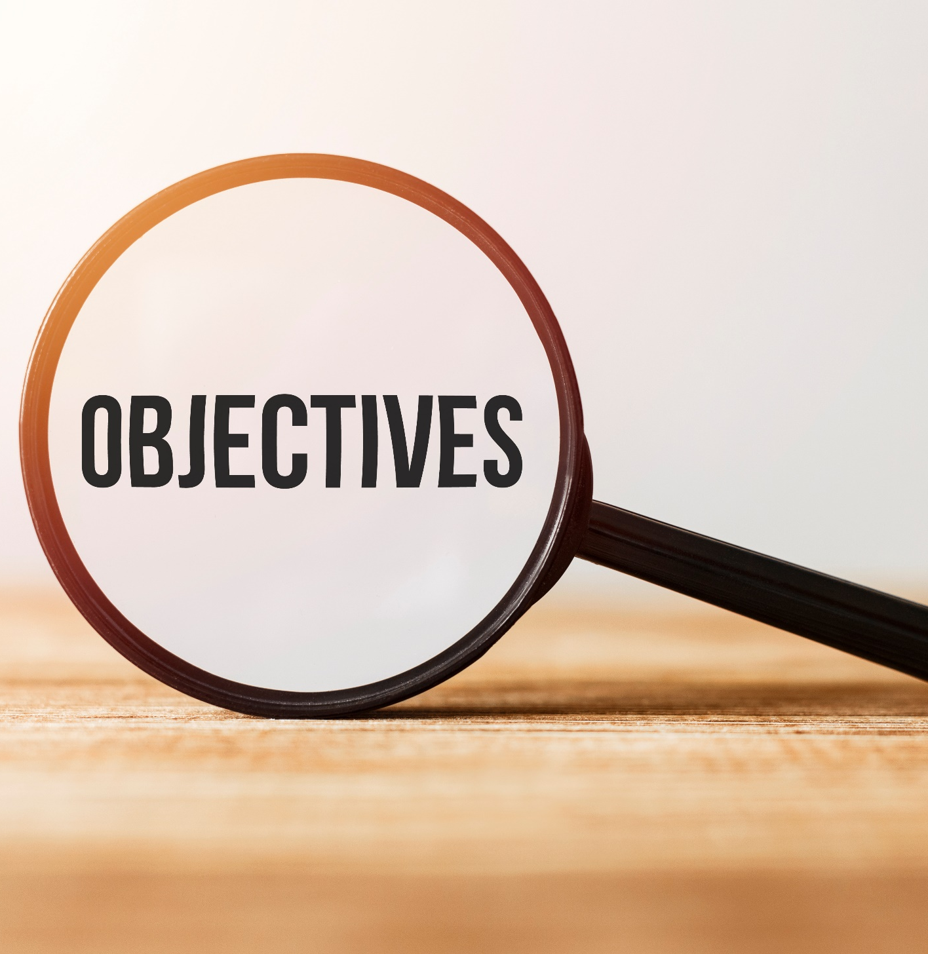
By the end of this lesson, students will be able to…
- to practice and use Wh-questions and Yes/No questions correctly.

Slide 4
WARM UP

Slide 5
Crossword puzzle
w
e
i
g
h
t
s
t
o
r
t a b l e
g g b y e
a
g
e
s r e n

Slide 6
Presentation

Slide 7
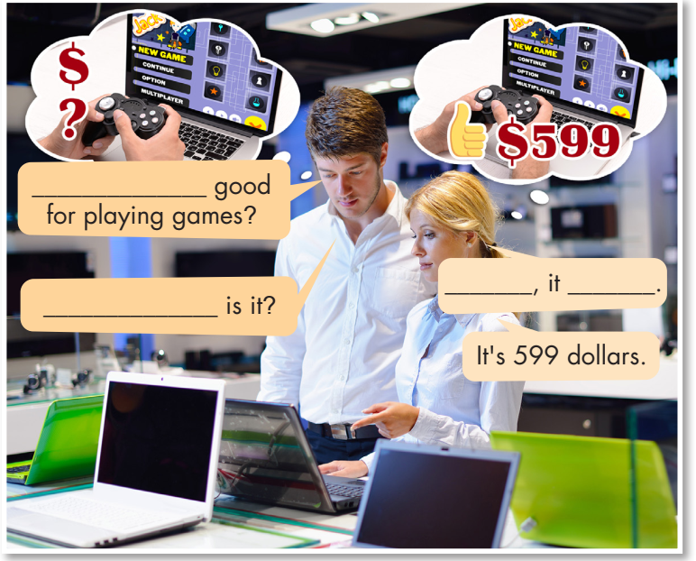
Look at the picture and fill in the blanks.
Who are they?
Where are they?
Are they a customer and a seller?
What are they talking about?
Is the laptop
Yes is
How much

Slide 9
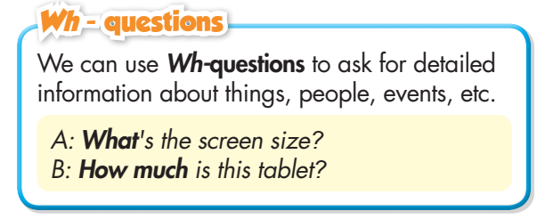
Read the box and answer the question below.
What can we use Wh-questions for?

Slide 10
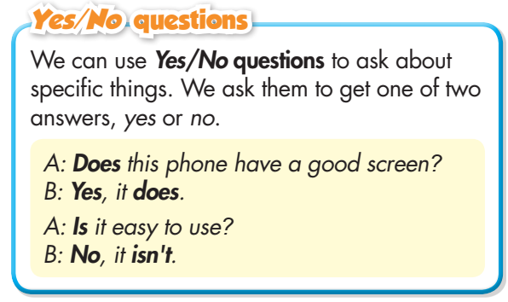
Read the box and answer the question below.
What can we use Yes/ No questions for?

Slide 11
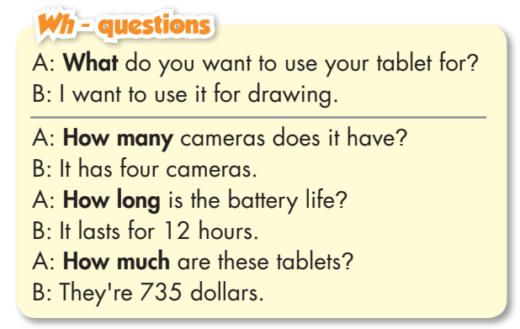
- Read the sentences and underline the question words and answers.
- Focus on the position of auxiliary verbs and subjects.

Slide 12
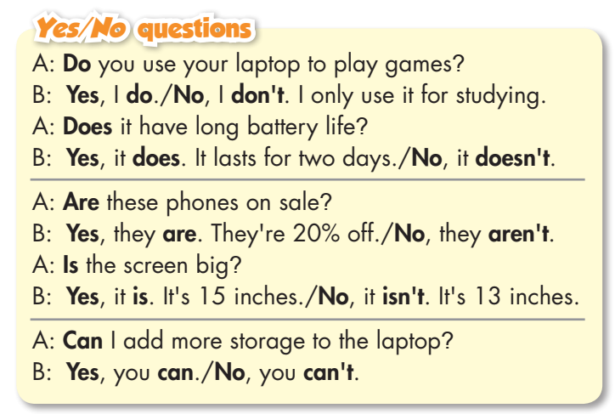
- Read the sentences and underline the bold words.
- Focus on the beginning words and answers: Yes/No.

Slide 13
Yes/No question vs. Wh- question
Question Type | Formation | Example
Yes/No | Auxiliary verb + Subject + Main Verb? (Do/Does/Did/Is/Are/Am/Was/Were) | Does your phone have a camera?
Wh- | Question word + Auxiliary Verb + Subject + Main Verb? (Who/What/When/Where/Why/How) | How do you charge your smartwatch?

Slide 14
Practice

Slide 15
Are
aren’t
How much
Is
isn’t
What
How long

Slide 16
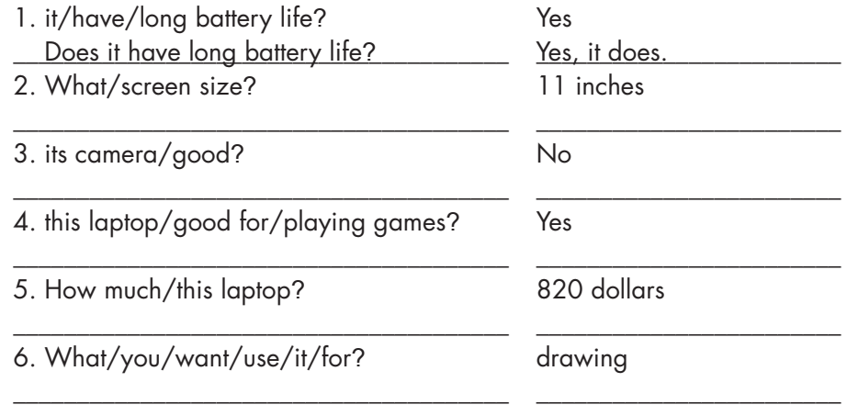
What is its screen size?
It’s 11 inches.
Is its camera good?
No, it isn't.
Is this laptop good for playing games?
Yes, it is.
How much is this laptop?
It’s 820 dollars.
What do you want to use it for?
I want to use it for drawing.

Slide 17
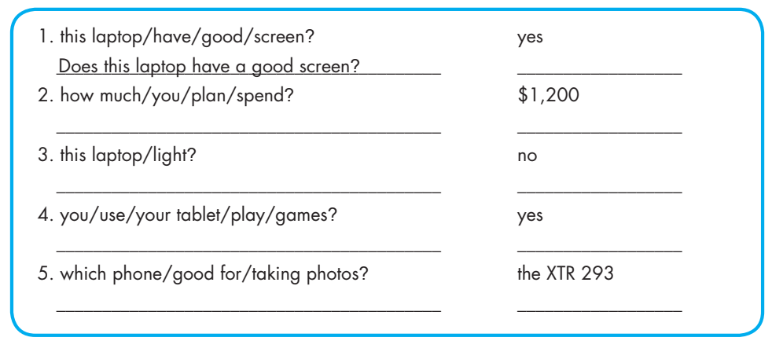
Extra Practice
WB page 27
How much do you plan to spend?
(I plan to spend) 1,200 dollars.
Is this laptop light?
No, it isn't.
Do/Can you use your tablet to play games?
Yes, I do/can.
Which phone is good for taking photos?
The XTR 293 (is good for taking photos).

Slide 18
Production:
Speaking

Slide 19
Work in pairs
Ask and answer about two devices your friend has.

Slide 20
CONSOLIDATION

Slide 21
Ask 3 friends these questions
Do you own a smartphone?
Is the screen big?
Do you often listen to music on your phone?
Can you add more storage to your smart phone?
What kind of phone do you have?
What do you want to use your smart phone/ tablet for?
Which app do you often use on your phone?
How many apps do you have on your phone?

Slide 22
WRAP-UP

Slide 23
Today’s lesson
Grammar:
Using Wh-questions to ask for detailed information about things, people and Yes/No questions to ask about specific things.
Speaking:
Talking about two devices your friend has.

Slide 24
Homework
- Make four sentences using Wh-questions and Yes/No questions.
- Do the exercises in WB: Grammar (page 27).
- Complete the grammar notes in Tiếng Anh 8 i-Learn Smart World Notebook (page 40).
- Play consolidation games in Tiếng Anh 8 i-Learn Smart World DHA App on www.eduhome.com.vn
- Prepare: Lesson 1 – Pronunciation and Speaking (pages 45 & 46 – SB).

Slide 25
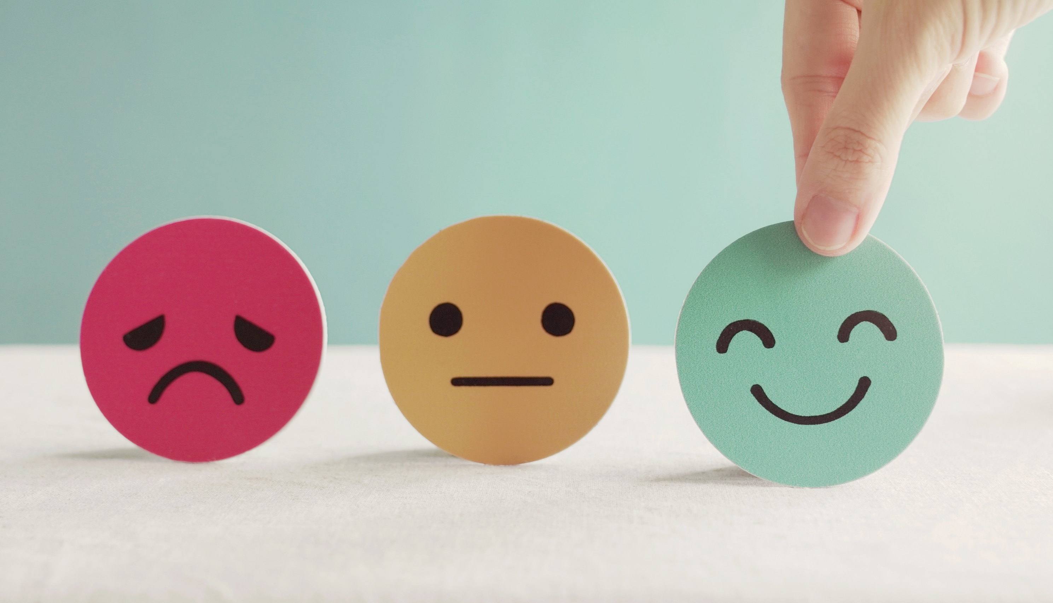
Lesson 3
Stay positive and have a nice day!

