Slide 1

Unit 5: London Was Great!
Lesson 5g: CLIL
Page 98

Slide 2
Lesson Outline
Warm-up
Reading
Listening
Speaking
Consolidation
Wrap-up

Slide 3
Objectives
By the end of this lesson, students will be able to…
- learn words related to the topic: hero, in memory of, tomb, connect, fog.
- read and listen for specific information.
- develop research skills to prepare a poster.
- present a poster about various landmarks around the world.

Slide 4

WARM-UP

Slide 5
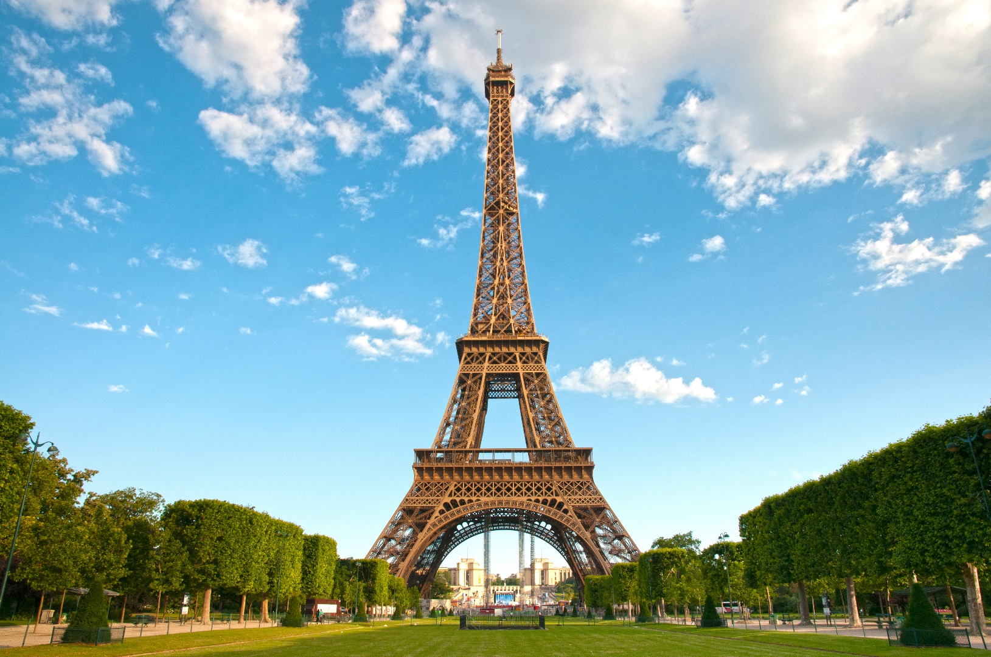
Can you recognise this place?
Eiffel Tower
Where is it?
Paris

Slide 6
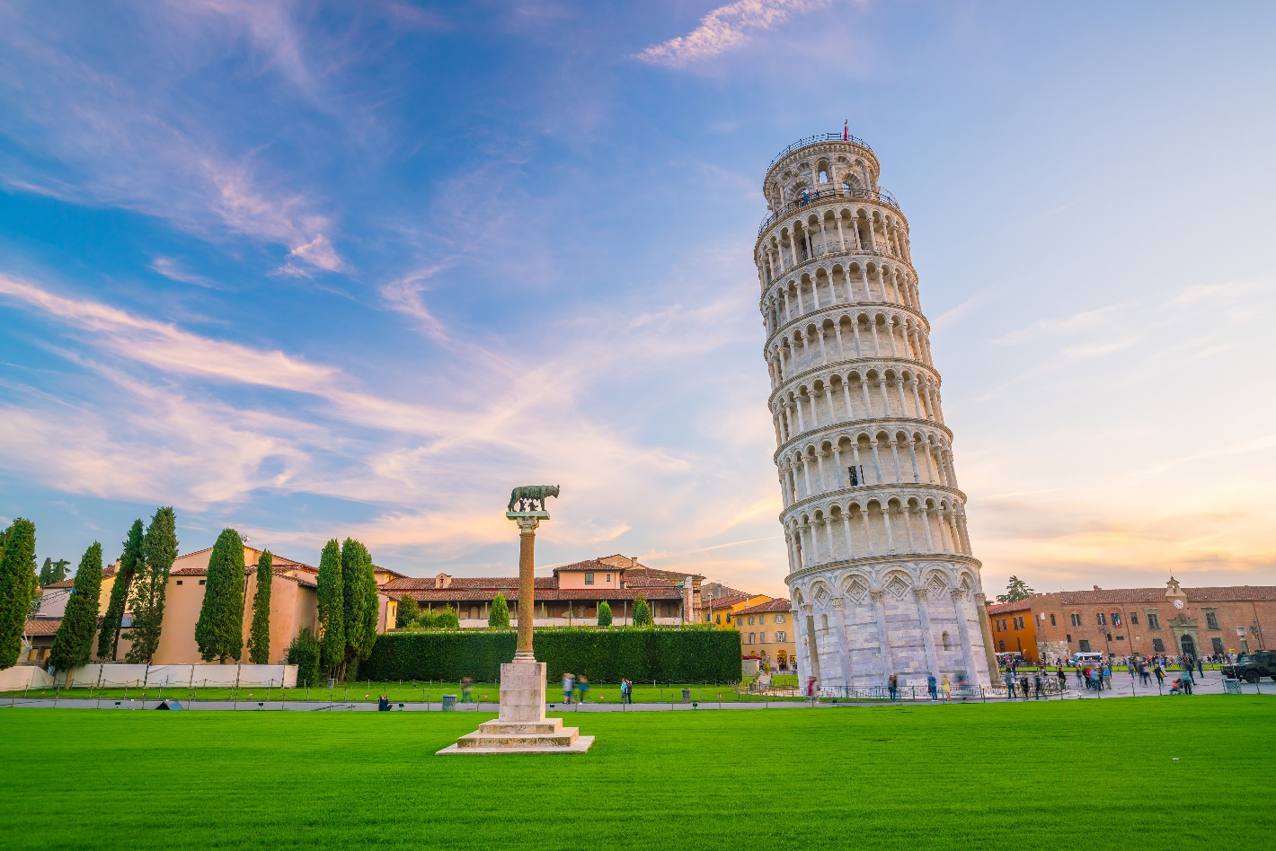
Can you recognise this place?
The Leaning Tower
Where is it?
Italy

Slide 7
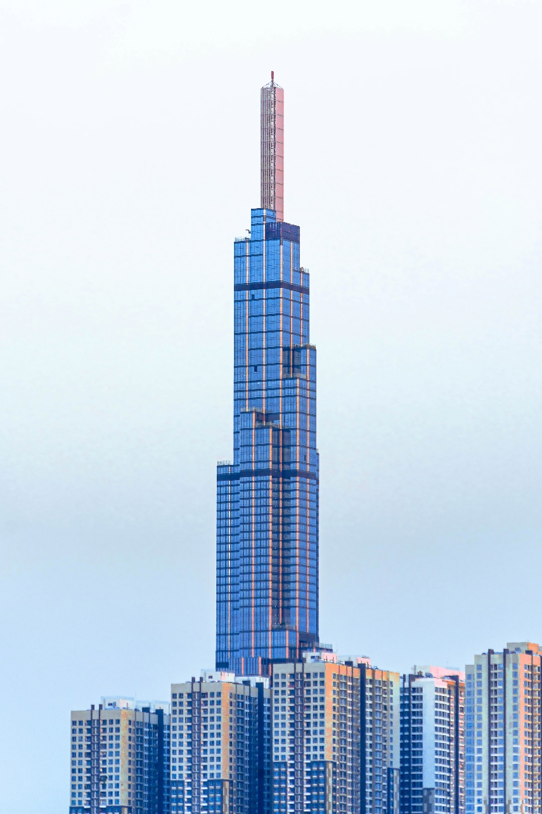
Can you recognise this place?
Landmark 81
Where is it?
Ho Chi Minh City

Slide 8
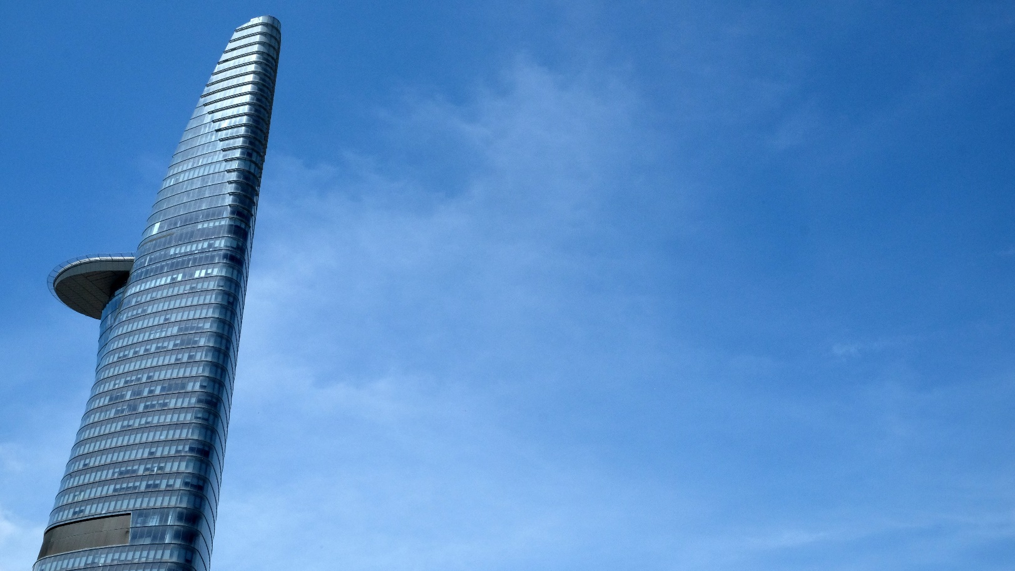
Can you recognise this place?
Bitexco Financial Tower
Where is it?
Ho Chi Minh City

Slide 9
What do you think about those places?
They are large and famous buildings. They help us to know where we are.
→ landmarks

Slide 10

Work in pairs
Which of those landmarks do you know? How do you know about them?
Which landmark are you interested in?

Slide 11

It’s time to learn …

Slide 12

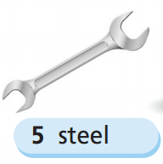
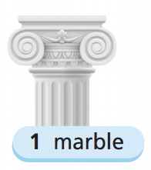
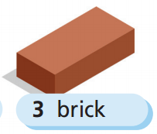
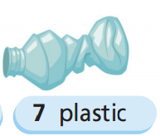
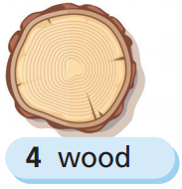
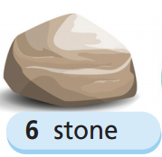
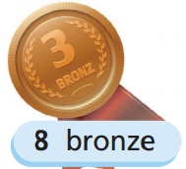
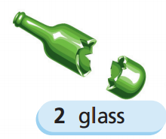
Listen and repeat

Slide 13

New words
hero, in memory of, tomb, connect, fog

Slide 14
Listen and repeat. Click each phrase to hear the sound.
hero (n) /ˈhɪərəʊ/ người anh hùng
in memory of (phr) /ɪn ˈmeməri əv/ tưởng nhớ
tomb (n) /tuːm/ mộ, ngôi mộ
connect (v) /kəˈnekt/ kết nối
fog (n) /ˈfɒɡ/ sương mù

Slide 15
Fill in each blank with an appropriate word/ phrase.
hero in memory of fog tombs connect fog
1. In the past, people built stone pyramid as _______________ for their pharaohs.
2. She draws a picture __________________ of her mother.
My laptop can _________________ to the internet to help me find information.
He is always a/an _____________ to his son.
We can’t see the way because of the __________________.
tombs
in memory of
connect
hero
fog

Slide 16
Pre-reading
Underline key words
Which materials did they use to build each landmark (1-4) in the text? Read through to find out.

Slide 17
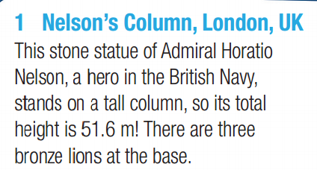
While-reading
1 They used stone to build Nelson’s Column. They
used bronze to build the lions at the base.

Slide 18
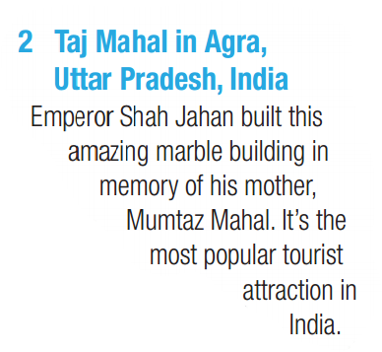
While-reading
2 They used marble to build the Taj Mahal.

Slide 19
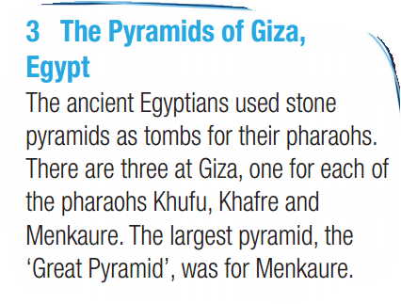
While-reading
3 They used stone to build the Pyramids of Giza.

Slide 20
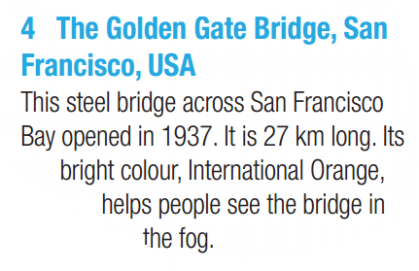
While- =reading
4 They used steel to build the Golden Gate Bridge.

Slide 22
1 There aren’t three lions at the base of Nelson’s Column. There are four.
M1: Sorry, Janine – it is in fact true. There are three lions at the base, Tony.
M2: No, there are four.

Slide 23
2 Shah Jahan didn’t build the Taj Mahal for his mother. He built it for his wife.
M1: And… it is true! 2-1. Tony, Shah Jahan built it to remember his mother.
M2: That sounds like it’s true.
M1: But it isn’t! He built it to remember his wife! Still 2-1.

Slide 24
3 The largest pyramid of Giza wasn’t for Menkaure. It was for Khufu.
There are three Great Pyramids of Giza, Egypt.
W: Yes, there are.
M1: That’s correct, and that makes the score 2-all! Tony, the largest of the pyramids was for the pharaoh Menkaure.
M2: False!
M1: It is false. It was for the pharaoh Khufu.

Slide 25
4 The Golden Gate Bridge isn’t 27 km long. It’s 2.7 km long.
M1: Correct, Janine – they built it in 1937, in fact. 3-3. It is 27 kilometres long, Tony.
M2: No, that’s much too long.
M1: Correct, Tony, it’s 2.7 km long, actually.

Slide 26
M1: Welcome to Know your Globe, our geography quiz. Today it’s landmarks, and I want you to tell me if the following statements are true or false. First, Nelson’s Column in London. It’s made of stone, Tony.
M2: That’s true, it is.
M1: It is indeed. It’s 51.6 metres high, Janine.
W: No, that’s false.
M1: Sorry, Janine – it is in fact true. There are three lions at the base, Tony.
M2: No, there are four.
M1: Well done, Tony! Two points for you. Now let’s move on to the Taj Mahal in Uttar Pradesh, India. Janine, it took 22 years to build.
W: Without being sure, I’ll say that’s true.
M1: And… it is true! 2-1. Tony, Shah Jahan built it to remember his mother.
M2: That sounds like it’s true.
M1: But it isn’t! He built it to remember his wife! Still 2-1. An easy one for you to draw level, Janine. There are three Great Pyramids of Giza, Egypt.
W: Yes, there are.
M1: That’s correct, and that makes the score 2-all! Tony,
the largest of the pyramids was for the pharaoh
Menkaure.
M2: False!
M1: It is false. It was for the pharaoh Khufu. 3-2. Now
to the Golden Gate Bridge in San Francisco. They built it in 1973, Janine.
W: No, no way.
M1: Correct, Janine – they built it in 1937, in fact. 3-3. It
is 27 kilometres long, Tony.
M2: No, that’s much too long.
M1: Correct, Tony, it’s 2.7 km long, actually. 4-3 to Tony.
Janine, you need the next one to stay in the game. The bridge’s colour was chosen so it would be easy to see in bad weather.
W: No, I don’t think so…
M1: It’s true, I’m afraid, Janine, and that means we
have a winner…

Slide 27
Extra reading
Read the text with the correct information and decide which landmark is described,
The Golden Gate Bridge, San Francisco, USA
You can see it easily in bad weather.
People built it in remember of a famous person who did something brave.
It’s a famous place which people built in remember of a member in royal family.
People in the past built it for their kings.
Nelson’s Column, London, UK
Taj Mahal in Agra, Uttar Pradesh, India
The Pyramids of Giza, Egypt

Slide 28

Post-reading

Slide 29
Requirement for a poster
Use the main heading: NAME OF THE LANDMARK.
Content: Location (where?)/ History (built in?)/ Interesting facts (use, size, weight, height, ….).
Clear and brief information.
Effective display, especially pictures.

Slide 30
Steps
Work in groups to decide on a landmark you like.
Find information about that landmark (where, built, use, size, height, weight, …).
Try to draw simple illustrations for that landmark.
Write a headline for the poster - nice and big so it gets attention.
Put in your message.
Put your names on it.

Slide 31
Example of a poster

Slide 32
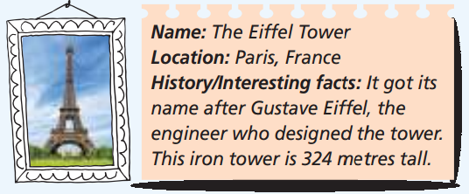
Example of a poster

Slide 33
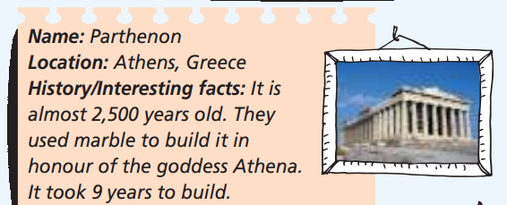
Example of a poster

Slide 34
Present your poster
Welcome everyone to our group’s poster. Can you guess where it is?
Let’s follow us to discover this place. We are sure that you will want to visit it after our presentation.
Let’s get started with its location. It is in ………………..
Next, I will tell you about its history …………………
Then, there are some interesting facts about it …………………..
What we want to tell you is …………………………. (your message).
Thanks for listening.
Remember to vote for us. Thank you!

Slide 35
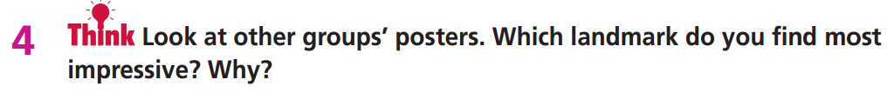
Ask Ss to look at the posters of other groups and then ask various Ss to tell the class which landmarks they think are the most impressive and why.
I think Stonehenge is the most impressive because it is
so old and they brought the huge stones from far away.

Slide 36
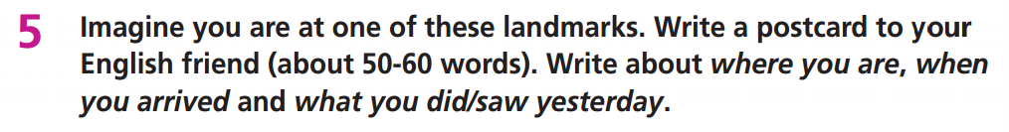
Hi Mary,
Greetings from …………………………… I’m having a great time. We arrived in ………………….. (when). Yesterday we ……………… (activities). It’s a ……………………… (some information about that place: history, interesting facts)
Talk soon.
(Your name)

Slide 37
Hi Mary,
Greetings from Athens, Greece. I’m having a great
time. We arrived in Athens three days ago and visited
some places. Yesterday we visited the Parthenon. It’s
a marble temple they built in honour of the goddess
Athena. It took 9 years to build it. It’s 2,500 years old.
It’s amazing.
Talk soon.
Cẩm

Slide 38

CONSOLIDATION

Slide 39
Imagine you are at a famous landmark in Vietnam. Write a postcard to your friend (about 50-60 words). Write about where you are, when you arrived, and what you did/saw.

Slide 40

WRAP-UP

Slide 41
Today’s lesson
Reading and Listening
Read and listening for specific information.
Vocabularies
hero
in memory of
tomb
connect
fog
Speaking
Develop research skills to prepare a poster.
Present a poster about various landmarks around the world.

Slide 42
Homework
Practise the vocabularies and make sentences using them.
Prepare the next lesson (p. 99 SB).

Slide 43

Enjoy your day!

