Slide 1

Unit 6: Community Services
Lesson 1.2: Grammar
Page 47

Slide 2
Lesson Outline
Warm-up
Grammar
Consolidation
Wrap-up

Slide 3
Objectives
By the end of this lesson, students will be able to…
Use articles and prepositions of place correctly.
Write sentences about the positions of places.

Slide 4

WARM-UP

Slide 5

Work in pairs.
Pick out one redundant letter in each word to make the correct words
1. supermarrket
2. train statioon
3. oppossite
4. beetween
5. post offiice

Slide 6
Work in pairs.
Pick out one redundant letter in each word to make the correct words
1. supermareket
2. train statiaon
3. opporsite
4. beutween
5. post offaice
1. supermarket
2. train station
3. opposite
4. between
5. post office
ANSWER

Slide 7

Presentation
Articles,
Prepositions of place

Slide 8
Is there a train station near here?
The train station is on Queen's Street.
It's between the police station and the hospital.

Slide 9
Lead in
1. What do we call a/the in sentence 1, 2?
Articles.
2. When do we use a/the?
We use a in front of a singular noun when we talk about it for the first time. We use the when it's clear from the situation which one we're talking about.
3. How about between in sentence 3?
Prepositions of place.
4. What do we use prepositions of place for?
→ To say where things are.

Slide 10
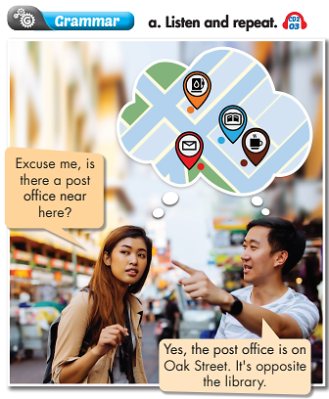

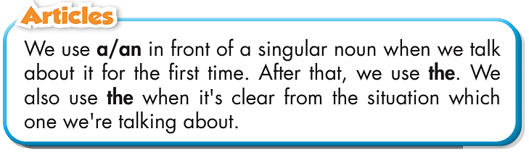
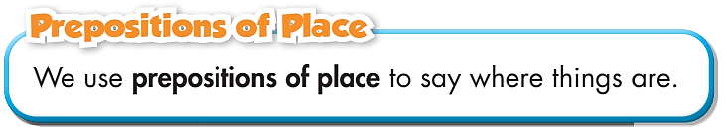

Slide 11

Practice

Slide 12
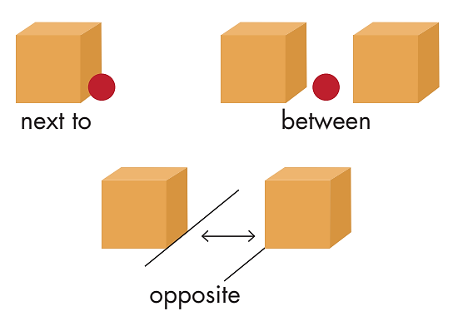
Some prepositions of place

Slide 13
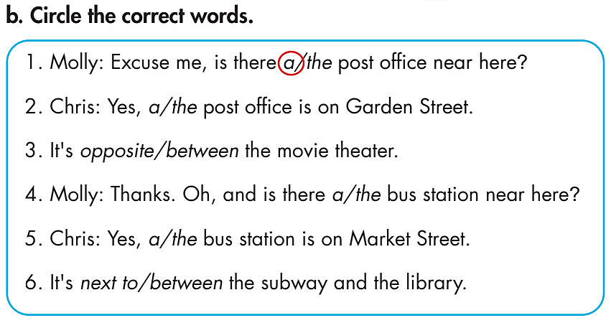
Practice
How many sentences are there?
→ There are 6.
What are you going to do?
Circle the correct words.

Slide 14
Practice
Circle the correct words.
1. Molly: Excuse me, is there a/the post office near here?
2. Chris: Yes, a/the post office is on Garden Street.
3. It's opposite/between the movie theater.
4. Molly: Thanks. Oh, and is there a/the bus station near here?
5. Chris: Yes, a/the bus station is on Market Street.
6. It's next to/between the subway and the library.

Slide 15
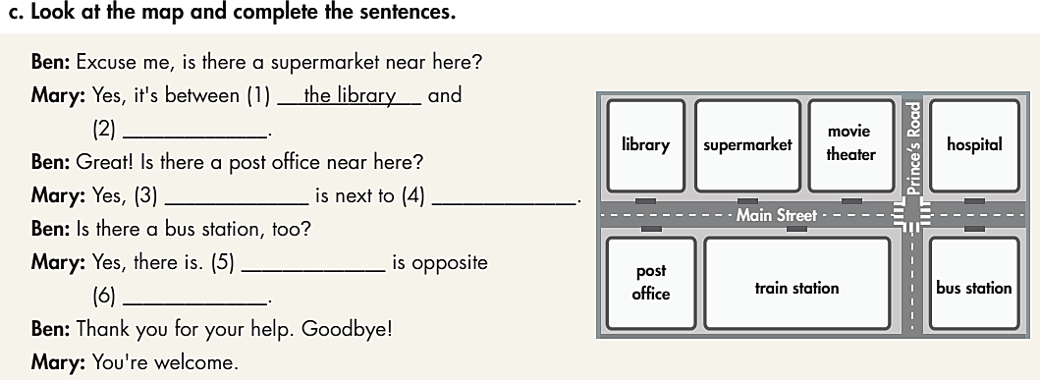
Practice
Who are there in the dialogue?
→ Ben and Mary.
Look at the map and complete the sentences.
What are you going to do?

Slide 16
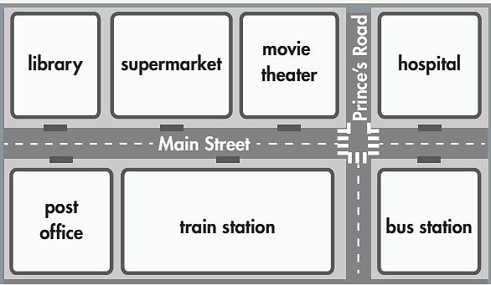
Practice
Look at the map and complete the sentences.
Ben: Excuse me, is there a supermarket near here?
Mary: Yes, it's between (1) _________
and (2) ________________.
Ben: Great! Is there a post office near here?
Mary: Yes, (3) _____________ is next to (4) ______________.
Ben: Is there a bus station, too?
Mary: Yes, there is. (5) _____________ is opposite (6) __________.
Ben: Thank you for your help. Goodbye!
Mary: You're welcome.
the library
the movie theater
the post office
the train station
The bus station
the hospital

Slide 17
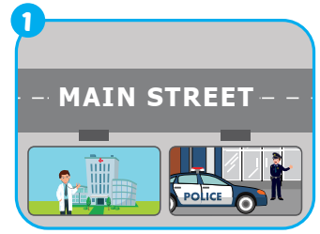
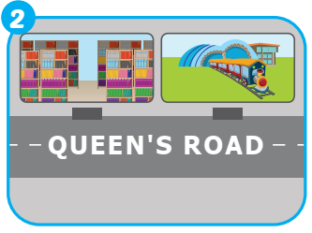
Extra Practice
WB, page 33
1. Joe: Excuse me, is there a hospital
near here?
Me: _______hospital is on __________.
It's _____________________.
2. Jill: Excuse me, is there a library near here?
Me: ____, the _________ is on ___________.
It's________ the ___________.
Yes, the
Main Street
next to the police station
Yes
the library
Queen’s Road
next to
train station

Slide 18
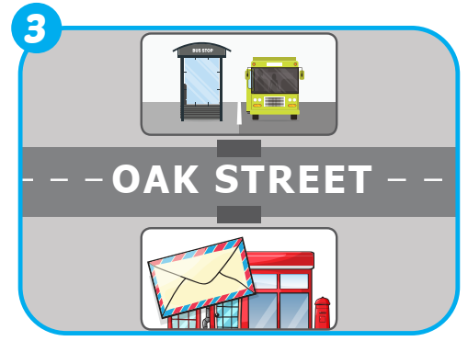
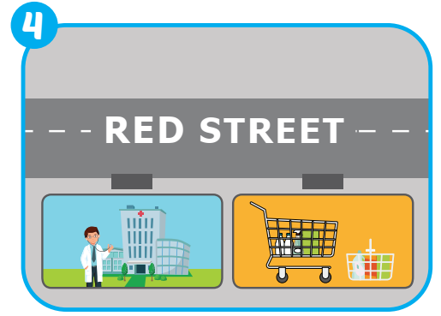
Extra Practice
WB, page 33
3. Jill: Excuse me, is there a post office
near here?
Me: Yes, ____________ is on
_________. __________ the__________.
4. Max: Excuse me, is there a supermarket
near here?
Me: ___, ____ supermarket ______________.
It's ________________.
the post office
Oak Street
It’s opposite
bus station
Yes
the
is on Red Street
next to the hospital

Slide 19

Production

Slide 20


Work in pairs.
Now, practice the conversation with
your partner.
Ben: Excuse me, is there a supermarket near here?
Mary: Yes, it's between the library and the movie theater.
Ben: Great! Is there a post office near here?
Mary: Yes, the post office is next to the train station.
Ben: Is there a bus station, too?
Mary: Yes, there is. The bus station is opposite the hospital.
Ben: Thank you for your help. Goodbye!
Mary: You're welcome.

Slide 21

CONSOLIDATION

Slide 22
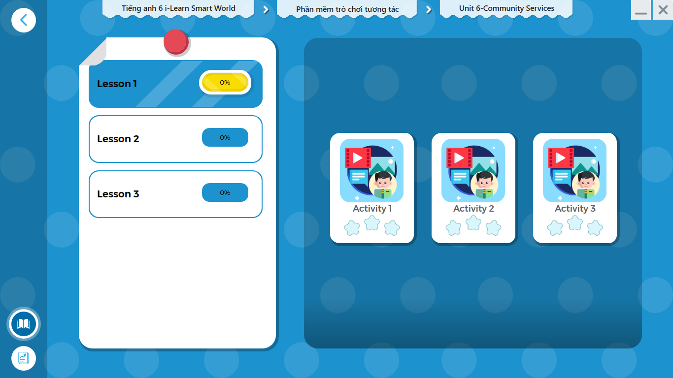
LET’S PLAY!
Click here to play the games.

Slide 23
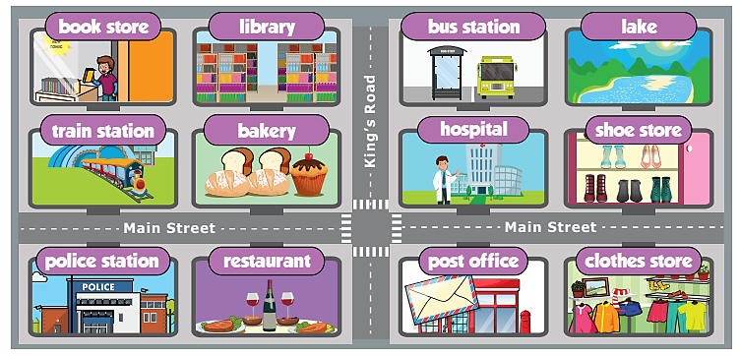
Extra Practice
WB, page 33
Write sentences saying where the hospital, library, train station,
bus station, and police station are. Write 50 to 60 words.
Ex:
The hospital is on Main Street. It's opposite the post office.

Slide 24

WRAP-UP

Slide 25
Today’s lesson
Grammar: Practice and use articles and prepositions of place correctly.
Writing: Write sentences about the positions of places.

Slide 26
Homework
Learn by heart the use of articles and prepositions and make sentences using them.
Do the exercises on page 33 WB.
Do the exercises in Tiếng Anh 6 i-Learn Smart World Notebook on page 35.
Prepare the next lesson (page 48 - SB).
Play the consolidation games in Tiếng Anh 6 i-Learn Smart World DHA App on www.eduhome.com.vn.

Slide 27

Enjoy your day!

