Slide 2
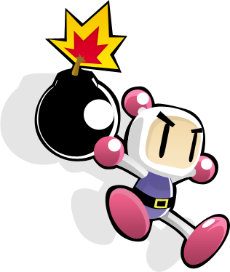
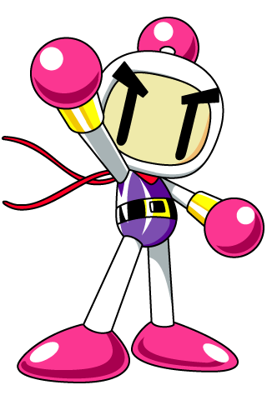
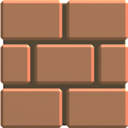
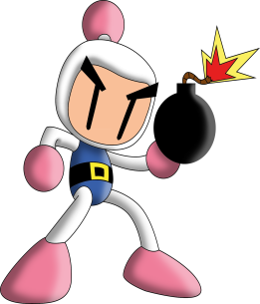
Rules
Choose a question.
Right answer = +1 points
Then choose one bonus box

Slide 3
Types of boxes
“?” box: + very good or very bad -
Grey box: + points
Brick: ??? mystery prize ???

Slide 4
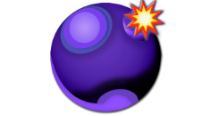
Bonus
Bonus:
+ Points
- Points
Switch / Change Points
Bomb!
Nuclear!!! ALL points, bye!

Slide 5
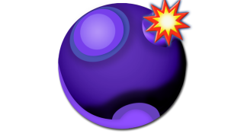
A1
A2
A3
A4
A5
A6
B1
B2
B3
B4
B5
B6
C1
C2
C3
C4
C5
C6
D1
D2
D3
D4
D5
D6
E1
E2
E3
E4
E5
E6
Notes:
Question selection page

Slide 6
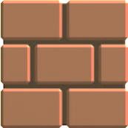
B
C
D
E
F
G
A
+8
+2
+2
+1
+1
+1
+3
H
I
J
M
N
+4
K
L
+2
- 8
O
P
R
S
T
U
+5
Q
+2
+1
+10
+3
+1
V
W
X
Y
- 5
+3
+3
Z
1
2
+8
3
4
5
6
7
8
9
+1
+5
+2
Questions
Notes:
Once a team answers a question correctly, they will be hyperlinked to this screen. There are 35 boxes to choose from.
Each box will contain a different prize.
There are 3 kinds of boxes. The students can choose how safe they want to play it when choosing a prize.
“?” boxes: Really good or really bad.
Grey boxes: + points (the safest option…but they wont get many points)
Brick boxes: Random. It has everything including bombs, + points, nuclear, and nothing.
Click on the questions arrow (bottom right) when finished. It will link you to the question selection page.
To change the prizes, see slide 37 template.

Slide 7
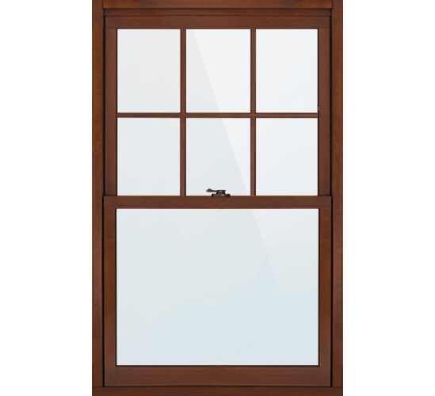
What is it? How does it Feel?
A) It’s hard B) It’s soft C) It’s thick D) it’s thin E) it’s Hot F) it’s Cold
Notes:
Click once to reveal answer.
Click on bomber-man to hyperlink to the bonus page.

Slide 8
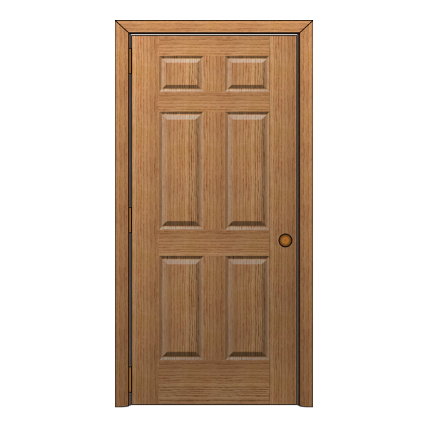
What is it? How does it Feel?
A) It’s hard B) It’s soft C) It’s thick D) it’s thin E) it’s Hot F) it’s Cold
Notes:
Click once to reveal answer.
Click on bomber-man to hyperlink to the bonus page.

Slide 9
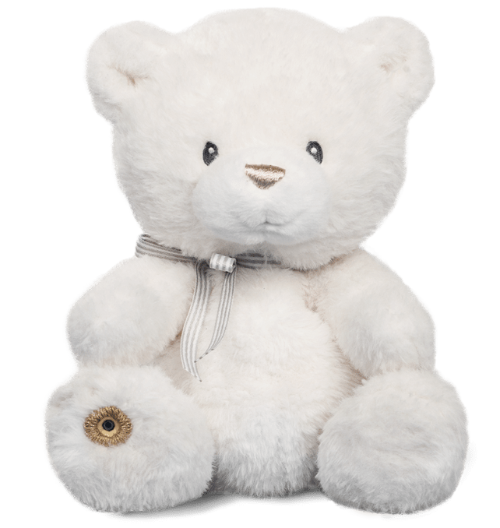
What is it? How does it Feel?
A) It’s hard B) It’s soft C) It’s thick D) it’s thin E) it’s Hot F) it’s Cold
Notes:
Click once to reveal answer.
Click on bomber-man to hyperlink to the bonus page.

Slide 10
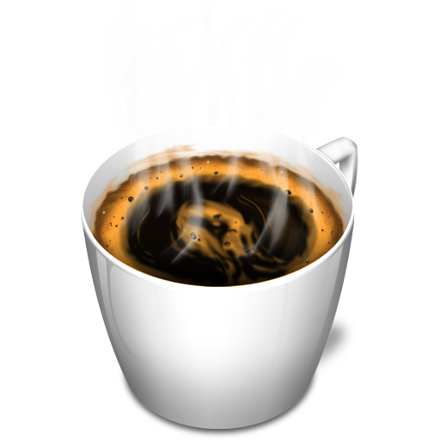
What is it? How does it Feel?
A) It’s hard B) It’s soft C) It’s thick D) it’s thin E) it’s Hot F) it’s Cold
Notes:
Click once to reveal answer.
Click on bomber-man to hyperlink to the bonus page.

Slide 11
What is it? How does it Feel?
A) It’s hard B) It’s soft C) It’s thick D) it’s thin E) it’s Hot F) it’s Cold
Notes:
Click once to reveal answer.
Click on bomber-man to hyperlink to the bonus page.

Slide 12
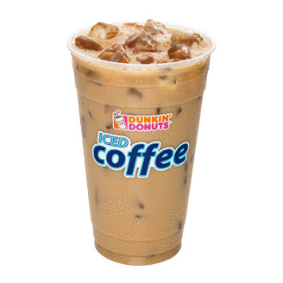
What is it? How does it Feel?
A) It’s hard B) It’s soft C) It’s thick D) it’s thin E) it’s Hot F) it’s Cold
Notes:
Click once to reveal answer.
Click on bomber-man to hyperlink to the bonus page.

Slide 13
What is it? How does it Feel?
A) It’s hard B) It’s soft C) It’s thick D) it’s thin E) it’s Hot F) it’s Cold
Notes:
Click once to reveal answer.
Click on bomber-man to hyperlink to the bonus page.

Slide 14
What is it? How does it Feel?
A) It’s hard B) It’s soft C) It’s thick D) it’s thin E) it’s Hot F) it’s Cold
Notes:
Click once to reveal answer.
Click on bomber-man to hyperlink to the bonus page.

Slide 15
What is it? How does it Feel?
A) It’s hard B) It’s soft C) It’s thick D) it’s thin E) it’s Hot F) it’s Cold
Notes:
Click once to reveal answer.
Click on bomber-man to hyperlink to the bonus page.

Slide 16
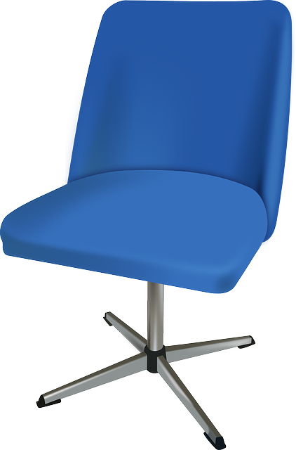
What is it? How does it Feel?
A) It’s hard B) It’s soft C) It’s thick D) it’s thin E) it’s Hot F) it’s Cold
Notes:
Click once to reveal answer.
Click on bomber-man to hyperlink to the bonus page.

Slide 17
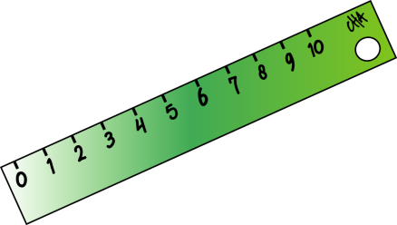
What is it? How does it Feel?
A) It’s hard B) It’s soft C) It’s thick D) it’s thin E) it’s Hot F) it’s Cold
Notes:
Click once to reveal answer.
Click on bomber-man to hyperlink to the bonus page.

Slide 18
What is it? How does it Feel?
A) It’s hard B) It’s soft C) It’s thick D) it’s thin E) it’s Hot F) it’s Cold
Notes:
Click once to reveal answer.
Click on bomber-man to hyperlink to the bonus page.

Slide 19
What is it? How does it Feel?
A) It’s hard B) It’s soft C) It’s thick D) it’s thin E) it’s Hot F) it’s Cold
Notes:
Click once to reveal answer.
Click on bomber-man to hyperlink to the bonus page.

Slide 20
What is it? How does it Feel?
A) It’s hard B) It’s soft C) It’s thick D) it’s thin E) it’s Hot F) it’s Cold
Notes:
Click once to reveal answer.
Click on bomber-man to hyperlink to the bonus page.

Slide 21
What is it? How does it Feel?
A) It’s hard B) It’s soft C) It’s thick D) it’s thin E) it’s Hot F) it’s Cold
Notes:
Click once to reveal answer.
Click on bomber-man to hyperlink to the bonus page.

Slide 22
What is it? How does it Feel?
A) It’s hard B) It’s soft C) It’s thick D) it’s thin E) it’s Hot F) it’s Cold
Notes:
Click once to reveal answer.
Click on bomber-man to hyperlink to the bonus page.

Slide 23
What is it? How does it Feel?
A) It’s hard B) It’s soft C) It’s thick D) it’s thin E) it’s Hot F) it’s Cold
Notes:
Click once to reveal answer.
Click on bomber-man to hyperlink to the bonus page.

Slide 24
This scarf ______ nice.
A) It’s hard B) It’s soft C) It’s thick D) it’s thin E) it’s Hot F) it’s Cold
Notes:
Click once to reveal answer.
Click on bomber-man to hyperlink to the bonus page.

Slide 25
What is it? How does it Feel?
A) It’s hard B) It’s soft C) It’s thick D) it’s thin E) it’s Hot F) it’s Cold
Notes:
Click once to reveal answer.
Click on bomber-man to hyperlink to the bonus page.

Slide 26
What is it? How does it Feel?
A) It’s hard B) It’s soft C) It’s thick D) it’s thin E) it’s Hot F) it’s Cold
Notes:
Click once to reveal answer.
Click on bomber-man to hyperlink to the bonus page.

Slide 27
What is it? How does it Feel?
A) It’s hard B) It’s soft C) It’s thick D) it’s thin E) it’s Hot F) it’s Cold
Notes:
Click once to reveal answer.
Click on bomber-man to hyperlink to the bonus page.

Slide 28
What is it? How does it Feel?
A) It’s hard B) It’s soft C) It’s thick D) it’s thin E) it’s Hot F) it’s Cold
Notes:
Click once to reveal answer.
Click on bomber-man to hyperlink to the bonus page.

Slide 29
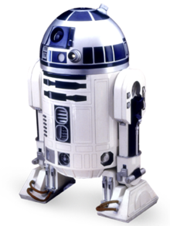
What is it? How does it Feel?
A) It’s hard B) It’s soft C) It’s thick D) it’s thin E) it’s Hot F) it’s Cold
Notes:
Click once to reveal answer.
Click on bomber-man to hyperlink to the bonus page.

Slide 30
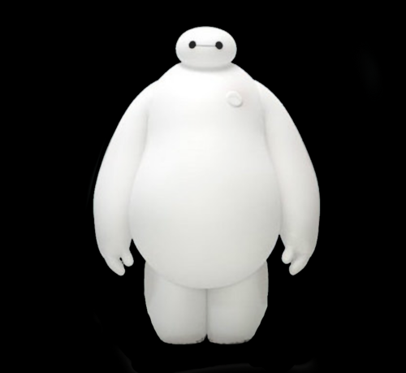
What is it? How does it Feel?
A) It’s hard B) It’s soft C) It’s thick D) it’s thin E) it’s Hot F) it’s Cold
Notes:
Click once to reveal answer.
Click on bomber-man to hyperlink to the bonus page.

Slide 31
What is it? How does it Feel?
A) It’s hard B) It’s soft C) It’s thick D) it’s thin E) it’s Hot F) it’s Cold
Notes:
Click once to reveal answer.
Click on bomber-man to hyperlink to the bonus page.

Slide 32
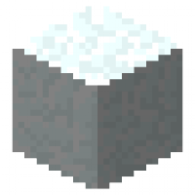
What is it? How does it Feel?
A) It’s hard B) It’s soft C) It’s thick D) it’s thin E) it’s Hot F) it’s Cold
Notes:
Click once to reveal answer.
Click on bomber-man to hyperlink to the bonus page.

Slide 33
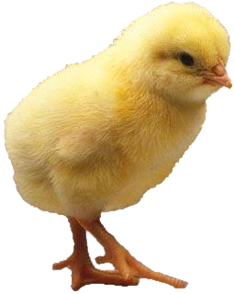
What is it? How does it Feel?
A) It’s hard B) It’s soft C) It’s thick D) it’s thin E) it’s Hot F) it’s Cold
Notes:
Click once to reveal answer.
Click on bomber-man to hyperlink to the bonus page.

Slide 34
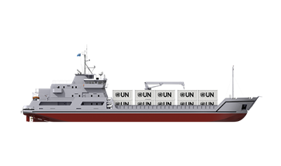
What is it? How does it Feel?
A) It’s hard B) It’s soft C) It’s thick D) it’s thin E) it’s Hot F) it’s Cold
Notes:
Click once to reveal answer.
Click on bomber-man to hyperlink to the bonus page.

Slide 35
What is it? How does it Feel?
A) It’s hard B) It’s soft C) It’s thick D) it’s thin E) it’s Hot F) it’s Cold
Notes:
Click once to reveal answer.
Click on bomber-man to hyperlink to the bonus page.

Slide 36
What is it? How does it Feel?
A) It’s hard B) It’s soft C) It’s thick D) it’s thin E) it’s Hot F) it’s Cold
Notes:
Click once to reveal answer.
Click on bomber-man to hyperlink to the bonus page.

Slide 37
+8
+4
+2
+1
+1
+1
+3
+4
- 8
+2
+5
+10
+3
+2
+1
+1
- 5
+3
+3
+8
+1
+5
+2
Notes:
You can use this as a template to re-arrange prizes or change up things if you re-use this game.

Slide 38
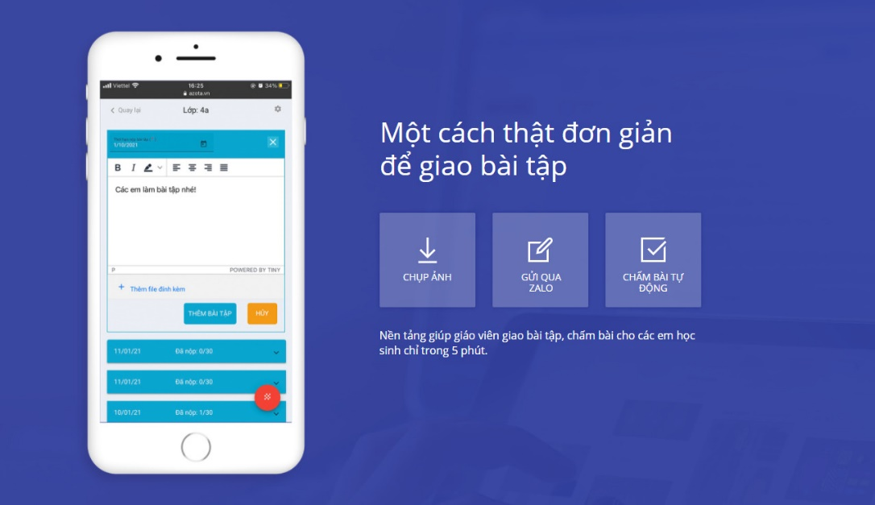
gioithieu.azota.vn

