Slide 1




Welcome to English Class 8A
Period 45
Unit 6: FOLK TALES
Let’s learn English !

Slide 2
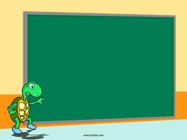
Perid 45
Unit 6: FOLK TALES
Lesson 5: Skills 1

Slide 3
Unit 6: FOLK TALES - SKILLS 1
I. Reading
1. Read the fable The Starfruit Tree. Then find the following words and underline them in the story. What do they mean?
fortune - starfruit tree - ripe- filled - load - repay
Once upon a time, there was a rich man living in a village. When he died, he left his two sons a fortune. But the elder brother gave his brother only a starfruit tree. When the fruit was ripe, an eagle came and ate the fruit. The younger brother begged the eagle not to. The eagle promised to repay him in gold and told him to make a bag to carry it. The eagle took him on its back to a place of gold. There, he filled the bag with gold. When he got home he was rich. The elder brother was surprised, so he asked his brother to explain. After hearing the story, he offered to swap his fortune for the starfruit tree, and his kind brother accepted. When the eagle came, the elder brother asked it to take him to the place of gold. The greedy brother filled a very large bag and all his pockets with gold. On the way home, because the load was too heavy, the eagle got tired and dropped him into the sea.

Slide 4
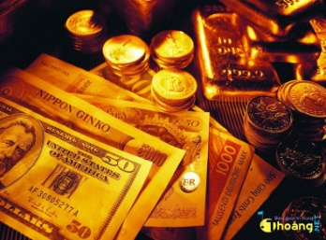
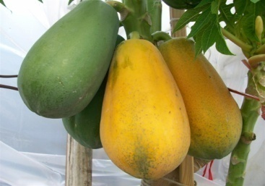
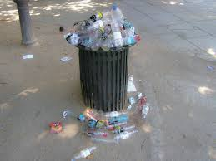
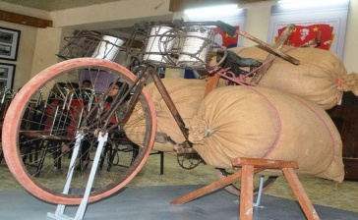
Unit 6: FOLK TALES - SKILLS 1
What do they mean? You match with the meanings
1. fortune
2. starfruit tree
3. Ripe
4. filled
5. Repay
6. load
a. ready to be eaten
b. Tree with green fruit shaped like a star
c. put gold into the bag until there is no more space
d. pay back
e. something that is being carried
f. a large amount of money

Slide 5
2. Read the story again and answer the questions.
Unit 6: FOLK TALES - SKILLS 1
1. What did the older brother give his younger brother?
2. What did the eagle promise to the younger brother?
3. What did the elder brother do when he found out how his younger brother became rich?
4. What did the elder brother do when he got to the place of gold?
5. What happened to the elder brother in the end?
ANSWERS:
1. He gave his younger brother only a starfruit tree.
2. The eagle promised to repay him in gold.
3. He offered to swap his fortune for his brother’s starfruit tree.
4. He filled a very large bag and all his pockets with gold.
5. He was dropped (by the eagle) into the sea.

Slide 6
3. Now complete the details of the fable.
Unit 6: FOLK TALES - SKILLS 1
Main characters | Character 1: The younger brother. He is kind and honest. Character 2: The elder brother. He is (1)________. Characters 3: The eagle. It is grateful. A. Generous B. good C. greedy
Plot: beginning | Once upon a (2) ________ , there was a rich man living in a village. A. Week B. time C. day
Plot: middle | The man left his two sons a (3) ________ but the elder brother gave his brother only a starfruit tree. An eagle came and ate the fruit. It repaid the younger brother by taking him to a place of (4) ________ . He brought home some gold and became very rich. The elder brother (5) ________ his fortune for his brother’s tree. The eagle helped the elder brother take gold. 3. A. house B. fortune C. book 4. A. Trees B. Mountains C. gold 5. A. swapped B. took away C. bought
Plot: end | As the eagle was flying back, the load was too heavy. The eagle got tired and (6) ________ the elder brother into the sea. 6. A. saved B. dropped C. Brought
C. greedy
B. time
B. fortune
C. gold
A. swapped
dropped

Slide 7
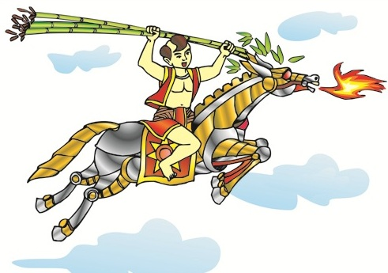
4. Read the story summaries below. Decide which story you would like to read.
Unit 6: FOLK TALES - SKILLS 1
II. Speaking
Title: Saint Giong
Genre: legend
Main characters: Thanh Giong
Plot: Thanh Giong lived in the village
of Phu Dong. He was already three
years old, but he couldn’t sit up or say
any words. However, when the enemy
invaded his country, he helped Emperor
Hung Vuong the Sixth defeat the enemy
and save the country. He flew to heaven
and became a Saint.

Slide 8

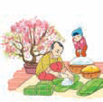
Unit 6: FOLK TALES - SKILLS 1
Title: Chung Cakes, Day Cakes
Genre: folk tale
Main characters: Prince Tiet Lieu,
his wife, and Emperor Hung Vuong
Plot: Emperor Hung Vuong announced
that the prince who made the most
delicious food would become the new
emperor. Prince Tiet Lieu and his wife
pleased the emperor by creating two
types of rice cakes that represented
Heaven and Earth. Emperor Hung Vuong made Tiet Lieu the new emperor.
Title: The Tortoise and the Hare
Genre: fable
Main characters: a hare and a tortoise
Plot: The hare always boasted about how fast he could run. The tortoise challenged him to a race. The hare soon left the tortoise behind.
The hare believed that he would win,
and he stopped to take a nap. When
he woke up, he found that the tortoise
arrived before him

Slide 9
5. Work in pairs. Ask and answer questions about the stories.
Unit 6: FOLK TALES - SKILLS 1
Questions
1. Which story do you want to read? | Giong Saint.
2. What kind of story is it? | (It is ) legend.
3. Who is the main character in it? | Giong Saint (is the main character)
4. What is it about? | It’s about Giong Saint who helped Emperor Hung Vuong the Sixth defeat the enemy and save the country
….

Slide 10
5. Work in pairs. Ask and answer questions about the stories.
Unit 6: FOLK TALES - SKILLS 1
Questions
1. Which story do you want to read? | A. We shouldn’t be arrogant. (kiêu ngạo)
2. What kind of story is it? | B. The tortoise and the hare.
3. Who is the main character in it? | C. It’s a race between a tortoise and a hare. The tortoise was the winner.
4. What is it about? | D. A tortoise and a hare.
5.What do you learn from the story? | E. Fable
1. B 2. E 3. D 4. C 5.A

Slide 11
5. Work in pairs. Ask and answer questions about the stories.
Unit 6: FOLK TALES - SKILLS 1
Student A | Student B
- Which story do you want to read? | - The tortoise and the hare.
- What kind of story is it? | - Fable
- Who are the main characters? | - A tortoise and a hare.
- What is it about? | - It’s a race between a tortoise and a hare. The tortoise was the winner.
- What do you learn from the story? | - We shouldn’t be arrogant.

Slide 12
6. Work in pairs. Ask and answer questions about the stories.
Unit 6: FOLK TALES - SKILLS 1
GAME
WHO AM I?
I was a three years old child. Then I grew up to be came a giant and save our country from the An under Emperor Hung King The sixth.
Thanh Giong / Giong Saint

Slide 13
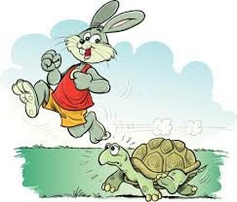
6. Work in pairs. Ask and answer questions about the stories.
Unit 6: FOLK TALES - SKILLS 1
GAME
WHO AM I?
I am an animal who can not run quickly. However I won the hare in a race because he was so arrogant.
The tortoise in the fable “ The tortoise and the hare”

Slide 14
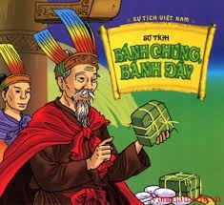
6. Work in pairs. Ask and answer questions about the stories.
Unit 6: FOLK TALES - SKILLS 1
GAME
WHO AM I?
I am a son of Hung King. I made Banh Chung and Banh Day. Emperor Hung Vuong made the new emperor
Tiet Lieu

Slide 15
.
Unit 6: FOLK TALES - SKILLS 1
* Homework:
- Learn vocabulary by heart and rewrite them in sentences.
- Redo the exercise in your notebook.
- Prepare for SKILLS 2

