Slide 1

Unit 10: Energy Sources
Review
Pages 110 & 111

Slide 2






LESSON OUTLINE
Consolidation

Slide 3

By the end of this lesson, students will be able to…
- review vocabularies and grammar points.
- talk about
• types and sources of energy
• the advantages and disadvantages of energy sources.
- practice listening, reading, and speaking skills.

Slide 4

WARM-UP

Slide 5
Work in groups: Complete the diagram.
Advantages
………………….
Disadvantages
……………………
Solar power
Advantages
………………….
Advantages
………………….
Energy sources
Coal
Hydropower
Disadvantages
……………………
Disadvantages
……………………
Wind power
Advantages
………………….
Disadvantages
……………………

Slide 6

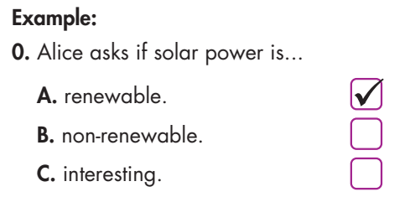
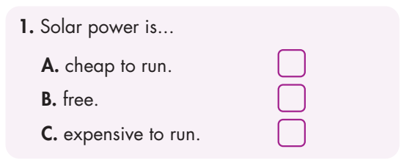
Click on the icon to hear the sound
✓

Slide 7
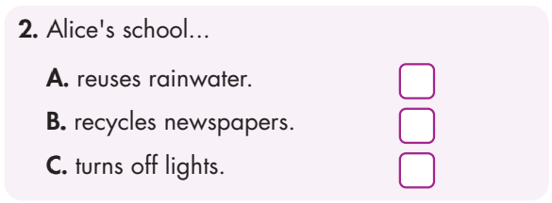
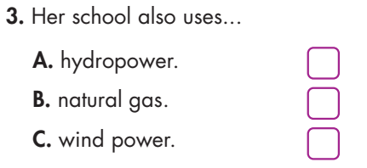
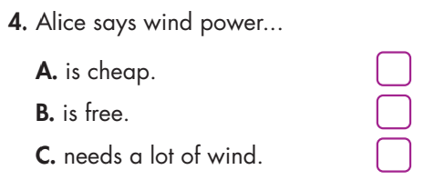
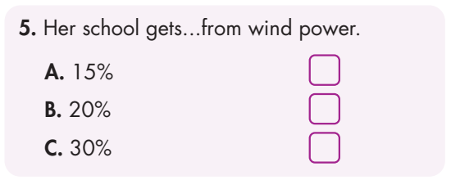
Click on the icon to hear the sound
✓
✓
✓
✓

Slide 8
Audio Scripts
Alice: What are those things on your roof, Steve?
Steve: Oh, they're solar panels.
Alice: Ah, interesting. Is solar power a renewable energy source?
Steve: Yes, it is.
Alice: What happens if the panels fall off the roof?
Steve: They won't fall! It's OK, they're not dangerous.
Alice: Are they expensive?
Steve: They're expensive to buy, but solar power is cheap to run.
Alice: We try to save energy at our school, too.
Steve: How does your school save energy? Do you reuse rainwater? Or recycle newspapers?
Alice: No, we make sure to turn off lights to save power.
Steve: That's a good idea!

Slide 9
Audio Scripts
Alice: Our school also uses renewable energy.
Steve: Oh, that's good. Do you use power from natural sources, like hydropower?
Alice: We use wind power.
Steve: Oh, that's good. Wind power is clean to run!
Alice: Yes. It's clean, but it needs a lot of wind.
Steve: How much power does your school get from wind power?
Alice: Erm...Let's see. It gets thirty percent from natural gas and fifteen percent from solar power. Ah, it gets about twenty percent from wind power.
Steve: Wow, that's great.

Slide 10
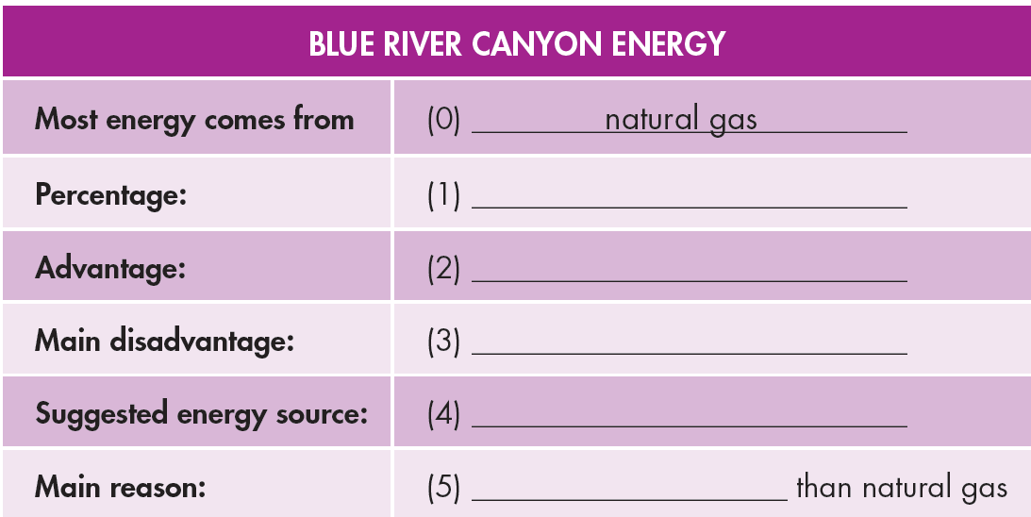
Extra Practice
WB, page 71
You will hear an energy expert talking about the energy sources of a town. Listen and fill in the blanks. You will hear the information twice.
Click on the icon to hear the sound
31%
creates jobs
expensive
hydropower
cheaper

Slide 11
Audio Scripts
M: Blue River Canyon uses a lot of non-renewable energy. It gets most of its energy from natural gas.
At the moment it gets thirty-one percent of its energy from natural gas. It's now a bigger non-renewable energy source than coal or oil.
The best thing about natural gas is that it creates jobs. However, it is quite difficult to get natural gas from underground, and the biggest problem with gas is that it is expensive. Blue River Canyon spends a lot of money on it. I think Blue River Canyon could use more hydropower. We can use the river that runs through Blue River Canyon to make hydropower, and of course, the energy from hydropower is clean and renewable.
However, the most important reason for using hydropower instead of gas is that it will be cheaper than natural gas.

Slide 12
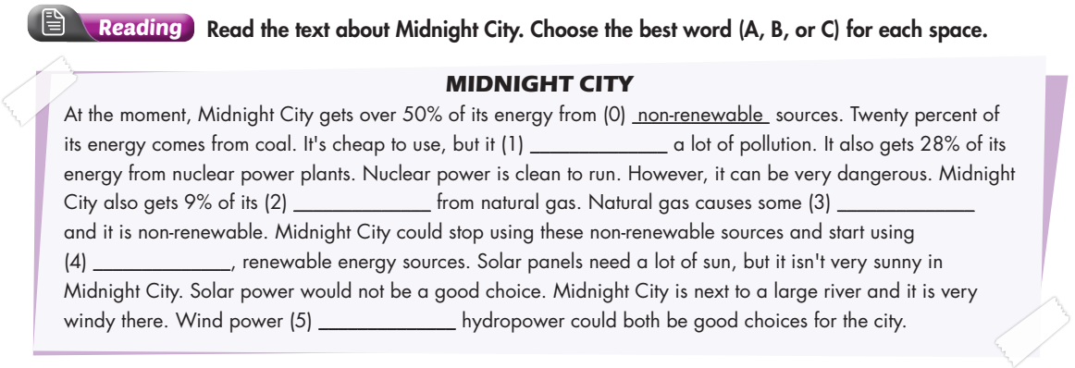
Underline the key words and guess the answer to each question.

Slide 13
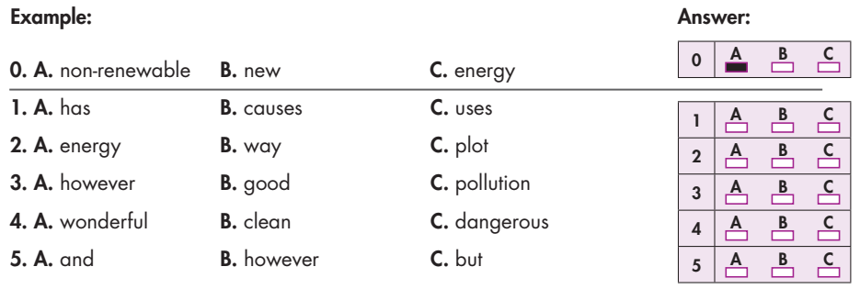
✓
✓
✓
✓
✓

Slide 14
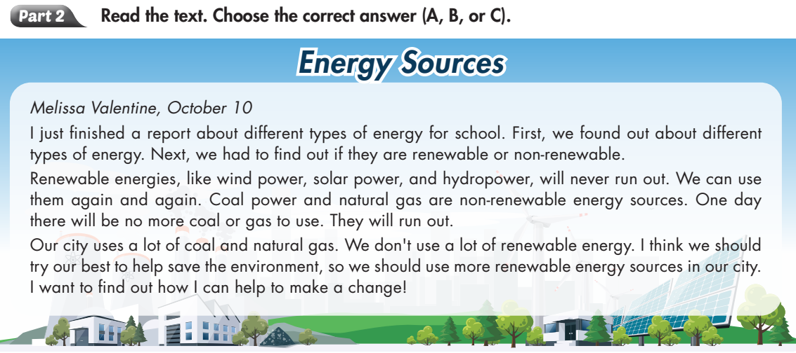
Extra Practice
WB, page 71
Skim and scan the text to grasp the information.
1
2
3
4

Slide 15
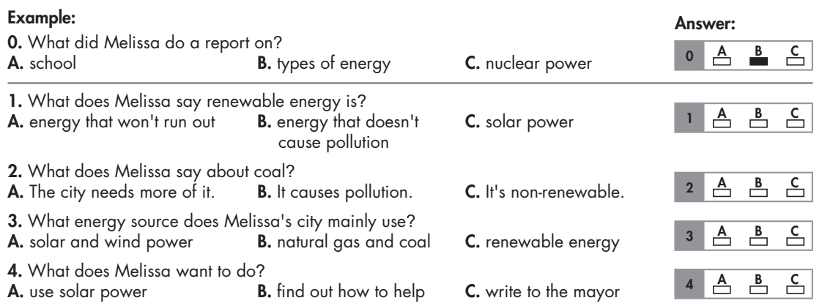
✓
✓
✓
✓

Slide 16
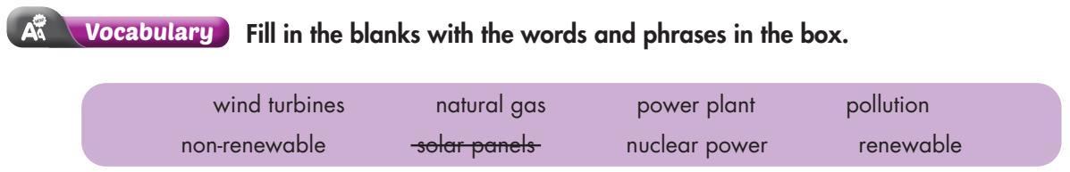
Underline the key words
1. ______________ are expensive to buy, but they save a lot of money by taking energy from the sun.
2. He works at a coal ______________. It produces the electricity for Springfield Town.
3. The good thing about ______________ energy like solar power is that it never runs out.
4. Non-renewable energy sources like coal causes a lot of ______________ which is bad for the environment.
Solar panels
power plant
renewable
pollution

Slide 17
Underline the key words
natural gas
5. My cooker uses ______________. We have to replace the bottles twice a year.
6. ______________ sources like coal and oil cannot last forever.
7. ______________ is a very powerful energy source, but it can be very dangerous.
8. He repairs the ______________ when they break down and stop turning.
Non-renewable
Nuclear power
wind turbines

Slide 18
We use and to add similar ideas, & but to add different information.
1. Coal isn't very clean. It keeps us warm in the winter.
2. Natural gas is cheap. It is excellent for cooking.
3. The power plant is big. It provides enough power for the whole town.
Coal isn't very clean, but it keeps us warm in the winter.
Natural gas is cheap and it is excellent for cooking.
The power plant is big and it provides enough power for the whole town.

Slide 19
4. The solar panels are expensive to buy. They save money on electricity bills later.
5. My father loves a coal fire. I hate it.
6. I don't think we should use nuclear power. My brother thinks using it is a good idea.
The solar panels are expensive to buy, but they save money on electricity bills later.
My father loves a coal fire, but I hate it.
I don't think we should use nuclear power, but my brother thinks using it is a good idea.

Slide 20
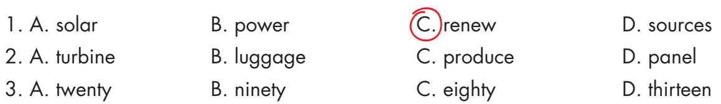
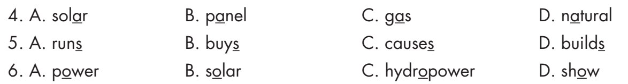

Slide 21

CONSOLIDATION

Slide 22
Work in groups: Present about the diagram (which is completed before).
Advantages
………………….
Disadvantages
……………………
Solar power
Advantages
………………….
Advantages
………………….
Energy sources
Coal
Hydropower
Disadvantages
……………………
Disadvantages
……………………
Wind power
Advantages
………………….
Disadvantages
……………………

Slide 23

WRAP-UP

Slide 24
Today’s lesson
Reading & Listening:
- Understand instructions.
- Practice reading and listening for general and specific information.
Speaking:
- Talk about the advantages and disadvantages of energy sources.

Slide 25
Homework
Review all vocabularies and grammar points in Unit 10.
Practice presenting the energy sources based on the diagram.
Play the consolidation games in Tiếng Anh 7 i-Learn Smart World DHA App on www.eduhome.com.vn

Slide 26

Lesson 3
Stay positive and have a nice day!

