Slide 2

Unit
6
OUR TET HOLIDAY
LESSON 3: A CLOSER LOOK 2

Slide 3
Unit
6
OUR TET HOLIDAY
LESSON 3: A CLOSER LOOK 2

Slide 4



LESSON 3: A CLOSER LOOK 2
LESSON 3: A CLOSER LOOK 2
WARM-UP
Should or Shouldn't?
Task 1: Look at the signs at the library and complete the sentences.
Task 2: Tick the activities.
Task 3: Discussion.
SHOULD OR SHOULDN'T
Task 4: Complete the sentences with some and any.
Task 5: Make sentences.
SOME/ANY
PRODUCTION
Planning a Tet Holiday Celebration
CONSOLIDATION
Wrap-up
Homework

Slide 5
WARM-UP
SHOULD OR SHOULDN’T

Slide 6
WARM-UP
HOW TO PLAY

Slide 7
WARM-UP
- Work in groups
- There is a list of sentences related to Tet's holiday, some suggest things people should do and others suggest things they shouldn't do.
- I will read the sentences by one, and the teams have to decide whether it is a "should" or "shouldn't" statement by reading whole sentences.
- The first team to raise their hand and give the correct answer gets a point.

Slide 8
WARM-UP
LET’S PLAY

Slide 9
WARM-UP
You give lucky money during Tet.
SHOULD
SHOULDN’T
You should give lucky money during Tet.

Slide 10
WARM-UP
You wear black clothes during Tet.
SHOULD
SHOULDN’T
You shouldn’t wear black clothes during Tet.

Slide 11
WARM-UP
You say bad or unlucky words.
SHOULD
SHOULDN’T
You shouldn’t say bad or
unlucky words.

Slide 12
WARM-UP
You visit your relatives.
SHOULD
SHOULDN’T
You should visit your relatives.

Slide 13
WARM-UP
You break dishes.
SHOULD
SHOULDN’T
You shouldn’t break dishes.

Slide 14
WARM-UP
You make a wish.
SHOULD
SHOULDN’T
You should make a wish.

Slide 15
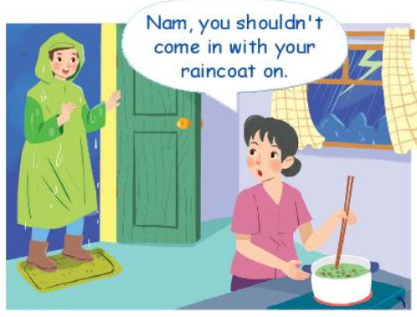
SHOULD OR SHOULDN’T
Questions:
- Where are they?
- Why is Nam wearing a raincoat?
- What will happen if Nam comes into the kitchen with his raincoat still on?

Slide 16

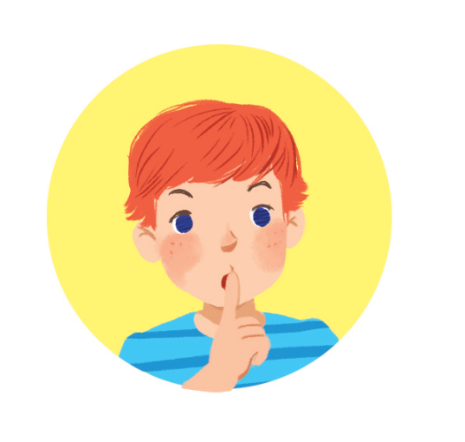

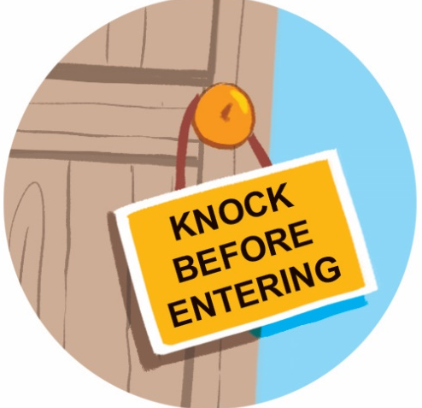
SHOULD OR SHOULDN’T
Look at the signs at the library and complete the sentences with should or shouldn’t.
1. You ________ keep quiet. | 2. You ________ eat or drink. | 3. You ______ knock before you enter. | 4. You ________ run.
should
should
shouldn’t
shouldn’t

Slide 17
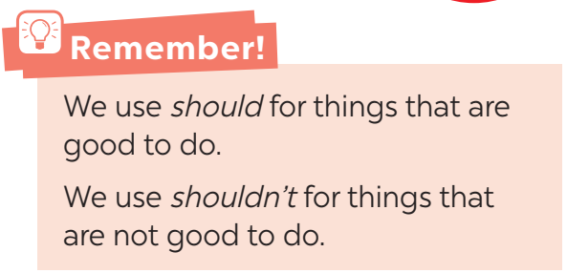
SHOULD OR SHOULDN’T
Should / shouldn’t for advice

Slide 18

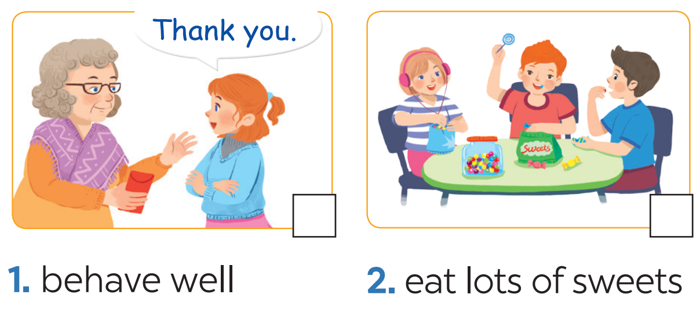
SHOULD OR SHOULDN’T
Tick the activities children should do at Tet and cross the ones they shouldn’t.



Slide 19
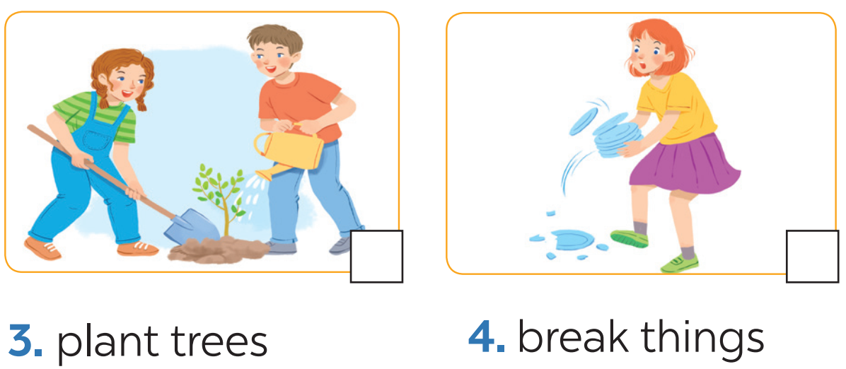
SHOULD OR SHOULDN’T
Tick the activities children should do at Tet and cross the ones they shouldn’t.



Slide 20
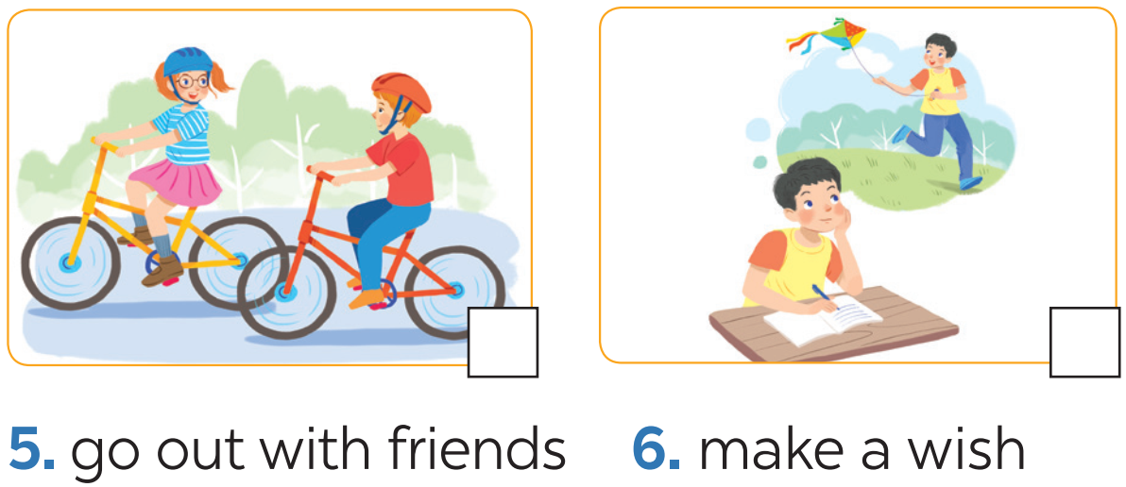
SHOULD OR SHOULDN’T
Tick the activities children should do at Tet and cross the ones they shouldn’t.



Slide 21
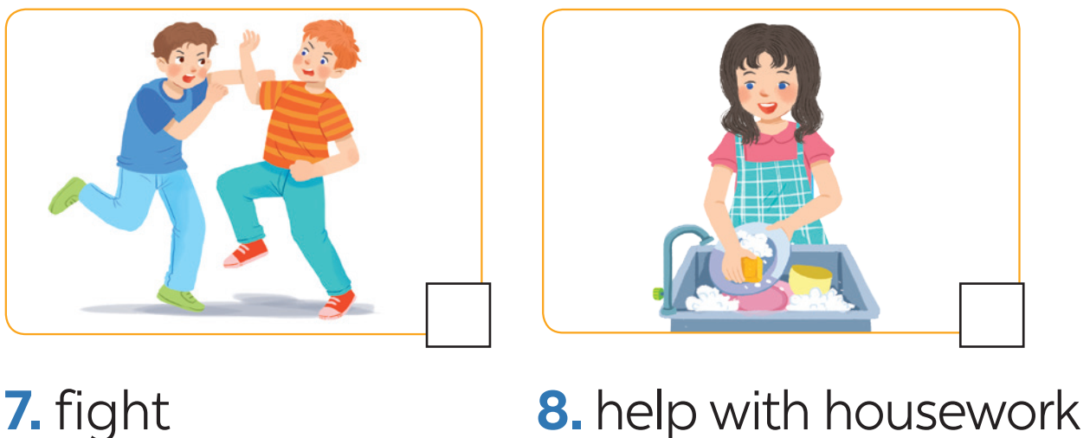
SHOULD OR SHOULDN’T
Tick the activities children should do at Tet and cross the ones they shouldn’t.



Slide 22
SHOULD OR SHOULDN’T
3
Look at the activities in 2. Take turns to say what you think children should / shouldn’t do.
Example:
Children should behave well.
Children shouldn’t eat lots of sweets.

Slide 23
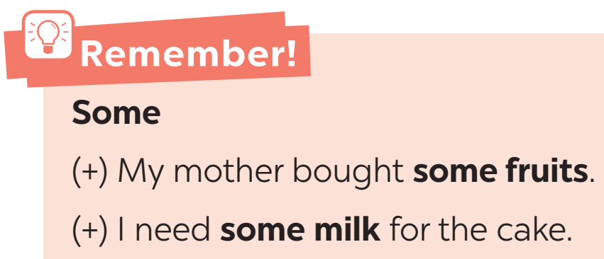
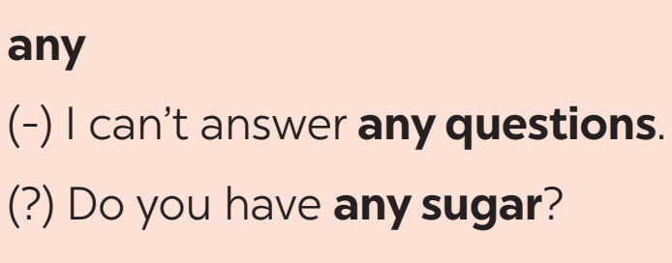
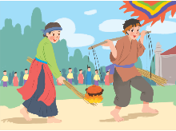
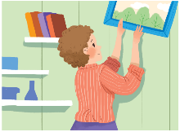
SOME/ANY
some / any for amount

Slide 24

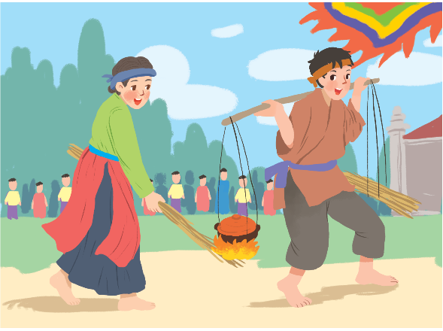
SOME/ANY
4
Complete the sentences with some and any.
1. – What do you need to decorate your room?
– I need _______ colour paper and _______
pictures.
2. – Do you have _______ free time for sports?
– Yes, I do.
3. – Are there _______ interesting activities here
during Tet?
– Yes, there are _______ traditional games like
human chess, running and cooking.
some
some
any
any
some

Slide 25
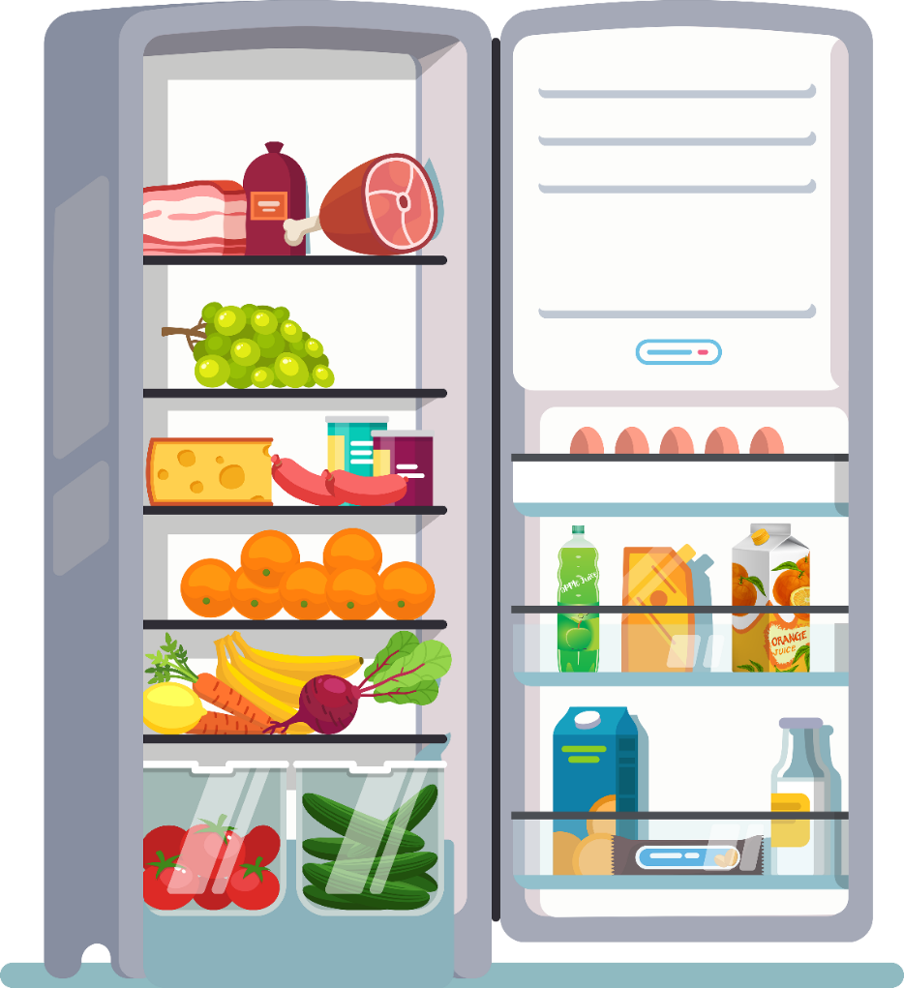
SOME/ANY
5
Look at the fridge. Make sentences with the words/phrases provided, using some or any.
Example:
ice cream
There is not any ice cream.
cucumbers
There are some cucumbers.

Slide 26

SOME/ANY
5
Look at the fridge. Make sentences with the words/phrases provided, using some or any.
1.
eggs
There are some eggs (in the fridge).
2.
fruit juice
There is some fruit juice.
3.
apples
There aren’t any apples.

Slide 27
SOME/ANY
5
Look at the fridge. Make sentences with the words/phrases provided, using some or any.
4.
bread
There isn’t any bread.
5.
bananas
There are some bananas.
6.
cheese
There is some cheese.

Slide 28
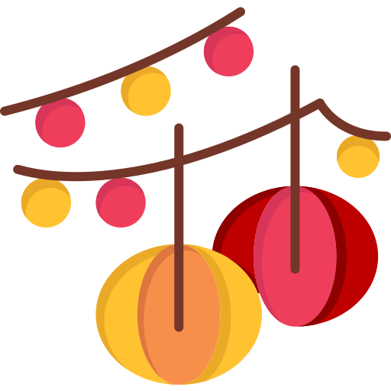


PRODUCTION
5
Planning a Tet Holiday Celebration

Slide 29
PRODUCTION
- Work in groups
- There is a list of items related to Tet holiday celebrations, such as food, decorations, activities.
- You plan a Tet holiday celebration using the given items.
- You discuss and make decisions within their groups by using "should/shouldn't" and "some/any" in 4 minutes.

Slide 30
PRODUCTION
Example:
Student A: We should have some traditional food like banh chung and banh tet for our Tet celebration.
Student B: Yes, I agree! We shouldn't forget about some fresh fruits too.
Student C: How about decorations? Should we have any?
Student D: Definitely! We should decorate our classroom with some red lanterns and lucky money envelopes.

Slide 31
PRODUCTION
List:
- Food (Vietnamese sticky rice cake, spring rolls, braised Pork with eggs, pickled scallion, dried shrimp,…)
- Decorations (flowers, plants, trees, lanterns, red pockets, tray of five fruits,…)
- Activities (visit relatives, give lucky money, Kitchen God farewell ritual, go to flower market,…)
4 MINUTES

Slide 32

CONSOLIDATION
1
Wrap-up
What have we learnt in this lesson?
Use should and shouldn’t to make advice
Use some and any to talk about quantity

Slide 33

CONSOLIDATION
2
Homework
- Write 5 rules that students should and shouldn’t do at home.
- Write 5 things available in their house’s fridge, and 5 things unavailable.

Slide 34






Website: hoclieu.vn
Fanpage: facebook.com/www.tienganhglobalsuccess.vn/

