Slide 1


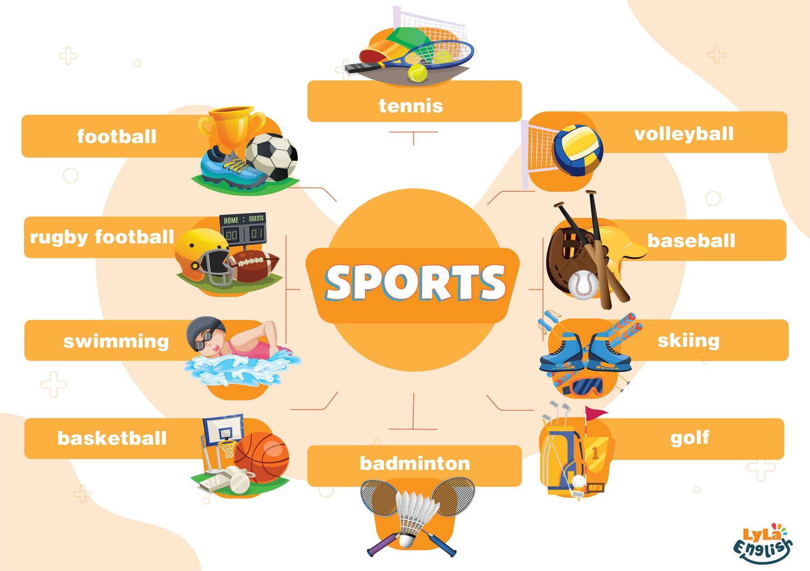


Slide 2

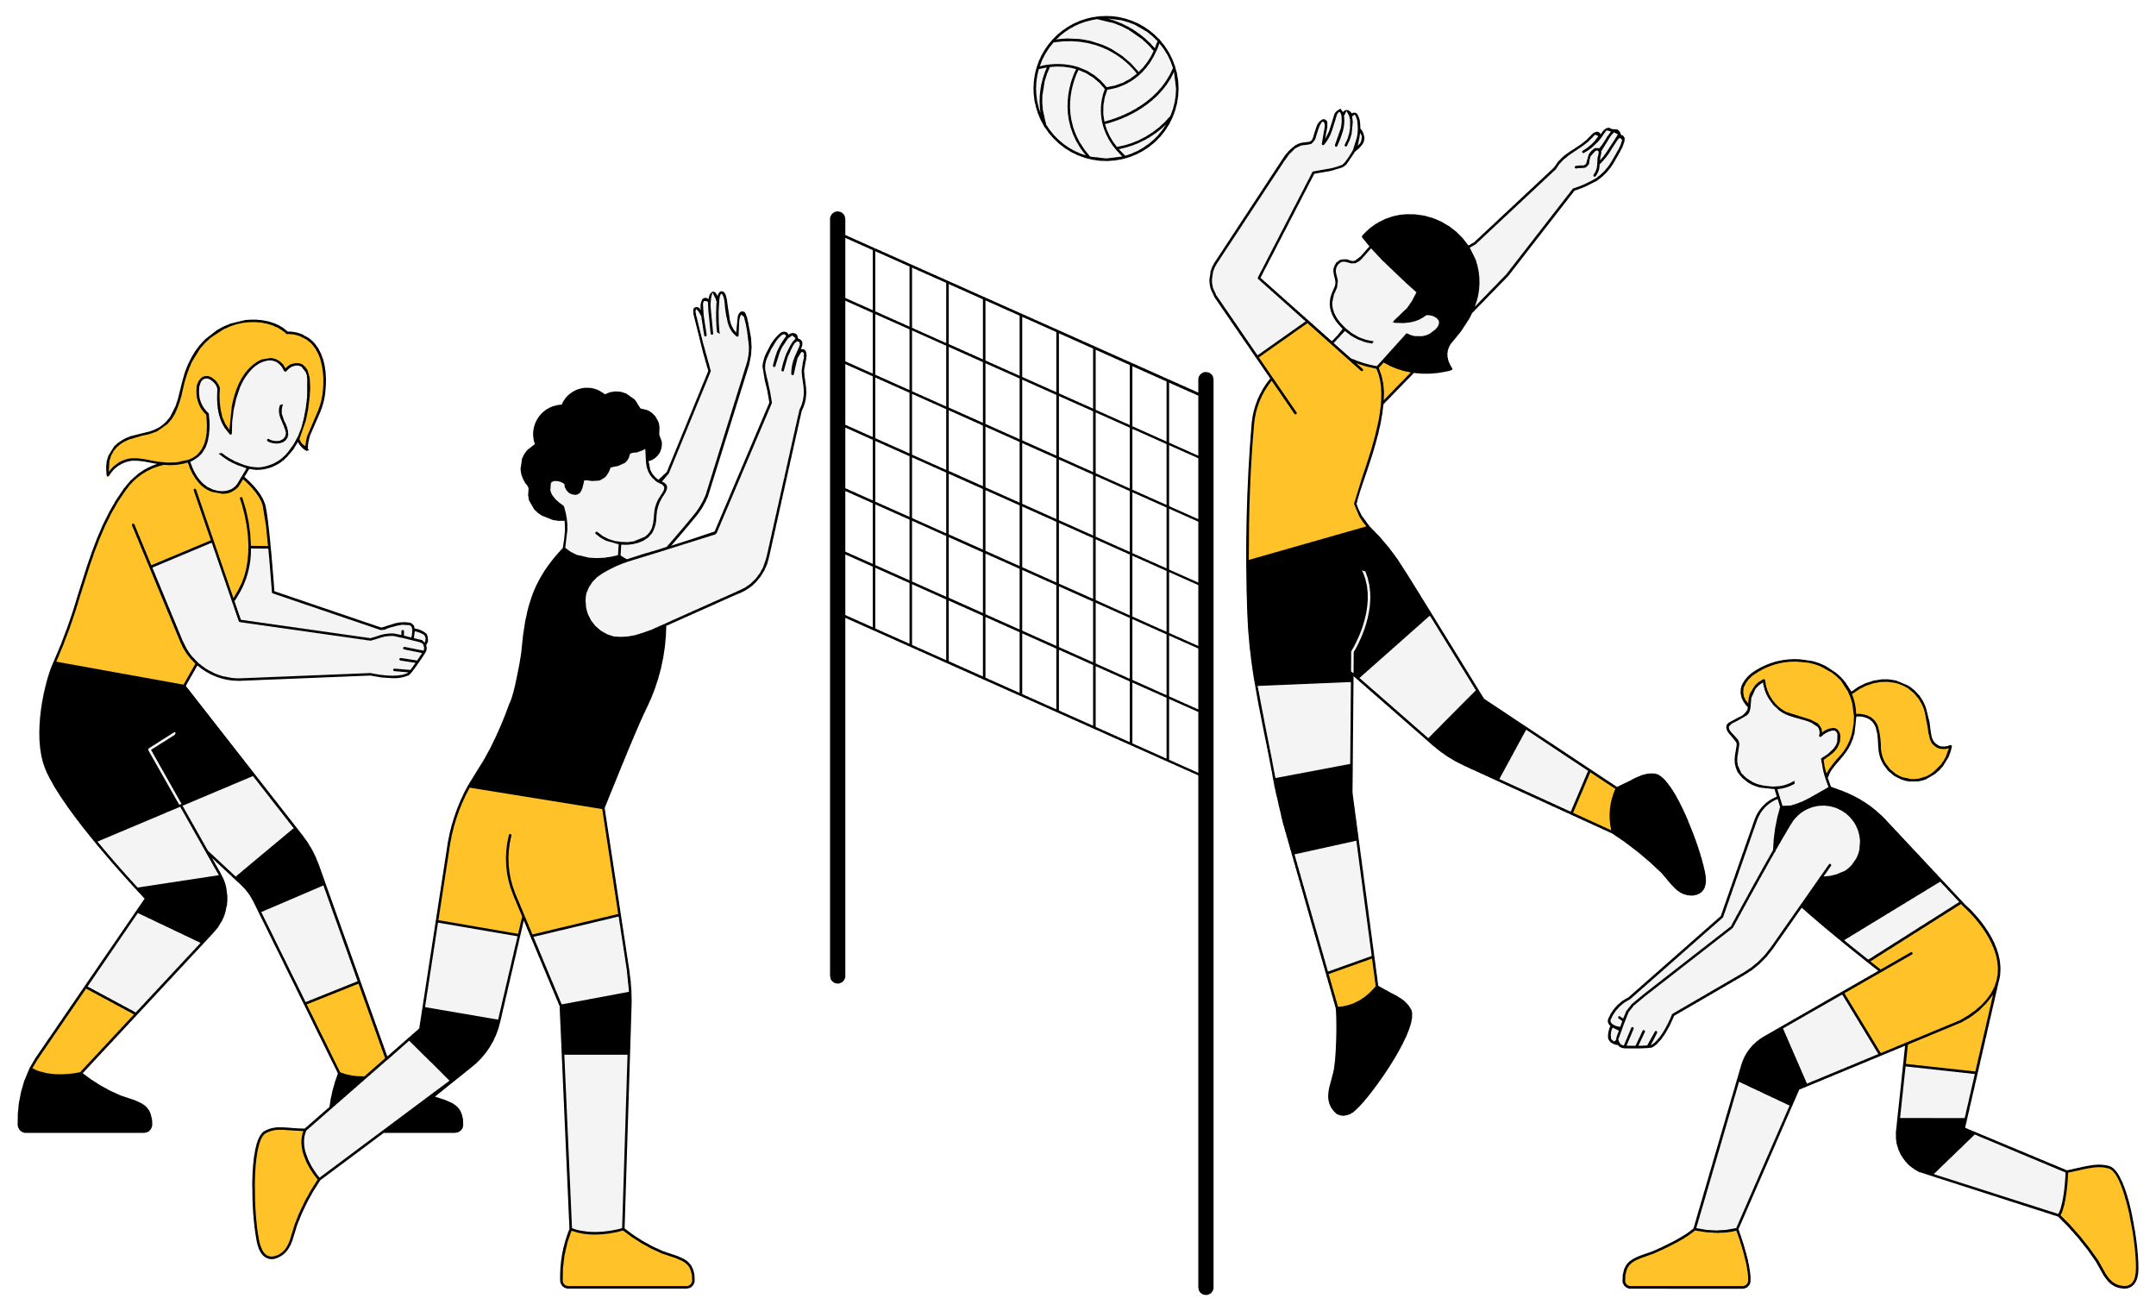


I. QUESTION
1.What is your favorite sport?
- It’s ...
2. How many teams are there?
- There are ... teams.
3. How many players are there?
- There are ... players.
4. What do you need to play volleyball?
...
5. When do you often play volleyball?
- On Sunday.

Slide 3

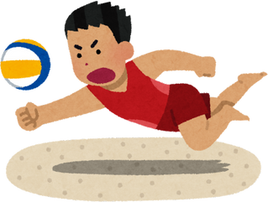
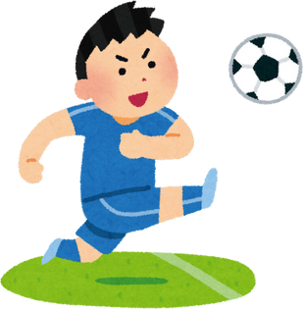
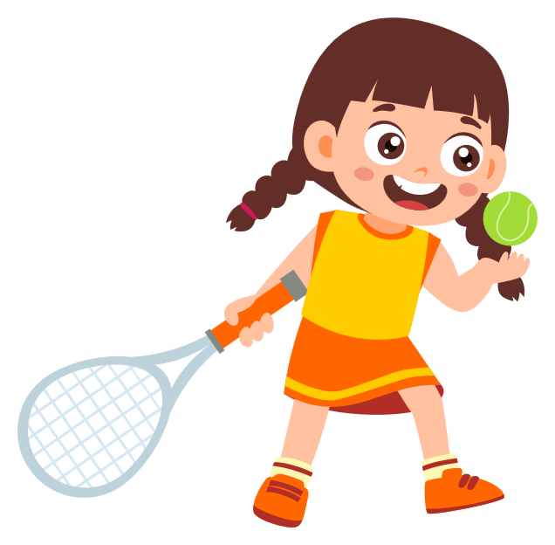
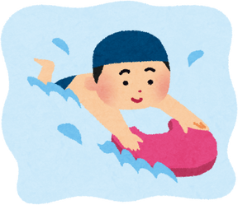
II. VOCABULARY
volleyball:...........................................................
football:.............................................................
tennis:................................................................
swimming:.........................................................

Slide 4
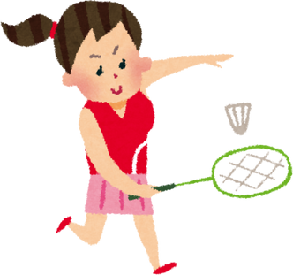
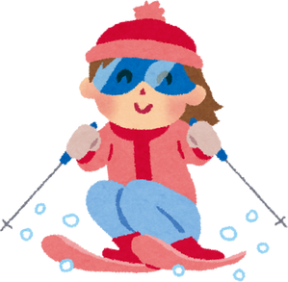
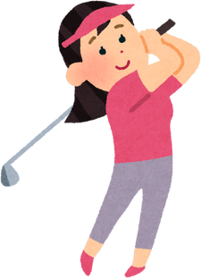
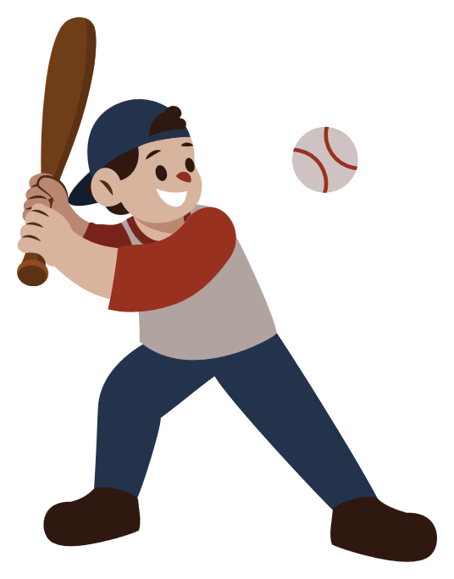
II. VOCABULARY
badminton:...........................................................
skiing:..................................................................
golf:.....................................................................
baseball:.............................................................

Slide 5


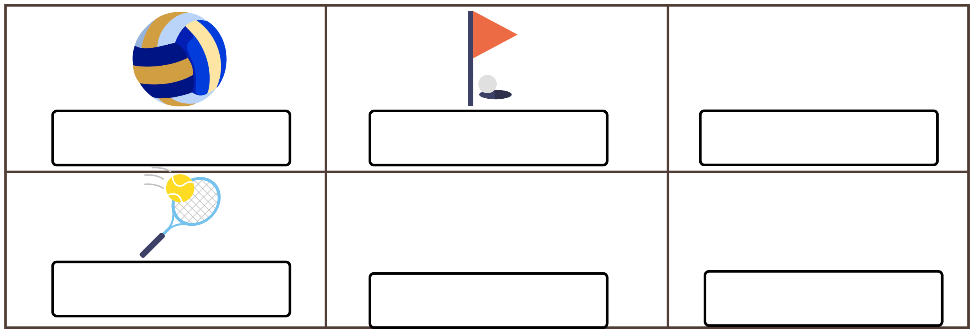
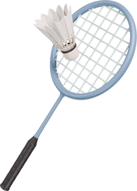

III. EXERCISES:
1. Fill the name of sports:
golf
badminton
volleyball
baseball
skiing
tennis

Slide 6

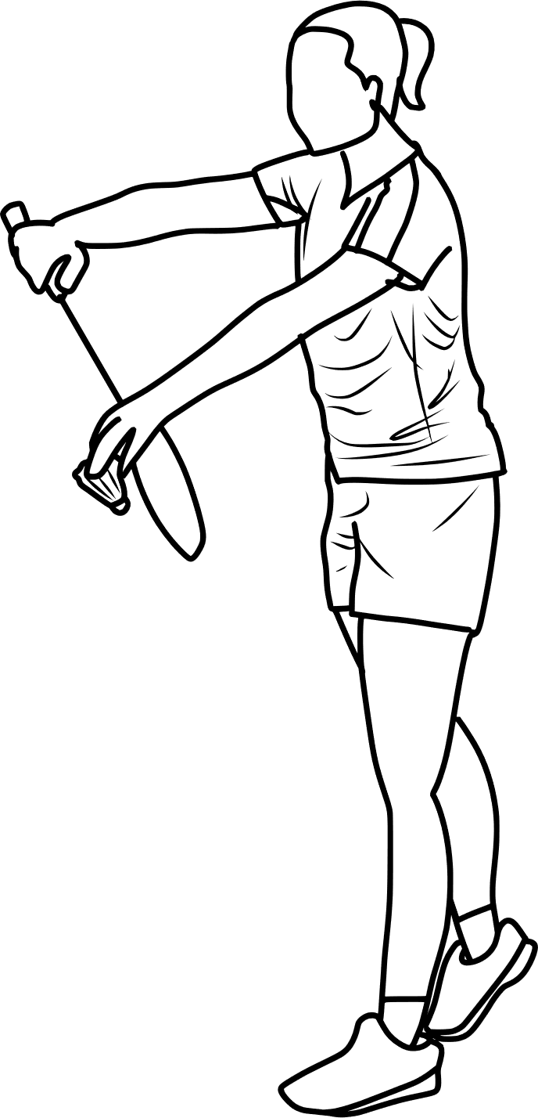
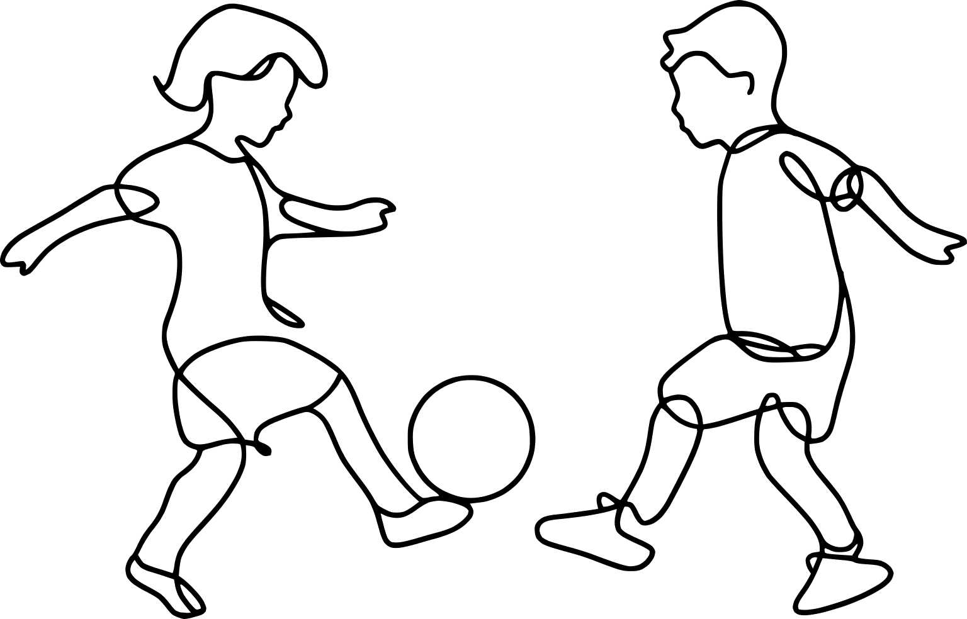
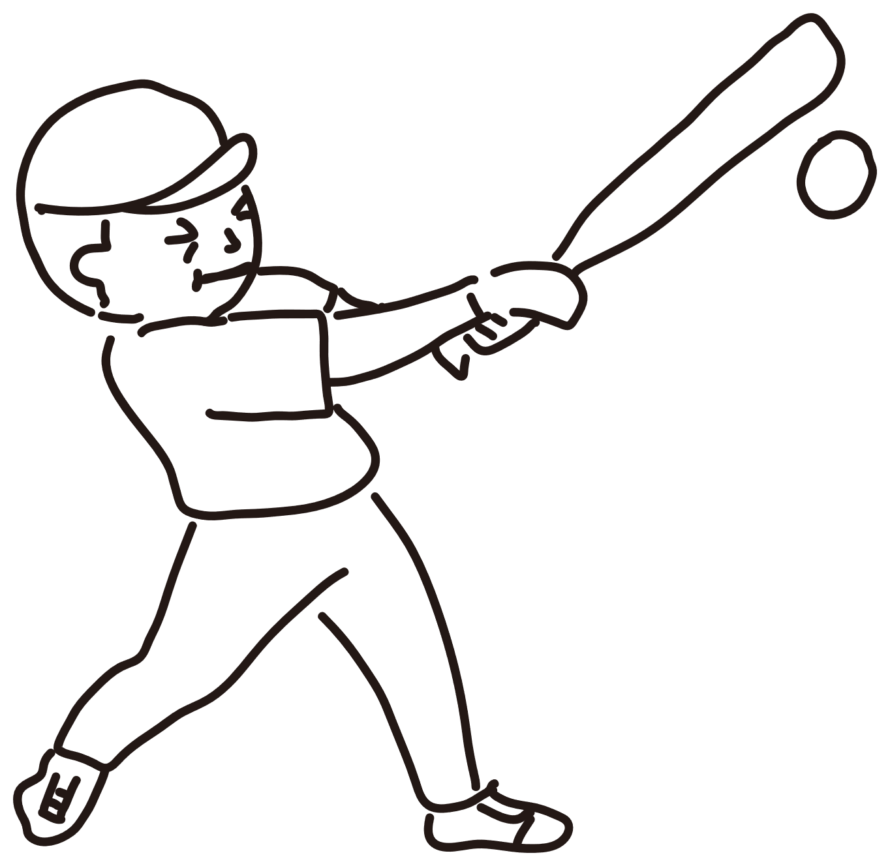
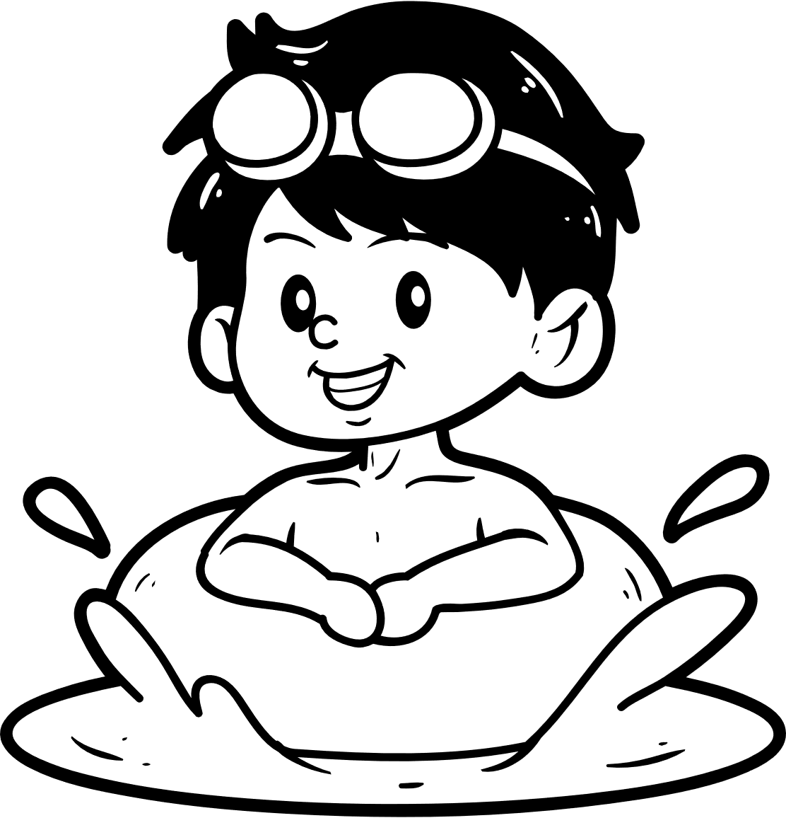
III. EXERCISES:
2. Read and color the activities:
I play badmiton
I play football
I play baseball
I swim

Slide 7

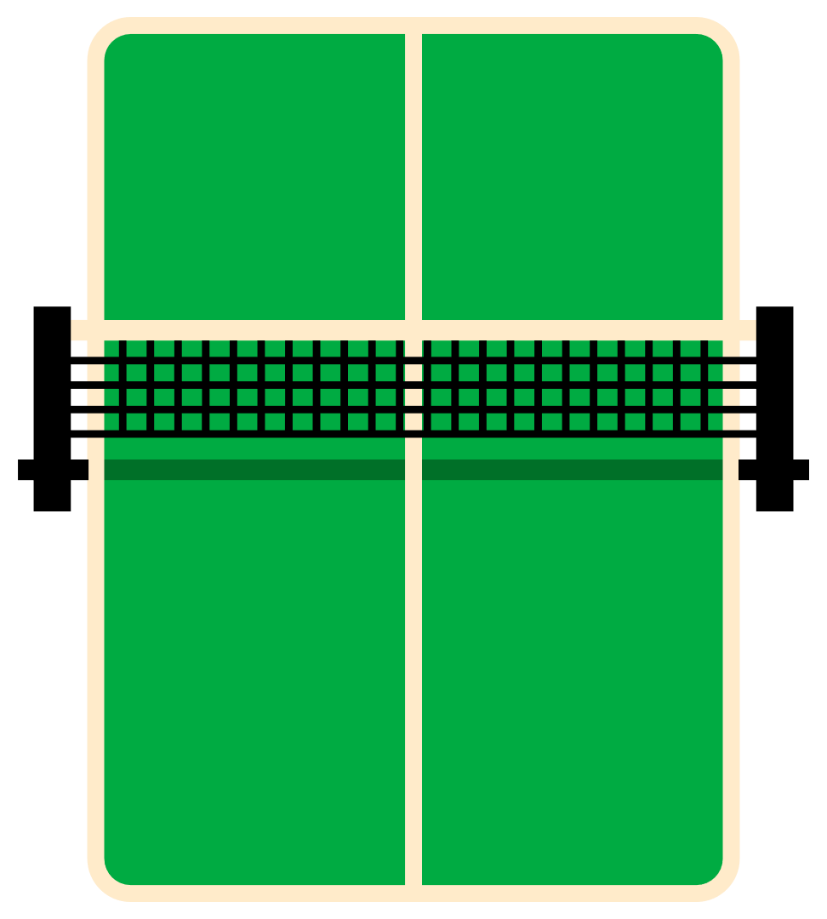

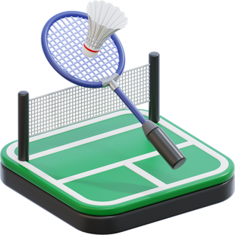
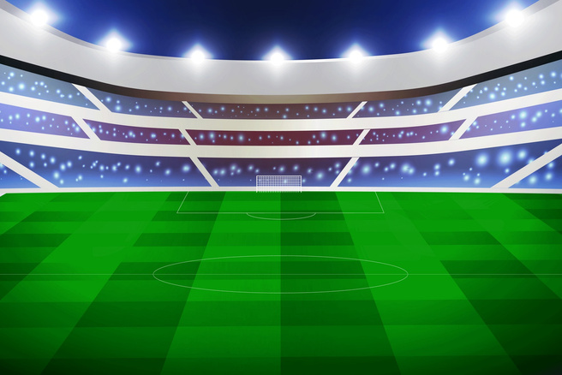
III. EXERCISES:
3. Look and match:
swimming football
volleyball badminton
skiing golf

Slide 8
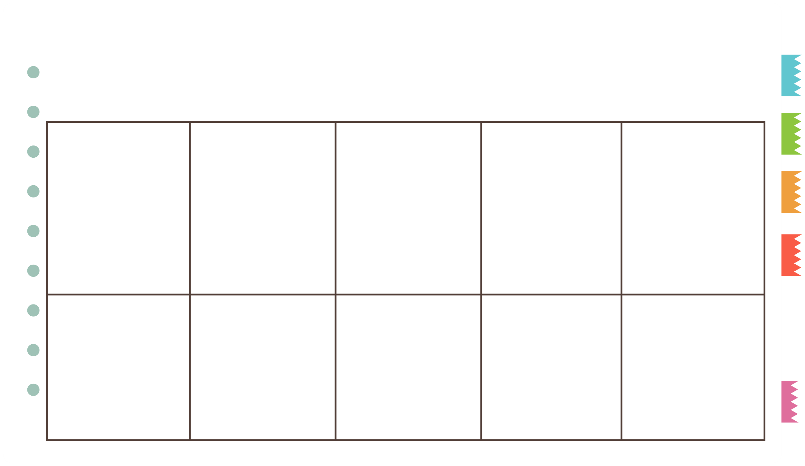

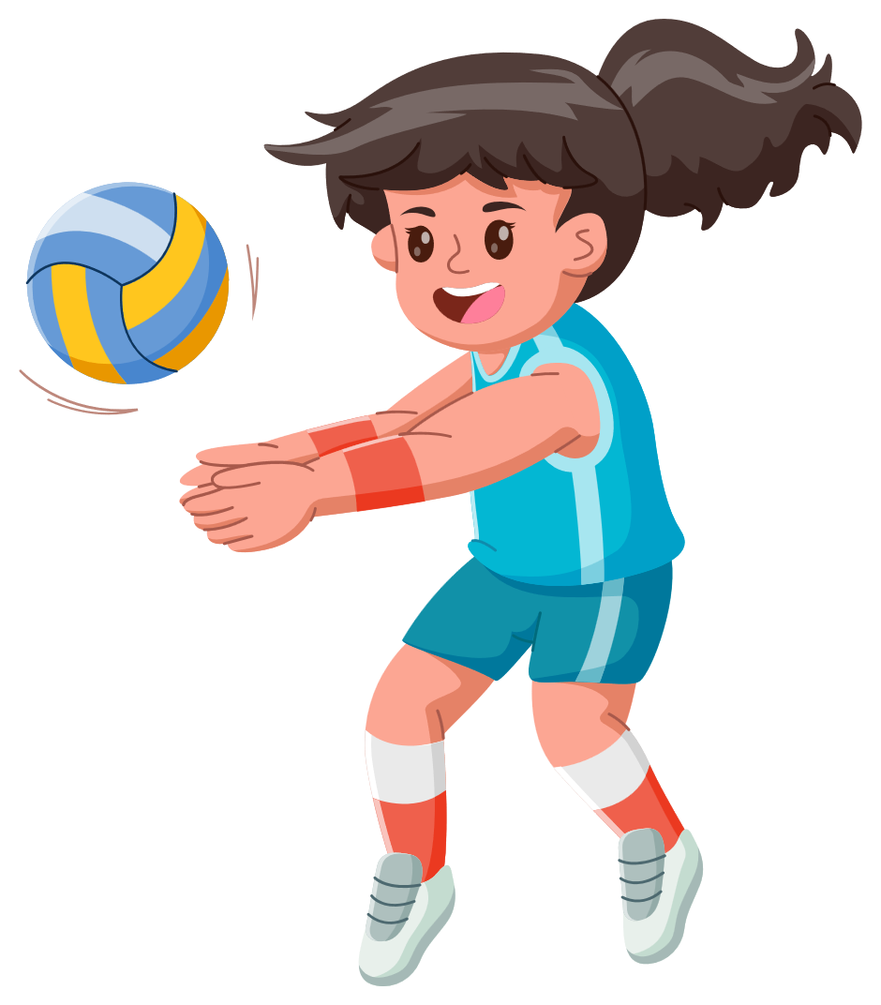
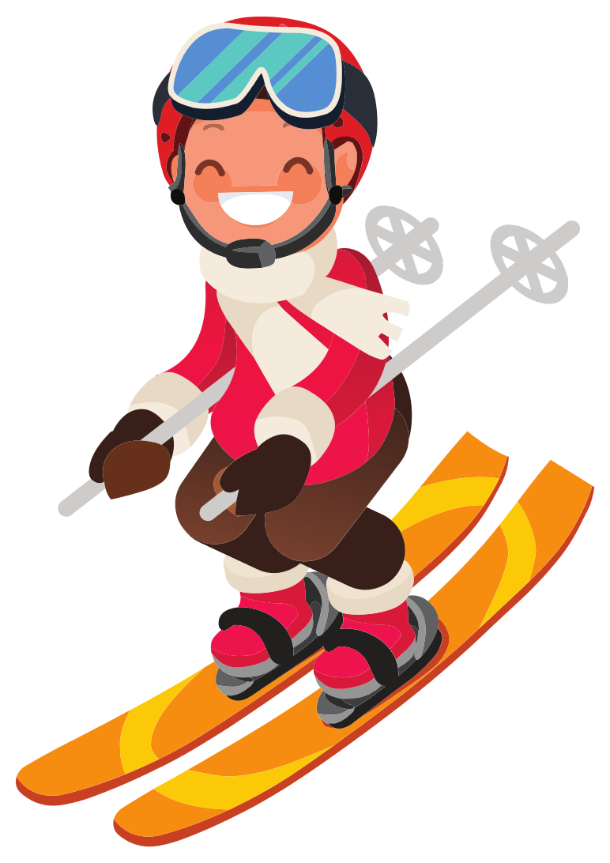
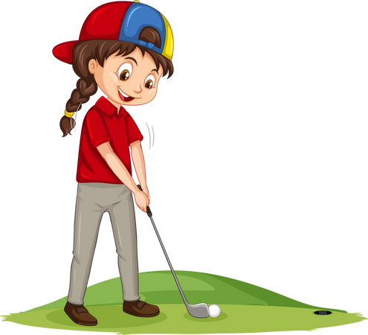
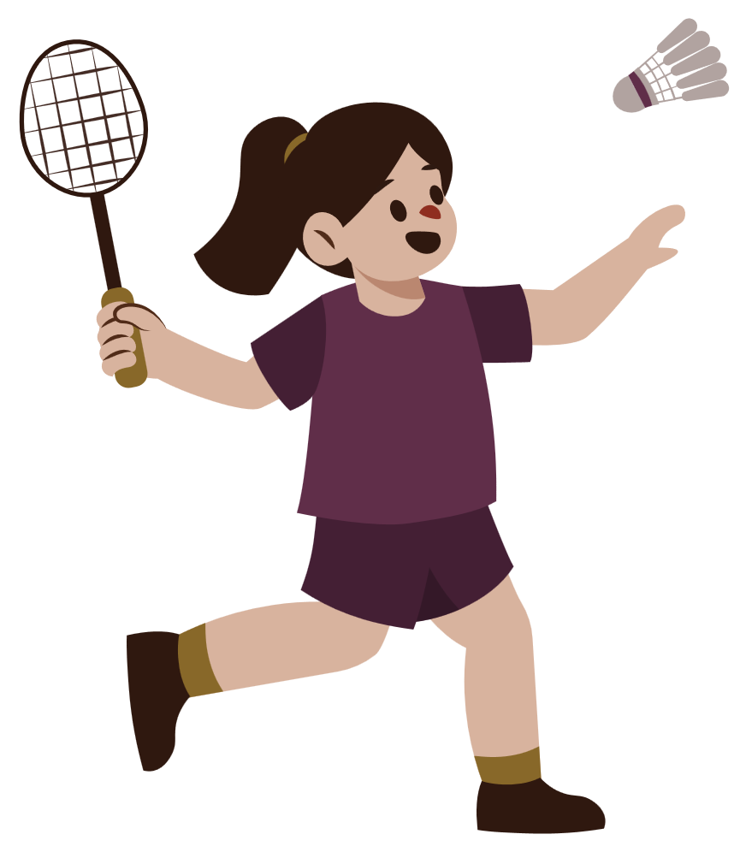
III. EXERCISES
4. Fill the missing words:
Go_f
Ba_eball
Badm_nton
_olleyball
Ski_ng

Slide 9

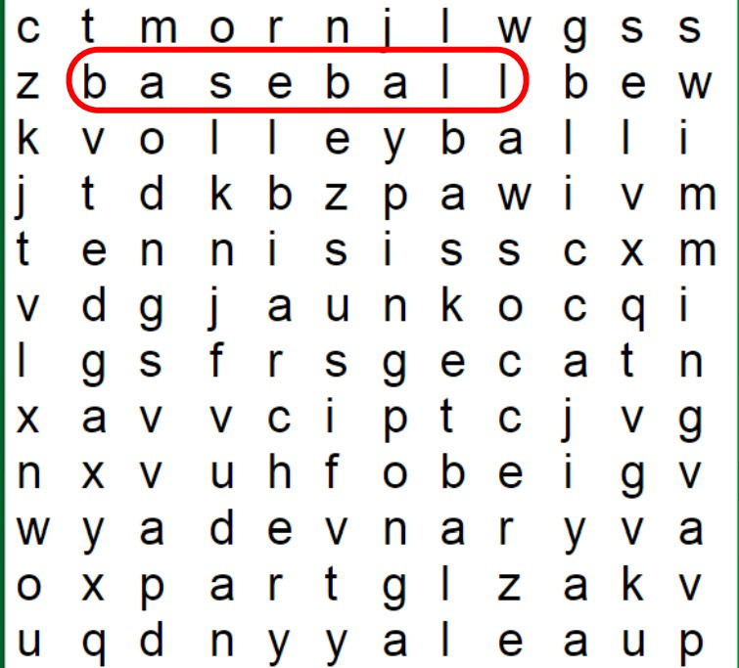
III. EXERCISES
5. Find the word:
volleyball
tennis
swimming
soccer

Slide 10

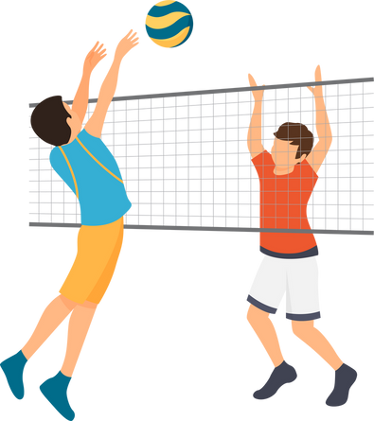


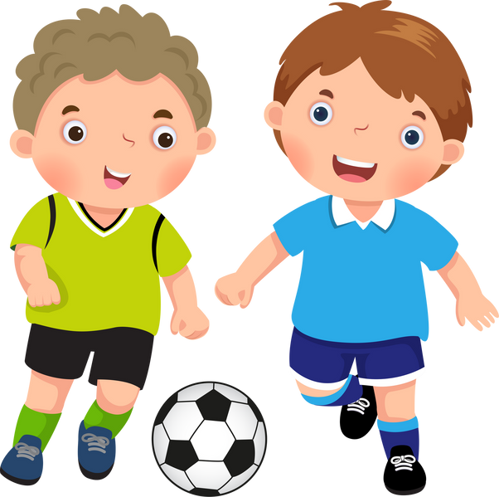
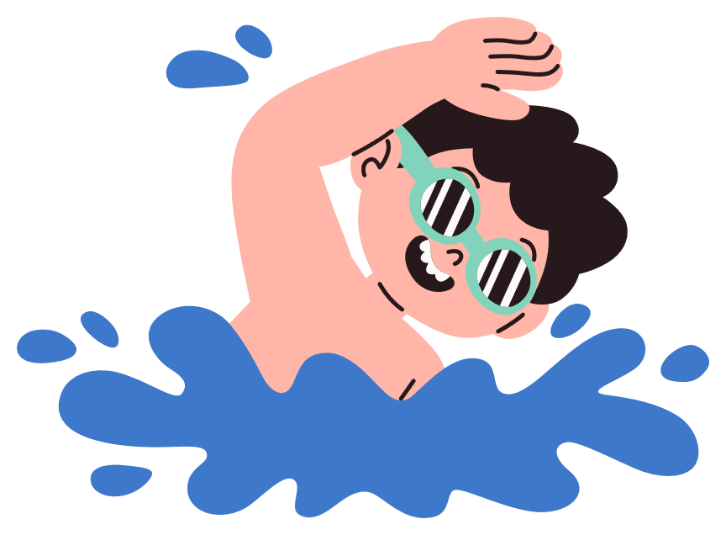
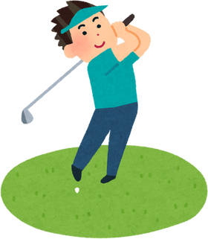
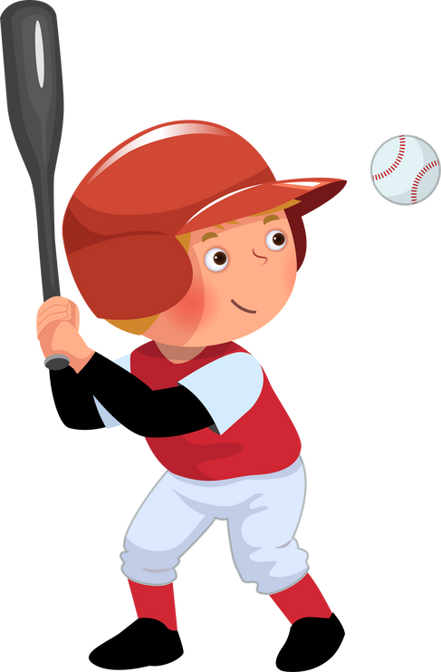
III. EXERCISES
6. Choose True or False:
Volleyball
skiing
Golf
football
Swimming
baseball

Slide 11

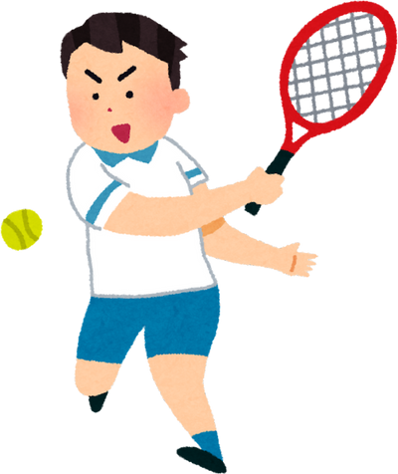
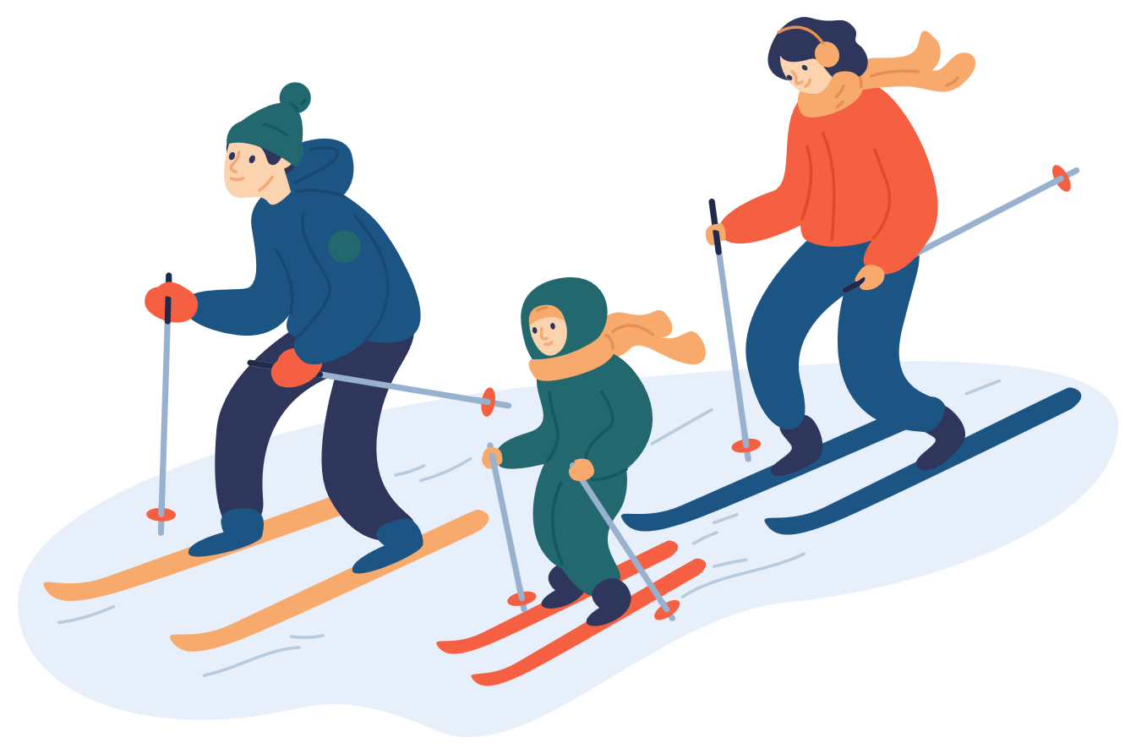
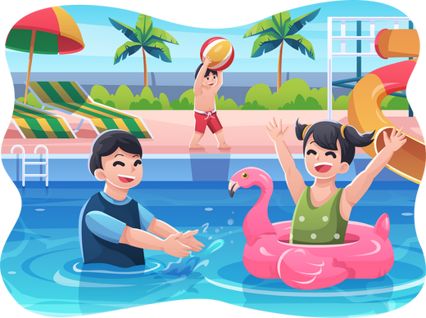
III. EXERCISES
7. Reorder the words:
f/t/o/b/l/o/l/a ...
t/n/e/i/s/n .....
s/i/k/i/g/n ...
s/i/w/m/i/m/g/n ...

Slide 12
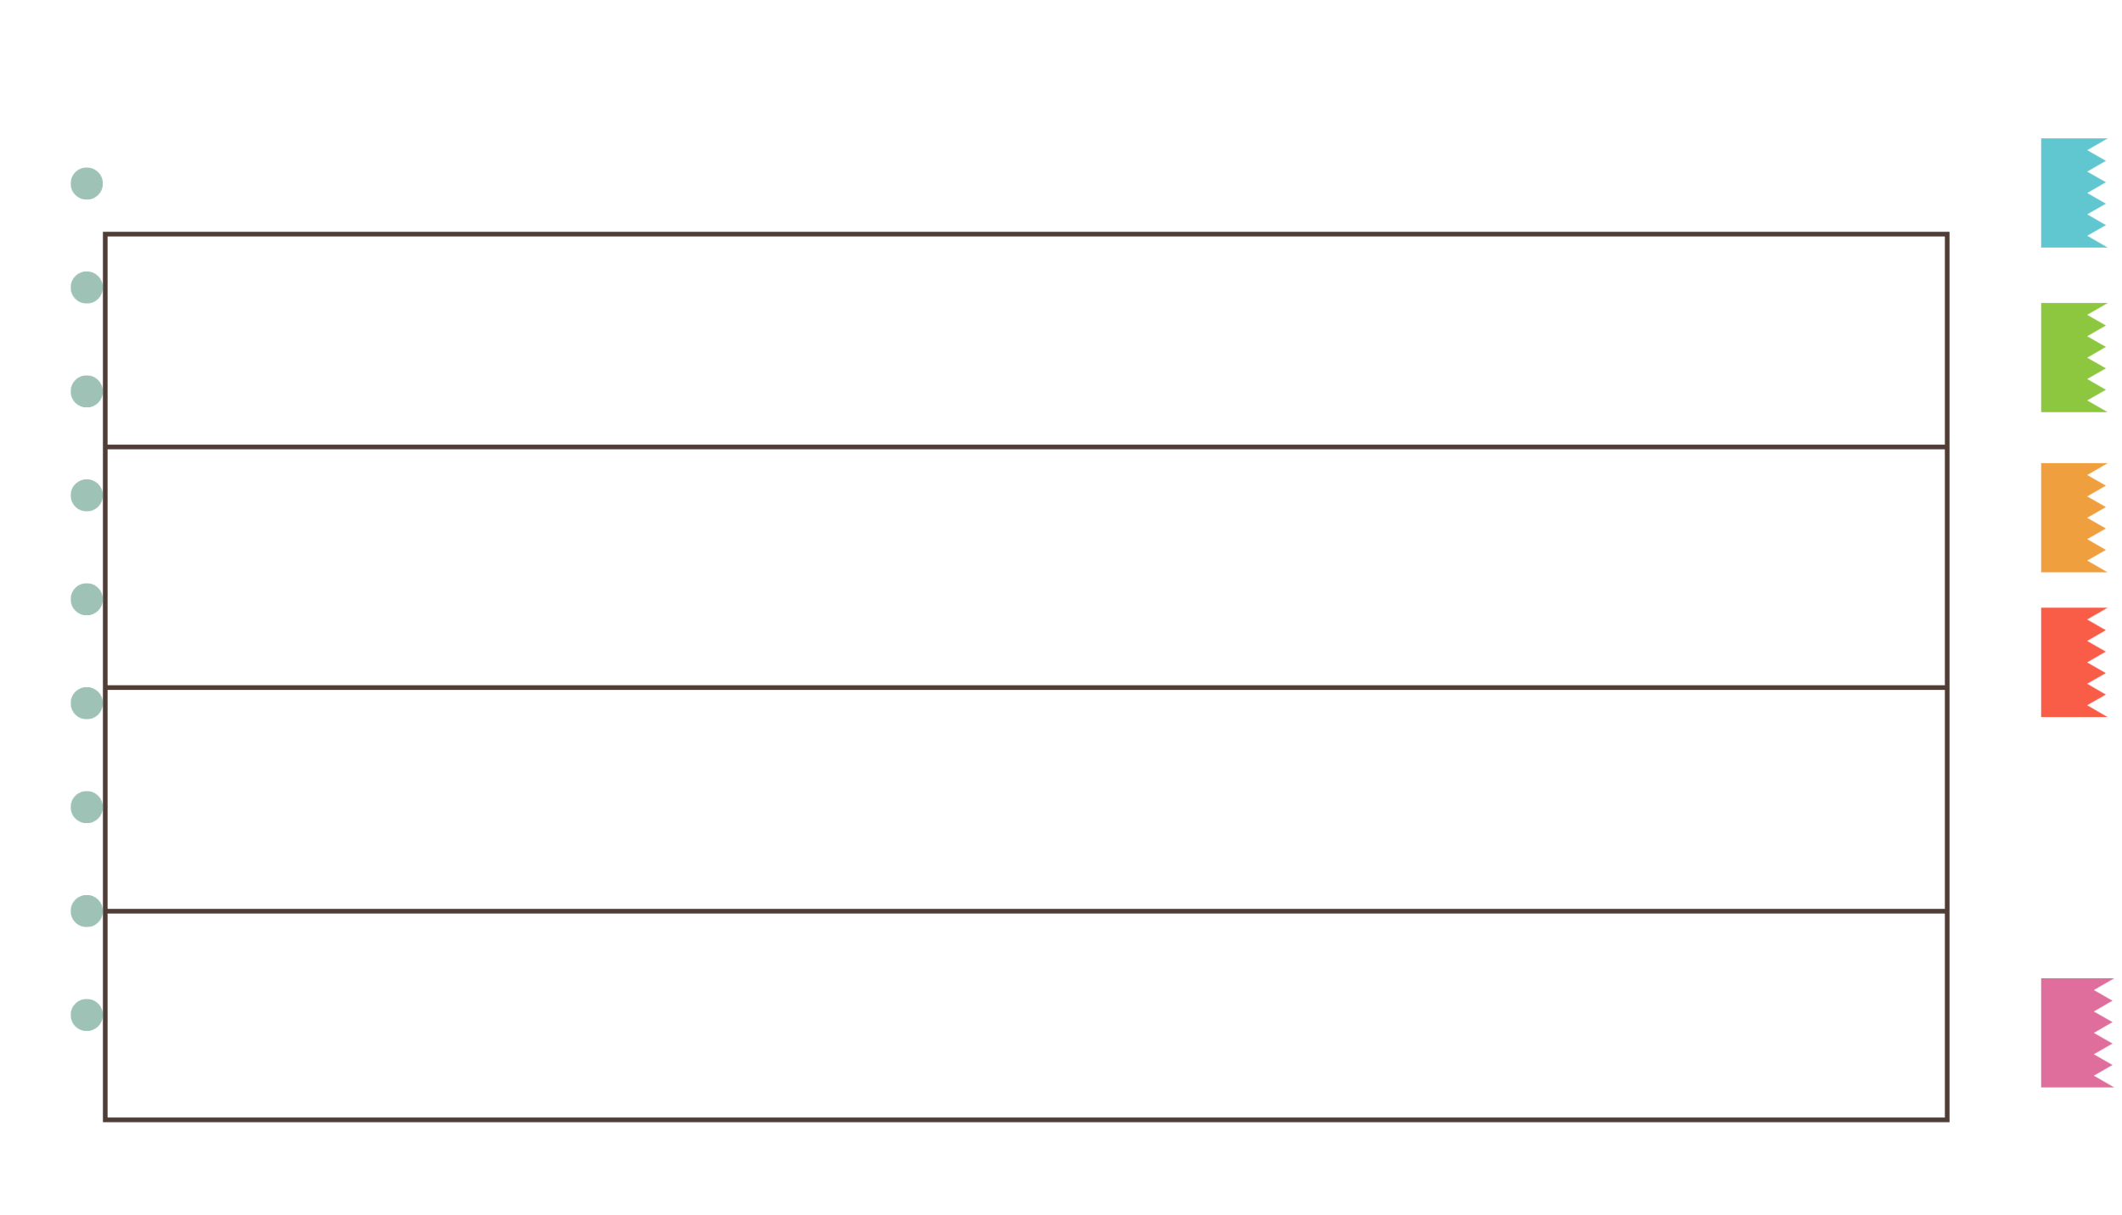







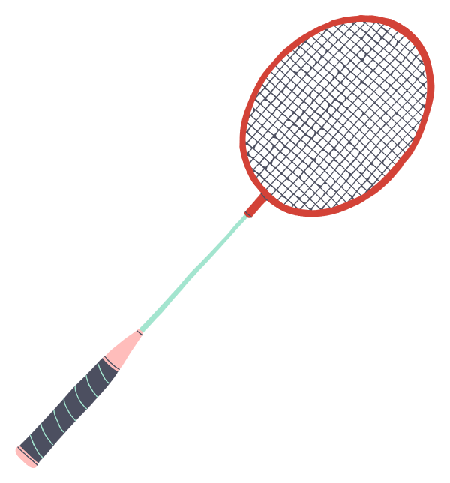


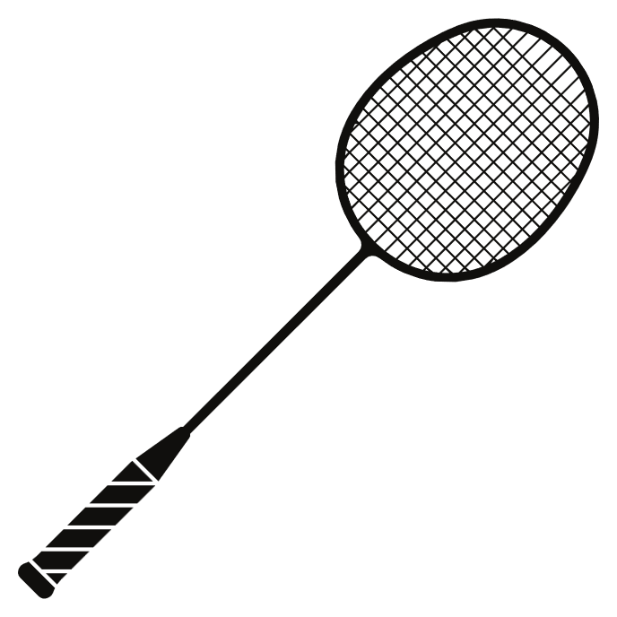

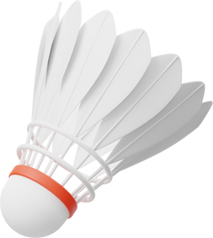
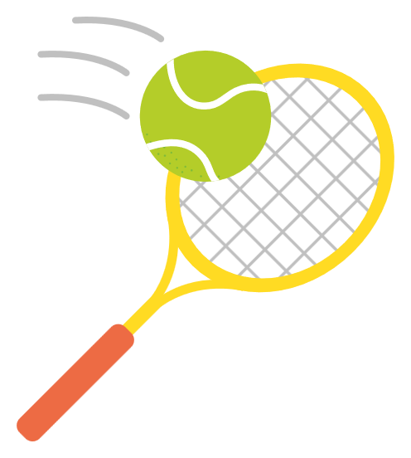

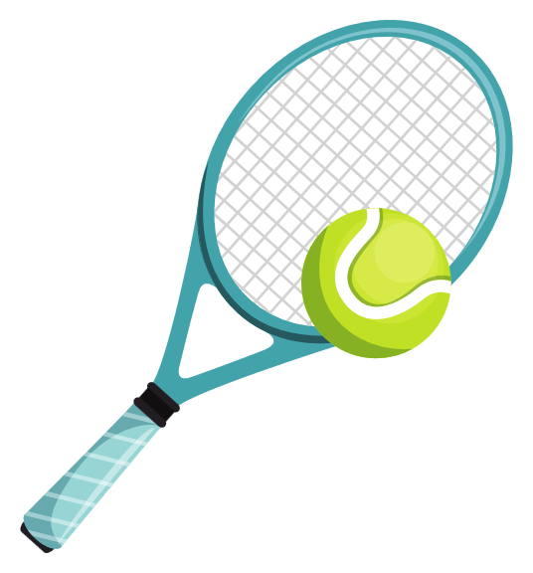

III. EXERCISES
8. Which is different?

