Slide 1
1
T
E
A
C
H
E
R
2
F
R
I
E
N
D
3
S
T
U
D
E
N
T
4
C
U
L
T
U
R
A
L
5
C
L
A
S
S
6
T
E
S
T
H
I
S
T
O
R
Y
7
S
C
H
O
O
L
8
K
N
O
W
L
E
D
G
E
9

Slide 2
IS A KNOWLEDGE TRANSMITTER?
BACK

Slide 3
ALWAYS THAT WE HAVE PEOPLE WITH THEM
BACK

Slide 4
OBJECTS OF KNOWLEDGE OF KNOWLEDGE
BACK

Slide 5
WHAT ARE VIETNAMESE HUMAN PERSONS WHO HAD?
BACK

Slide 6
A COLLECTION IN A SCHOOL
BACK

Slide 7
TERMINATION OF A CURRICULUM…
BACK

Slide 8
COURSE RELATED TO VIETNAMESE ETHNIC TRADITIONAL CIRCUMSTANCES
BACK

Slide 9
WHEN TO STUDY AGE TO LEARN?
BACK

Slide 10
WHAT THE COMMON TEACHER PREPOSES FOR STUDENTS?
BACK

Slide 11
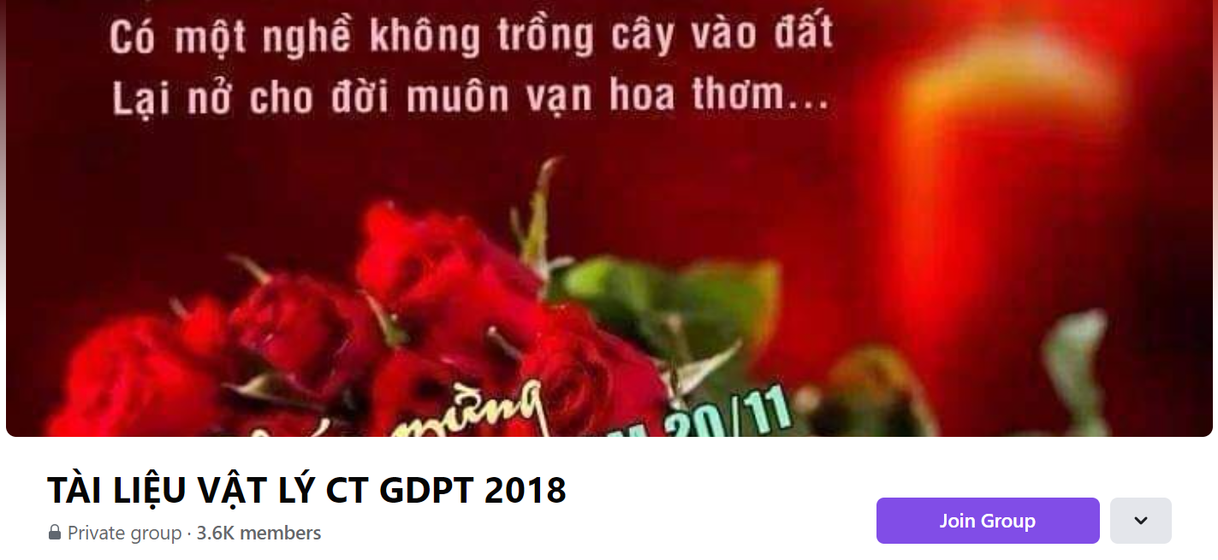
SƯU TẦM: ĐOÀN VĂN DOANH, NAM TRỰC, NAM ĐỊNH
LINK NHÓM DÀNH CHO GV BỘ MÔN VẬT LÝ TRAO ĐỔI TÀI LIỆU VÀ CHUYÊN MÔN CT 2018
https://www.facebook.com/groups/299257004355186

