Slide 1

Unit 4: HOME
Lesson 3.3
Page 60

Slide 2
Lesson Outline
Warm-up
Practice
Speaking
Consolidation
Wrap-up

Slide 3
Objectives
By the end of this lesson, students will be able to ask where people are.
Vocabulary: Revision (bedroom, bathroom, living room, kitchen, yard).
Structure: Where’s Tom? He’s in the living room.
Where’s Grandma? She’s in the bathroom.

Slide 4

WARM UP

Slide 5

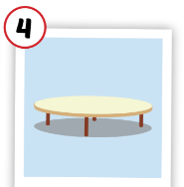
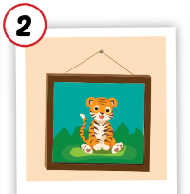

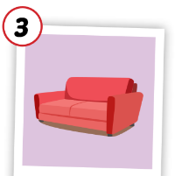

Matching the picture with its meaning.
table
picture
house
mirror
sofa
box

Slide 6

It’s time to learn …

Slide 7

Practice

Slide 8

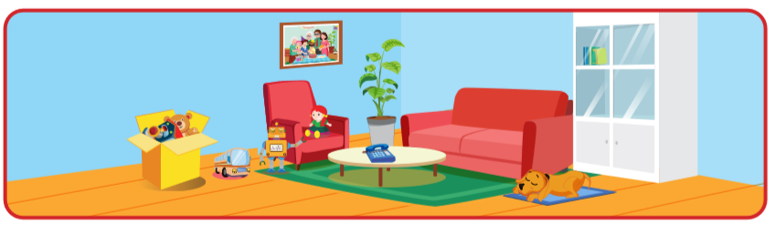
Is the table in the living room?
Yes, it is.

Slide 9
Is the mirror in the living room?
No, it isn’t.

Slide 10
Is the box in the living room?
Yes, it is.

Slide 11

Is the mirror in the living room?
Yes, it is.

Slide 12
Is the picture in the bedroom?
Yes, it is.

Slide 13

Is the cat in the kitchen?
Yes, it is.

Slide 14

Speaking

Slide 15
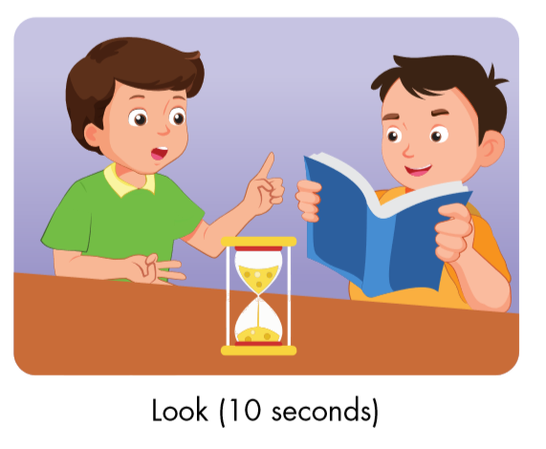

Is the cat in the bedroom?
No, it isn’t.
Correct.

Slide 16
Is the table in the living room?
Yes, it is.
Correct.

Slide 17
Is the picture in the living room?
Yes, it is.
Correct.

Slide 18
Is the box in the kitchen?
No, it isn’t.
Correct.

Slide 19

Workbook
p. 43

Slide 20

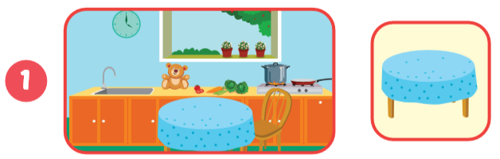
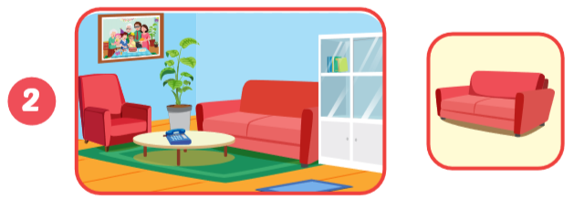
A: Is the table in the kitchen ?
B: Yes, it is .
sofa
living room
A: Is the in the ?
B: Yes, .
it is

Slide 21
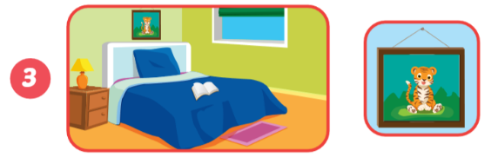
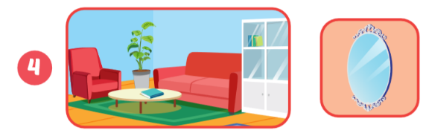
the picture
A: Is in ?
B:
the bedroom
Yes, it is.
A:
B:
Is the mirror in the living room?
No, it isn’t.

Slide 22

CONSOLIDATION

Slide 23
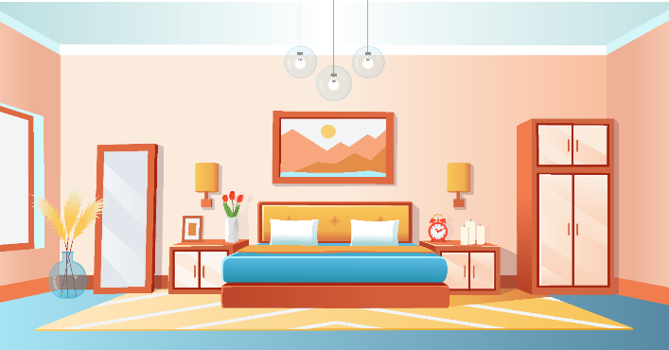
Ask and answer.
Is the picture in the bedroom?
Yes, it is.

Slide 24

Ask and answer.
Is the mirror in the living room?
No, it isn’t.

Slide 25
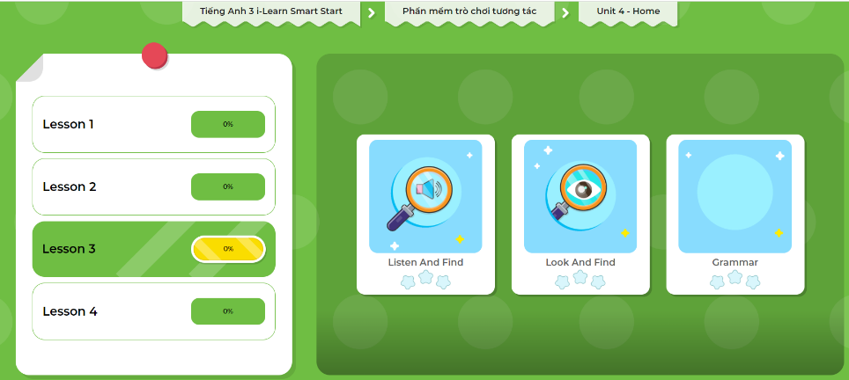
LET’S PLAY!
Click here to play the games!

Slide 26

WRAP-UP

Slide 27
Lesson 3
Today’s lesson
Vocabularies
Revision (bedroom, bathroom, living room, kitchen, yard).
Structures/ Sentence patterns
Is the picture in the bedroom?
Yes, it is.
Is the mirror in the living room?
No, it isn’t.

Slide 28
Homework
Review the vocabularies and sentence patterns. Make sentences using them.
Do the exercise D on page 43 (WB)
Prepare the next lesson (page 61 SB)
Play the consolidation games in Tiếng Anh 3 i-Learn Smart Start DHA App on www.eduhome.com.vn
Do the exercises in Tiếng Anh 3 i-Learn Smart Start Notebook on page 30.

Slide 29

Enjoy your day!

Slide 30

Have a nice day!

