Slide 1


Unit 5: INVENTIONS
Lesson 3: Reading
Artificial intelligence

Slide 2

Unit
1
1
FAMILY LIFE
Family Life
Unit
OBJECTIVES
Develop reading skills for main ideas and specific information about artificial intelligence.

Slide 3
Table of contents
01
02
03
Warm-up
Pre-reading
While-reading
04
Post-reading
05
Consolidation

Slide 4
Warm-up
01
Video watching

Slide 5

VIDEO WATCHING
READING
Unit
Work individually.
Watch a video about artificial intelligence (AI) and take notes.
Answer the questions using the notes.
Notes:
https://www.youtube.com/watch?v=UdE-W30oOXo

Slide 6
ANSWER THE QUESTIONS
1. What is artificial intelligence?
2. What are some real-life cases in which we have probably dealt with AI?
3. What benefits do robots/ AI bring to us?
4. Can AI replace human?

Slide 7
Pre-reading
02

Slide 8
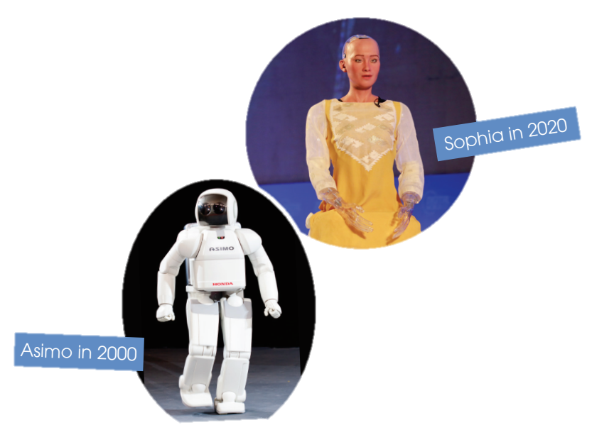
PRE-READING
1
Look at the pictures of Asimo and Sophia and discuss the questions below in pairs.
1. What are they?
2. What do you think they can do?
They are robots.
They can walk, talk, show emotions, and do household chores.

Slide 9
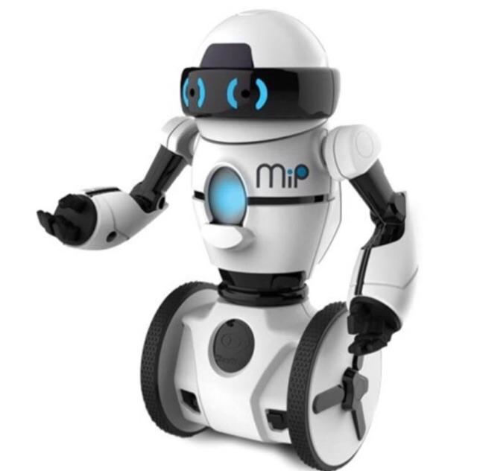

VOCABULARY
robot (n)
/ˈrəʊbɒt/
a machine that can perform a complicated series of tasks by itself

Slide 10

VOCABULARY
VOCABULARY
communicate (v)
/kəˈmjuːnɪkeɪt/
to share or exchange information, news, ideas, feelings, etc

Slide 11

VOCABULARY
VOCABULARY
emotion (n)
/ɪˈməʊʃn/
a strong feeling such as love, fear or anger; the part of a person’s character that consists of feelings

Slide 12
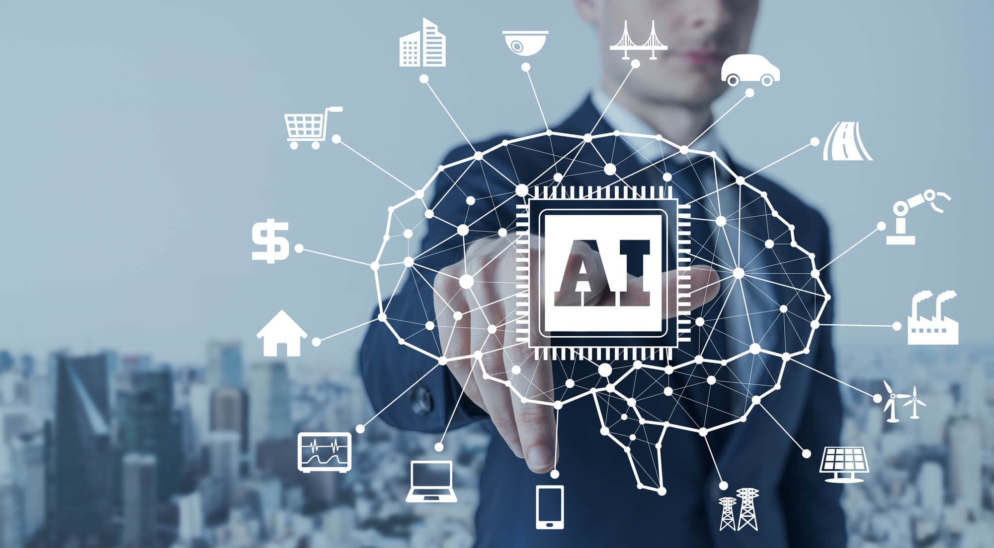
VOCABULARY
artificial intelligence (AI)
(n)
/ɑːtɪfɪʃl ɪnˈtelɪdʒəns/
the study and development of computer systems that can copy intelligent human behaviour

Slide 13
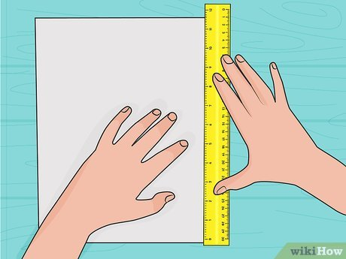
VOCABULARY
measure (v)
/ˈmeʒə(r)/
to find the size, quantity, etc. of something in standard units

Slide 14
VOCABULARY
New words | Pronunciation | Meaning
1. robot (n) | /ˈrəʊbɒt/ | a machine that can perform a complicated series of tasks by itself
2. communicate (v) | /kəˈmjuːnɪkeɪt/ | to share or exchange information, news, ideas, feelings, etc.
3. emotion (n) | /ɪˈməʊʃn/ | a strong feeling such as love, fear or anger; the part of a person’s character that consists of feelings
4. artificial intelligence (AI) (n) | /ˌɑːtɪfɪʃl ɪnˈtelɪdʒəns/ | the study and development of computer systems that can copy intelligent human behaviour
5. measure (v) | /ˈmeʒə(r)/ | to find the size, quantity, etc. of something in standard units

Slide 15


Slide 16


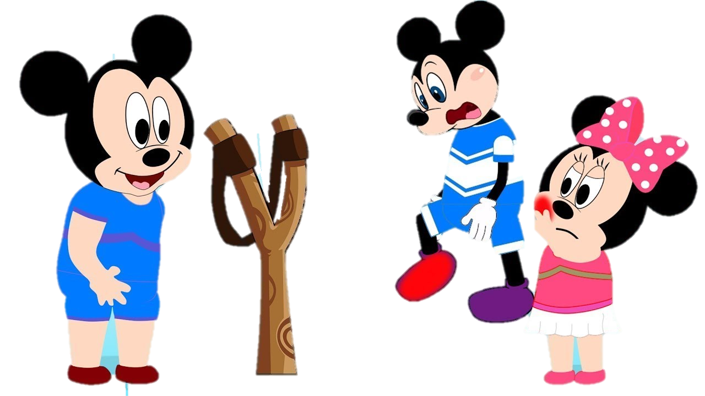



Slide 17


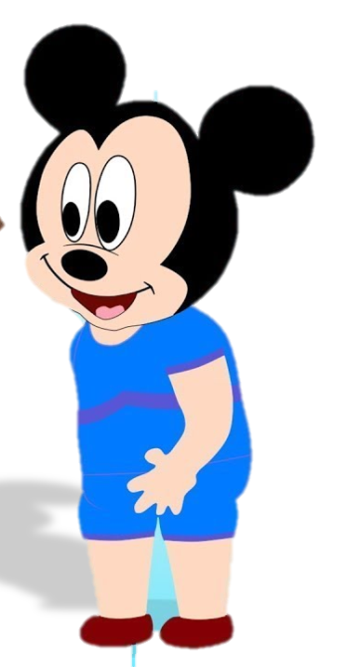

measure
Will the table fit in here? - I don't know. Let's ……………. it.
measure
communicate
robot
NEXT
Click on the right can

Slide 18
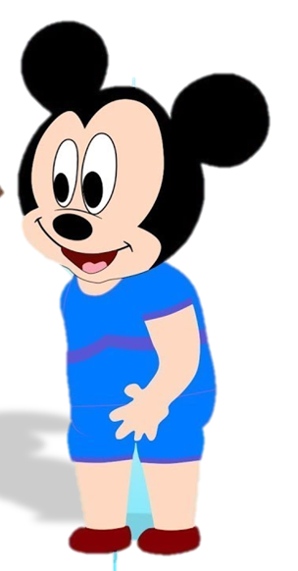

emotions
As an actor he could communicate a whole range of …………….. .
emotions
artificial intelligence
measure
NEXT
Click on the right can

Slide 19
robots
Industrial …………… are replacing people.
emotion
devices
robots
NEXT
Click on the right can

Slide 20
I find I just can't ………………….. with her.
communicate
app
invent
communicate
NEXT
Click on the right can

Slide 21
Artificial intelligence
………………………………. is the technology that allows machines to possess human-like intelligence.
Artificial intelligence
hardware
software
Click on the right can

Slide 22
While-reading
03

Slide 23
WHILE-READING
2
Read the text and choose the main idea.
In 2000, Asimo, a robot created by Honda, amazed everyone by just walking down the stairs.
Twenty years later, a robot named Sophia can even communicate with people by using human
language and expressing emotions.
However, robots are just one example of Artificial Intelligence (AI) – the study and development of
machines that can copy human intelligence. Nowadays, AI has been applied to various areas of life.
At home, devices such as vacuum cleaners can now use AI to measure the room size and recognise
any furniture. They can then decide on the most effective way to clean the house.
In transport, AI can be used on many smartphones to collect information about traffic. This can then
help drivers find the most suitable route. Travelling has become much more convenient thanks to AI.
At work, the uses of AI are even more useful and exciting. Computer programs, such as AI software or chatbots, can help customers plan their holidays, book flights and hotels, and answer questions.
AI is one of the most important inventions of the 21st century. It has completely changed our daily
work and life.

Slide 24
WHILE-READING
2
Read the text and choose the best title for it.
A. AI development over time
B. Robots: The best AI inventions
C. AI in use today
D. AI in education

Slide 25
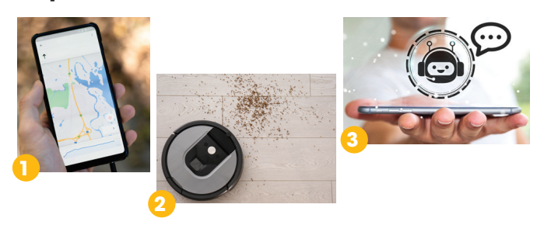
WHILE-READING
3
Match the pictures with the uses of AI.
a. Uses of AI at home
b. Uses of AI at work
c. Uses of AI in transport

Slide 26
PRACTICE
WHILE-READING
4
True or false
 | T | F
1. Sophia can show emotions when talking to humans.
2. AI helps to make machines that think and act like humans.
3. AI is one of the most important inventions of the 20th century.
✔
✔
✔

Slide 27
Post-reading
04

Slide 28
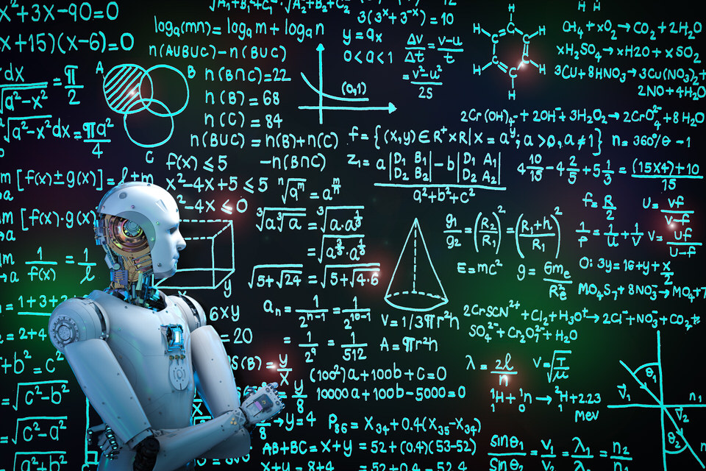
POST-READING
5
Discussion
Work in groups and brainstorm possible uses of AI in schools.

Slide 29
Consolidation
05

Slide 30
CONSOLIDATION
1
Wrap-up
Reading for general and specific information about artificial intelligence.

Slide 31
CONSOLIDATION
2
Homework
Prepare for the next lesson: Unit 5 – Speaking
2. Do exercises in the workbook

Slide 32
SEE YOU NEXT TIME !!

