Slide 1

Unit 8: Food
Lesson 3.1
Page 116

Slide 2
Lesson Outline
Warm-up
Vocabulary
Structure
Consolidation
Wrap-up

Slide 3
Objectives
By the end of this lesson, students will be able to…
Vocabulary: learn and practice fries, pizza, cake, ice cream, chicken, fish
Structure: Learn and practice
Would you like some fries?
Yes, please./Sure, thanks!
No, thank you.

Slide 4

WARM UP

Slide 5



Slide 6
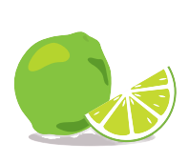

Slide 7
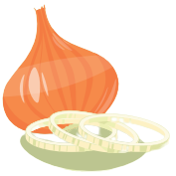

Slide 8


Slide 9
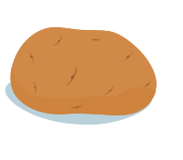

Slide 10

It’s time to learn …

Slide 11
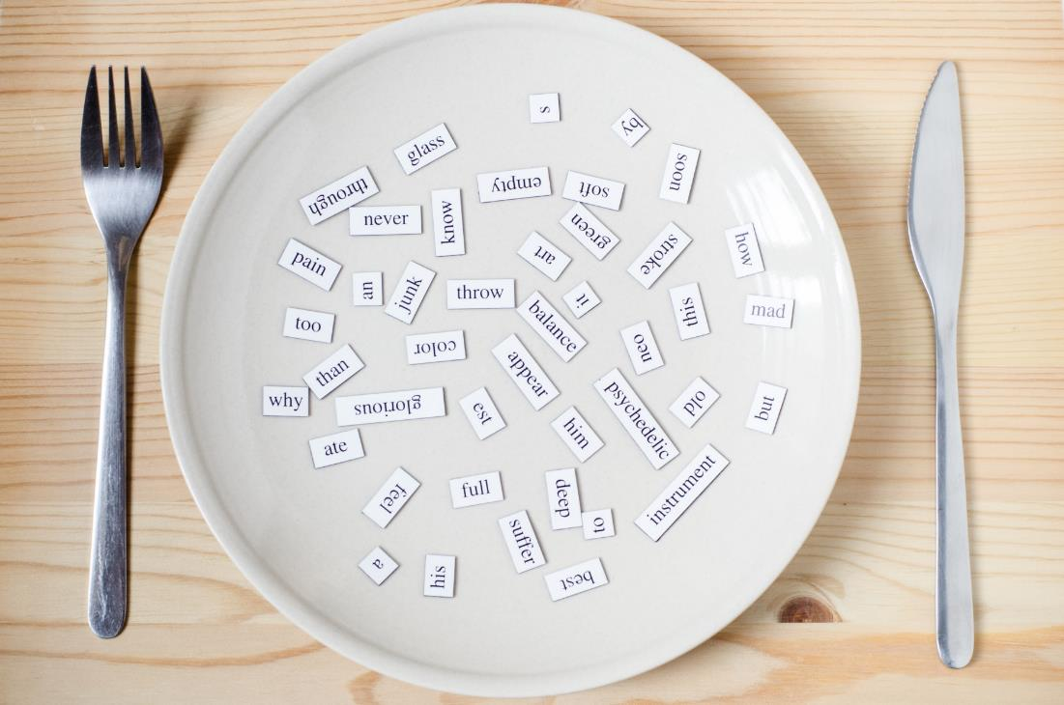
New words
fries, pizza, cake, ice cream, chicken, fish

Slide 12

Presentation

Slide 13



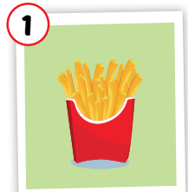
Click each picture to hear the sound.
fries
/fraɪz/
khoai tây chiên
Notes:
Click chữ nghe đọc

Slide 14
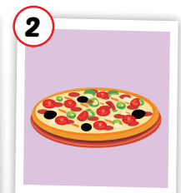
Click each picture to hear the sound.
pizza
/ˈpiːtsə/
Bánh pi-za
Notes:
Click chữ nghe đọc

Slide 15
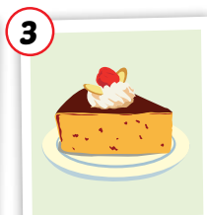
Click each picture to hear the sound.
cake
/keɪk/
bánh ngọt
Notes:
Click chữ nghe đọc

Slide 16
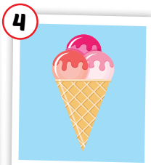
Click each picture to hear the sound.
ice cream
/ˈaɪs kriːm/
kem
Notes:
Click chữ nghe đọc

Slide 17
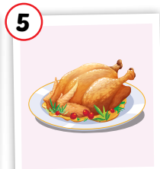
Click each picture to hear the sound.
chicken
/ˈtʃɪkɪn/
thịt gà
Notes:
Click chữ nghe đọc

Slide 18
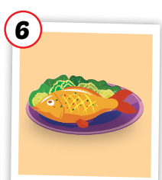
Click each picture to hear the sound.
fish
/fɪʃ/
con cá, món cá
Notes:
Click chữ nghe đọc

Slide 19
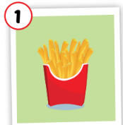

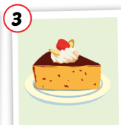
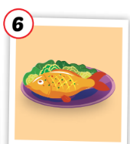
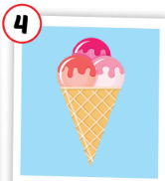

Click each picture to hear the sound.
fries
pizza
cake
ice cream
chicken
fish
/fraɪz/
khoai tây chiên
/ˈpiːtsə/
Bánh pi-za
/keɪk/
bánh ngọt
/ˈaɪs kriːm/
kem
/ˈtʃɪkɪn/
thịt gà
/fɪʃ/
con cá, món cá
Notes:
Click chữ nghe đọc

Slide 20

Practice

Slide 21

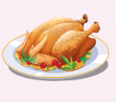

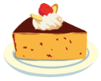



MEMORY GAME
1
2
3
4
5
6
7
8
9
10
11
12
13
14
15
16
17
18

Slide 22
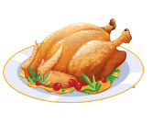
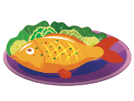
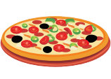
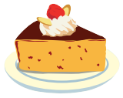
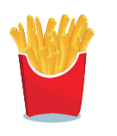

SLAP THE BOARD

Slide 23

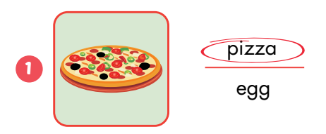
Extra Practice
WB, P. 82

Slide 24
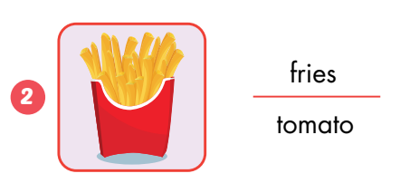

Slide 25
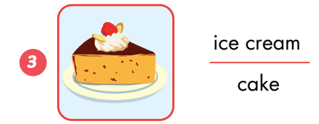

Slide 26
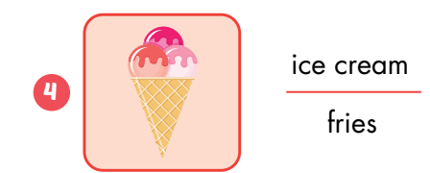

Slide 27
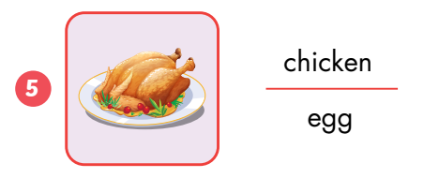

Slide 28
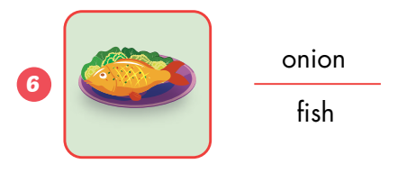

Slide 29
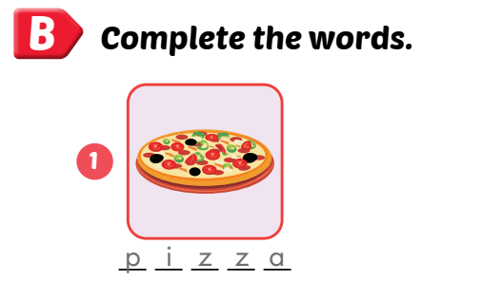
Extra Practice
WB, P. 82

Slide 30

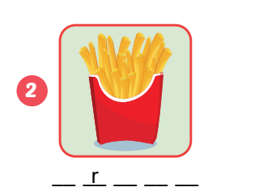
fries

Slide 31
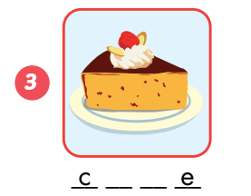
cake

Slide 32
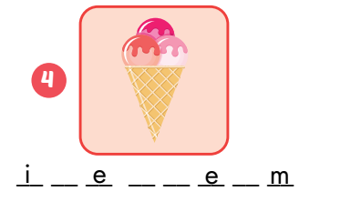
ice cream

Slide 33
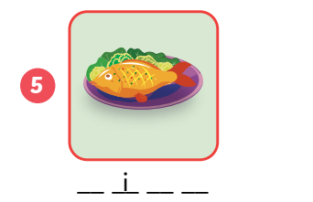
fish

Slide 34
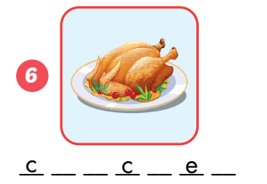
chicken

Slide 35
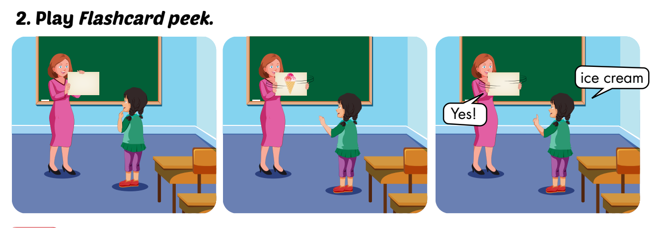

Slide 36
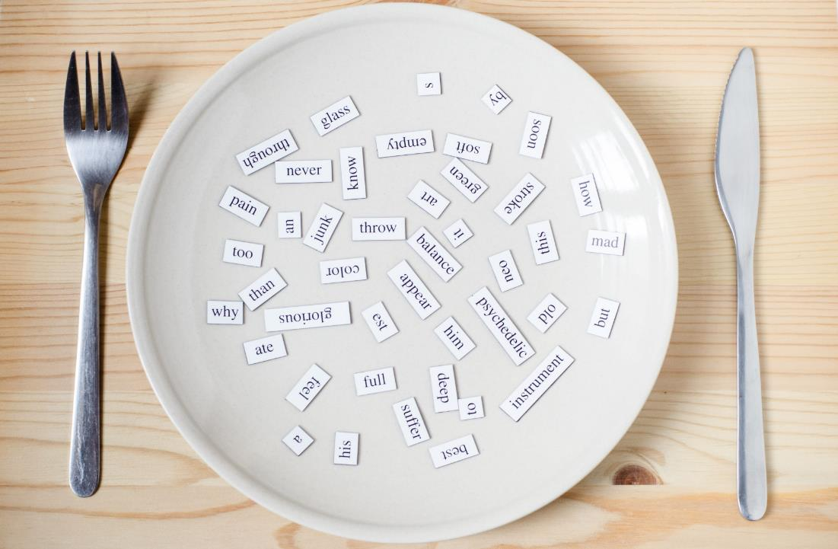
Structures
Would you like some fries?
- Yes, please. / Sure, thanks!
- No, thank you.

Slide 37
Presentation

Slide 38







Click on each sentence to listen
Would you like some fries?
Yes, please./Sure, thanks!
Would you like some cake?
No, thank you.

Slide 39
Practice

Slide 40
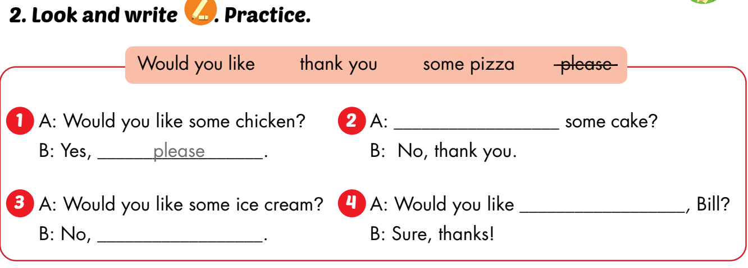
Would you like
some pizza
thank you

Slide 41
some chicken
Would you like ____________?
Yes, ________.
please

Slide 42
some ice cream
Would you like _______________?
No, ________.
thank you

Slide 43
some pizza
Would you like ___________?
Yes, ________.
please

Slide 44
some fish
Would you like __________?
No, ________.
thank you

Slide 45
some fries
Would you like ____________?
Yes, ________.
please

Slide 46
some pizza
Would you like _________?
Yes, ________.
please

Slide 47

CONSOLIDATION

Slide 48
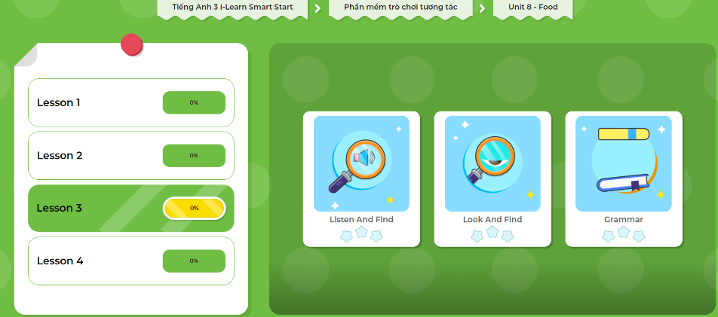
Extra Practice
DHA App
LET’S PLAY!
Click here to play the games

Slide 49

WRAP-UP

Slide 50
Lesson 3
Today’s lesson
Vocabularies
fries, pizza, cake, ice cream, chicken, fish
Structures/ Sentence patterns
Would you like some fries?
Yes, please./Sure, thanks!
No, thank you.

Slide 51
Homework
Practice the vocabularies and structure; and make sentences using them.
Do the exercises in Tiếng Anh 3 i-Learn Smart Start WB (page 82)
Do the exercise in Tiếng Anh 3 i-Learn Smart Start DHA Notebook (page 54)
Prepare the next lesson (page 117 SB)
Play the consolidation games in Tiếng Anh 3 i-Learn Smart Start DHA App on www.eduhome.com.vn

Slide 52
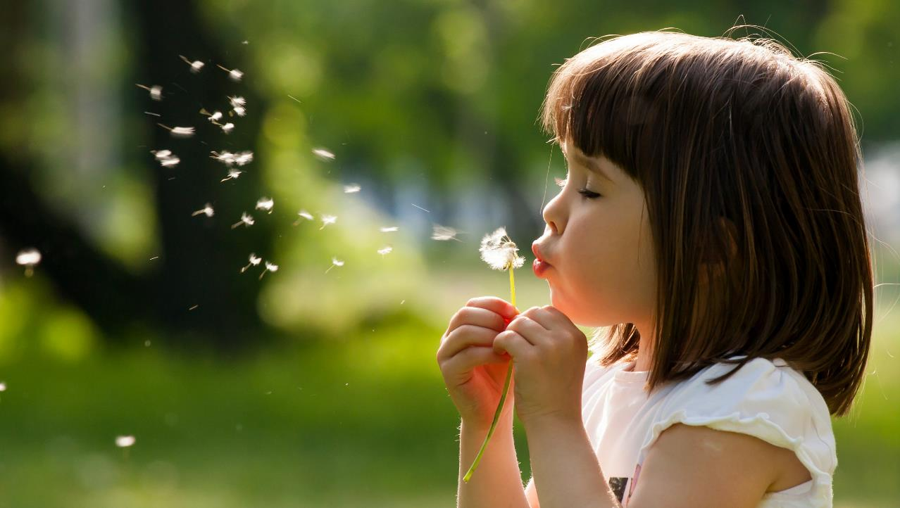
Enjoy your day!

