Slide 2
REVIEW
2
UNITS 4-5
Unit
FAMILY LIFE
LESSON 3
SKILLS (2)
Reading and Writing

Slide 3
LESSON 3
SKILLS (2)
WARM-UP
Brainstorming
Task 1. Read the text and choose the best title.
Task 2. Answer the questions.
READING
WRITING
Write a proposal to Youth
CONSOLIDATION
Wrap-up
Homework

Slide 4
WARM-UP
WHAT CAN YOU SEE IN THE PICTURE?
What can you do to go green?

Slide 5
BRAINSTORMING
cycling or going to school or work by public transport
planting trees
organising clean-up events in the community
What can you do to go green?
reducing the use of fossil fuels
turning off the devices when not in use
recycling plastic products

Slide 6
READING
1
Read the text and choose the best title for it.
ASEAN Youth Forum (AYF) is a programme for young people in ASEAN, which allows them to express their opinions and fight for their right to live in a sustainable and caring regional community. Its members regularly hold meetings and workshops to discuss the problems facing young people in ASEAN and how to address them. AYF also organises Youth: Open Space – an online space for young Southeast Asians to meet, connect, share and talk about current issues such as climate change, health, education, technology and online security.
Over the past decade, AYF has had meetings in all ASEAN countries. It has connected thousands of young leaders from Southeast Asia, who meet to discuss and suggest strategies for making ASEAN a better community. These conferences aim to improve young people’s leadership skills and strengthen regional unity.

Slide 7
READING
1
Read the text and choose the best title for it.
A. Youth activities in ASEAN
B. A forum for ASEAN Youth
C. ASEAN and its forum

Slide 8
READING
2
Answer the questions.
1. In what kind of community do young people in ASEAN want to live?
2. What do AYF members regularly have?
3. What's the name of their online platform?
sustainable and caring
meetings and workshops
Youth: Open Space

Slide 9
READING
2
Answer the questions.
4. In which countries has AYF had meetings?
5. What do the AYF conferences aim to strengthen?
all ASEAN members
regional unity

Slide 10
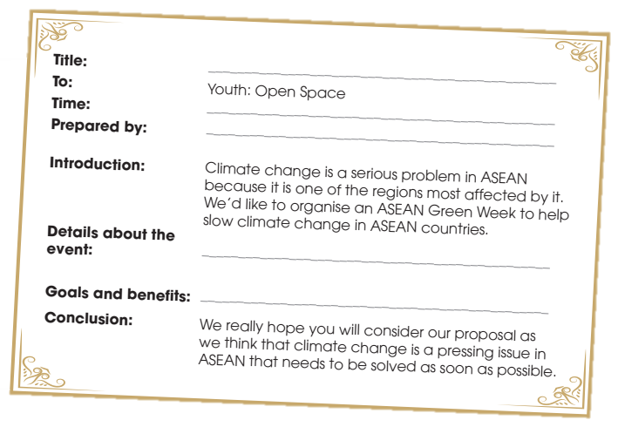
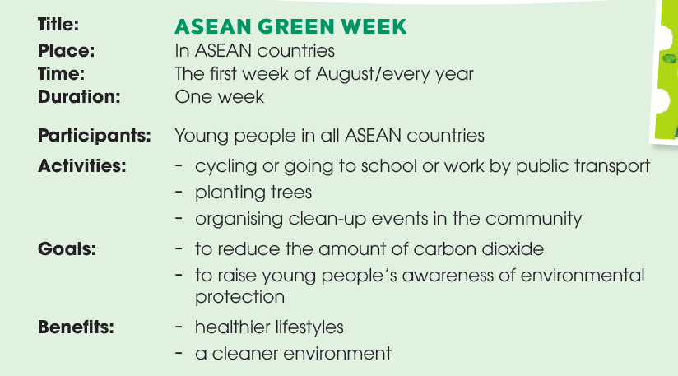
WRITING
Write a proposal (120–150 words) to Youth: Open Space for a youth event to slow climate change in ASEAN countries.

Slide 11
WRITING
Title: To: Time: Prepared by: Introduction: Details about the event: Goals and benefits Conclusion | ASEAN GREEN WEEK Youth – Open Space The first week of August/ every year Students from Chu Van An High school Climate change is a serious problem in ASEAN because it is one of the regions most affected by it. We’d like to organise an ASEAN Green Week to help limit climate change in ASEAN countries. The event will take place in all ASEAN member countries during the first week of August. The young people in ASEAN will be the main participants in this event. They will take part in activities such as cycling or going to school or work by public transport, planting trees and organising clean-up events in the community. This event aims at reducing the amount of carbon dioxide, which is the main cause of global warning, and raising young people’s awareness of environmental protection in ASEAN. It will help ASEAN countries adopt healthier lifestyles and live in a cleaner environment. We really hope you will consider our proposal as we think that climate change is a pressing issue in ASEAN that needs to be solved as soon as possible.

Slide 12
CONSOLIDATION
1
Wrap-up
What have you learnt today?
Practice the skills reading for main ideas and specific information;
Develop develop writing skills on the given topic.

Slide 13
CONSOLIDATION
2
Homework
Do exercises in the workbook.
Prepare for Unit 6 – Lesson 1.

Slide 14
Website: hoclieu.vn
Fanpage: facebook.com/www.tienganhglobalsuccess.vn
Website: hoclieu.vn
Fanpage: facebook.com/sachmem.vn/

