Slide 1


Slide 2

1
REVIEW
1
FAMILY LIFE
Unit
SKILLS (1)
(Listening & Speaking)
LESSON 2

Slide 3

Unit
1
1
FAMILY LIFE
Family Life
Unit
OBJECTIVES
By the end of this lesson, students will be able to:
practise listening for general and specific information about music;
practise talking about a favourite singer or musician.

Slide 4
LESSON 2
SKILLS (1)
Unit
GETTING STARTED
WARM-UP
Name the pictures: Traditional music
Task 1: Listen and choose the best title for the talk.
Task 2: Listen and fill in the gaps.
LISTENING
SPEAKING
Talk about your favourite singer or musician.
CONSOLIDATION
Wrap-up
Homework

Slide 5
LESSON 2
SKILLS (1)
Unit
GETTING STARTED
WARM-UP
Name the pictures: Traditional music

Slide 6

WARM-UP
Name the pictures

Slide 7
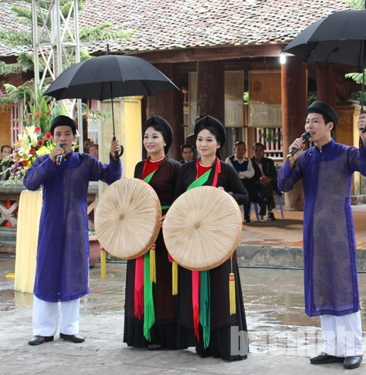

Xoan singing
Chau van singing
Quan ho singing

Slide 8
LESSON 2
SKILLS (1)
Unit
GETTING STARTED
WARM-UP
Name the pictures: Traditional music
Task 1: Listen and choose the best title for the talk.
Task 2: Listen and fill in the gaps.
LISTENING

Slide 9

LISTENING
1
Listen and choose the best title for the talk.
A. Presley’s death
B. Presley’s singles
C. Presley’s life and career

Slide 10
LISTENING
2
Listen again and fill in each gap in the Quick facts with a number.
Quick facts
1. He was born in ______.
2. He had his number 1 hit when he was _____.
3. He won _____ Grammy awards.
4. He died at the age of _______.
1935
21
3
42

Slide 11
LESSON 2
SKILLS (1)
Unit
GETTING STARTED
WARM-UP
Name the pictures: Traditional music
Task 1: Listen and choose the best title for the talk.
Task 2: Listen and fill in the gaps.
LISTENING
Talk about your favourite singer or musician.
SPEAKING

Slide 12
SPEAKING
1
Work in pairs. Talk about your favourite singer or musician. Use the expressions below to help you.
Useful expressions:
- My favourite singer / musician is ...
- His / Her (most famous) single / song / album / work is ...
- His / Her single became a (number 1) hit in ...
- (During his / her life), he / she has received (many / some …) awards, including ...

Slide 13
LESSON 2
SKILLS (1)
Unit
GETTING STARTED
WARM-UP
Name the pictures: Traditional music
Task 1: Listen and choose the best title for the talk.
Task 2: Listen and fill in the gaps.
LISTENING
SPEAKING
Talk about your favourite singer or musician.
CONSOLIDATION
Wrap up
Homework

Slide 14
CONSOLIDATION
1
Wrap-up
Practise listening for general and specific information about music;
Practise talking about favourite singer or musician.

Slide 15
CONSOLIDATION
2
Homework
Prepare for Review 1 – Skills 2 (Reading and Writing).

Slide 16

Website: hoclieu.vn
Fanpage: facebook.com/www.tienganhglobalsuccess.vn

