Slide 1

HAVE FUN + Watch Video =
玩得开心 + 看视频 =
Wán dé kāixīn + Kàn shìpín=
Be quiet 安靜 Ānjìng
Sit down 坐下 Zuò xià
Look at me 看着我 Kànzhe wǒ
Listen to me 听我说 Tīng wǒ shuō
Answer me 回答我 Huídá wǒ
.

Slide 3




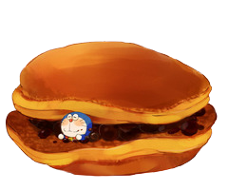

I can’t find my red bean cakes.
Please help me find them.
I’m hungry!

Slide 4

= Mystery
power-up
= points

Slide 5

Scoreboard: – Click the
top right corner to add 1,
bottom right to subtract 1,
top left to add 5,
bottom left to subtract 5.

Slide 6
A
B
C
D
E
F
G
H
I
J
K
L
M
N
O
P
Q
R
S
T
U
V
W
X
Y
Z

Slide 7



Do you like …ing?
Yes. I like skating.
No. I like …ing.

Slide 9

Do you like …ing?
Yes. I like hopping.
No. I like …ing.

Slide 11

Do you like …ing?
Yes. I like running.
No. I like …ing.

Slide 13


Do you like …ing?
Yes. I like skipping.
No. I like …ing.

Slide 15

Do you like …ing?
Yes. I like dancing.
No. I like …ing.

Slide 17

Do you like …ing?
Yes. I like riding a bicycle.
No. I like …ing.

Slide 19

Do you like …ing?
Yes. I like singing.
No. I like …ing.

Slide 21

Do you like …ing?
Yes. I like writing.
No. I like …ing.

Slide 23

Do you like …?
Yes. I like swimming.
No. I like …ing.

Slide 25

Do you like …ing?
Yes. I like flying.
No. I like …ing.

Slide 27
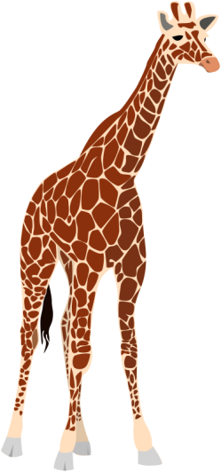
What are they?
They’re giraffes.

Slide 29
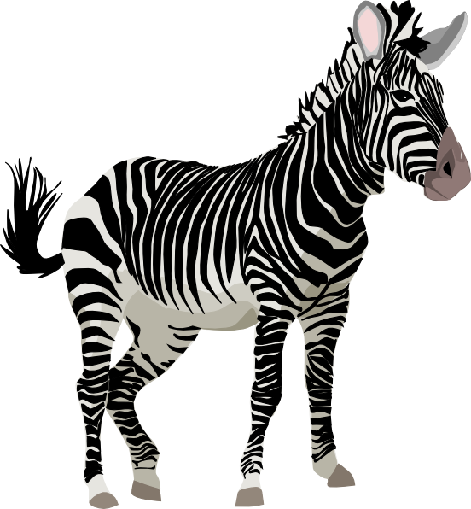
What are they?
They’re zebras.

Slide 31

What are they?
They’re elephants.

Slide 33
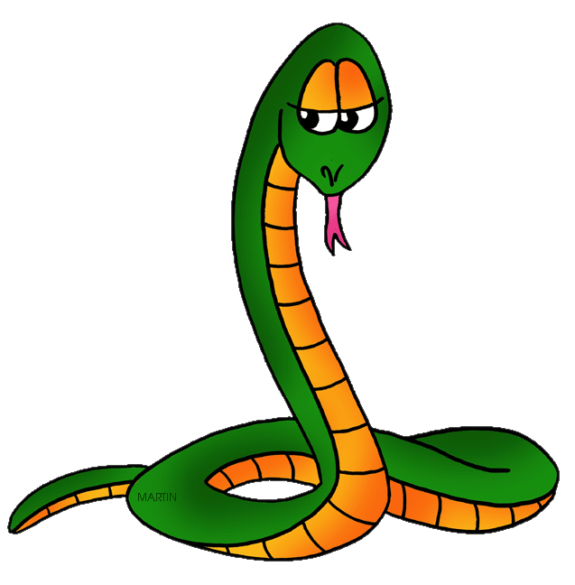
What are they?
They’re snakes.

Slide 35

What are they?
They’re lions.

Slide 37
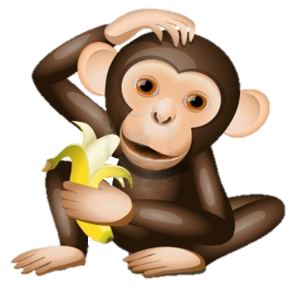
What are they?
They’re monkeys.

Slide 39
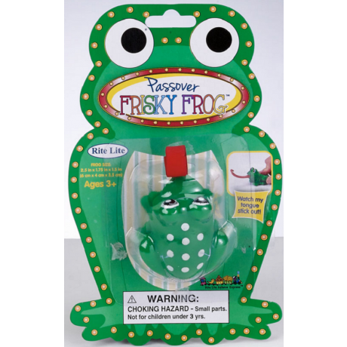
What are they?
They’re toy frogs.

Slide 41
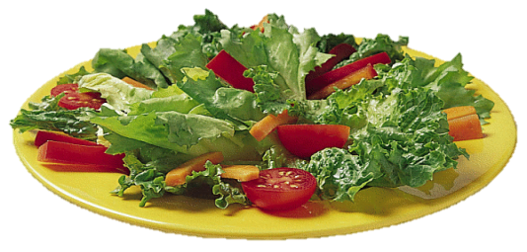
Would you like some …?
Sure. I like salad.
No, thanks. I don’t like salad.

Slide 43
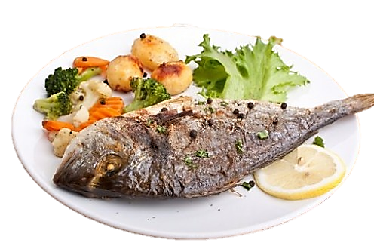
Would you like some …?
Sure. I like fish.
No, thanks. I don’t like fish.

Slide 45
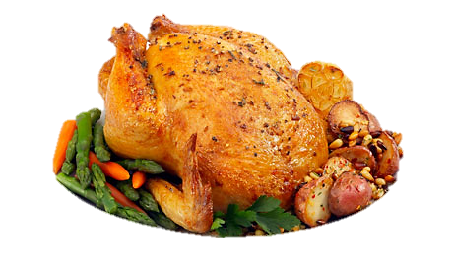
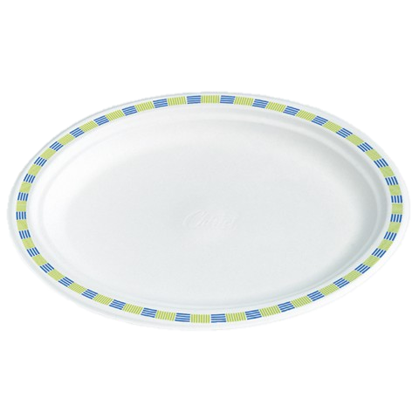
Would you like some …?
Sure. I like chicken.
No, thanks. I don’t like ….

Slide 47
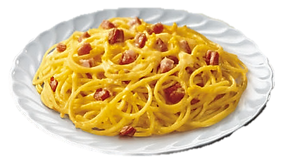
Would you like some noodles?
Sure. I like noodles.
No, thanks. I don’t like ….

Slide 48
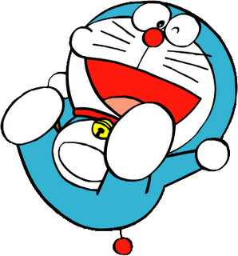


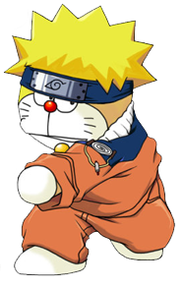

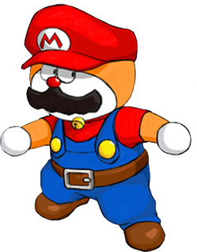

Slide 49
Change points!

Slide 50
Steal 3 points!

Slide 51
7 points!

Slide 52
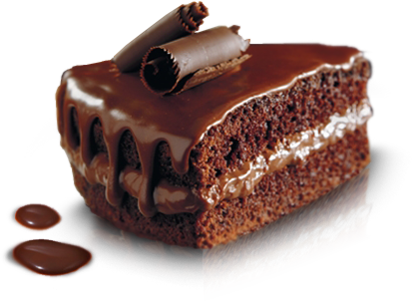
Would you like some cake?
Sure. I like cake.
No, thanks. I don’t like ….

Slide 54
Change points!

Slide 55
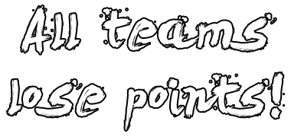

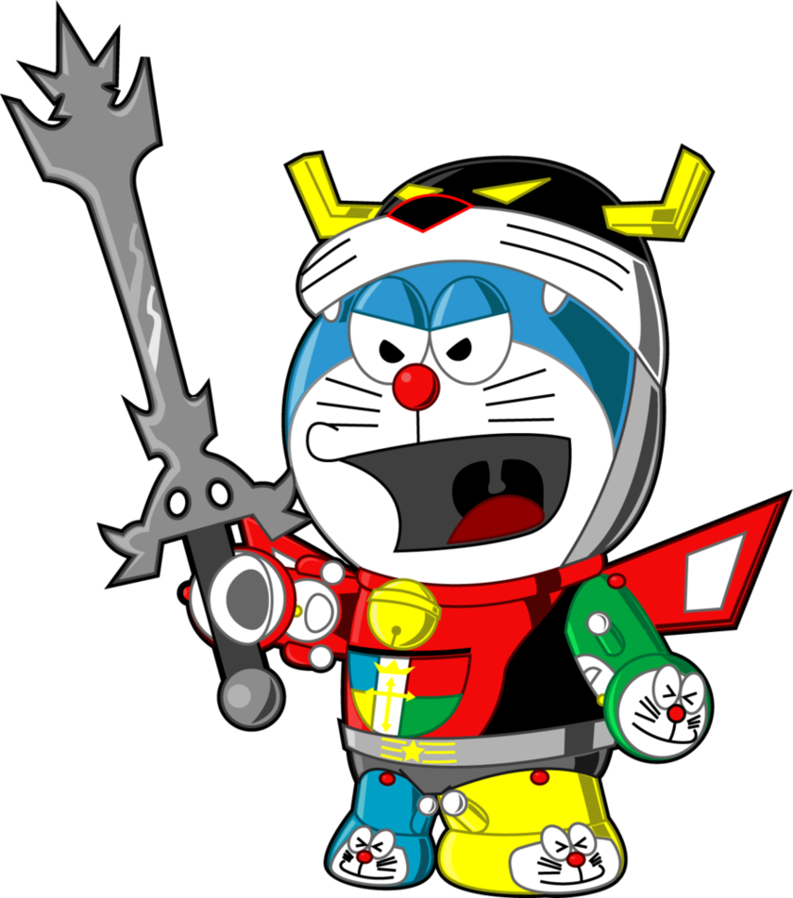

Slide 56
8 points!

Slide 57
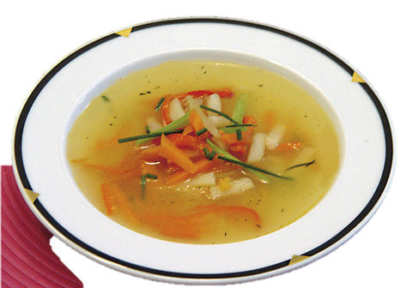
Would you like some soup?
Sure. I like soup.
No, thanks. I don’t like ….

Slide 58
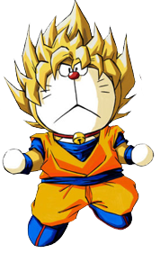
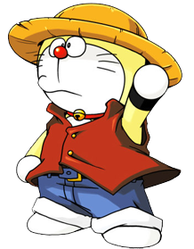
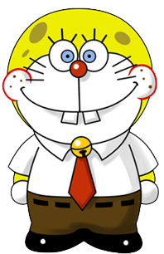

Slide 59
6 points!

Slide 60
Change points!

Slide 61
Steal 3 points!

Slide 62
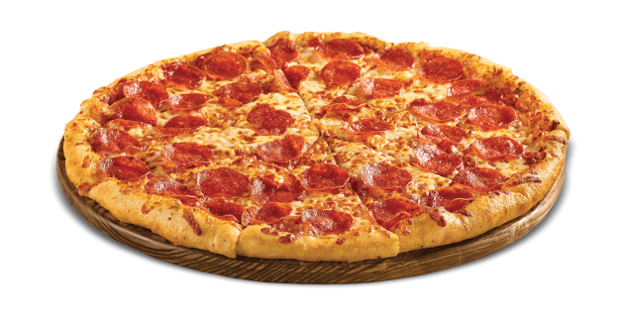
Would you like some pizza?
Sure. I like pizza..
No, thanks. I don’t like ….

Slide 64
Steal 3 points!

Slide 66
9 points!

Slide 67
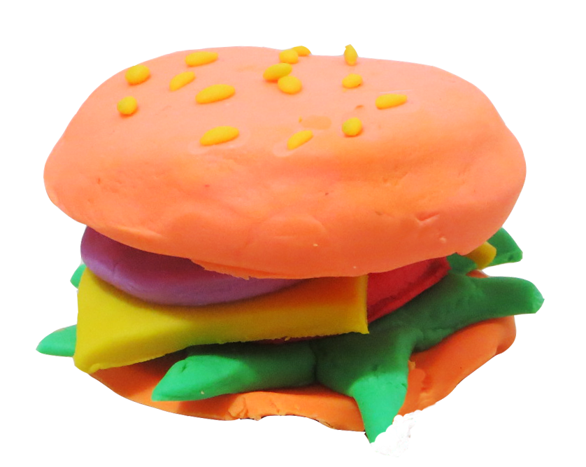
What are they?
They’re toy hamburgers.

Slide 68


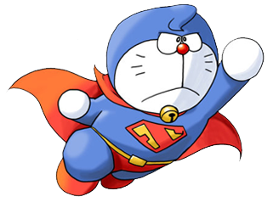

Slide 69
Change points!

Slide 70
Steal 3 points!

Slide 72
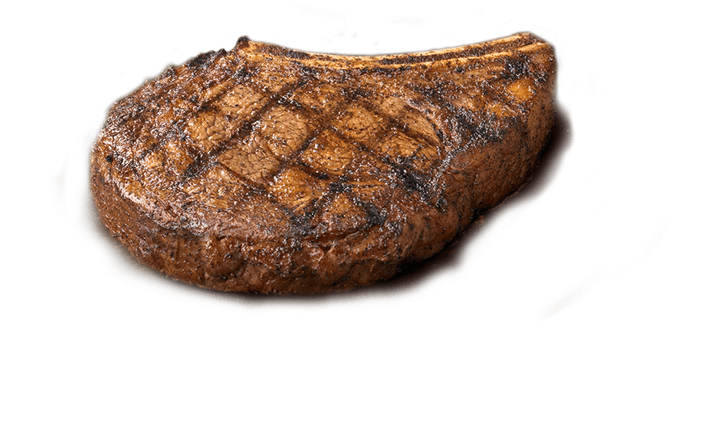
Would you like some meat?
Sure. I like meat..
No, thanks. I don’t like ….

Slide 74
10 points!

Slide 75
Change points!

