Slide 1
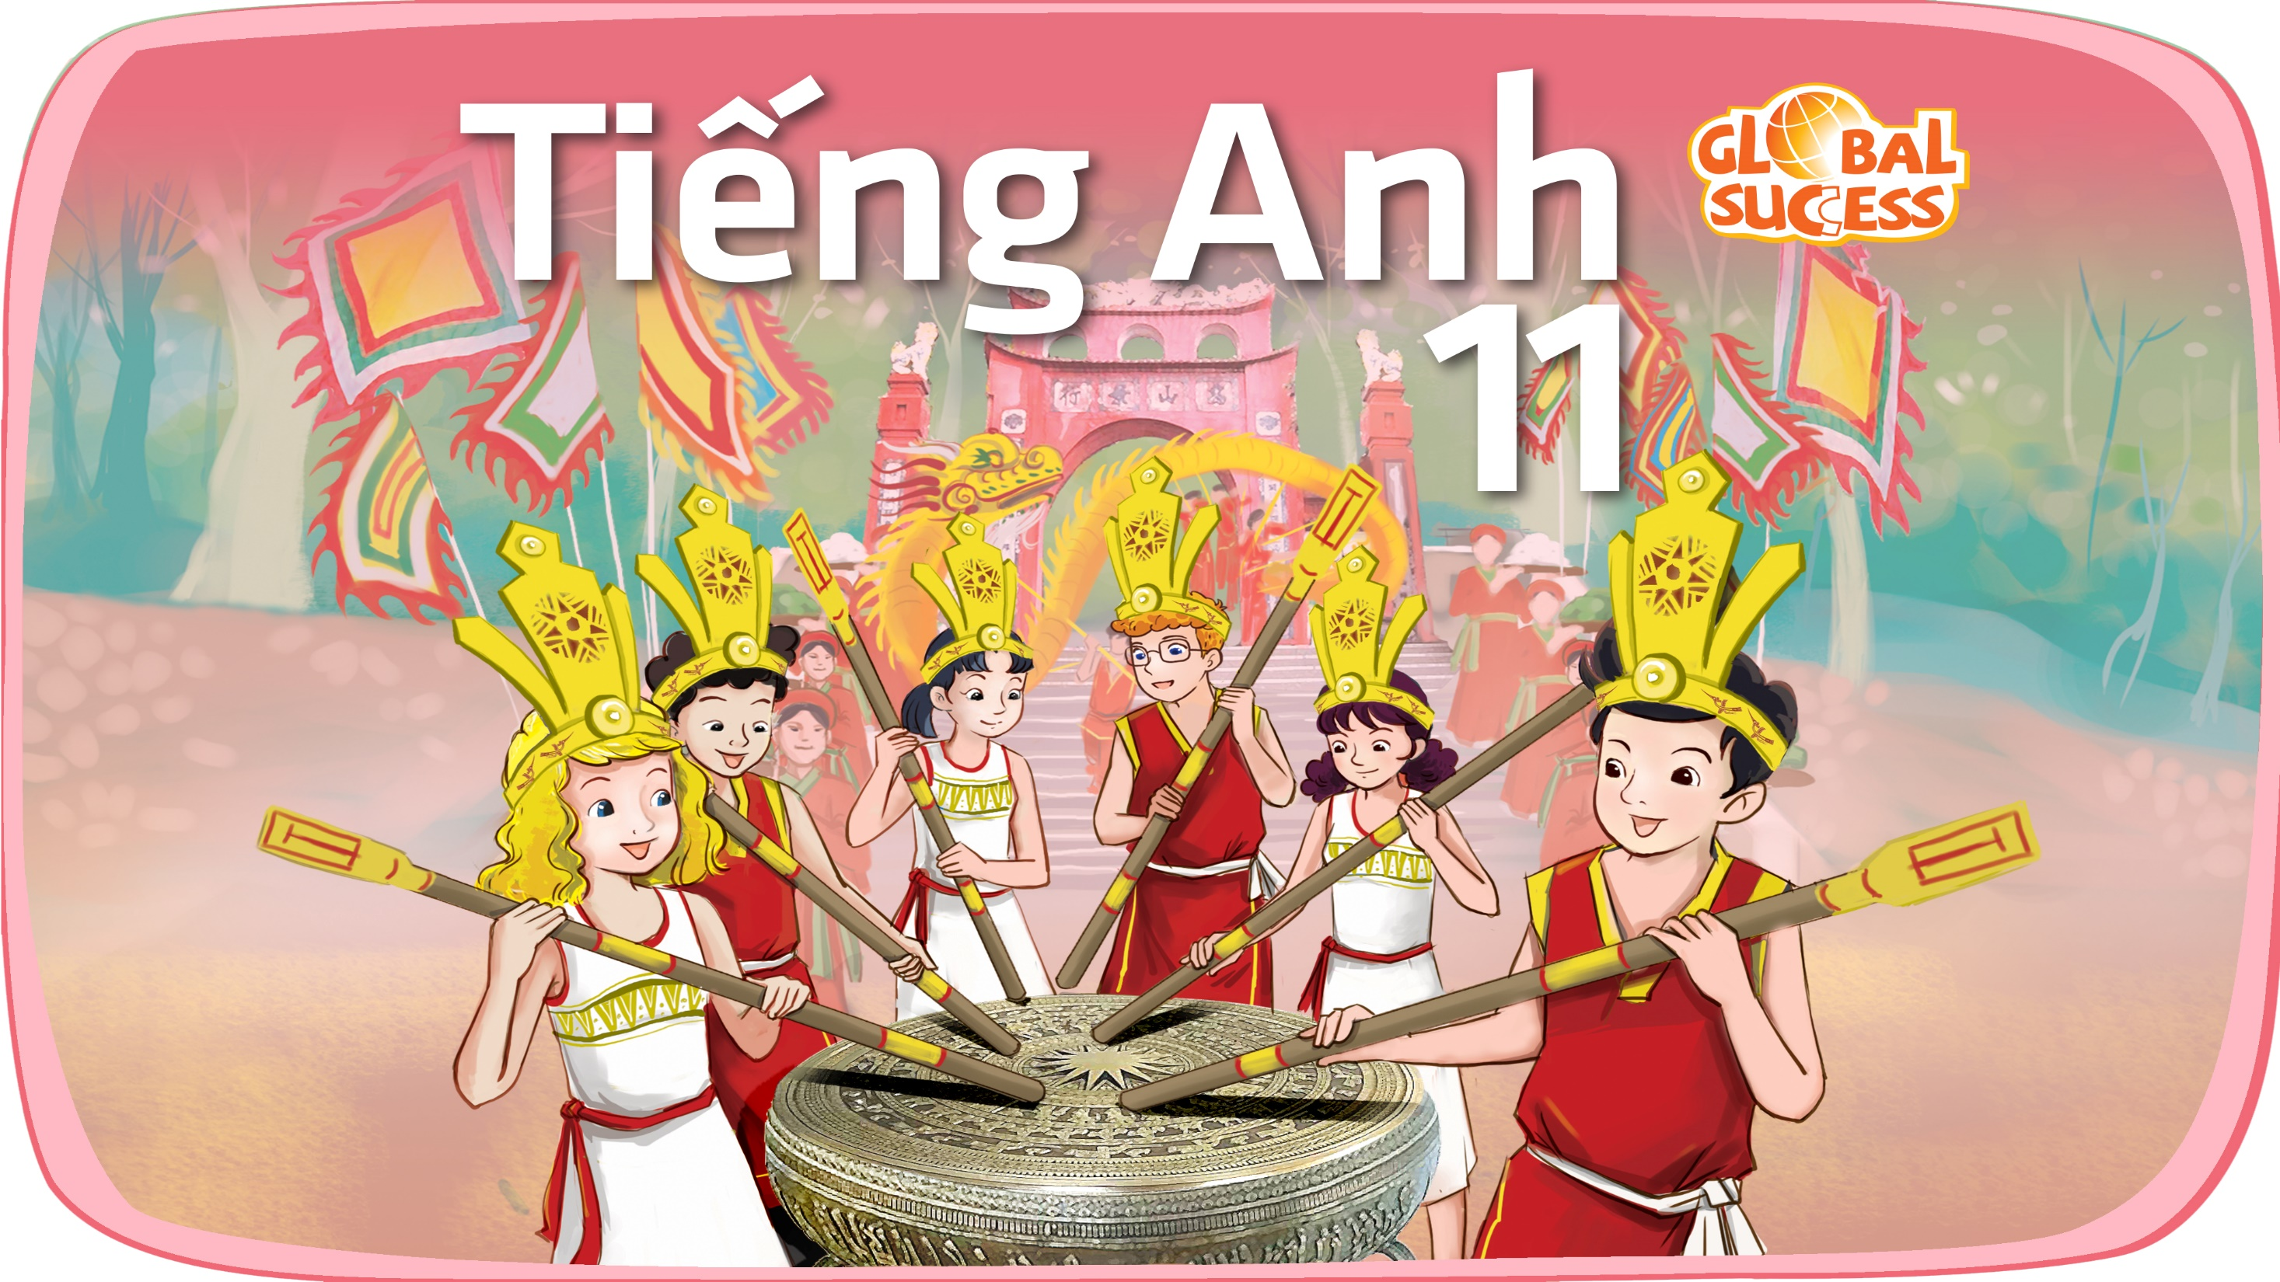

Slide 2
REVIEW
3
(UNITS 6-8)
Unit
FAMILY LIFE
LESSON 3
READING & WRITING

Slide 3
LESSON 3
READING & WRITING
WARM-UP
Game: Guess the music genre
READING
Task 1: Choose the best heading for each paragraph.
Task 2: True or false.
WRITING
Task 1: Discussion.
Task 2: Write an email to the club president asking for more information.
CONSOLIDATION
Wrap up
Homework

Slide 4
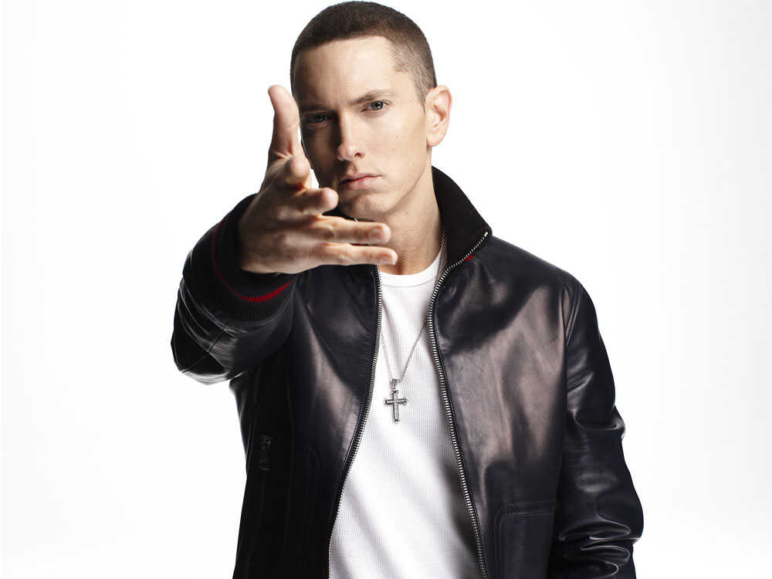
GUESS THE MUSIC GENRE
Hip hop/Rap

Slide 5
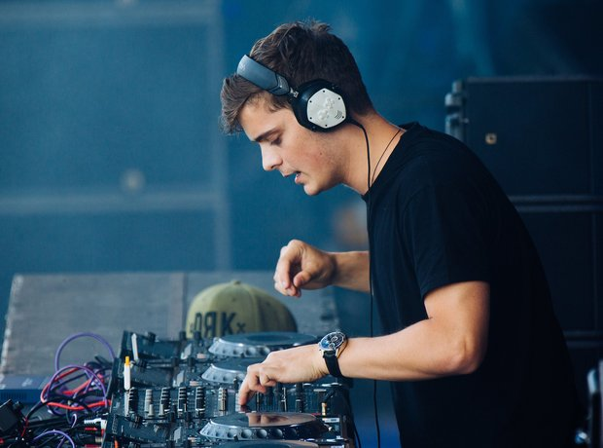
GUESS THE MUSIC GENRE
Electronic dance music (EDM)

Slide 6
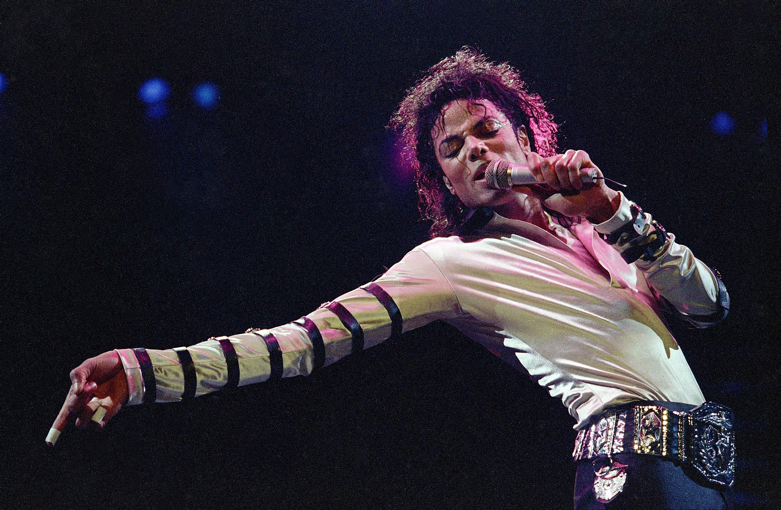
GUESS THE MUSIC GENRE
Pop music

Slide 7
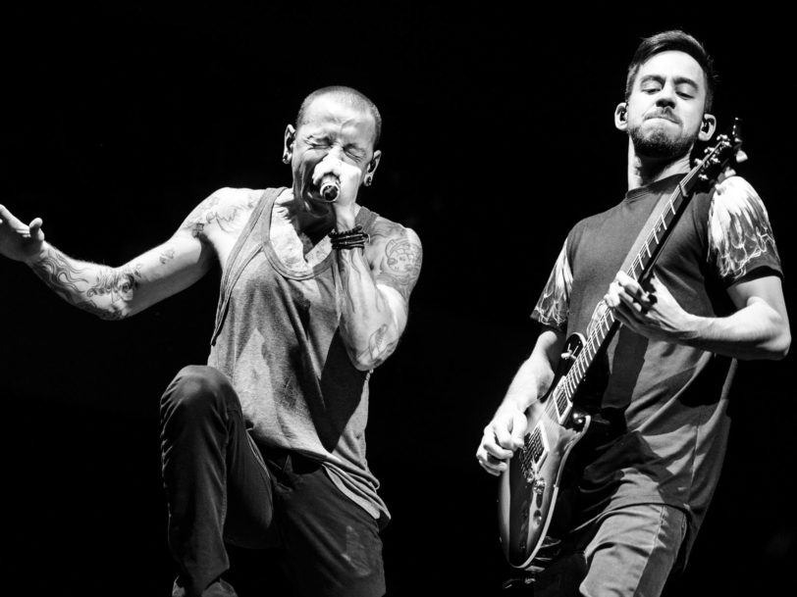
GUESS THE MUSIC GENRE
Rock music

Slide 8
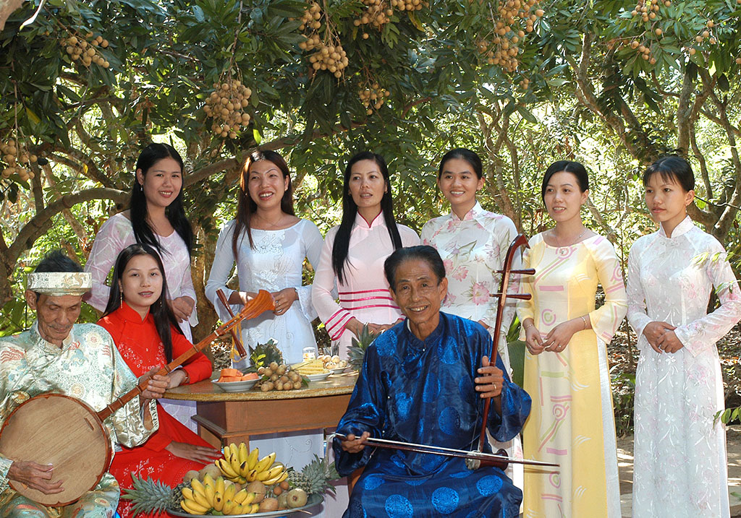
GUESS THE MUSIC GENRE
Don ca tai tu

Slide 9
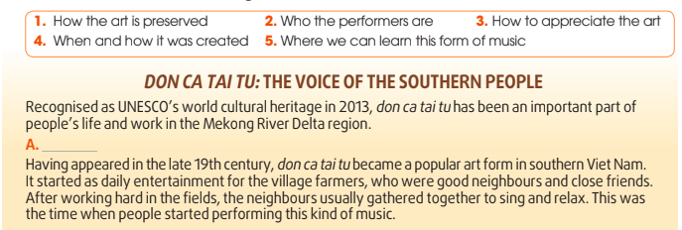
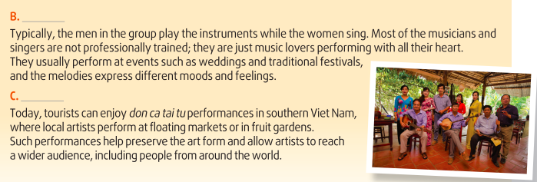
READING
1
Choose the best heading for each paragraph.
Key:
A – 4
B – 2
C – 1

Slide 10

READING
2
Read the text again and decide whether the statements are true (T) or false (F).
 | T | F
Don ca tai tu was added to the UNESCO World Heritage list in 2013.
Don ca tai tu was originally performed at important ceremonies.
All the performers of this art form are well-trained and perform on big stages.
Don ca tai tu can be heard at different events such as weddings and festivals.
Performances of don ca tai tu at floating markets help keep the art alive for future generations.

Slide 11
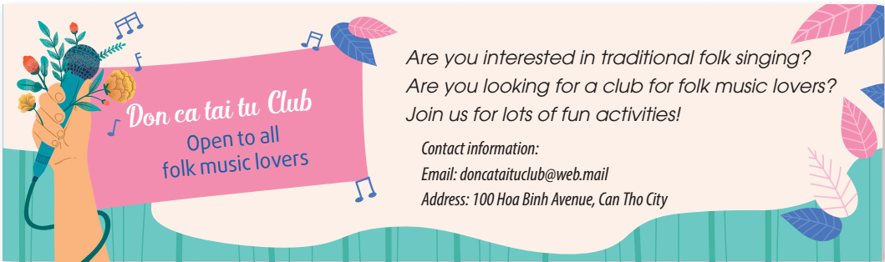
WRITING
1
Work in pairs. Read the advert below and discuss what other information you want to know about how to become a club member.

Slide 12
WRITING
2
Write an email to the club president asking for more information about how to become a club member.
Dear Sir/Madam,
I am writing this email to ask for information about joining the Don ca tai tu Club. I enjoy listening to folk music because it keeps me connected to my past and culture.
First, I would like to know if there is an application form that I need to complete. If not, do you need any other information about me, such as age, school, interests, and musical skills?
Second, I wonder whether there is a club fee. If there is one, how much is it and how often do I need to make payments? Are there any discounts for students?
Finally, I want to know what benefits I will get for my membership. Will I get any training in don ca tai tu singing? Will I get any free tickets to enjoy don ca tai tu performances?
I look forward to hearing from you.
Yours faithfully,
Nguyen Van An

Slide 13
CONSOLIDATION
1
Wrap-up
What have you learnt today?
Practice the skills listening for main ideas and specific information;
Develop ideas for the speaking task and discuss in groups.

Slide 14
CONSOLIDATION
2
Homework
Do exercises in the workbook.
Prepare for Unit 9 – Lesson 1.

Slide 15

Website: hoclieu.vn
Fanpage: facebook.com/tienganhglobalsuccess.vn/

