Slide 1

Hello every one !!!

Slide 2
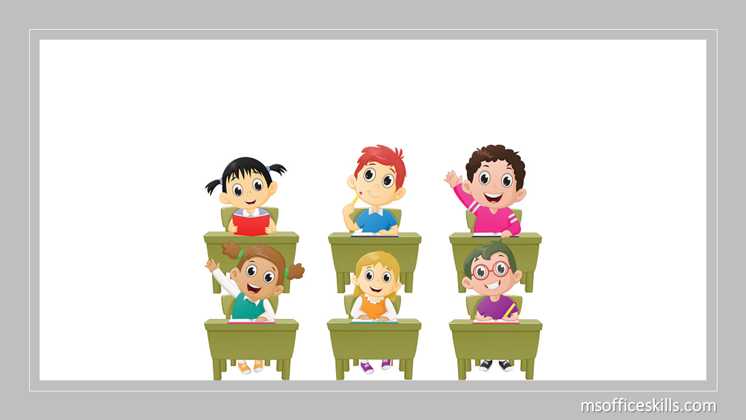
4 GROUPS
Kim’s Game
GAME :

Slide 3

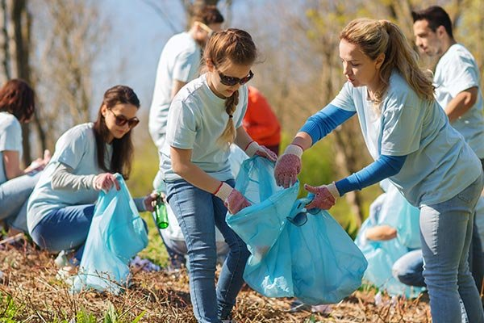
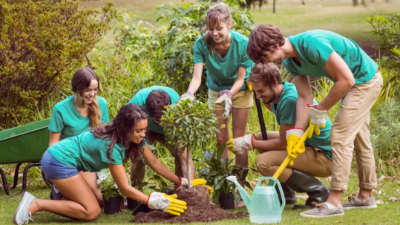

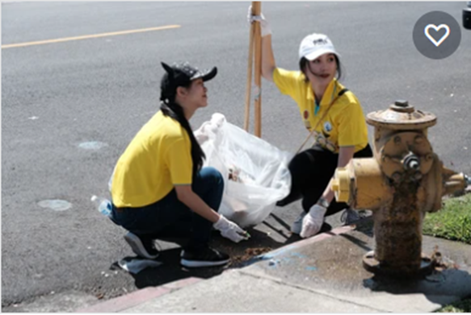
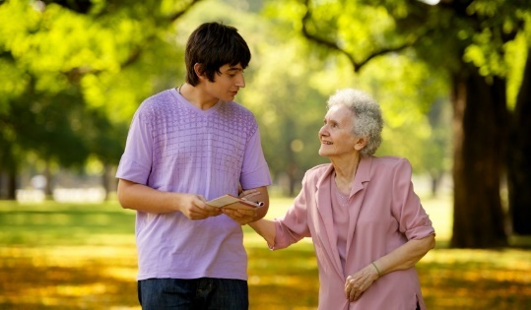
- donating clothes
- collecting
rubbish
- planting trees
Kim’s Game
- cleaning
the street
- tutoring
homeless children
- helping
old people

Slide 4




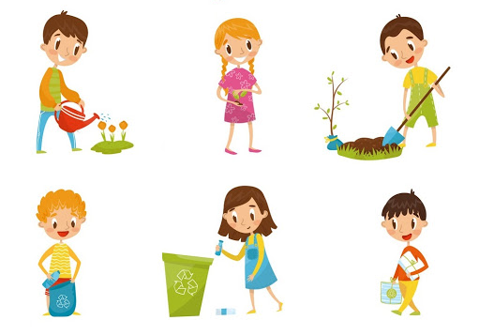
Unit
5
COMMUNITY SERVICE
LESSON 5: SKILLS 1
READING
SPEAKING
Unit
Projects in Bright Future School
What project you can do?

Slide 5

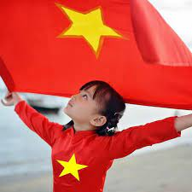
* VOCABULARY
- proud (adj):
/praʊd/
- hài lòng, tự hào

Slide 6

* VOCABULARY
- monthly (adj/adv):
/ˈmʌnθli/
hằng tháng

Slide 7
* VOCABULARY
New words | Pronunciation | Meaning
monthly (adj/adv) | /ˈmʌnθli/ | hằng tháng
proud (adj) | /praʊd/ | hài lòng, tự hào

Slide 8
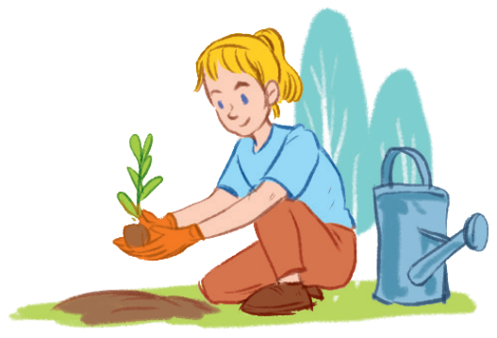
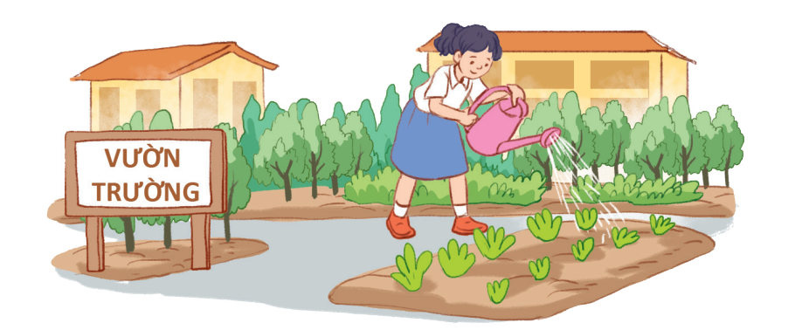
I/ READING
1
Work in pairs. Circle the activities you would like to do at your school.
A. growing vegetables in the school garden
B. tutoring other students
C. collecting books for the school library

Slide 9

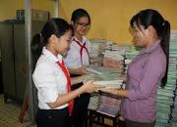
I/ READING
1
Work in pairs. Circle the activities you would like to do at your school.
A. growing vegetables in the school garden
B. tutoring other students
C. collecting books for the school library
* Example:
A: What would you like to do at your school?
B: I would like to grow vegetables in the school garden.

Slide 10
2
Read the passage and match the highlighted words with their meanings.
1. give 2. give and receive 3. every month 4. pleased 5. teach
Bright Future school has many community activities for students. The school believes that a good way for students to develop themselves is through community service. All students can join any of these different projects:
- Tutoring: Upper grade students tutor lower grade students.
- Postcard-to-Help: Students make and sell postcards to raise money for local children.
- Visit-to-Read: Students visit a nursing home monthly and read books to the elderly.
- Garden-to-Give: Students grow vegetables and donate them to local schools.
- Paper-Plant-Exchange: Students collect paper and exchange it for plants. They then look after the plants in their school garden.
Students learn that they can help people and the world around them when they do community service. They feel useful and proud because they do good things.

Slide 11
2
Read the passage and match the highlighted words with their meanings.
1. give
donate
2. give and receive
exchange
3. every month
monthly
4. pleased
proud
5. teach
tutor

Slide 12

3
Read the passage again and tick True or False.
 | True | False
1. Community service allows students to develop themselves.
2. Each student can join only one project.
3. They tutor younger students.
4. Local children receive postcards from the Postcard-to-Help project.
5. Students receive plants when they give paper.

Slide 13
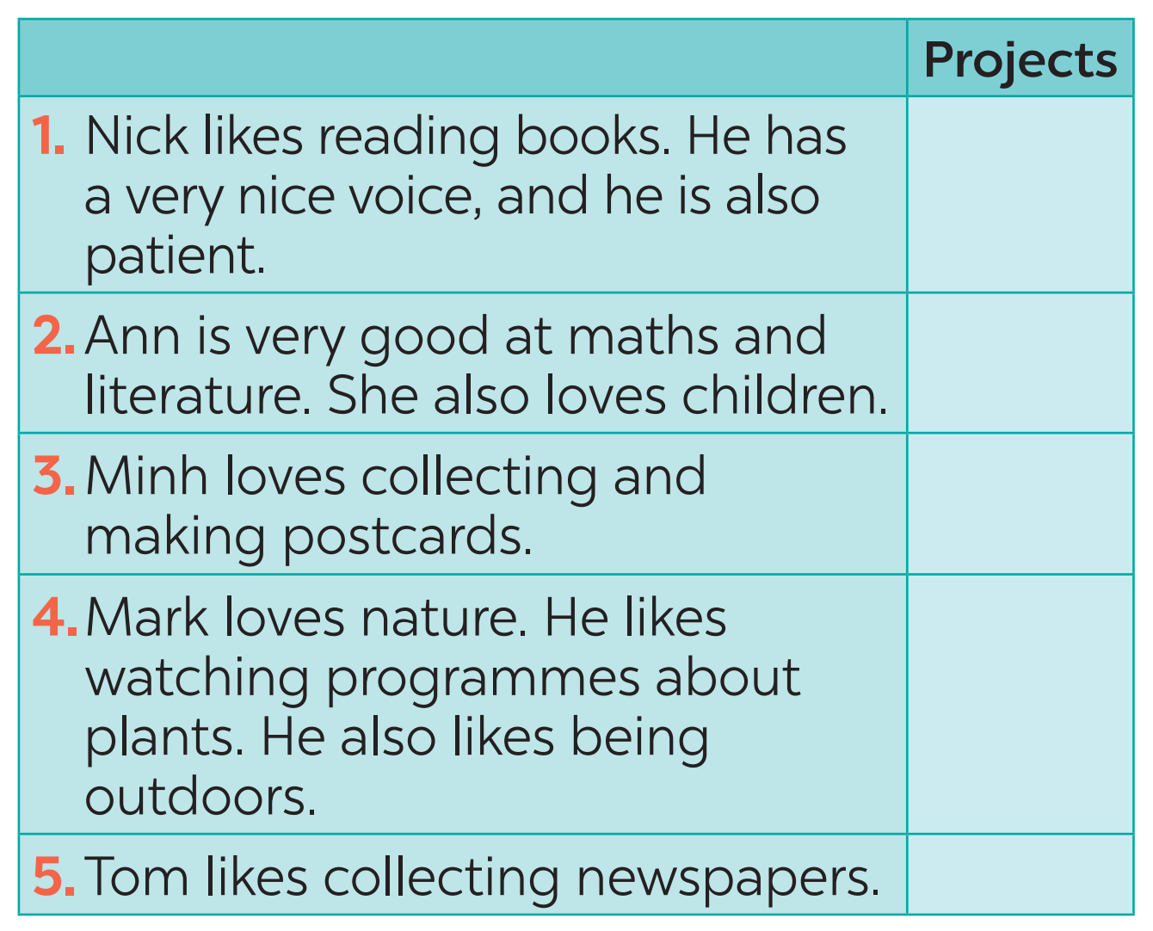
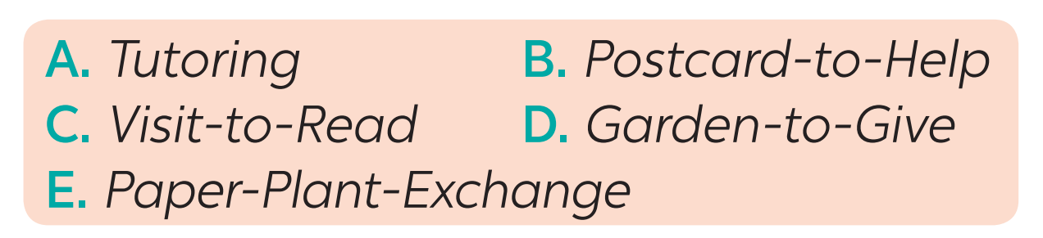
II/ SPEAKING
4
Read about these students. Write the names of the projects you think they should join in the Projects column.
C
A
B
D
E

Slide 14
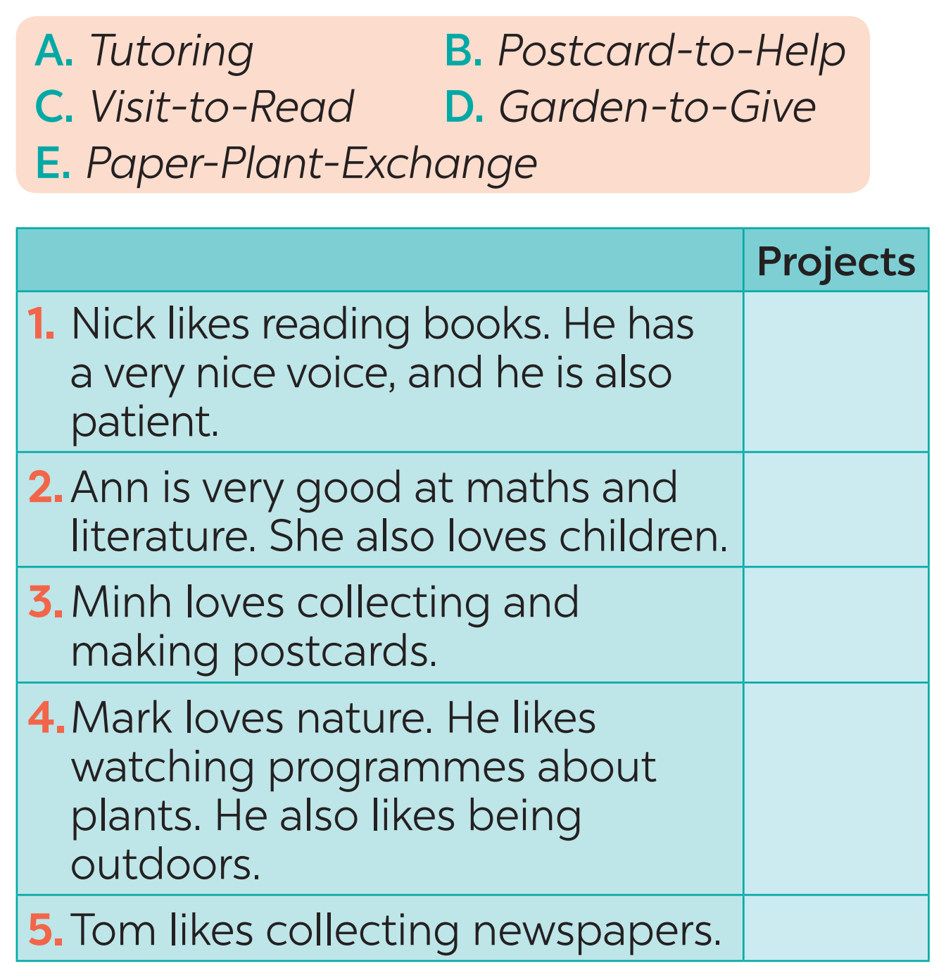
II. SPEAKING
5
Discuss which project in Task 4 you would like to join, and why. Report your group’s answers to the class.
A. Tutoring
B. Postcard-to-Help
C. Visit-to-Read
D. Garden-to-Give
E. Paper-Plant-Exchange
(Dạy kèm)
(Bưu thiếp giúp đỡ)
(Thăm hỏi và đọc sách)
(Khu vườn cho đi)
(Trao đổi cây xanh và giấy)

Slide 15
II. SPEAKING
5
Discuss which project in Task 4 you would like to join, and why. Report your group’s answers to the class.
Example:
Lan will join the Tutoring project because she is good at maths and English. She also loves children.

Slide 16
II. SPEAKING
5
Discuss which project in Task 4 you would like to join, and why. Report your group’s answers to the class.
Example:
Minh will join the Visit-to-Read project because she wants to help elderly people less lonely.

Slide 17
II. SPEAKING
5
Discuss which project in Task 4 you would like to join, and why. Report your group’s answers to the class.
Example:
Linh will join the Postcard-to-Help project because she likes making postcards.

Slide 18
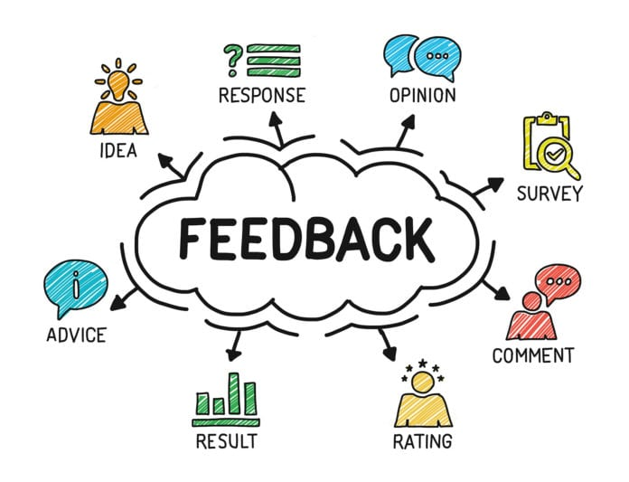
* POST-READING & SPEAKING
Let’s give comments for your friends and vote for the most interesting and informative presentation.

Slide 19
* CONSOLIDATION
1
Wrap-up
READING
SPEAKING
Projects in Bright Future School
What project you can do?

Slide 20


homework
Redo all the exercises.
Prepare SKILLS 2

Slide 21


Thank you!
Goodbye!

