Slide 1



Unit 4: OUR PLANET
Lesson Review

Slide 2



www.phuongnam.edu.vn

Slide 3

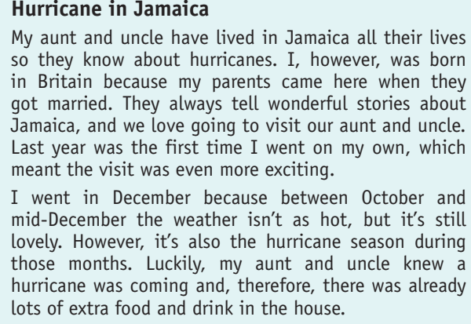



F
T
F
T
www.phuongnam.edu.vn

Slide 4
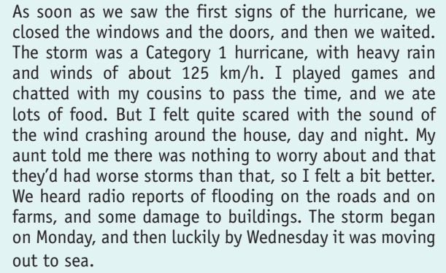
F
F
F
T
www.phuongnam.edu.vn

Slide 5


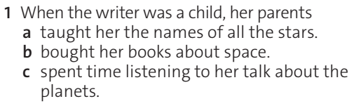

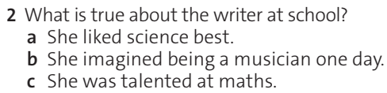
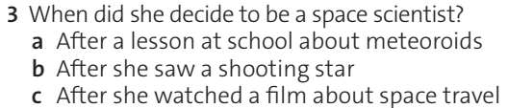
www.phuongnam.edu.vn

Slide 6
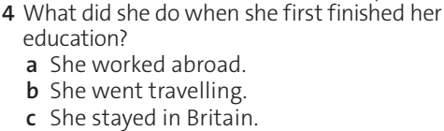
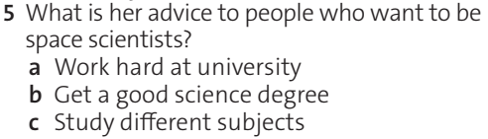
www.phuongnam.edu.vn

Slide 7
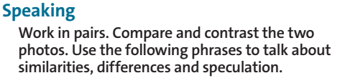
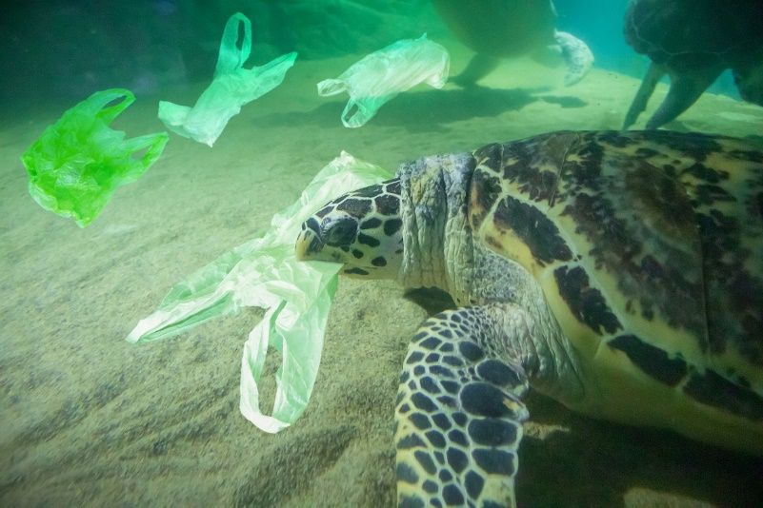
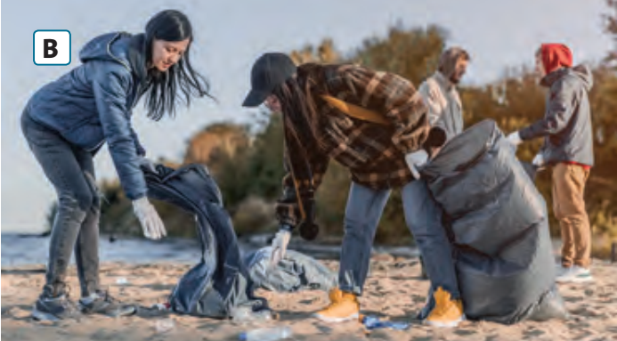
A
The common theme in the photos is…..
It must be…..
Both photos show…..
One obvious difference is…..
Another difference is…..
There may be…..
www.phuongnam.edu.vn

Slide 8
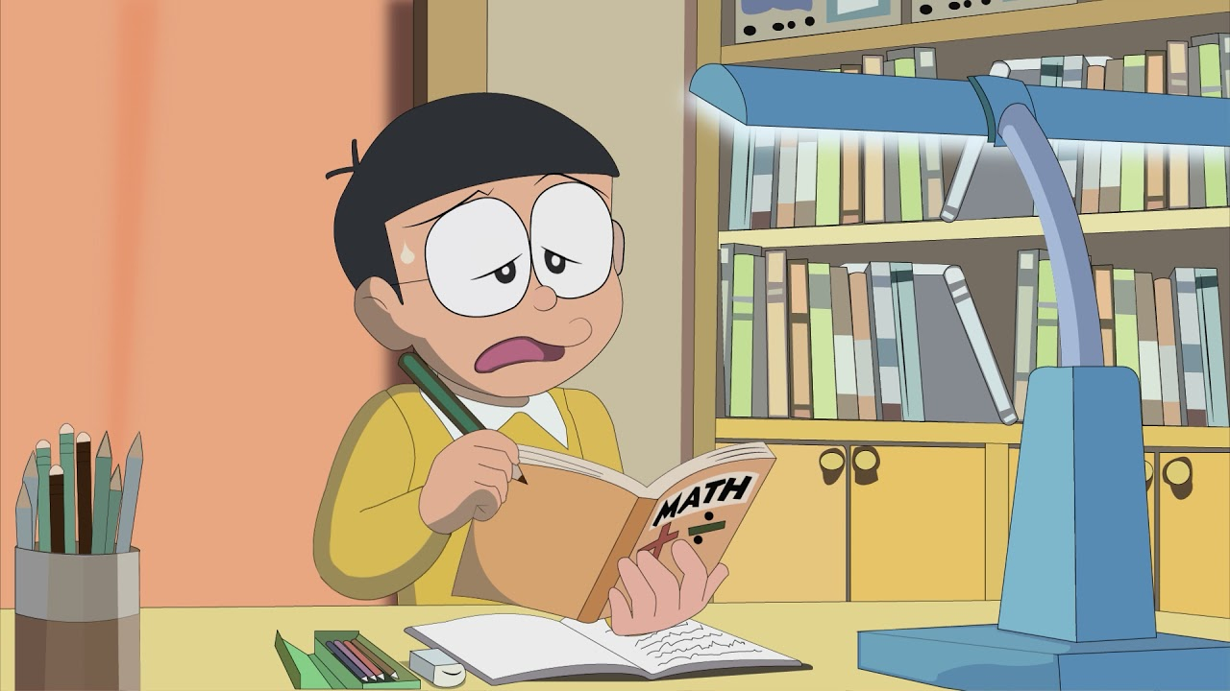
SPEAKING WITH NOBITA
Compare and & contrast the two photos
Talk about differences, similarities and speculation by using following phrases
www.phuongnam.edu.vn

Slide 9

Using the following phrase:
The common theme in the photos is...
A
1. The common theme in the photos is plastics.
www.phuongnam.edu.vn

Slide 10

Using the following phrase:
2. It must be
A
2. It must be left by the people those who came to the beach.
www.phuongnam.edu.vn

Slide 11
Using the following phrase:
3 . Both photos show
A
3. Both photos show that the environment is full of plastics.
www.phuongnam.edu.vn

Slide 12
Using the following phrase:
4. One obvious difference is
A
4. One obvious difference is that A is in the ocean, but B is on the seashore.
www.phuongnam.edu.vn

Slide 13
Using the following phrase:
5. Another difference is
A
5. Another difference is that animals in picture A misunderstand plastic bags as food, and people in picture B are trying to clean up the beach.
www.phuongnam.edu.vn

Slide 14
Using the following phrase:
6. There may be
A
6. There may be positive effect in the future when the oceans are cleaned, and inhabitants are environmentally aware.
www.phuongnam.edu.vn

Slide 15
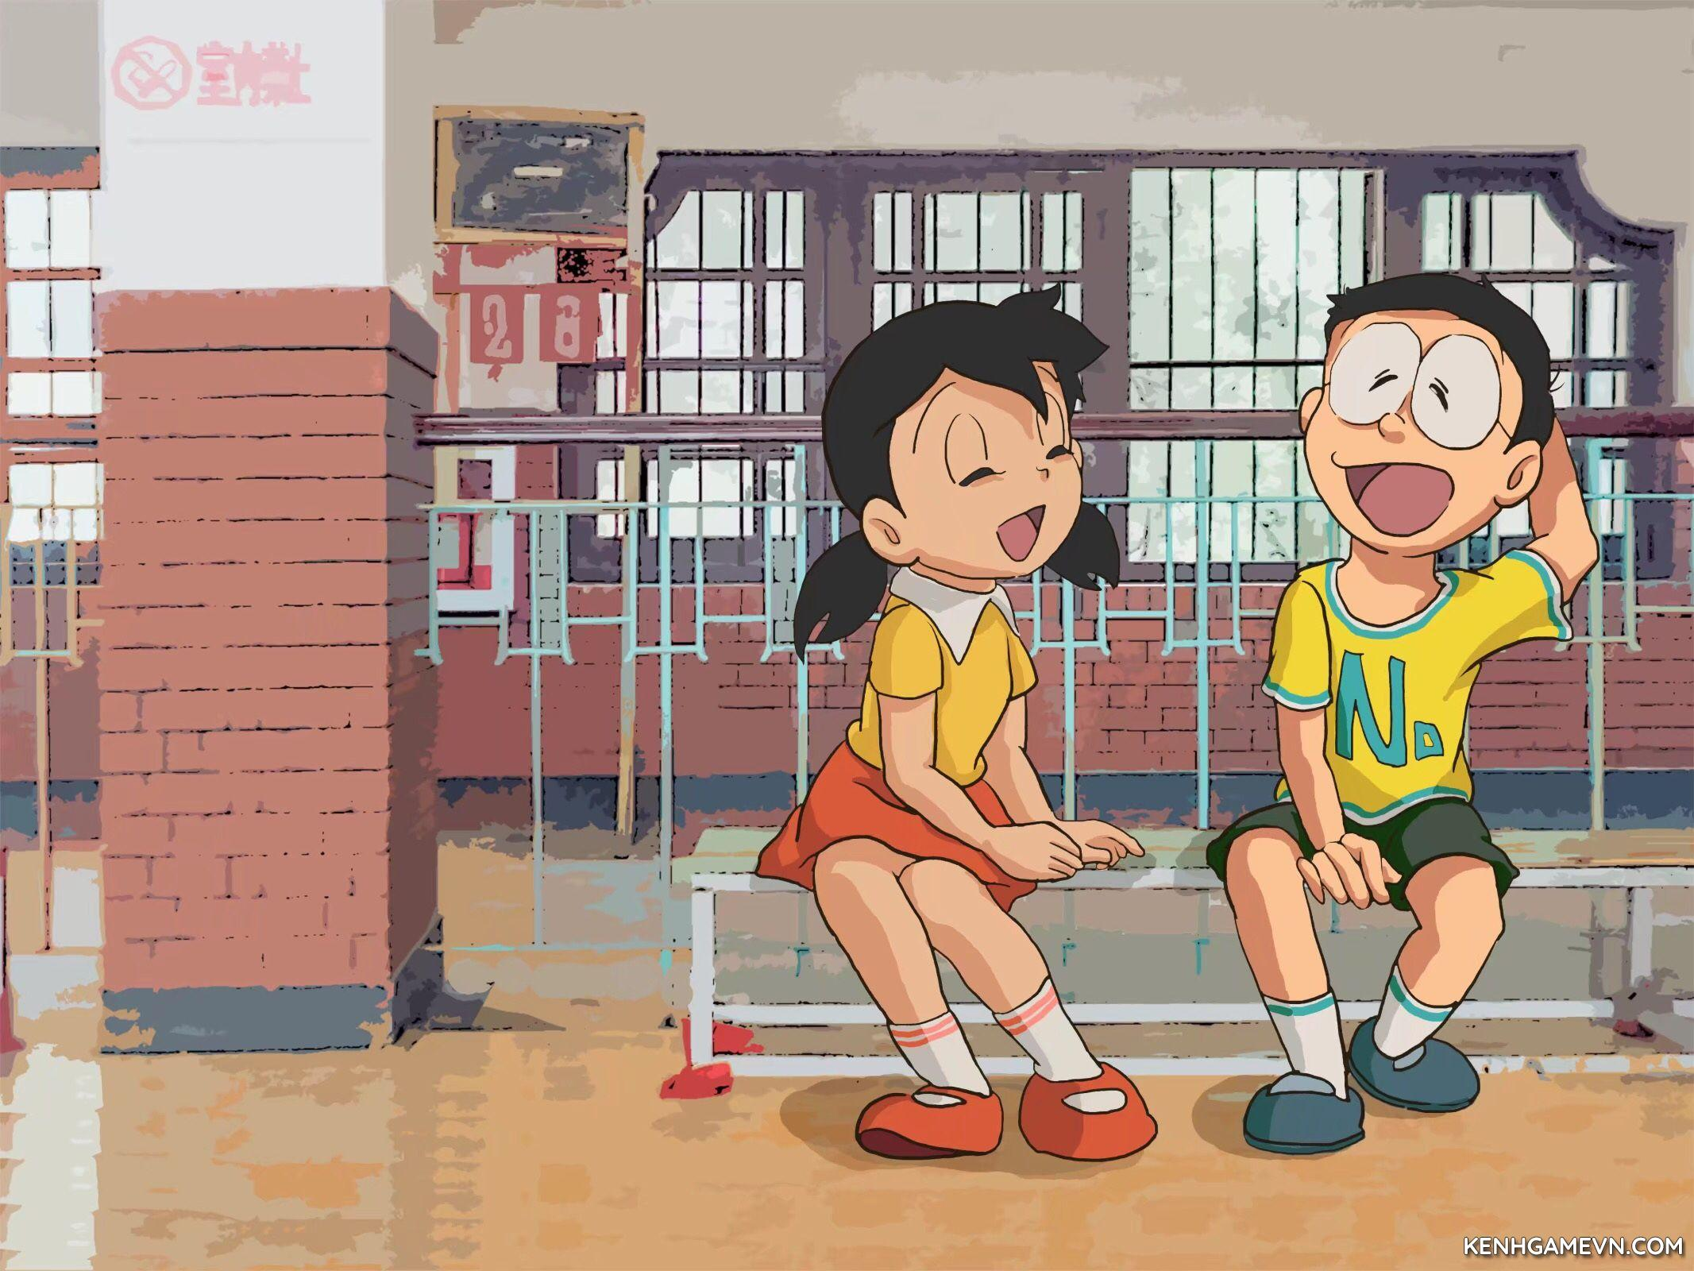
Thanks! I tried my best
Well-done!
www.phuongnam.edu.vn

Slide 16

“Climate change cannot be reversed at all”
Sample:
I completely disagree with this opinion, because I believe that we still have time to reduce the human impact on the Earth's climate.
There are various measures that governments and individuals could take to prevent climate change. Governments could introduce laws to limit the carbon dioxide emissions that lead to global warming, and they could invest in renewable energy production from solar, wind or waterpower. As individuals, we should also try to limit our contribution to climate change, by flying less, and by using bicycles and public transport.
If we simply try to live with climate change, I believe that the consequences will be disastrous. For example, millions of people would be displaced by flooding. These people would lose their homes and their jobs, and they would be forced to migrate to nearby cities or other countries. Disease, famine, as well as homelessness and poverty are inevitable.
In conclusion, climate change can be reversed in the future if we act immediately.
www.phuongnam.edu.vn

Slide 17
Homework
 Learn by heart all the new words.
 Prepare for next lesson – grammar: Past simple affirmative.
www.phuongnam.edu.vn

Slide 18

www.phuongnam.edu.vn

Slide 19



Thank you!
CTCP ĐẦU TƯ VÀ PHÁT TRIỂN GIÁO DỤC PHƯƠNG NAM

