Slide 1

Unit 6: Be green
Progress Check
Page 108

Slide 2
Lesson Outline
Vocabulary
Grammar
Listening

Slide 3
Objectives
By the end of this lesson, students will be able to…
to test/consolidate vocabulary and grammar learnt throughout the unit.
to listen for key information.

Slide 4

WARM-UP

Slide 5
Choose the word whose underlined part is pronounced from that of the others. Practise saying them.
1. A. sight B. kite C. lips D. signs
/saɪt/ /kaɪt/ /lɪps/ /saɪz/
2. A. spot B. core C. box D. pot
/spɒt/ /kɔːr/ /bɒks/ /pɒt/
3. A. managed B. reduced C. reused D. installed
/ˈmænɪdʒd/ /rɪˈdʒuːst/ /ˌriːˈjuːzd/ /ɪnˈstɔːld/

Slide 6
Choose the word whose main stress is placed differently from that of the others. Practise saying them.
1. A. encourage B. recycle C. organise D. preserve
/ɪnˈkʌrɪdʒ/ /ˌriːˈsaɪkəl/ /ˈɔːɡənaɪz/ /prɪˈzɜːv/
2. A. litter B. raincoat C. campsite D. idea
/ˈlɪtər/ /ˈreɪŋkəʊt/ /ˈkæmpsaɪt/ /aɪˈdɪə/
3. A. volunteer B. holiday C. engineer D. magazine
/ˌvɒlənˈtɪər/ /ˈhɒlədeɪ/ /ˌendʒɪˈnɪər/ /ˌmæɡəˈziːn/

Slide 7

It’s time to learn …

Slide 8
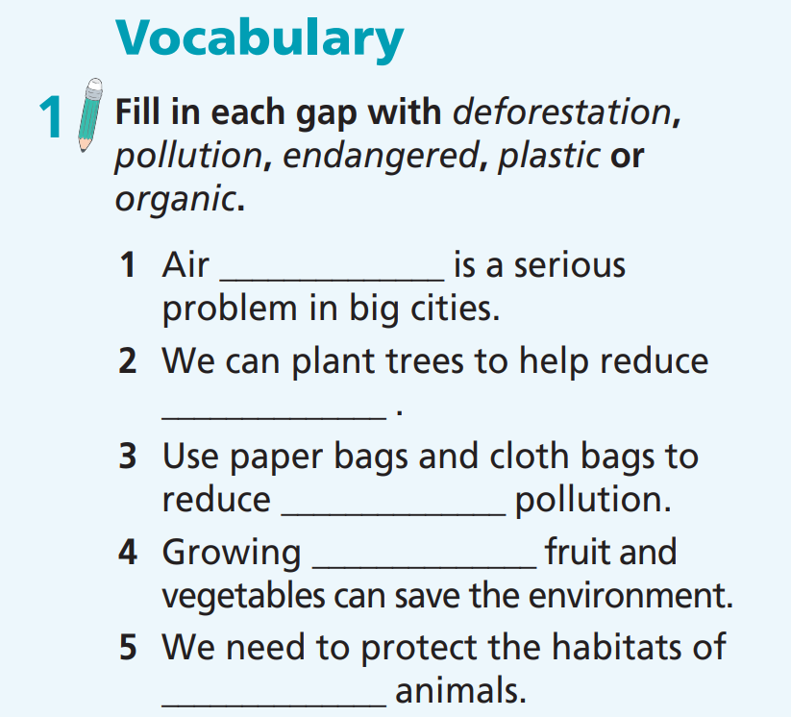
First, decide on the suitable form of words.
VOCABULARY
noun
noun
noun
adj
adj

Slide 9
VOCABULARY
pollution
deforestation
plastic
organic
endangered

Slide 10
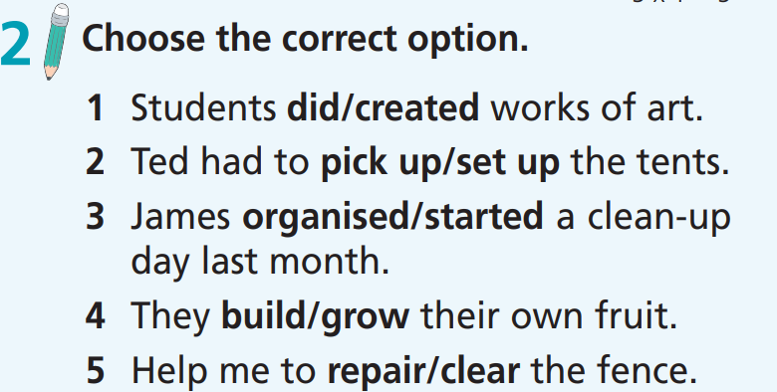
VOCABULARY

Slide 11

GRAMMAR
1. We’re not going to the park because/so it’s cold.
2. We should walk but/or we should ride our bikes to school.
3. He’s tired. Although/However, he won’t stop.
4. I will plant trees so/and you will pick up litter.
5. We can give our old toys to children in hospital, so/and they will feel happy.
6. He arrived late although/however he left early.
7. He wanted to help the community, so/because he joined a recycling club.
8. They couldn’t pick up all the litter, because/so we helped them.

Slide 12

GRAMMAR
1. They cut/are cutting down thousands of trees every week.
2. Millions of people visit/visited the forest every year.
3. They didn’t collect/won’t collect the rubbish last night.
4. We took/are taking part in the clean-up day last Sunday.
5. I’m volunteering/volunteered at a national park next summer.

Slide 13

GRAMMAR
1 John ____________ (work) at the animal shelter two years ago.
2 Sally ____________ (go) to the food bank last Monday.
3 This restaurant usually ____________(prepare) meals for the homeless.
4 John ____________ (plant) trees now.
5 Anita ____________ (give) her toys to kids in the local hospital next Monday.
worked
went
prepares
is planting
is giving

Slide 14
LISTENING
Read the instruction carefully and underline they key words
Listen to some information about Earth Day at a secondary school. For questions (1-4), choose the correct answer (A, B or C).
1. When is the school going to celebrate Earth Day?
A. on Friday B. on Saturday C. all weekend
2. When will Earth Day activities start?
A. at 9:00 B. at noon C. at 1:30
3. Who is Brian Howard?
A. an art teacher B. a weather forecaster C. a scientist on the TV
4. What don’t the students need to bring?
A. work gloves B. plastic bottles C. glue

Slide 15

LISTENING
Now listen choose the correct answer.  FIRST TIME
☞ YOUR ANSWER?
Listen to some information about Earth Day at a secondary school. For questions (1-4), choose the correct answer (A, B or C).
1. When is the school going to celebrate Earth Day?
A. on Friday B. on Saturday C. all weekend
2. When will Earth Day activities start?
A. at 9:00 B. at noon C. at 1:30
3. Who is Brian Howard?
A. an art teacher B. a weather forecaster C. a scientist on the TV
4. What don’t the students need to bring?
A. work gloves B. plastic bottles C. glue
☞ WHY?

Slide 16
While - listening
Now listen again and check.  SECOND TIME
While you are listening, focus on what the speaker says.
This Saturday 22nd April is Earth Day and we’re going to celebrate it – but you don’t have to come to school at the weekend! On Friday, we’ll have classes as usual from 9 a.m.,. but we’ll stop at noon to do Earth Day activities!
☞ THE ANSWER IS …
1. When is the school going to celebrate Earth Day?
A. on Friday B. on Saturday C. all weekend

Slide 17
While - listening
Now listen again and check.  SECOND TIME
While you are listening, focus on what the speaker says.
This Saturday 22nd April is Earth Day and we’re going to celebrate it – but you don’t have to come to school at the weekend! On Friday, we’ll have classes as usual from 9 a.m.,. but we’ll stop at noon to do Earth Day activities!
☞ THE ANSWER IS …
2. When will Earth Day activities start?
A. at 9:00 B. at noon C. at 1:30

Slide 18
While - listening
Now listen again and check.  SECOND TIME
While you are listening, focus on what the speaker says.
Then, at around 1:30, we’re going to hear a talk on global warming from the TV weather forecaster, Brian Howard.
☞ THE ANSWER IS …
3. Who is Brian Howard?
A. an art teacher B. a weather forecaster C. a scientist on the TV

Slide 19
While - listening
Now listen again and check.  SECOND TIME
While you are listening, focus on what the speaker says.
For the tree planting, please bring a pair of work gloves and for the art class bring empty plastic bottles. Ms Jenkins will supply glue and any other materials you might need.
☞ THE ANSWER IS …
4. What don’t the students need to bring?
A. work gloves B. plastic bottles C. glue

Slide 20
Extra Task
Listen and decide if the statements are True/False.
First, underline the key words.
The speaker, Mr Franklin, is the headmaster.
The Earth Day is not going to be celebrated at the school.
Brian Howard is going to teach the students how to plant trees.
The students are going to make art from plastic bottles.

Slide 21
Extra Task
Now listen and decide if the statements are True/False.  FIRST TIME
☞ YOUR ANSWER?
1. The speaker, Mr Franklin, is the headmaster.
T
2. The Earth Day is not going to be celebrated at the school.
F
3. Brian Howard is going to teach the students how to plant trees.
F
4. The students are going to make art from plastic bottles.
T
☞ WHY?

Slide 22
While - listening
Now listen again and check.  SECOND TIME
While you are listening, focus on what the speaker says.
Good morning, students. This is your headmaster, Mr Franklin, speaking.
☞ THE ANSWER IS …
1. The speaker, Mr Franklin, is the headmaster.
T

Slide 23
While - listening
Now listen again and check.  SECOND TIME
While you are listening, focus on what the speaker says.
This Saturday 22nd April is Earth Day and we’re going to celebrate it – but you don’t have to come to school at the weekend! On Friday, we’ll have classes as usual from 9 a.m., but we’ll stop at noon to do Earth Day activities!
☞ THE ANSWER IS …
F
2. The Earth Day is not going to be celebrated at the school.

Slide 24
While - listening
Now listen again and check.  SECOND TIME
While you are listening, focus on what the speaker says.
Then, at around 1:30, we’re going to hear a talk on global warming from the TV weather forecaster, Brian Howard. And finally, Ms Jenkins is going to teach us how to make art from recycled materials.
☞ THE ANSWER IS …
3. Brian Howard is going to teach the students how to plant trees.
F

Slide 25
While - listening
Now listen again and check.  SECOND TIME
While you are listening, focus on what the speaker says.
For the tree planting, please bring a pair of work gloves, and for the art class bring empty plastic bottles.
☞ THE ANSWER IS …
4. The students are going to make art from plastic bottles.
T

Slide 26

WRAP-UP

Slide 27
Today’s lesson
To test/consolidate vocabulary and grammar learnt throughout the unit.
To listen for key information.

Slide 28
Homework
Prepare the next lesson (page 109 SB).
Do Unit 6 Test 2 in Bài Tập Bổ Trợ TA 7 Right On (pages 54 & 55).
Do Semester 2 Test in TA 7 Right On Notebook (pages 58 & 59).

Slide 29
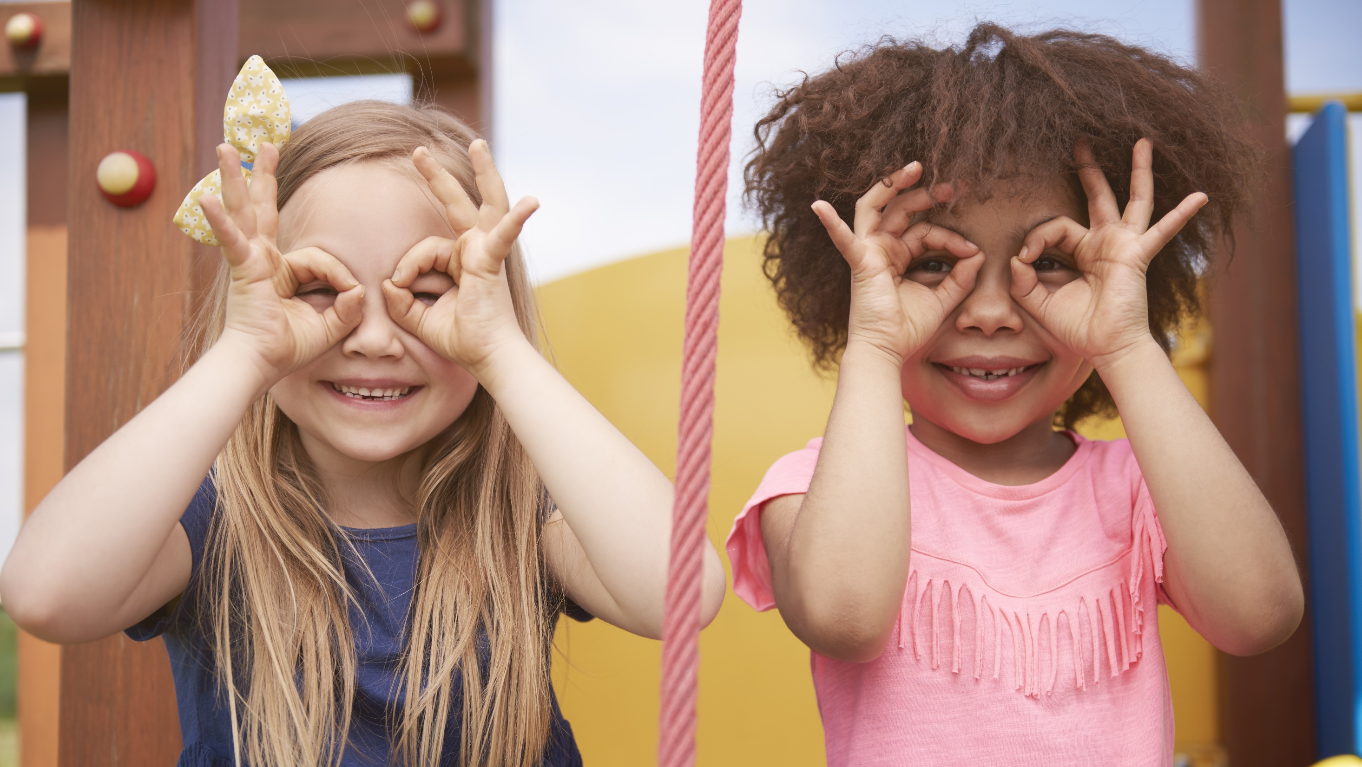
Enjoy your day!

