Slide 1


Teacher :

Slide 2

Kim’s Game
Height left
Fill weight record
Male measure took
Check- up female

Slide 3

Unit 11: Keep fit, stay healthy
Period 68 Lesson 3:
B- What was wrong with you?
(B1 page 110)

Slide 4
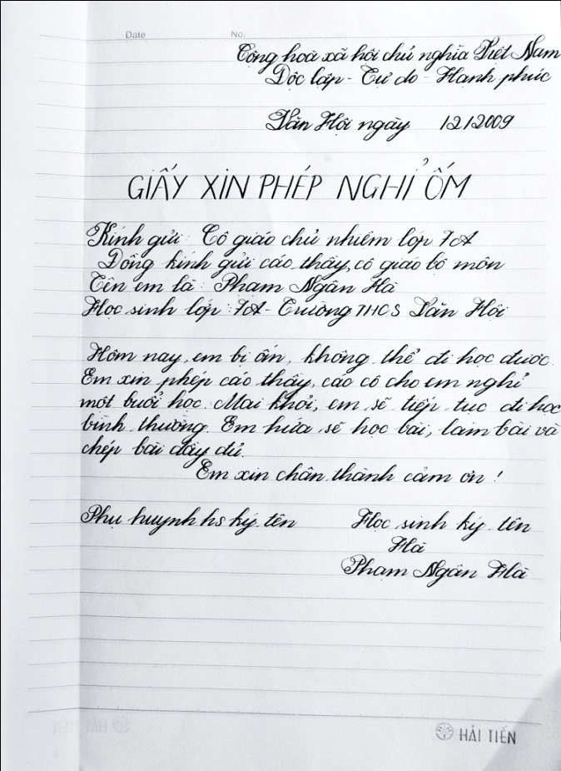
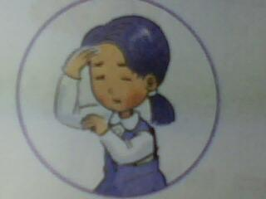
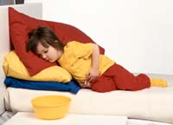
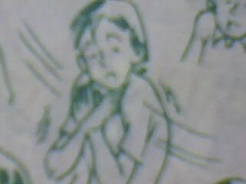
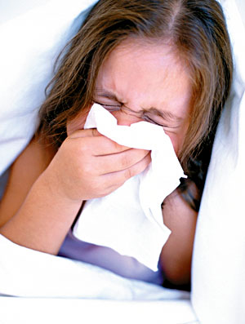
Unit 11: Keep fit, stay healthy
Lesson 3: B - What was wrong with you?- B1
i: pre-reading
1/ New words:
sick note (n) :
Giấy phép nghỉ ốm
headache (n) :
Đau đầu
cold (n) :
Cảm lạnh
virus (n) :
vi rút
flu (n) :
cúm
stomachache (n) :
đau dạ dày

Slide 5
Unit 11: Keep fit, stay healthy
Lesson 3: B - What was wrong with you?- B1
1/ New words:
*Matching:
A
B
1. cold a. đau đầu
2. virus b. cúm
3. sick note c. cảm lạnh
4. Headache d. vi rút
5. Flu e. giấy phép xinnghỉ học
6.Stomachache f. đau dạ dày

Slide 6

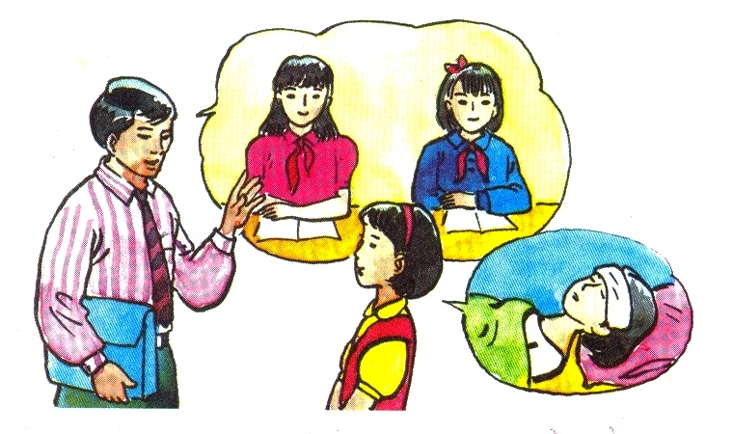
Mr Tan
Lan
Lan and Mr Tan are talking about the reason Lan was absent from class yesterday.

Slide 7
Unit 11: Keep fit, stay healthy
Lesson 3: B - What was wrong with you?- B1
i: pre-reading
2/ True/ false statement prediction:
T
Lan had a bad cold yesterday
Her mother wrote a sick note for her
She is very well today
She should stay in class at recess
F
F
T

Slide 8
Unit 11: Keep fit, stay healthy
Lesson 3: B - What was wrong with you?- B1
Read :
Mr. Tan : Where were you yesterday, Lan? You didn’t come to school.
Lan : I had a bad cold. I had a headache, too.
Mr. Tan : Oh, dear! You were sick. How do you feel now?
Lan : I feel OK, but I’m a little tired.
Mr. Tan : Oh, you should stay inside at recess. The weather’s awful
today. Did your Mom write a sick note for you?
Lan : No, she didn’t. But I have this note from the doctor.
Mr. Tan : That’ll be fine. Oh, I see. You had a virus.
I hope you will be OK.
Lan : Thank you.
Mr Tan
Lan

Slide 9
Unit 11: Keep fit, stay healthy
Lesson 3: B - What was wrong with you?- B1
II: WHILE- READING
2/ Answer the questions
What didn’t Lan go to school yesterday?
What was wrong with her?
What does Mr. Tan tell Lan to do?
What did the doctor say about Lan's problems?
Who wrote Lan's sick note?
Because she had a bad cold.
She had a headache.
Mr .Tan told her to stay inside at recess.
The doctor said that Lan had a virus.
The doctor wrote Lan’s sick note.

Slide 10
Unit 11: Keep fit, stay healthy
Lesson 3: B - What was wrong with you?- B1
Iii: post-reading
GAME: NOUGHTS & CROSSES
Ex:
A: what was wrong with you?
B: I had a cold
YOU/
A COLD
HANH/
A VIRUS
LAN/
TOOTHACHE
DAT/
HEADACHE
LINH/
FLU
THANG/
RUNNY NOSE
HIEN/
EARACHE
THANH/
A COLD
TAM/
STOMACHACHE

Slide 11

Unit 11: Keep fit, stay healthy
Lesson 3: B - What was wrong with you?- B1
structure
What was wrong with you?
=> I had a cold

Slide 12

Unit 11: Keep fit, stay healthy
Lesson 3: B - What was wrong with you?- B1
Homework
- learn by heart the new words
- make 10 examples with structure “ what were wrong with you?”
- prepare for new lesson

Slide 13

Thank you for your attention!

