Slide 2



REVIEW
3
UNITS 7 – 8 – 9
LESSON 2: SKILLS
1

Slide 3
LESSON 2: SKILLS
LESSON 1: GETTING STARTED
Board Race
WARM-UP
READING
Task 1: Read the following passage and choose the correct answer A, B, C, or D to each question.
Task 2: Work in pairs. Look at the list of the natural wonders below. Rank them from 1 (most interesting) to 5 (least
interesting), based on how interesting the places are for you.
SPEAKING
LISTENING
Task 3: Listen to the passage and fill in each blank with no more than TWO words.
WRITING
Task 4: Make sentences using the words and phrases given.
CONSOLIDATION
Wrap-up
Homework

Slide 4
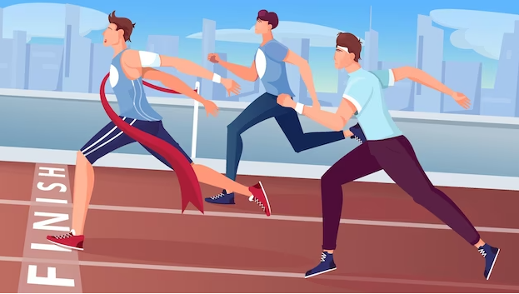
WARM-UP
BOARD RACE
- Work in teams.
- One students from each team comes to the board.
- Teacher asks a question
- The first person to write the correct answer on the board wins a point for their team. (The students at the board only get one try)
- If they all miss the question, teacher takes the answer from the first person in the audience who raises their hand.

Slide 5


WARM-UP
the printed papers
HARD COPY
Notes:
hard copy (n): the printed papers
revise (v): to change something, such as a book or an estimate, in order to correct or improve it
dictionary (n): a book or electronic resource that gives a list of the words of a language in alphabetical order and explains what they mean, or gives a word for them in a foreign language
phrase (n): a group of words that is part of, rather than the whole of, a sentence

Slide 6

WARM-UP
to change something, such as a book or an estimate, in order to correct or improve it
REVISE
Notes:
hard copy (n): the printed papers
revise (v): to change something, such as a book or an estimate, in order to correct or improve it
dictionary (n): a book or electronic resource that gives a list of the words of a language in alphabetical order and explains what they mean, or gives a word for them in a foreign language
phrase (n): a group of words that is part of, rather than the whole of, a sentence

Slide 7

WARM-UP
a book or electronic resource that gives a list of the words of a language in alphabetical order and explains what they mean, or gives a word for them in a foreign language
DICTIONARY
Notes:
hard copy (n): the printed papers
revise (v): to change something, such as a book or an estimate, in order to correct or improve it
dictionary (n): a book or electronic resource that gives a list of the words of a language in alphabetical order and explains what they mean, or gives a word for them in a foreign language
phrase (n): a group of words that is part of, rather than the whole of, a sentence

Slide 8

WARM-UP
a group of words that is part of, rather than the whole of, a sentence
PHRASE
Notes:
hard copy (n): the printed papers
revise (v): to change something, such as a book or an estimate, in order to correct or improve it
dictionary (n): a book or electronic resource that gives a list of the words of a language in alphabetical order and explains what they mean, or gives a word for them in a foreign language
phrase (n): a group of words that is part of, rather than the whole of, a sentence

Slide 9
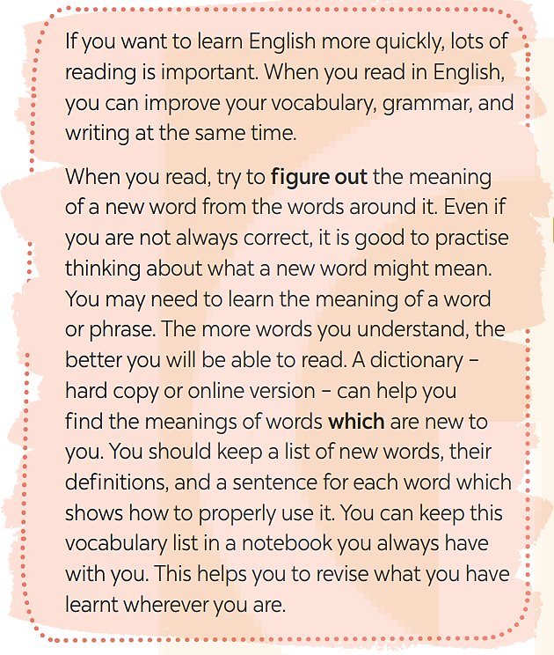

READING
1
Read the following passage and choose the correct answer A, B, C, or D
to each question.

Slide 10
READING
1
Read the following passage and choose the correct answer A, B, C, or D
to each question.
1. What skill can you improve when you read in English?
A. Social. B. Speaking.
C. Writing. D. Listening.
2. The phrase ‘figure out’ in the passage probably means ______.
A. understand B. try out
C. look up D. use
Notes:
1. C 2. A 3. B 4. D 5. D

Slide 11
READING
1
Read the following passage and choose the correct answer A, B, C, or D
to each question.
3. You can guess the meaning of a new word from the ______.
A. phrase B. context
C. grammar D. notebook
4. The word ‘which’ in the passage refers to ______.
A. dictionary B. copy
C. meanings D. words
5. The writer’s advice for English readers is to ______.
A. buy a dictionary C. show how to use words
B. find new words D. keep a vocabulary list
Notes:
1. C 2. A 3. B 4. D 5. D

Slide 12

SPEAKING
2
Work in pairs. Look at the list of the natural wonders below. Rank them
from 1 (most interesting) to 5 (least interesting), based on how interesting the places are for you.
– The Amazon Rainforest
– The Sahara Desert
– The Galápagos Islands
– Ha Long Bay
– Mount Everest
What place would you like to visit most,
and why?

Slide 13

LISTENING
3
Listen to the passage and fill in each blank with no more than TWO words.
some tips
1. There are _____________ for travellers to the Galápagos Islands.
2. Travellers can’t bring any food or live _____________ to the islands.
3. Travellers mustn’t litter on the islands or _____________ into the ocean.
4. Visitors shouldn’t buy souvenirs made from animals or _____________ from the islands.
5. Visitors can help _____________ this natural wonder of the world.
material
throw rubbish
plants
preserve
Notes:
1. some tips 2. material 3. throw rubbish
4. plants 5. preserve

Slide 14
WRITING
4
Make sentences using the words and phrases given.
1. village / nearly inaccessible / by cars / rainy days / .
________________________________
2. what countries / people / speak English / first language / ?
________________________________
3. should learn / speak English / fluently / a native speaker / .
________________________________
The village is nearly inaccessible by cars on rainy days.
In what countries do people speak English as a first language?
You should learn to speak English fluently with a native speaker.
Notes:
1. The village is nearly inaccessible by cars on rainy days.
2. In what countries do people speak English as a first language?
3. You should learn to speak English fluently with a native speaker.
4. We will stay at the hotel which my friend has recommended to us. /
We stayed at the hotel which my friend recommended to us.
5. Many foreign tourists like Viet Nam because the accommodation and food are affordable.

Slide 15
WRITING
4
Make sentences using the words and phrases given.
4. We / stay / hotel / which / my friend / recommend / us / .
________________________________
5. Many / foreign tourist / like Viet Nam / because / accommodation and food / affordable / .
________________________________
We will stay at the hotel which my friend has recommended to us. / We stayed at the hotel which my friend recommended to us.
Many foreign tourists like Viet Nam because the accommodation and food are affordable.
Notes:
1. The village is nearly inaccessible by cars on rainy days.
2. In what countries do people speak English as a first language?
3. You should learn to speak English fluently with a native speaker.
4. We will stay at the hotel which my friend has recommended to us. /
We stayed at the hotel which my friend recommended to us.
5. Many foreign tourists like Viet Nam because the accommodation and food are affordable.

Slide 16

CONSOLIDATION
1
Wrap-up
What have we learnt in this lesson?
Read for specific information;
Revise and talk about the world’s natural wonders;
Listen for specific information;
Write correct sentences from words and phrases given.

Slide 17

CONSOLIDATION
2
Homework
Do the exercises in the workbook.
.

Slide 18
Website: hoclieu.vn
Fanpage: facebook.com/www.tienganhglobalsuccess.vn/

