Slide 1


Slide 2


Unit
9
NATURAL DISASTERS
Unit
ETHNIC GROUPS OF VIET NAM
LESSON 3: A CLOSER LOOK 2
LESSON 3: A CLOSER LOOK 2
Unit
HOBBIES

Slide 3
LESSON 3: A CLOSER LOOK 2
WARM-UP
Questions and answers.
PRESENTATION
The past continuous
Task 1: Complete the sentences by putting the verbs in brackets into the past continuous.
Task 2: Circle the correct answer to complete each sentence.
Task 3: Look at the picture and write what each person in Lan’s family was doing when the earthquake happened.
Task 4: Form questions using the past continuous. Ask and answer.
PRACTICE
PRODUCTION
Task 5: Say sentences to describe what each person in the picture is doing.
CONSOLIDATION
Wrap-up
Homework

Slide 4
WARM-UP: Questions and answers
What were you doing 8 p.m. yesterday?
I was watching TV at 8 p.m. yesterday.

Slide 5
PRESENTATION
Form of the past continuous:
(+) S + was/ were + V-ing…
(-) S + was/ were not + V-ing…
(?) Was/ were + S + V-ing…?

Slide 6
PRESENTATION
The use of the past continuous:
We use the past continuous to describe:
- an action that was happening at a particular time in the past.
Example: I was having dinner at 6 p.m. yesterday.
Were you having dinner at 6 p.m. yesterday? – Yes, I was.
- a past action that was happening when another action interrupted it. We use the past simple for the action that interrupted it.
Example: When / While we were watching TV, we felt the earthquake.
What were they doing when they felt the earthquake? – They
were watching TV.
Notes: - We can use when or while before the past continuous.
- We can only use when before the past simple.

Slide 7
PRACTICE
1
Complete the sentences by putting the verbs in brackets into the past continuous.
1. They (help) ____________ the flood victims at 10 o’clock last night.
2. It (not snow) ______________ when I left home this afternoon.
3. While she (work) ____________ in the field, the tornado came.
4. – What you ______ (do) ______ at 9 o’clock yesterday morning?
– I (watch) ____________ the news about a volcanic eruption.
5. – ______ you (cry) ______ when I saw you two days ago?
– No, I wasn’t.
were helping
wasn’t snowing
was working
were
doing
was watching
Were
crying

Slide 8
PRACTICE
2
Circle the correct answer to complete each sentence.
1. We donated / were donating money to help the earthquake victims last month.
2. – What did you do / were you doing when the volcano erupted? – I slept / was sleeping in my bed.
3. While they camped / were camping near the river, the flood
was coming / came suddenly.

Slide 9
PRACTICE
2
Circle the correct answer to complete each sentence.
4. After Tom ran / was running out of his house, he moved / was moving quickly to a safer place.
5. I didn’t read / wasn’t reading a newspaper at 9 a.m. yesterday, but I watched / was watching the news about the tornado.

Slide 10
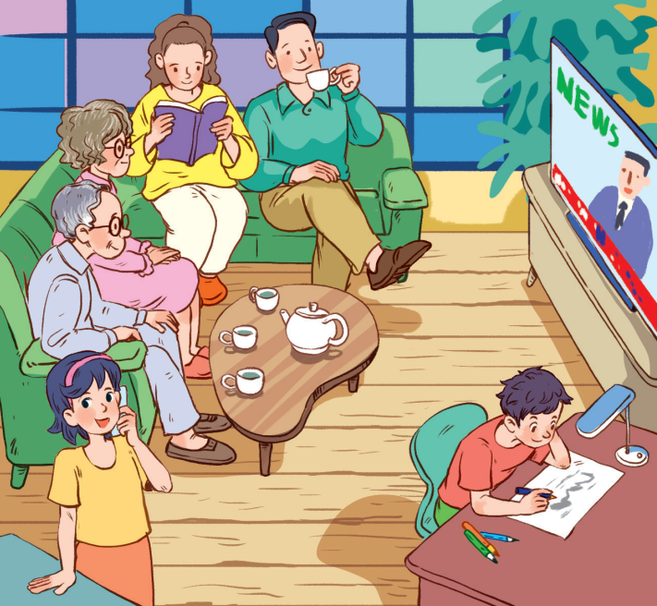
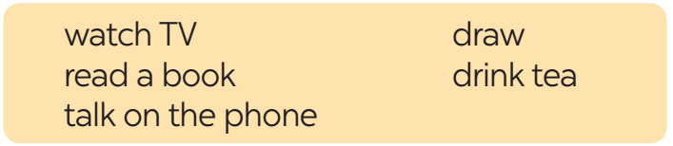
PRACTICE
3
Look at the picture and write what each person in Lan’s family was doing when the earthquake happened. Use the given word and phrases from the box.
1. Lan’s grandparents were watching TV.
2. Lan’s/ Her mother was reading a book.
3. Lan’s/ Her father was drinking tea.
4. Lan was talking on the phone.
5. Lan’s/ Her brother was drawing.

Slide 11
PRACTICE
4
Form questions using the past continuous. Then in pairs, ask and answer the questions.
Example: you / play / football / 5 o’clock yesterday afternoon?
Were you playing football at 5 o’clock yesterday afternoon?
Yes, I was. / No, I wasn’t. I was doing my homework

Slide 12
PRACTICE
4
Form questions using the past continuous. Then in pairs, ask and answer the questions.
1. you / have dinner / 7 o’clock yesterday evening?
=> Were you having dinner at 7 o’clock yesterday evening?
2. you / do / homework / 8 o’clock yesterday evening?
=> Were you doing your homework at 8 o’clock yesterday evening?
3. you / watch / film / 9 o’clock yesterday evening?
=> Were you watching a film at 9 o’clock yesterday evening?

Slide 13
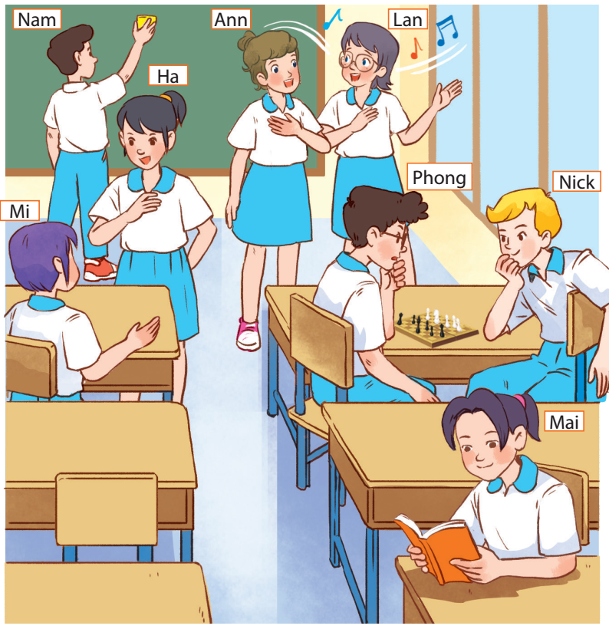
PRODUCTION
5
Work in groups. Take turns to say a sentence that describes what each person in the picture was doing
- Mai was reading.
- Phong and Nick were playing chess.
- Lan and Ann were singing.
- Nam was cleaning the board.
- Mi and Ha were talking.

Slide 14
CONSOLIDATION
1
Wrap-up
Structures:
(+) S + was/ were + V-ing …
(-) S + was/ were not + V-ing …
(?) Was/ were + S + V-ing …?

Slide 15

CONSOLIDATION
2
Homework
- Remember the structures and the use of the past continuous.
- Do exercises in the workbook.
- Prepare for Lesson 4 - Communication

Slide 16

Website: hoclieu.vn
Fanpage: facebook.com/tienganhglobalsuccess.vn/

