Slide 1

Hello 5
Pages 16 - 17

Slide 2
Lesson Outline
Warm-up
Speaking
Grammar
Consolidation
Wrap-up

Slide 3
Objectives
By the end of this lesson, students will be able to…
- Learn how to introduce yourself and others.
- Learn classroom language and imperative.

Slide 4

WARM-UP

Slide 5
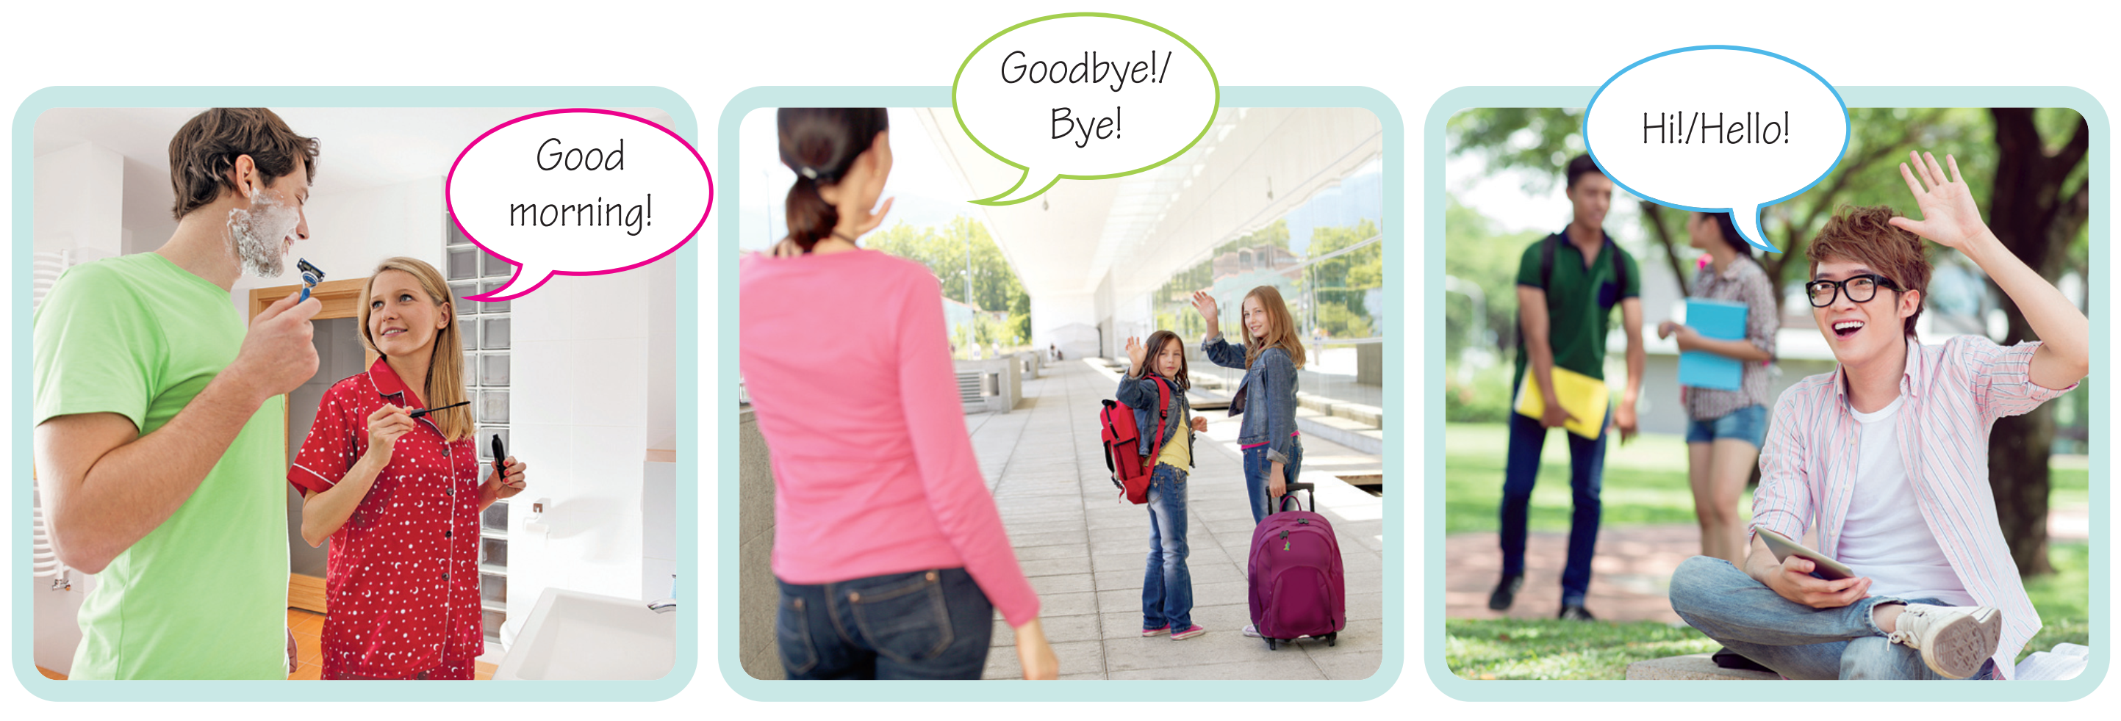
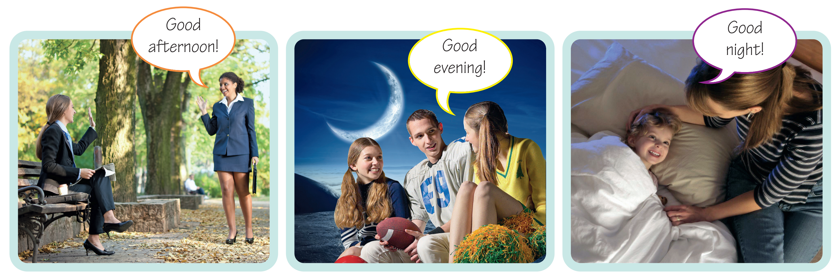
Match the sentences with the correct pictures.
Hi/Hello!
Good morning!
Good afternoon!
Good evening!
Good night!
Goodbye/Bye!

Slide 6

It’s time to learn …

Slide 7
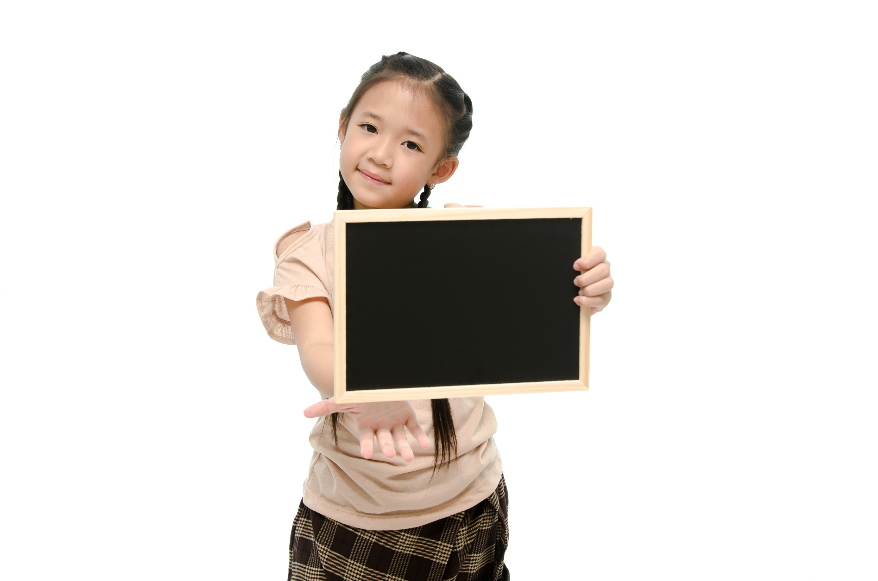
Speaking

Slide 8

1 Listen and repeat.
Pre-speaking

Slide 9
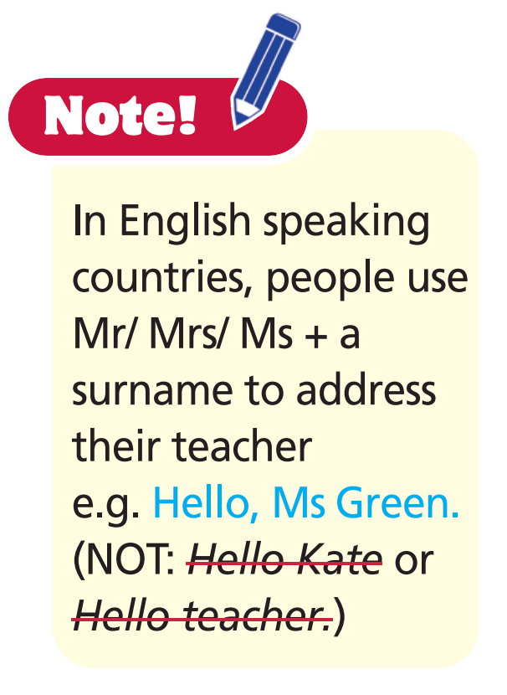
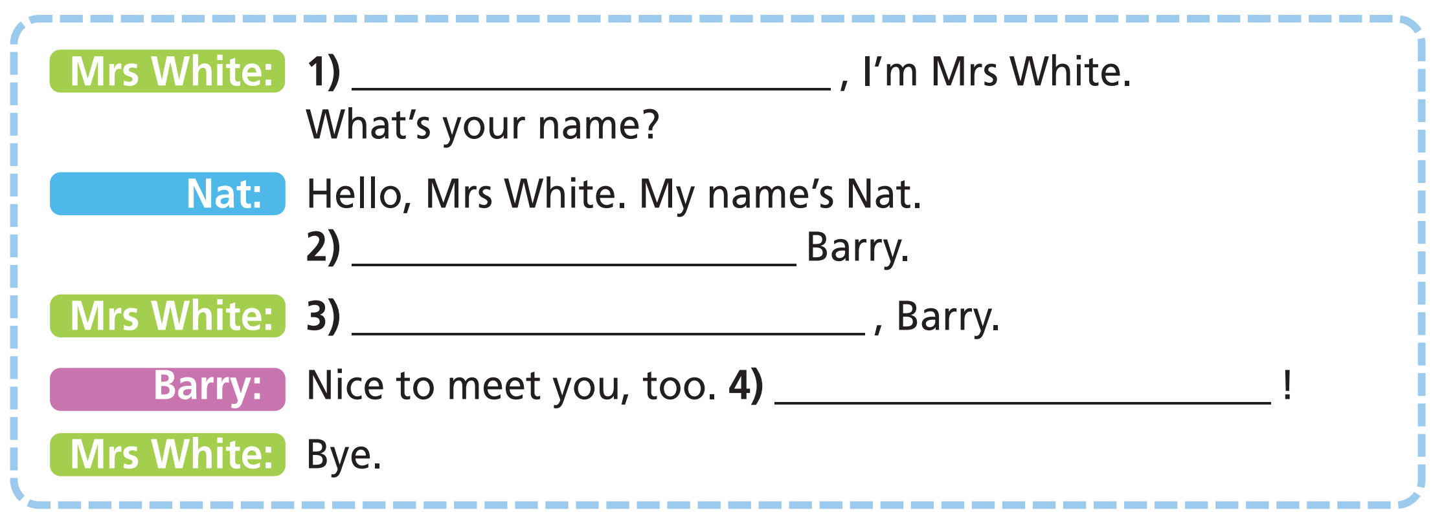
2 a) Complete the dialogue with the phrases below.
b) Listen and check. Then read the dialogue aloud.
Goodbye
Hello
This is
Nice to meet you

Slide 10

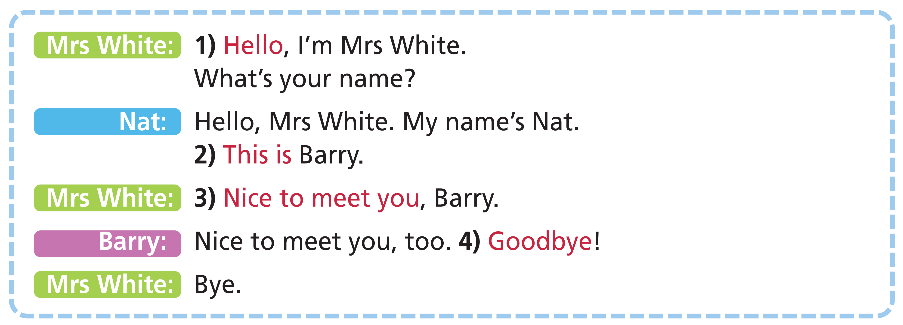
While-speaking
Work in groups of three. Make conversation as example.

Slide 11
Post-speaking
Make conversations to introduce yourself and others in front of your class.

Slide 12
Grammar

Slide 13

Presentation

Slide 14
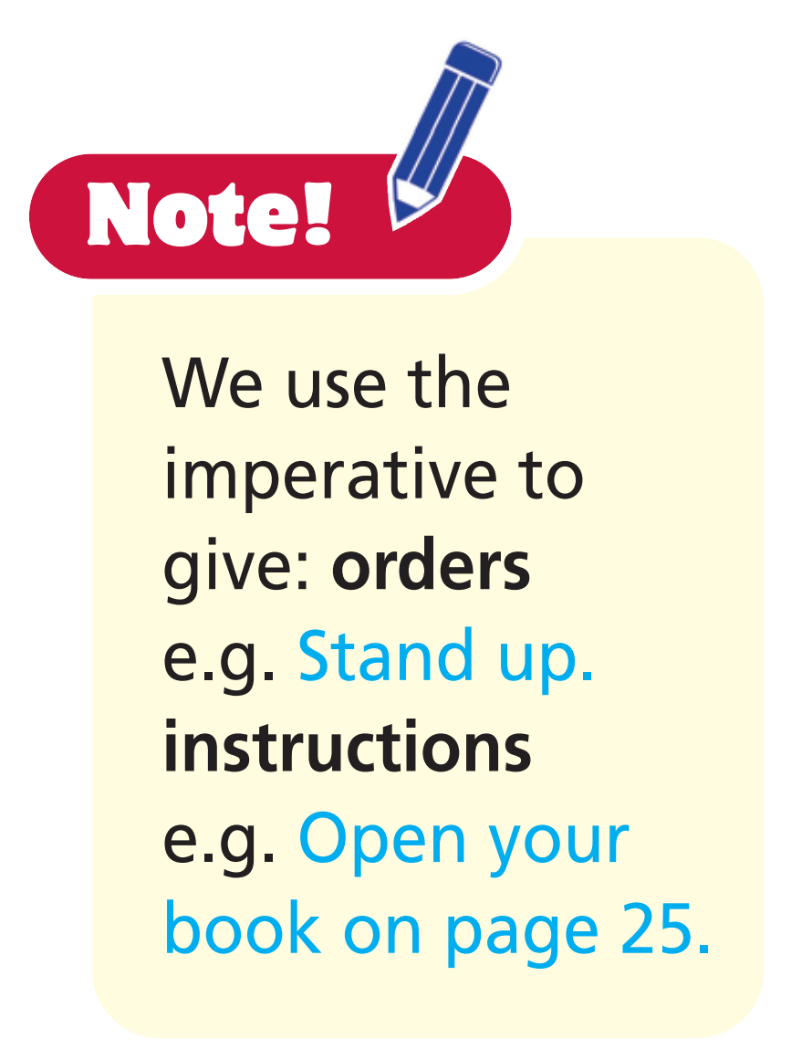
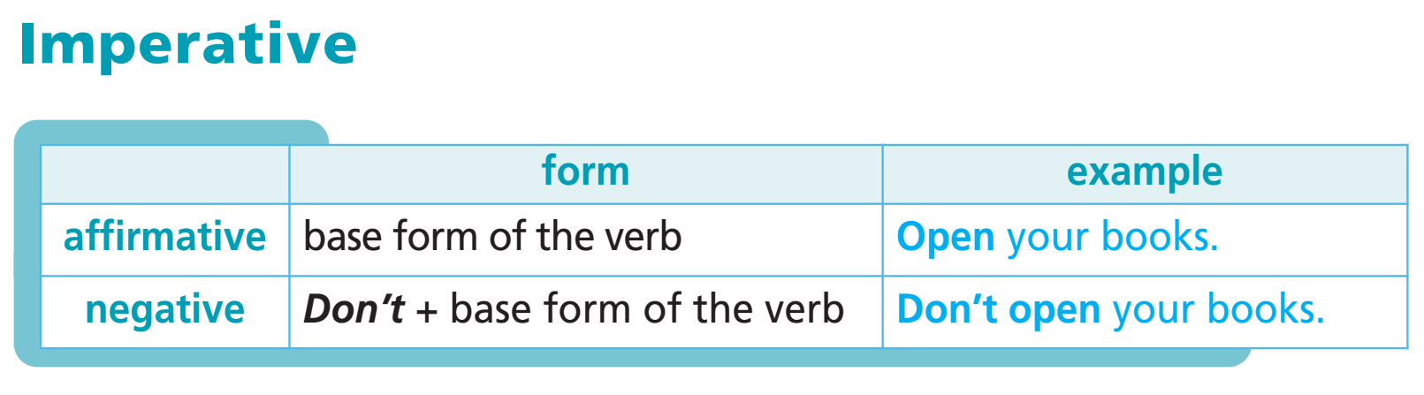

Slide 15
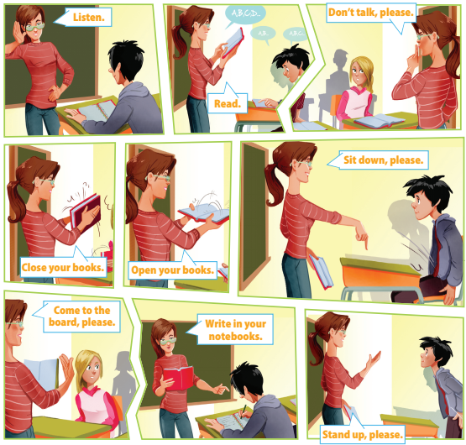
3 Listen and repeat.

Slide 16
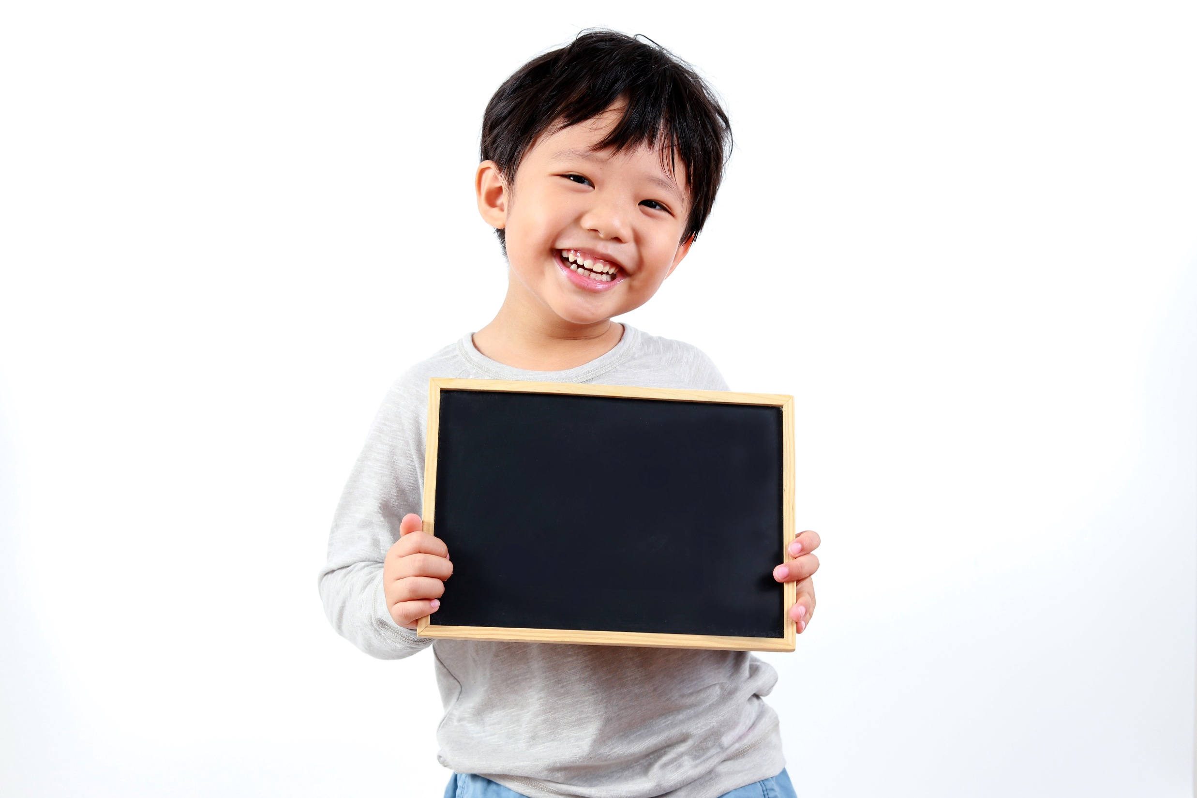
Practice

Slide 17

4 Make imperative sentences. Then your partner acts out what you ask him/her to do.
Example
Student A: Stand up, please.
Student B: (stands up)

Slide 18
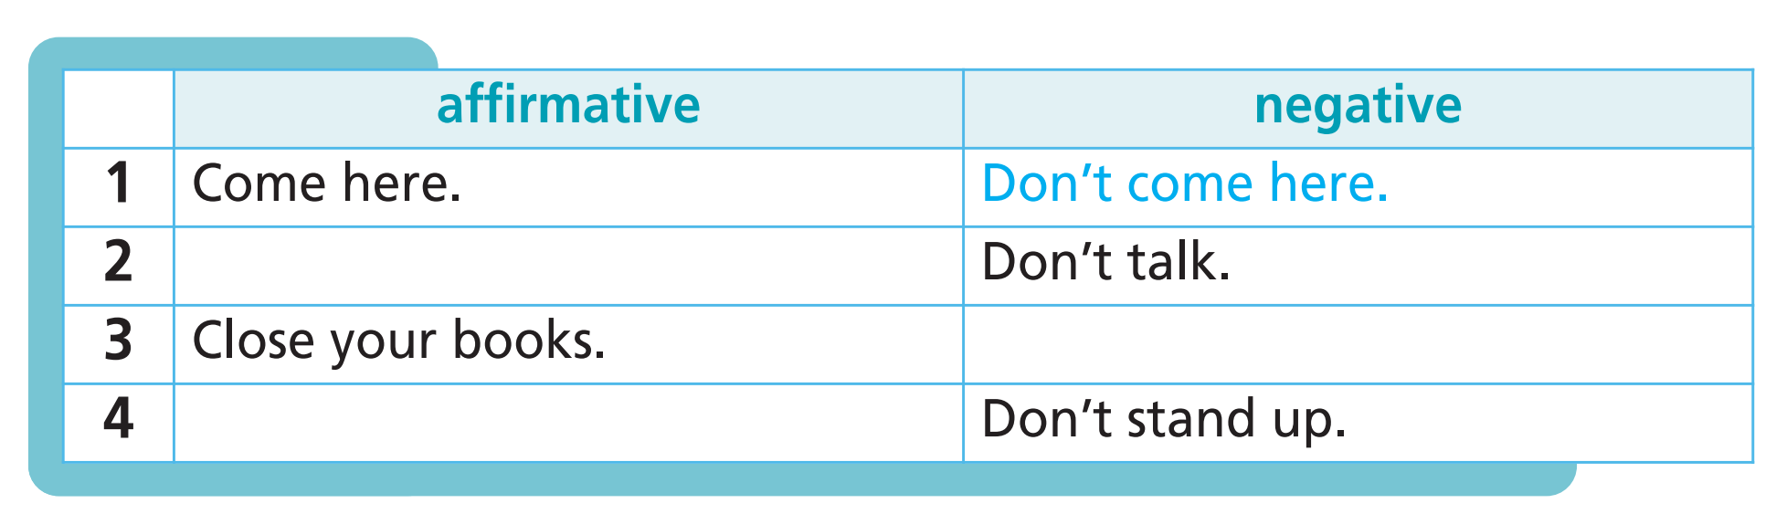
Further practice
Complete the table as in the example.
Talk, please.
Don’t close your books.
Stand up, please.

Slide 19

Production

Slide 20
Game “Simon says”
- Stand up!
Sit down!
Open your books!
Close your books!
Close your eyes!
Open your eyes!
Put your hands up!
Put your hands down!

Slide 21

CONSOLIDATION

Slide 22
Put the sentences in the correct order.
Nice to meet you, boys.
Hello, I’m Mr Sawyer. What’s your name?
Nice to meet you, too. Bye!
Hello, Mr Sawyer. My name is Charlie. This is Peter.
A: Hello, I’m Mr Sawyer. What’s your name?
B: Hello, Mr Sawyer. My name is Charlie. This is Peter.
A: Nice to meet you, boys.
B: Nice to meet you, too. Bye!

Slide 23

WRAP-UP

Slide 24
Today’s lesson
Grammar
Sentences to introduce yourself
Imperative

Slide 25
Homework
Practise the vocabularies and grammar and make sentences using them.
Do the exercises in TA 6 Right on WB (pp. 10, 11)
Prepare the next lesson (pp. 18, 19 SB)
Do Test 1 in Bài Tập Bổ Trợ TA 6 Right on (pp. 2-5)

Slide 26
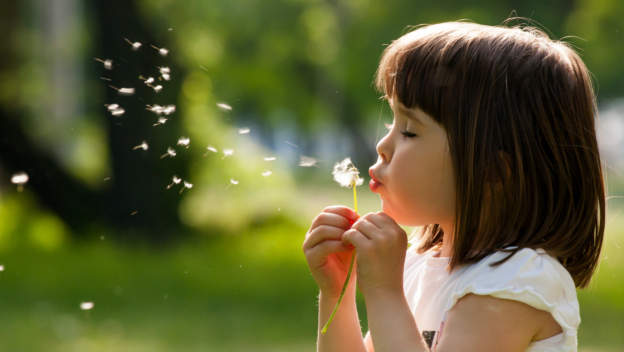
Enjoy your day!

