Slide 1
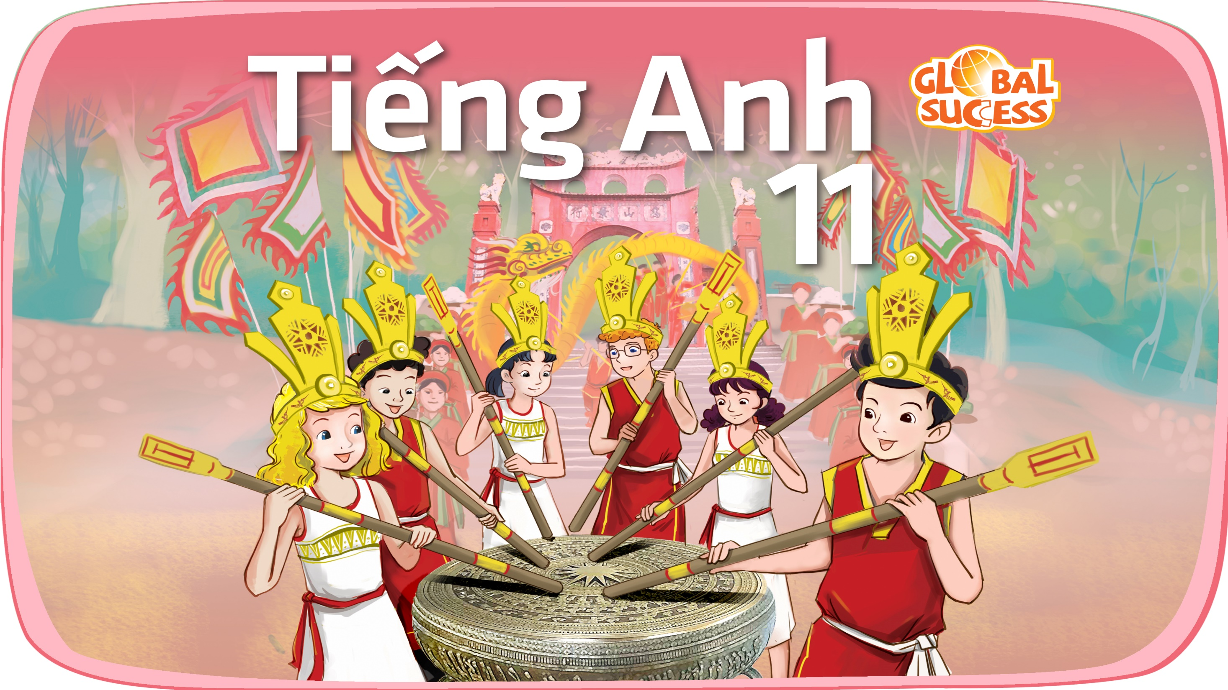

Slide 2
Unit
6
Preserving our heritage
Unit
FAMILY LIFE
LESSON 3
READING
Teenagers’ ideas for preserving heritage

Slide 3
LESSON 3
READING
WARM-UP
Brainstorming
PRE-READING
Task 1: Ask and answer the questions.
Vocabulary
Task 2: Read the article and circle the correct meanings of the highlighted words and phrases.
Task 3: Match the headings with the appropriate paragraph.
Task 4: Decide which paragraph includes the information.
WHILE-READING
POST-READING
Discussion
CONSOLIDATION
Wrap-up
Homework

Slide 4
WARM-UP
BRAINSTORMING
- Work in 4 groups.
- Discuss: What can we do to protect our heritage?
- 3 minutes to discuss and write.
- Stick your paper on the board.
- The group with the most appropriate ideas will be the winner.

Slide 5
WARM-UP
Suggested ideas
- Organise nature walks/excursions to local parks, areas of bio-diversity
- Organise site visits to museums, interpretation centres, and archaeological sites
- Organise essay competitions on literature (in English and local languages)
- Carry out small research projects for students that can be put up as mini-exhibitions/bulletin board displays on heritage.
- Involve students in documenting local living heritage like festivals, performing arts or craftsmen and women.
- Establish clubs for heritage debates, quizzes, discussions and activities like presentations, field trips and documentation.
- Organising painting and drawing competitions for students at built heritage sites
- Clean up the environment, investigate its local official and oral history.

Slide 6
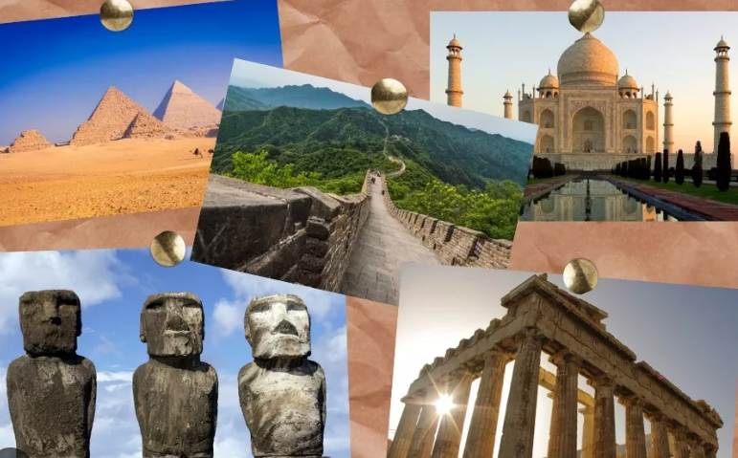
PRE-READING
1
Work in pairs. Ask and answer the questions.
Why do people visit heritage sites?
What can we do at heritage sites?
What can we learn from them?

Slide 7


PRE-READING
appreciate (v)
/əˈpriːʃieɪt/
to recognise the good qualities of somebody/something

Slide 8
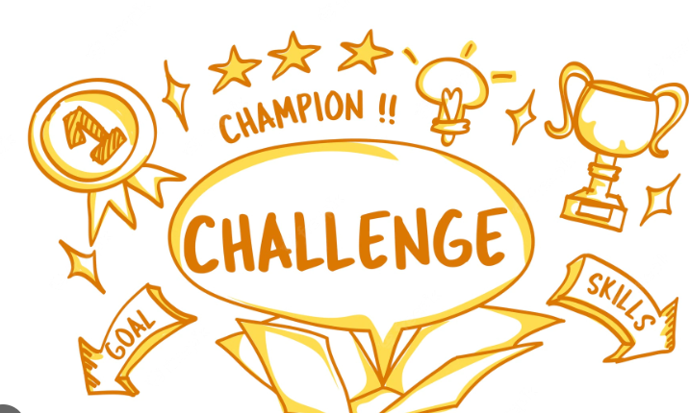
PRE-READING
challenge (n)
/ˈtʃælɪndʒ/
an invitation or a suggestion to somebody that they should enter a competition, fight, etc.

Slide 9

PRE-READING
trending (adj)
/ˈtrendɪŋ/
being discussed a lot on social media

Slide 10
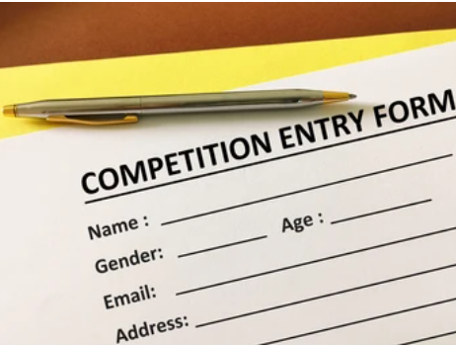
PRE-READING
entry (n)
/ˈentri/
something that you do, write or make to take part in a competition, for example answering a set of questions

Slide 11
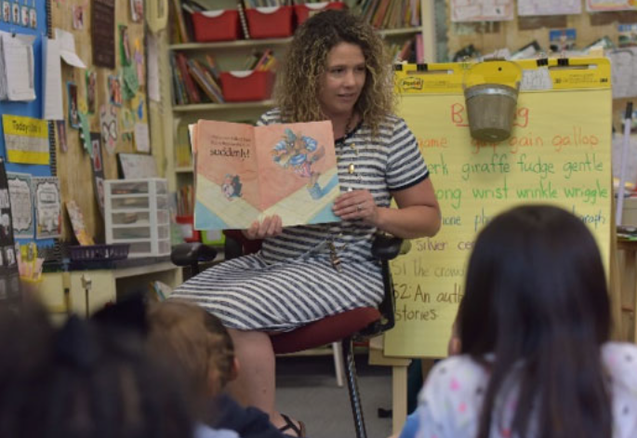
PRE-READING
keen (adj)
/kiːn/
[usually before noun] strong or deep
E.g. She took a keen interest in her daughter’s education.

Slide 12
Form | Pronunciation | Meaning | Vietnamese equivalent
1. appreciate (v) | /əˈpriːʃieɪt/ | to recognise the good qualities of somebody/something | trân trọng
2. challenge (n) | /ˈtʃælɪndʒ/ | an invitation or a suggestion to somebody that they should enter a competition, fight, etc. | thử thách
3. trending (adj) | /ˈtrendɪŋ/ | being discussed a lot on social media | theo xu hướng
4. entry (n) | /ˈentri/ | something that you do, write or make to take part in a competition, for example answering a set of questions | bài dự thi
5. keen (adj) | /kiːn/ | [usually before noun] strong or deep | mạnh mẽ, sâu sắc

Slide 13
WHILE-READING
2
Read the article and circle the correct meanings of the highlighted words and phrases.
1. appreciate
A. to recognise the good qualities of something
B. to realise that something is dangerous
C. to discuss a new idea
2. trending
A. being discussed a lot on social media
B. being forgotten by the public
C. creating and sharing information

Slide 14
WHILE-READING
2
Read the article and circle the correct meanings of the highlighted words and phrases.
3. give voice to
A. to take action about something
B. to listen to someone’s advice
C. to express opinions about something
4. proposed
A. asked someone for information
B. suggested something as a plan or course of action
C. invited guests for an event

Slide 15
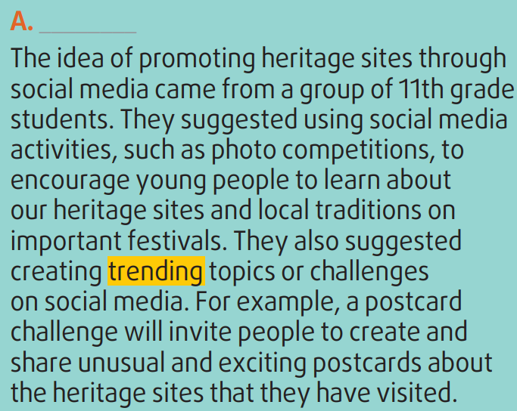
WHILE-READING
3
Read the article again. Match the section (A-C) with the heading (1-5) below. There is ONE extra heading.
3. Making use of social media to promote heritage

Slide 16
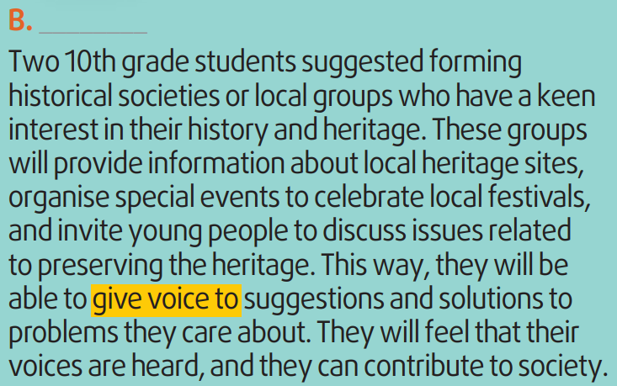
WHILE-READING
3
Read the article again. Match the section (A-C) with the heading (1-5) below. There is ONE extra heading.
4. Opportunities to learn about heritage and be involved in problem-solving

Slide 17
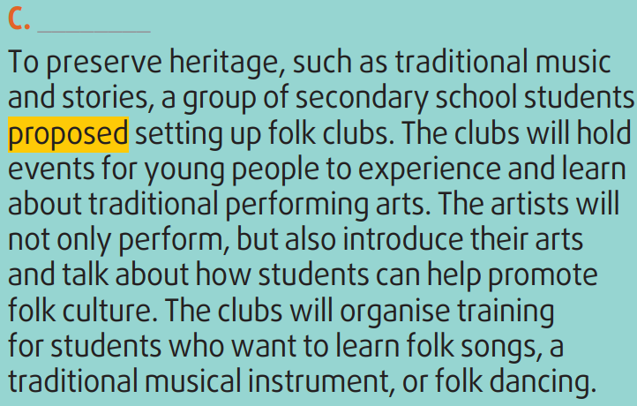
WHILE-READING
3
Read the article again. Match the section (A-C) with the heading (1-5) below. There is ONE extra heading.
2. Promoting and developing the folk arts

Slide 18
WHILE-READING
4
Read the article again and decide which paragraph includes the following information.
 | Paragraph
Creating popular topics on the Internet such as sharing postcards | A
Raising awareness of preserving our heritage through discussions
Organising photo competitions on social media
Setting up local historical societies to organise festivals and other events
Inviting artists to perform and teach folk singing, dancing, and music
B
A
B
C

Slide 19

POST-READING
5
Discussion
Which of the ideas in the text do you like most?
How will it help preserve heritage?

Slide 20
CONSOLIDATION
1
Wrap-up
What have you learnt today?
Some lexical items about preserving heritage;
Reading for main ideas and specific information

Slide 21
CONSOLIDATION
2
Homework
Do exercises in the workbook.
Prepare for Lesson 4 - Unit 6.

Slide 22

Website: hoclieu.vn
Fanpage: facebook.com/tienganhglobalsuccess.vn/
Website: hoclieu.vn
Fanpage: facebook.com/sachmem.vn/

