Slide 1

REVIEW 1 (Units 1-3)
Lesson 1 – Listening & Reading
Page 28

Slide 2



LESSON OUTLINE
Consolidation

Slide 3
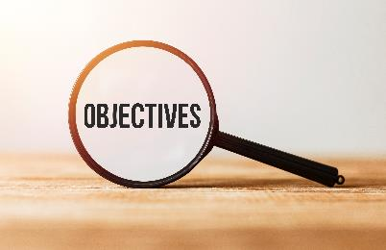
By the end of this lesson,
students will be able to …
practice listening and reading for specific information.
practice test-taking skills.

Slide 4



Slide 5

Work in pairs.
1. What do you often do in your free time?
2. Do you usually help your parents do chores?
3. Do you like shopping?
If yes, when and where do you often go shopping?
Who do you go shopping with?
What do you often buy?

Slide 6



Slide 7
Pre-Listening
Underline the key words/phrases.
You will hear five short conversations. You will hear each conversation twice. There is one question for each conversation. For each question, choose the correct answer (A, B, or C).
What is Jay doing on Sunday morning?
What activity does Lucy decide to do?
What activity does Susan say is boring?
What activity does Eddie like doing on Sundays?
What is Bill doing on Tuesday evening?

Slide 8

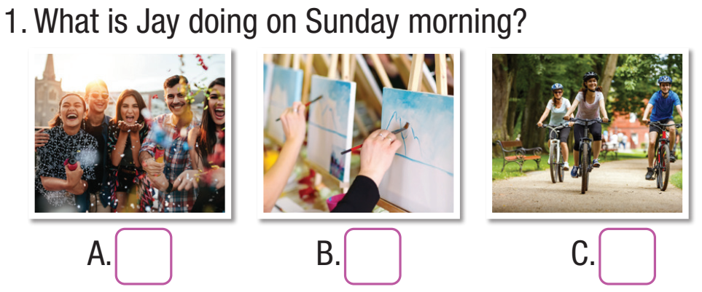
While-Listening
You will hear five short conversations. You will hear each conversation twice. There is one question for each conversation. For each question, choose the correct answer (A, B, or C).
Listen to conversation 1 twice and check
✓

Slide 9
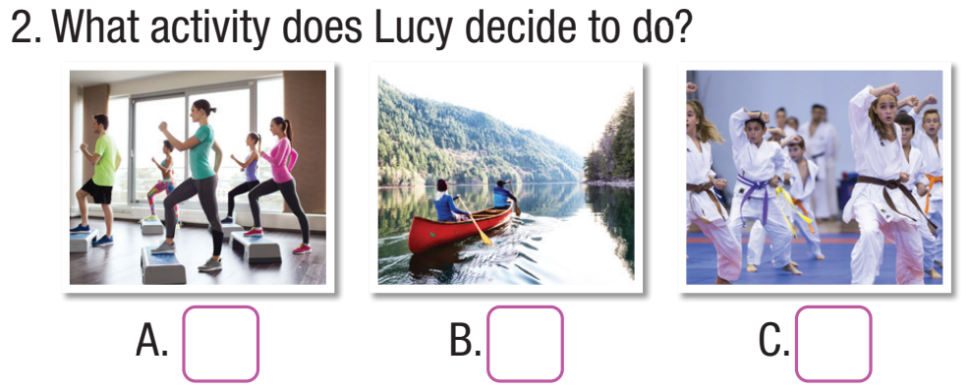
Continue listening to conversation 2 twice and check
✓

Slide 10
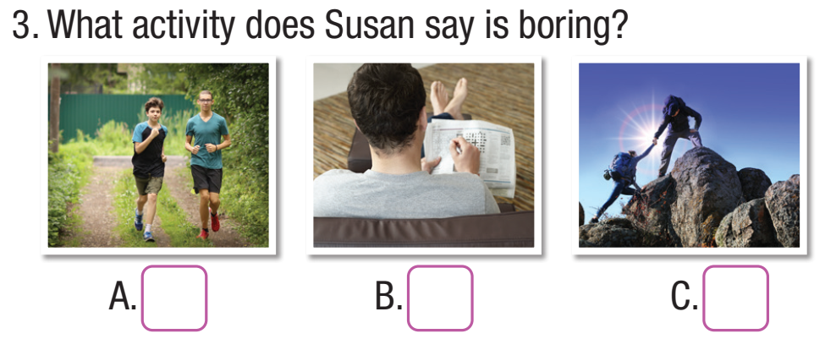
Continue listening to conversation 3 twice and check
✓

Slide 11
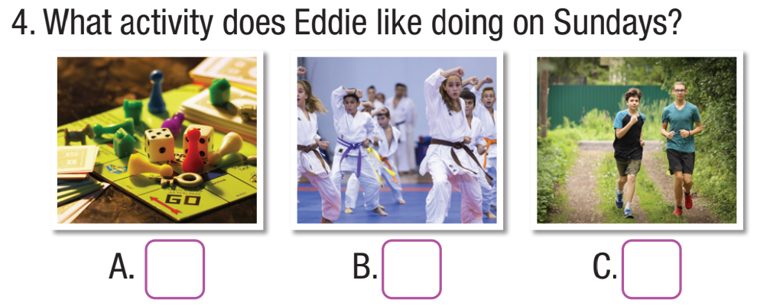
Continue listening to conversation 4 twice and check
✓

Slide 12
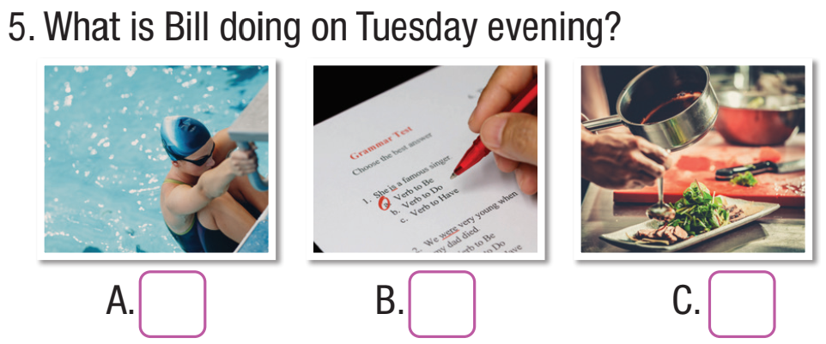
Continue listening to conversation 5 twice and check
✓

Slide 13

Scripts
1. Narrator: What is Jay doing on Sunday morning?
W: Hi, Jay. Leo came back yesterday.
M: Really? I haven't seen Leo for years.
W: Would you like to come to a party on Saturday morning? We're having a welcome home party.
M: Ah, sorry. I'd love to. But my parents are busy, so I offered to take my sister to her art class.
W: Oh, that's a shame. Well, would you like to go for a bike ride with Leo and me on Sunday morning instead?
M: Yeah, sounds great.
Narrator: Now, listen again.

Slide 14
2. Narrator: What activity does Lucy decide to do?
B: Hello, Lucy. I think I'm going to join the karate club.
It looks so fun.
G: That's great. I want to do something fun in my free time, but I don't know what to do.
B: Well, do you like doing aerobics?
G: No, I can't stand doing aerobics.
B: Do you like going canoeing? My sister usually goes canoeing on Sunday mornings. You could join her.
G: Wow, that sounds nice. I love outdoor activities.
Narrator: Now, listen again.

Slide 15
3. Narrator: What activity does Susan say is boring?
Susan: Hi, everyone. My name's Susan. I'm fourteen. I really like doing crossword puzzles. I like doing them with my brother on the weekends.
He's only ten years old, but he's smart. He can finish them quicker than me. I can't stand going running, it's so boring. But I enjoy going
mountain climbing with my friends. I’m a member of my high school outdoor club.
Narrator: Now, listen again.

Slide 16
4. Narrator: What activity does Eddie like doing on Sundays?
Eddie: Hello. I'm Eddie. I love sports. I like going running early in the morning on week days.
Lots of my friends don't like getting up early, but I do. I enjoy doing karate on Tuesdays and Thursdays. On Sundays, I want to stay at home and spend time with my younger brother, Brad.
We like playing board games together. They’re so much fun.
Narrator: Now, listen again

Slide 17
5. Narrator: What is Bill doing on Tuesday evening?
G: Hi, Bill. Would you like to go canoeing this Sunday morning?
B: Hi, Rose. I'm sorry, I can't. I have an English test next Monday, so I planned to study English this weekend.
G: OK. Are you free on Tuesday evening?
B: No, sorry. I promised to help my mom cook dinner.
G: That's so kind! Are you doing anything tomorrow?
B: I'm free.
G: Would you like to go swimming?
B: Yes, I'd love to.
Narrator: Now, listen again.

Slide 18
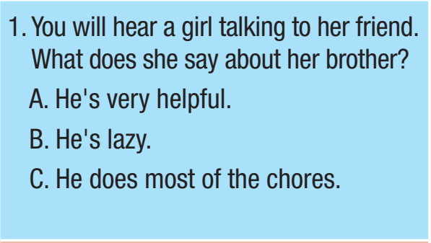
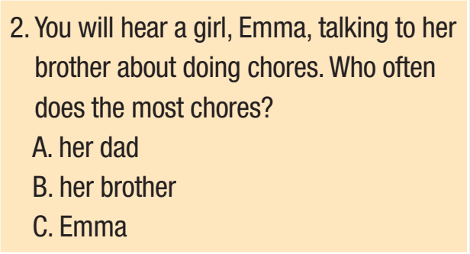
Extra Practice
WB, page 62
Pre-Listening
Underline the key words/phrases.
You will hear five short conversations. You will hear each conversation twice. There is one question for each conversation. For each question, choose the correct answer (A, B, or C).

Slide 19
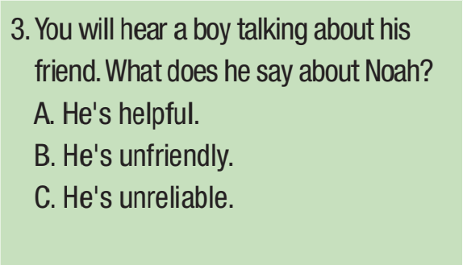
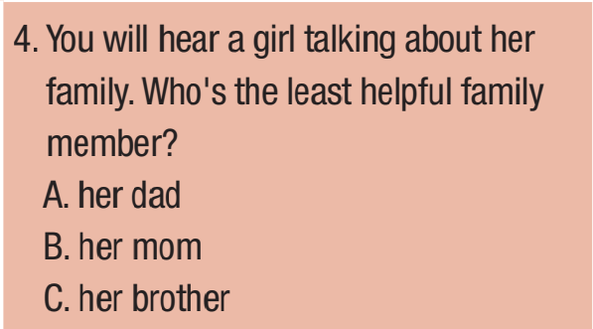
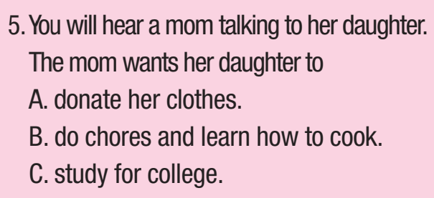

Slide 20
While-Listening
You will hear five short conversations. You will hear each conversation twice. There is one question for each conversation. For each question, choose the correct answer (A, B, or C).
Listen to each conversation twice and check

Slide 21
Listen to each conversation twice and check

Slide 22
Scripts
1. Narrator: You will hear a girl talking to her friend. What
does she say about her brother?
Lisa: Hey, Jane, are you free? Let’s go shopping!
Jane: Sorry, I have to do some chores.
Lisa: Oh, can’t you ask your brother James to do them?
Jane: He’ll never help me. He cleans his room like once a
month.
Lisa: Really? I’d never know that looking at him.
Jane: He likes to dress nicely but his room is a mess.
Anyway, how about later, at 4:00?
Lisa: OK!
Narrator: Now, listen again.

Slide 23
2. Narrator: You will hear a girl talking to her brother about
doing chores. Who often does more chores?
Emma: Matt, can you help me vacuum the floor?
Matt: You always make me do the vacuuming.
Emma: Well, then do you want to clean the kitchen and
bathroom? Or mop the floor?
Matt: Erm...I’ll do the vacuuming.
Emma: That’s about the only chore you do besides
helping Dad in the garden.
Matt: I know, I know! I’ll help you wash the dishes tonight.
Emma: Good.
Narrator: Now, listen again

Slide 24
3. Narrator: You will hear a boy talking about his friend. What
does he say about Noah?
James: What are you doing after school?
Alex: I’m going to Noah’s house. He’s bought a new game.
James: What’s he like?
Alex: He’s nice. He might seem a bit grumpy at first but he’s actually really friendly. However, he doesn’t always keep his promises. He said he’d help me do my vlogs every week but he’s only helped once.
James: Ah, OK.
Narrator: Now, listen again.

Slide 25
4. Narrator: You will hear a girl talking about her family. Who’s
the least helpful family member?
Adam: What’s your mom like, Kelly?
Kelly: She’s intelligent and hardworking. She’s busy so we
help her do housework.
Adam: What chores do you do?
Kelly: I do the laundry and dishes. Sometimes I make dinner.
Adam: What about your dad and your brother?
Kelly: My dad doesn’t do much. Just the shopping. My brother and I vacuum and mop the floor. We also help my mom clean the bathroom and kitchen.
Narrator: Now, listen again.

Slide 26
5. Narrator: You will hear a mom talking to her daughter. The
mom wants her daughter to
Mom: Molly, have you tidied up your room?
Molly: I’ll do it now! I forgot because I was looking for clothes online.
Mom: You already have so many clothes!
Molly: Sorry, Mom.
Mom: When you’re done, help me make lunch. You’re sixteen now and you can’t even do housework or make a simple meal. How will you take care of yourself when you’re in college?
Narrator: Now, listen again.

Slide 27
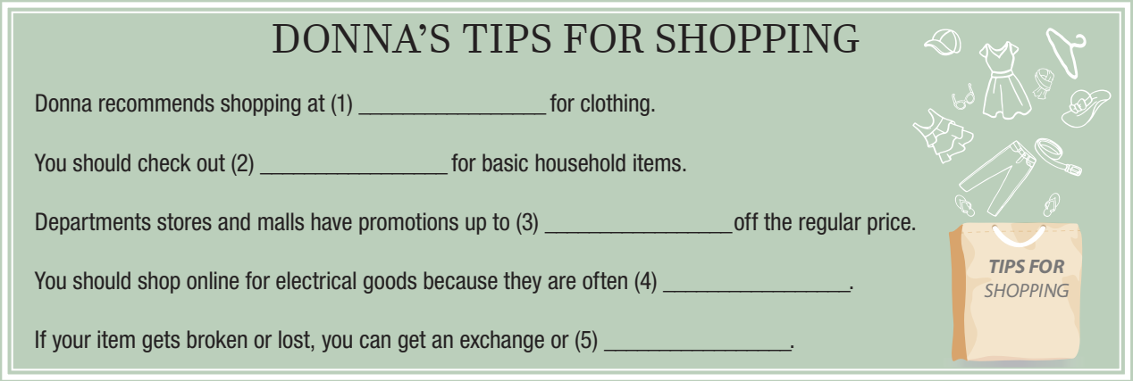
Extra Practice
WB, page 64
Pre-Listening
Underline the key words/phrases.
You will hear a teenager called Donna talking about her tips for shopping. For each question, write no more than two words or a number in the blank.

Slide 28
While-Listening
Listen twice and write no more than two words or a number in the blank.
thrift stores
local markets
70%
cheaper
refund

Slide 29
Scripts
Narrator: You will hear a teenager called Donna talking about her tips for shopping. For each question, write no more than two words or a number in the blank.
G: Hello, everyone, welcome to my channel. My name is Donna and the topic today is shopping. I’m going to give you some tips about what to buy, where to buy it, and how to save money.
My first tip is to check out thrift stores for clothes, shoes, and bags. You can find a lot of beautiful clothes for a low price. Look out for older clothes from the eighties and nineties because that style is very popular right now.
My second tip is to go to your local markets for basic household items like cups, bowls, and cooking things. You don’t need to spend a lot of money on these things and they are usually much cheaper in the market than in department stores.

Slide 30
My third tip is to go to buy more expensive things like furniture and bedding when malls and department stores have a sale. They often have huge promotions with up to seventy percent off the regular price.
My fourth and final tip is to shop online for electrical goods because they are often cheaper. A lot of people don't want to shop online in case their item gets broken or doesn't arrive. Don't worry because you can always get an exchange or refund.
I hope these tips help you save money and that you have fun shopping!
Narrator: Now, listen again

Slide 31
Post-Listening
Work in groups.
Summarize Donna’s tips for shopping.
Which tip do you agree with her?

Slide 32



Slide 33
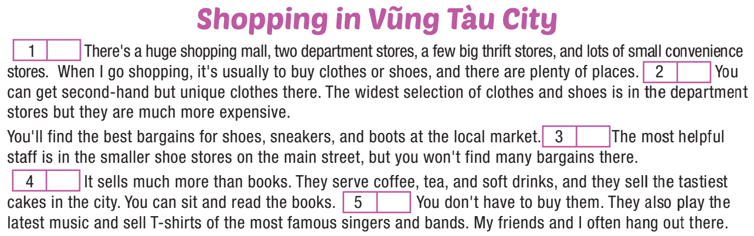
Pre-Reading
Five sentences have been removed from the text below. For each question, choose the best answer (A–H). There are three extra examples which you do not need to use.
Underline the key words/phrases.

Slide 34
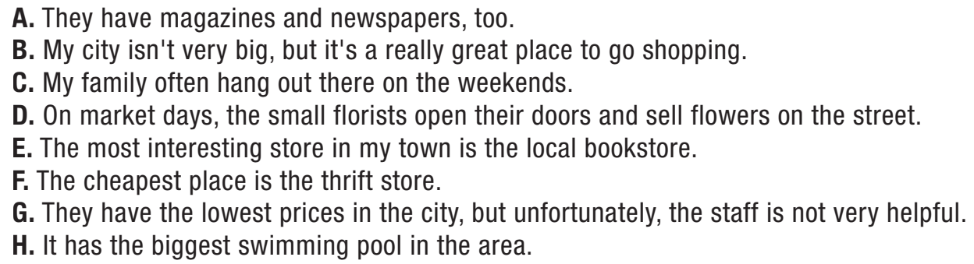

Slide 35
While-Reading
Skim and scan to get the specific information
Answer key: 1_B; 2_F; 3_G; 4_E; 5_A

Slide 36
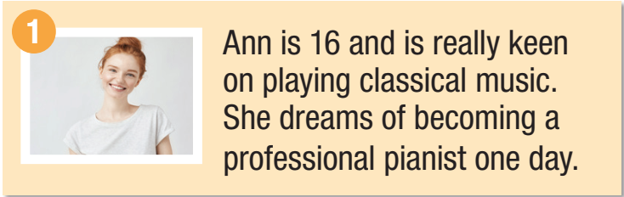
Extra Practice
WB, page 63
Pre-Reading
There are descriptions of four music clubs. The students below all want to join a music club. Decide which music club would be the most suitable for each student below.
Underline the key words/phrases.

Slide 37
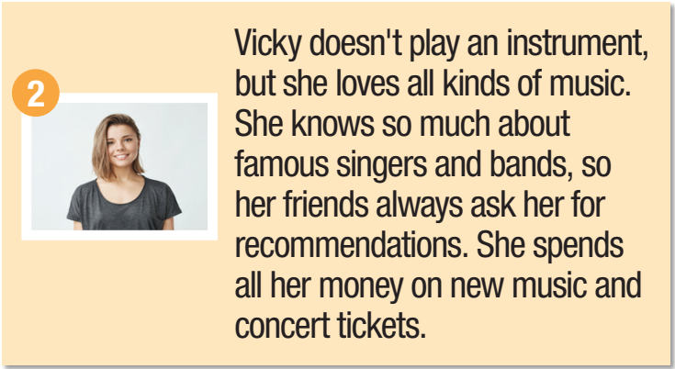

Slide 38
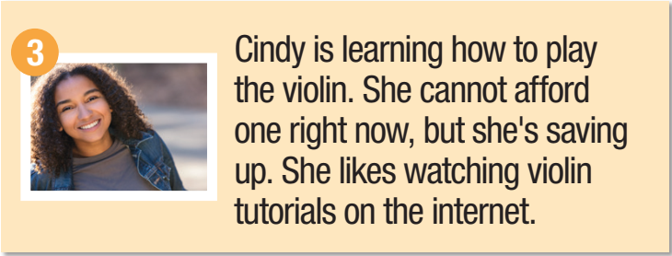

Slide 39
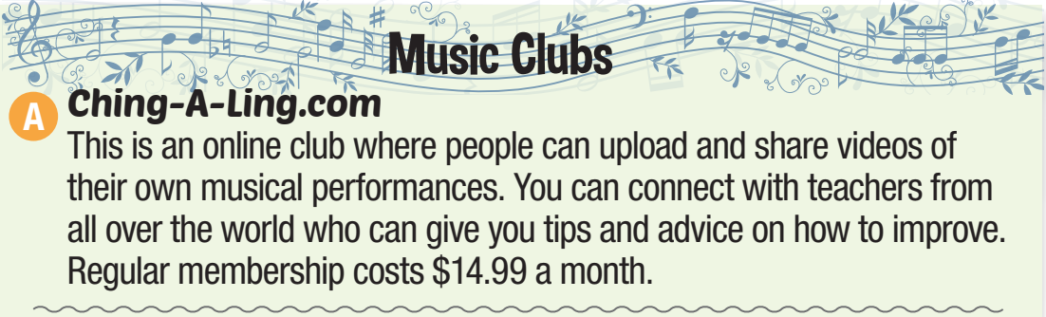
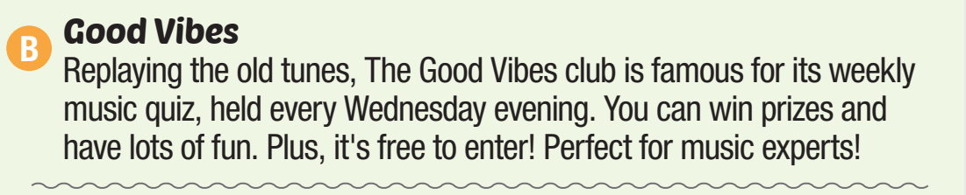

Slide 40
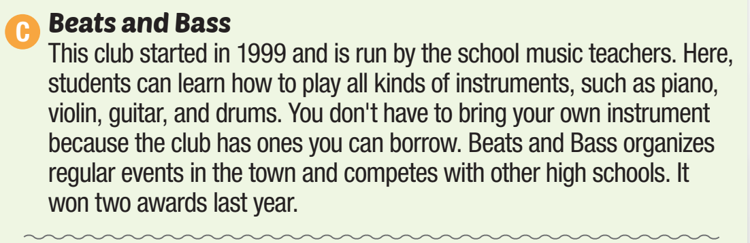
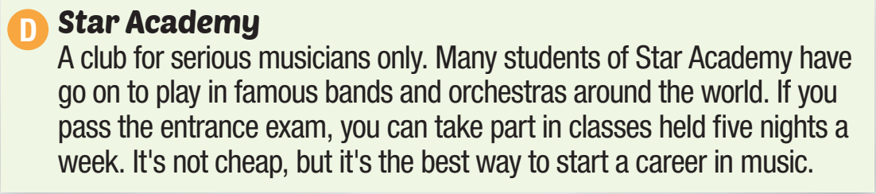

Slide 41
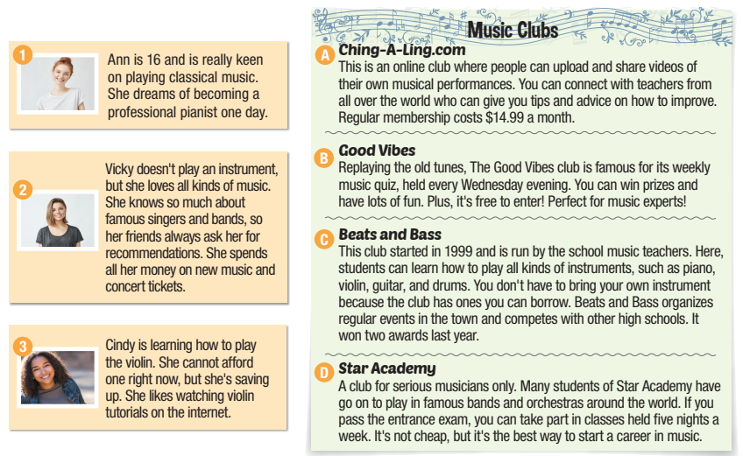
While-Reading
Skim and scan to get the specific information
Answer key: 1_D
2_B
3_C

Slide 42
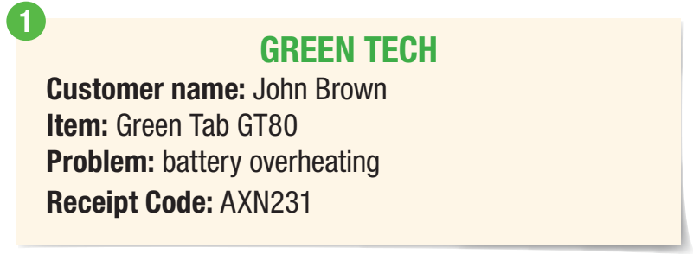
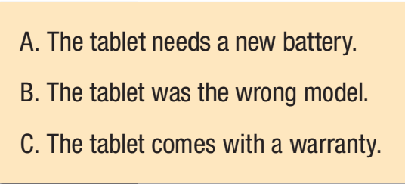
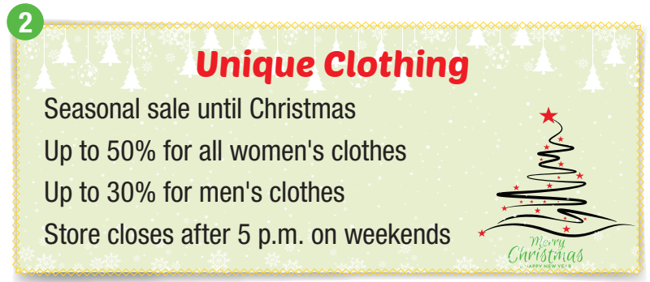
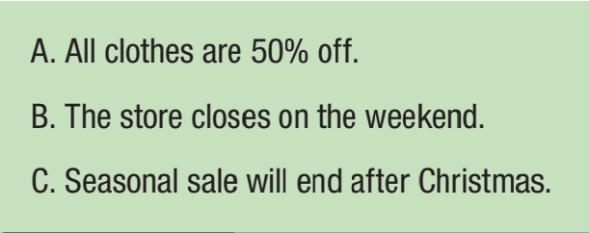
Extra Practice
WB, page 63
Pre-Reading
Look and read. Choose the correct answer (A, B, or C).
Underline the key words/phrases.

Slide 43
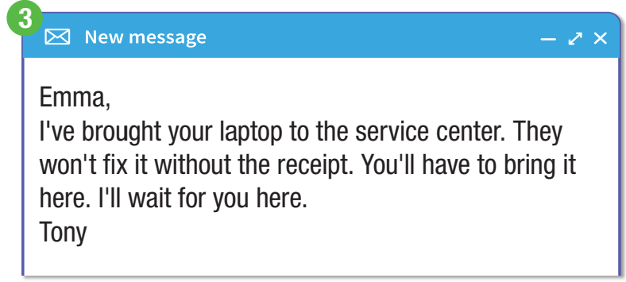
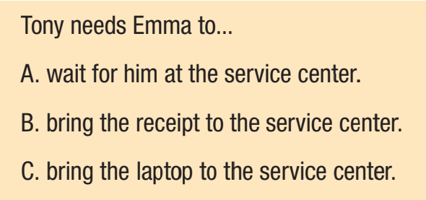

Slide 44
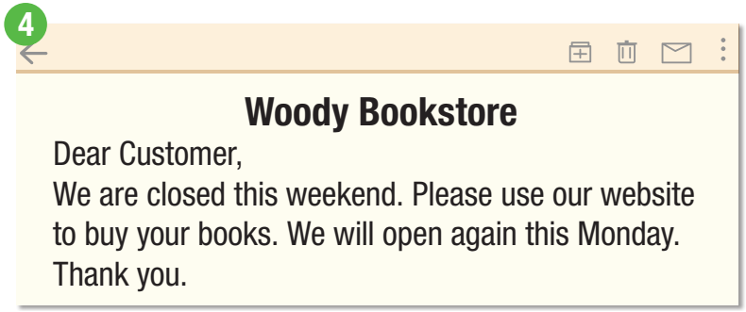
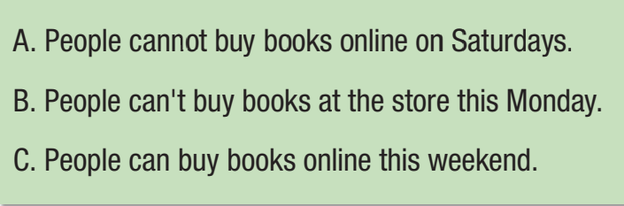

Slide 45
While-Reading
Skim and scan to get the specific information

Slide 48

Consolidation

Slide 49

Post-Reading
Work in pairs.
1. Which one do you prefer, online or offline shopping? Why?
2. Tell some advantages of online shopping.

Slide 50

WRAP-UP

Slide 51
Today’s lesson
Listening and Reading: practice listening and reading for specific information

Slide 52
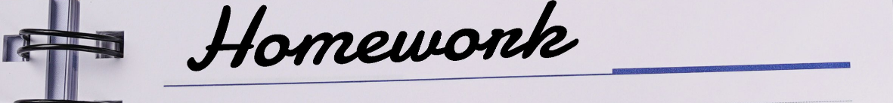
Review all the vocabularies and grammar that you learned earlier.
Do the exercises in WB on page 62 (Reading) & page 63 (Listening).
Prepare the next lesson on page 29 in SB.

