Slide 1
Unit 3:
Protecting the Environment
Lesson 3.1: Reading & Writing
Pages 32 & 33

Slide 2
Lesson Outline
Warm-up
Reading
Writing
Consolidation
Wrap-up

Slide 3
By the end of this lesson, students will be able to…
- practice reading for main ideas and specific information.
- write guides.

Slide 4
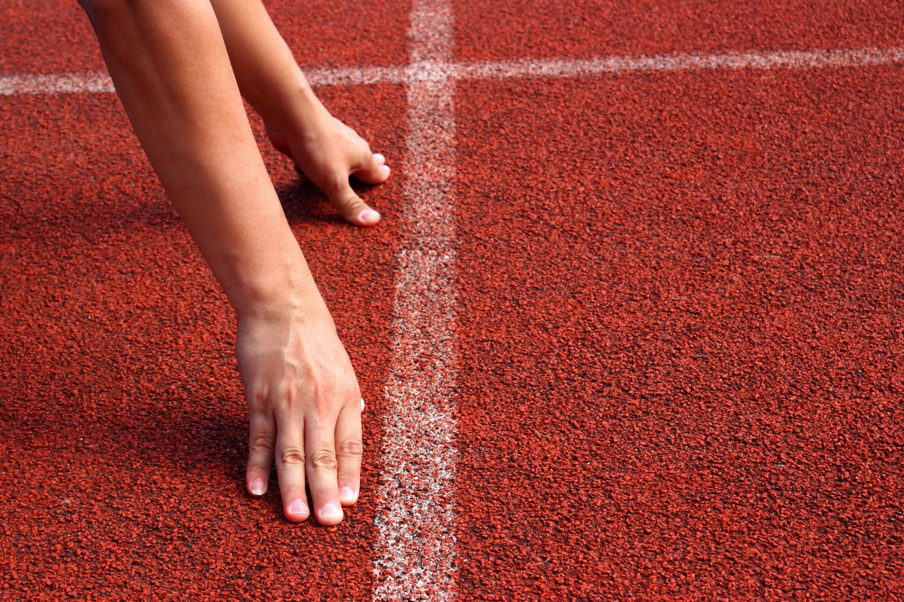
WARM UP

Slide 5
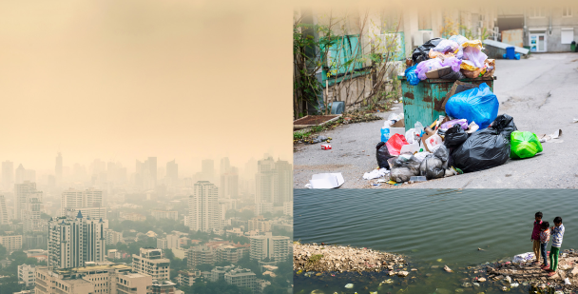
Let’s talk
In pairs: Look at the pictures.
What environmental problems can you see?
What can people to do improve the environment where they live?
land pollution
air pollution
water pollution

Slide 6
Reading

Slide 7
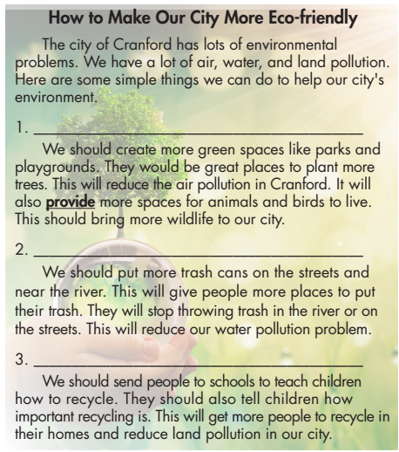
Task a. Read the guide and write the correct heading for each section.
Provide more trash cans.
Create some parks.
Teach people to recycle.

Slide 8
Vocabulary
provide (v) / prəˈvaɪd / cung cấp

Slide 9
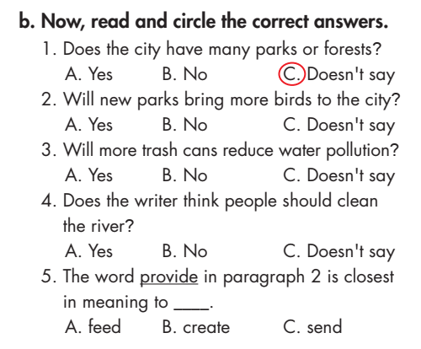
Task b
Now, read and circle the correct answers.

Slide 10
Task c
Listen and read.

Slide 11
In pairs
Do you have the same problems where you live?
What other solutions could help improve the problem?
Our town doesn’t have many green spaces. I think that we should plant more trees in our town.

Slide 12
Writing

Slide 13
Task a
Read about writing guides.

Slide 14
Create a title
Write an introduction
Create some parks.
Create clear, short headings
Explain each step

Slide 15
Read the guide from the reading again and circle the imperative and underline the reasons for solutions.
How to Make Our City More Eco-friendly
The city of Cranford has lots of environmental problems. We have a lot of air, water, and land pollution. Here are some simple things we can do to help our city’s environment.
Create some parks
We should create more green space like parks and playgrounds. They would be great places to plant more trees. This will reduce air pollution in Cranford. It will also provide more spaces for animals and birds to live. This should bring more wildlife
to our city.

Slide 16
Read the guide from the reading again and circle the imperative and underline the reasons for solutions.
2. Provide more trash cans.
We should put more trash cans on the streets and near the river. This will give people more places to put their trash. They will stop throwing trash in the river or on the streets. This will reduce our water pollution problem.

Slide 17
Read the guide from the reading again and circle the imperative and underline the reasons for solutions.
3. Teach people how to recycle.
We should send people to schools to teach children how to recycle. They should also tell children how important recycling is. This will get more people to recycle in their home and reduce land pollution in our city.

Slide 18
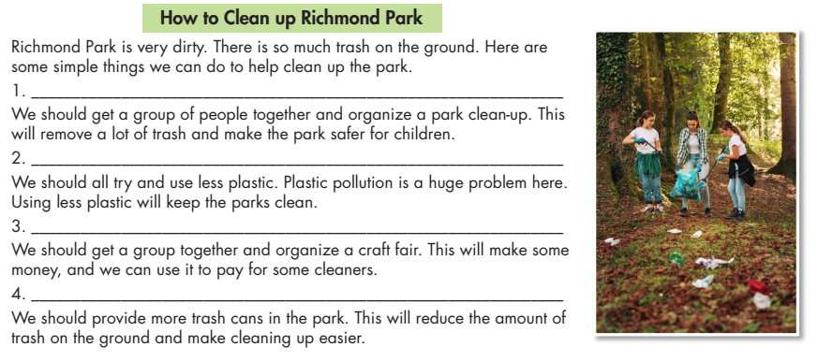
Task b
Read the guide and write headings for each section.
Organize a park clean-up.
Use less plastic.
Organize a craft fair.
Provide more trash cans.

Slide 19
CONSOLIDATION

Slide 20
Write the five sentences about how to clean up your neighborhood.
We should use less plastic and provide more trash cans.
………………………………………………………………………………………………………………………………………………………………………………………………………………………………………………………………………

Slide 21
WRAP-UP

Slide 22
Today’s lesson
Reading
Reading the guide about how to make our city more eco-friendly.
Writing
Writing guides.

Slide 23
Homework
Do the exercises on page 19 WB.
Prepare the next lesson (page 33 SB)
Do the exercises in TA 8 i-Learn Smart World Notebook, page 26
Play the consolidation games on www.eduhome.com.vn

Slide 24
Lesson 3
Stay positive and have a nice day!

