Slide 1


Slide 2




Unit
8
FILMS
LESSON 1: GETTING STARTED
Let’s go to the cinema tonight!
Unit
HOBBIES

Slide 3

OBJECTIVES
By the end of the lesson, students will be able to:
identify the topic of the unit
use lexical items:
  + types of films
  + adjectives describing films
identify the language features that are covered in the unit.

Slide 4
LESSON 1: GETTING STARTED
WARM-UP
Chatting
PRESENTATION
Vocabulary
Task 1: Listen and read.
Task 2: Read the conversation again and choose the correct answer.
Task 3: Choose the correct word or phrase.
Task 4: Complete the sentences.
PRACTICE
PRODUCTION
Task 5: Work in pairs. Ask and answer about a type of film.
CONSOLIDATION
Wrap-up
Homework

Slide 5
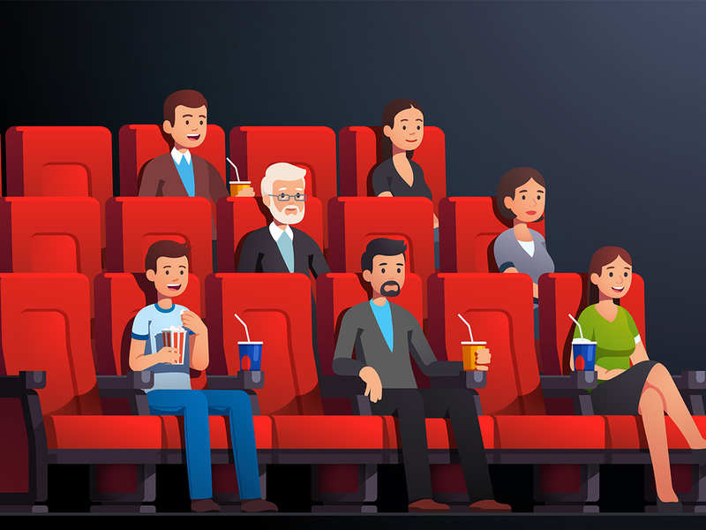
LESSON 1: GETTING STARTED
WARM-UP
Chatting
Aims of the stage:
to introduce the topic
to lead in the lesson

Slide 6

WARM-UP
What did you do last night after finishing your homework?
Do you like watching film?

Slide 7
LESSON 1: GETTING STARTED
WARM-UP
Chatting
PRESENTATION
Vocabulary

Slide 8

Aims of the stage:
to provide students with vocabulary.
to help students well-prepared for the listening and reading tasks.

Slide 9

PRESENTATION
fantasy (n)
/ˈfæntəsi /
phim viễn tưởng

Slide 10
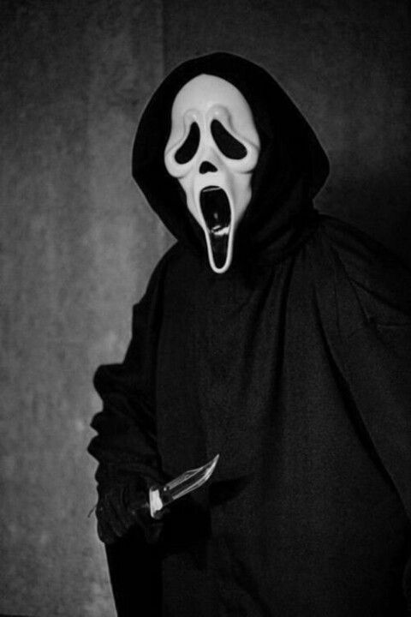
PRESENTATION
horror film (n)
/'hɒrə fɪlm/
phim kinh dị

Slide 11
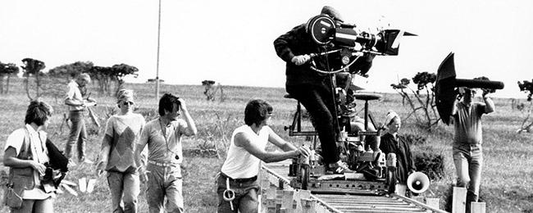
PRESENTATION
documentary (n)
/dɒkjʊˈmentəri/
phim tài liệu

Slide 12
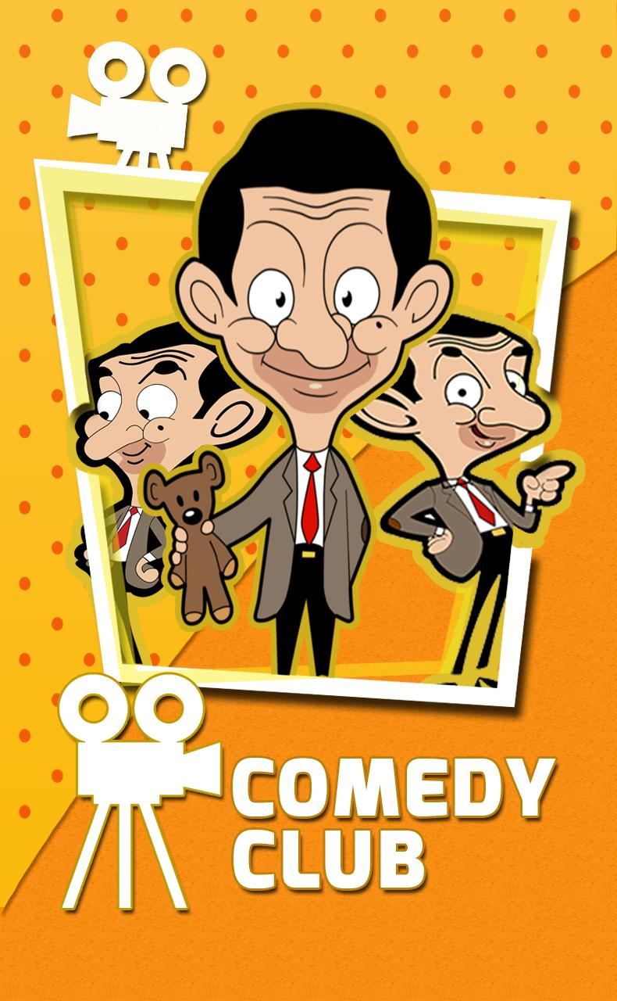
PRESENTATION
comedy (n)
/ˈkɒmədi/
phim hài

Slide 13
PRESENTATION
New words | Pronunciation | Meaning
horror film | /'hɒrə fɪlm/ | phim kinh dị
documentary | /dɒkjuˈmentri/ | phim tài liệu
comedy | /ˈkɒmədi/ | phim hài
fantasy | /ˈfæntəsi / | phim viễn tưởng

Slide 14
LESSON 1: GETTING STARTED
Chatting
WARM-UP
Vocabulary
PRESENTATION
Task 1: Listen and read.
Task 2: Read the conversation again and choose the correct answer.
Task 3: Choose the correct word or phrase.
Task 4: Complete the sentences.
PRACTICE

Slide 15
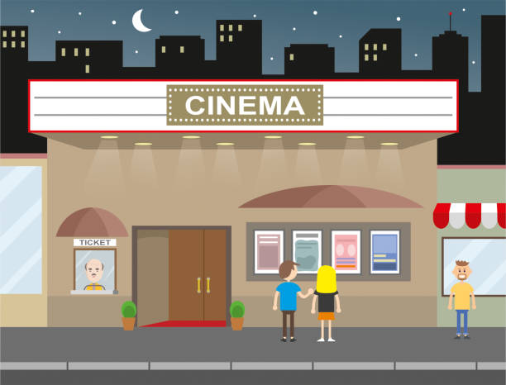
PRACTICE
1
Listen and read.
Aim of the task:
to have students get to know the topic.

Slide 16
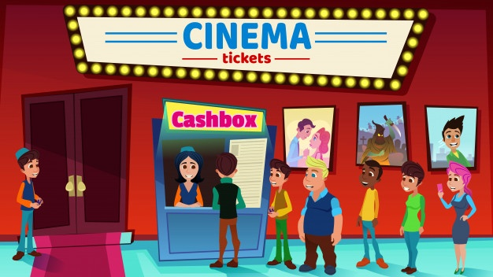
PRACTICE
2
Read the conversation again and choose the correct answer to each question.
Aim of the task:
to have students get specific information of the text.

Slide 17

PRACTICE
2
Read the conversation again and choose the correct answer to each question.
1. What does Mark suggest doing tonight?
a. Watching a TV show.
b. Watching a film.
c. Staying at home.
Mark: Let’s go to the cinema tonight!
Hoa: Good idea! What shall we see?

Slide 18
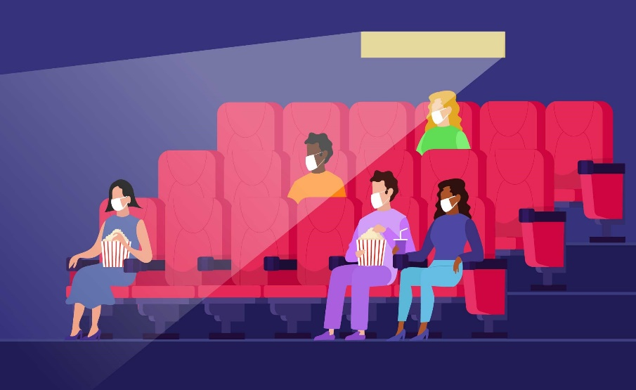
PRACTICE
2
Read the conversation again and choose the correct answer to each question.
2. Why doesn’t Mark want to see An Old Pier?
a. He doesn’t like that type of film.
b. It’s not on at a convenient time.
c. He saw it last week.
Hoa: That’s too frightening for me. Look! An Old Pier is on at the Town Cinema. It’s a documentary.
Mark: I don’t really like documentaries. They’re often boring. What about Our Holiday?

Slide 19

PRACTICE
2
Read the conversation again and choose the correct answer to each question.
3. The word “reviews” in the conversation mostly means ______.
a. people’s opinions about the film
b. interesting scenes in the film
c. what people don’t like about the film

Slide 20

PRACTICE
2
Read the conversation again and choose the correct answer to each question.
4. What do people think of Our Holiday?
a. Everyone likes it.
b. No one likes it.
c. Most people like it.
Hoa: What are the reviews like?
Mark: Well, although a few people say it’s a bit silly, most say it’s funny and interesting.

Slide 21
PRACTICE
3
Choose the correct word or phrase to complete each of
the following sentences.
comedy
Aim of the task:
to introduce more types of films.
fantasy
science fiction film
Types of films
horror film
docu-mentary
cartoon

Slide 22
PRACTICE
3
Choose the correct word or phrase to complete each of
the following sentences.
comedy
Game: Who is faster?
Slap the correct types of films.
fantasy
science fiction film
Types of films
1. A film that tries to make the audience laugh is a ………………
horror film
docu-mentary
cartoon

Slide 23
PRACTICE
3
Choose the correct word or phrase to complete each of
the following sentences.
comedy
Game: Who is faster?
Slap the correct types of films.
fantasy
science fiction film
Types of films
2. A film that is based only on
imagination, not on real facts, is a ……
horror film
docu-mentary
cartoon

Slide 24
PRACTICE
3
Choose the correct word or phrase to complete each of
the following sentences.
comedy
Game: Who is faster?
Slap the correct types of films.
fantasy
science fiction film
Types of films
3. A film that shows real life events or stories is a ……………..
horror film
docu-mentary
cartoon

Slide 25
PRACTICE
3
Choose the correct word or phrase to complete each of
the following sentences.
comedy
Game: Who is faster?
Slap the correct types of films.
fantasy
science fiction film
Types of films
4. A film that is set in the future, often about science, is a …………..
horror film
docu-mentary
cartoon

Slide 26
PRACTICE
3
Choose the correct word or phrase to complete each of
the following sentences.
comedy
Game: Who is faster?
Slap the correct types of films.
fantasy
science fiction film
Types of films
5. A film in which strange and frightening things happen is a ………..
horror film
docu-mentary
cartoon

Slide 27
PRACTICE
4
Complete the following sentences with the words in the box.
Aim of the task:
to introduce adjectives describing films.
funny
boring
frightening
moving
boring

Slide 28
PRACTICE
4
Complete the following sentences with the words in the box.
funny
interesting
frightening
moving
boring
frightening
1. Going to the hospital can be _________________ for a child.
2. The film was so _______________ that the audience couldn’t stop laughing.
3. Many people cried when they saw the _______________ scenes of the film.
4. The film last night was so _______________ that we fell asleep.
5. This book is ________________. I got a lot of useful information from it.
funny
moving
boring
interesting

Slide 29
LESSON 1: GETTING STARTED
WARM-UP
Chatting
PRESENTATION
Vocabulary
Task 1: Listen and read.
Task 2: Read the conversation again and choose the correct answer.
Task 3: Choose the correct word or phrase.
Task 4: Complete the sentences.
PRACTICE
PRODUCTION
Task 5: Work in pairs. Ask and answer about a type of film.

Slide 30

PRODUCTION
5
Work in pairs. ask and answer about a type of film. Use some of the adjectives in Task 4.
Example:
A: Do you like documentaries?
B: No, I don’t.
A: Why not?
B: I think they’re boring.

Slide 31
LESSON 1: GETTING STARTED
WARM-UP
Chatting
PRESENTATION
Vocabulary
Task 1: Listen and read.
Task 2: Read the conversation again and choose the correct answer.
Task 3: Choose the correct word or phrase.
Task 4: Complete the sentences.
PRACTICE
PRODUCTION
Task 5: Work in pairs. Ask and answer about a type of film.
CONSOLIDATION
Wrap-up
Homework

Slide 32
CONSOLIDATION
1
Wrap-up
Topic of the unit
FILMS
Vocabulary
Types of films
Adjectives describing films

Slide 33
CONSOLIDATION
2
Homework
Think about your favourite film.
Use at least 3 adjectives to describe it.

Slide 34

Website: hoclieu.vn
Fanpage: facebook.com/www.tienganhglobalsuccess.vn/

