Slide 1
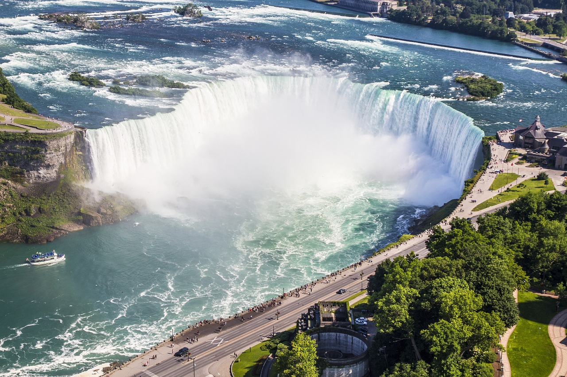

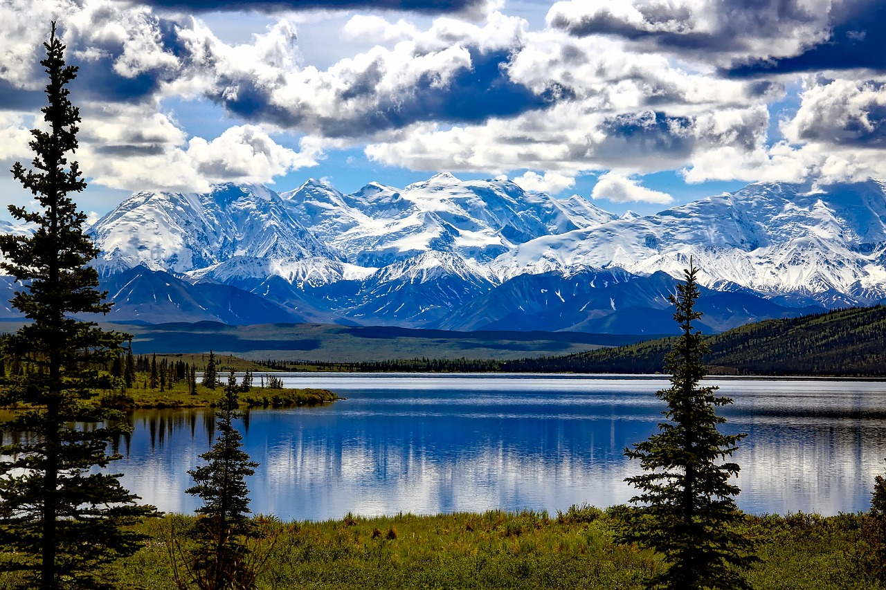



Unit
NATURAL WONDERS
6
LESSON 7: LOOKING BACK & PROJECT

Slide 2
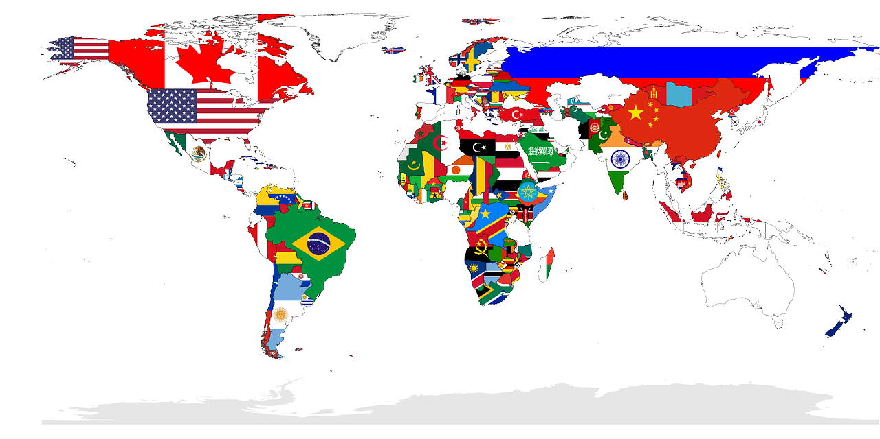

Unit
9
WORLD ENGLISHES
LESSON 7: LOOKING BACK & PROJECT

Slide 3
Unit
9
WORLD ENGLISHES
LESSON 7: LOOKING BACK & PROJECT

Slide 4

OBJECTIVES
By the end of the lesson, students will be able to:
Review the vocabulary and grammar of Unit 9
Apply what they have learnt (vocabulary and grammar) into practice through a project.

Slide 5

LESSON 7: LOOKING BACK & PROJECT
LESSON 1: GETTING STARTED
WARM-UP
Brainstorming
Task 1: Fill in the blank with word from the box.
Task 2: Choose the correct answer A, B, C, or D to complete each sentence.
VOCABULARY
Task 3: Read each sentence and circle the relative pronoun which can be omitted.
Task 4: Combine the two sentences, using a relative pronoun. Start the new sentence with the given phrase.
GRAMMAR
PROJECT
Poster presentation
CONSOLIDATION
Wrap-up
Homework

Slide 6
bilingual
mean
immigrants
concentric
fluent
WARM-UP
BRAINSTORMING
- Work in teams
- Members of each team take turns and write as many vocabulary in Unit 9 as possible in ................. minutes.
- The group having more correct answers is the winner.

Slide 7
VOCABULARY
1
Fill in the blank with word from the box
1. My students usually go ______ their homework before they hand it in.
A. into
B. over
C. in
D. up
bilingual
mean
immigrants
concentric
fluent
mean
2. Do you know how many ______ of English are there?
A. grammars
B. vocabulary
C. varieties
D. official languages
1. What does this word _____________in English?
concentric
2. The Kachru’s model has three _______________circles
3. The little boy talks to his mum in Vietnamese and to his dad in English. He’s ____________.
bilingual
fluent
4. Many children in this area are _________English speakers, but they can’t write in English
immigrants
5. The number of ____________ in this country has increased quickly for the last three years

Slide 8
VOCABULARY
2
Choose the correct answer A, B, C, or D to complete each sentence.
3. For homework, please copy these English sentences ______ your notebook.
A. into
B. over
C. on
D. up
1. My students usually go ______ their homework before they hand it in.
A. into
B. over
C. in
D. up
2. Do you know how many ______ of English are there?
A. grammars
B. vocabulary
C. varieties
D. official languages
4. She’s good at ______ English short stories into Vietnamese
A. translating
B. picking
C. looking
D. copying

Slide 9
1. My students usually go ______ their homework before they hand it in.
A. into
B. over
C. in
D. up
2. Do you know how many ______ of English are there?
A. grammars
B. vocabulary
C. varieties
D. official languages
VOCABULARY
2
Choose the correct answer A, B, C, or D to complete each sentence.
3. For homework, please copy these English sentences ______ your notebook.
A. into
B. over
C. on
D. up
4. She’s good at ______ English short stories into Vietnamese
A. translating
B. picking
C. looking
D. copying
5. After living in Singapore for several years, she has ______ up some Singaporean English
A. copied B. gone
C. looked D. picked

Slide 10
3. For homework, please copy these English sentences ______ your notebook.
A. into
B. over
C. on
D. up
4. She’s good at ______ English short stories into Vietnamese
A. translating
B. picking
C. looking
D. copying
VOCABULARY
2
Choose the correct answer A, B, C, or D to complete each sentence.
5. After living in Singapore for several years, she has ______ up some Singaporean English
A. copied B. gone
C. looked D. picked

Slide 11
LESSON 7: LOOKING BACK & PROJECT
LESSON 1: GETTING STARTED
WARM-UP
Brainstorming
Task 1: Fill in the blank with word from the box.
Task 2: Choose the correct answer A, B, C, or D to complete each sentence.
VOCABULARY
Task 3: Read each sentence and circle the relative pronoun which can be omitted.
Task 4: Combine the two sentences, using a relative pronoun. Start the new sentence with the given phrase.
GRAMMAR

Slide 12
GRAMMAR
Read each sentence and circle the relative pronoun which can be omitted.
3
When we can omit a relative pronoun in a relative clause?
We can omit a relative pronoun in English when it is an object.

Slide 13
GRAMMAR
3
Underline the correct answers to complete the sentences.
1.These are the words which are the same in both British English and American English.
=> Can’t omit
2. English is the language which people use the most in the world.
=> Can omit “which”
=> English is the language which people use the most in the world.

Slide 14
GRAMMAR
3
Underline the correct answers to complete the sentences.
3.The boy who is giving a presentation in English on the stage is my student.
=> Can’t omit
4. Spanish is the language which has the second largest number of nativespeakers
=> Can’t omit

Slide 15
GRAMMAR
3
Underline the correct answers to complete the sentences.
1. The English-English dictionary is on the table. My dad gave it to me last year
5. The exchange student who we invited to join our club comes from the Philippines, so his English is so good.
=> Can omit “which”
=> The exchange student we invited to join our club comes from the Philippines, so his English is so good.
The English-English dictionary

Slide 16
GRAMMAR
4
4
Combine the two sentences, using a relative pronoun. Start the new sentence with the given phrase.
2. She used some words in her speech. These words are from French
1. The English-English dictionary is on the table. My dad gave it to me last year
She used some
(which) my dad gave to me
last year is on the table.
The English-English dictionary
3. He has learnt English on a website. I recommended the website to him two years ago.
He has learnt

Slide 17
1. The English-English dictionary is on the table. My dad gave it to me last year
The English-English dictionary
GRAMMAR
4
4
Combine the two sentences, using a relative pronoun. Start the new sentence with the given phrase.
4. Some languages have a lot of speakers. English is one of them
2. She used some words in her speech. These words are from French
words which are from French in her speech.
She used some
English is one of
5. My sister is learning English at a language centre. It has the best teachers
in our town.
3. He has learnt English on a website. I recommended the website to him two years ago.
English on a website (which) I recommended to him two years ago.
My sister is learning
He has learnt

Slide 18
2. She used some words in her speech. These words are from French
She used some
3. He has learnt English on a website. I recommended the website to him two years ago.
He has learnt
GRAMMAR
4
4
Combine the two sentences, using a relative pronoun. Start the new sentence with the given phrase.
4. Some languages have a lot of speakers. English is one of them
the languages (which) has a lot of speakers.
English is one of
5. My sister is learning English at a language centre. It has the best teachers
in our town.
English at a language centre which has the best teachers in our town
My sister is learning

Slide 19



LESSON 7: LOOKING BACK & PROJECT
LESSON 1: GETTING STARTED
WARM-UP
Brainstorming
Task 1: Fill in the blank with word from the box.
Task 2: Choose the correct answer A, B, C, or D to complete each sentence.
VOCABULARY
Task 3: Read each sentence and circle the relative pronoun which can be omitted.
Task 4: Combine the two sentences, using a relative pronoun. Start the new sentence with the given phrase.
GRAMMAR
PROJECT
Poster presentation
CONSOLIDATION
Wrap-up
Homework

Slide 20
ENGLISH
AROUND THE WORLD
PROJECT

Slide 21
PROJECT
-Work in your groups. Give them a few minutes to prepare for the presentation.
- There are checklists for self and peer assessment.
- Check appropriate items while listening to your classmates’ presentations and write comments if you have any.

Slide 22
1/ Self-assessment
 | Tick where appropriate | Comments (in English or Vietnamese)
DELIVERY
1. I greeted the audience.
2. I spoke clearly and naturally.
3.I cooperated with my group members when delivering the talk.
4. I interacted with the audience.
5. I used some photos/pictures to illustrate my points.
6. I concluded my part of the talk appropriately.
CONTENT: presentation includes the following information
1. the number of English speakers in the country
2. any other languages its people speak
3. the roles of English in the country

Slide 23

1/ Peer-assessment
 | Tick where appropriate | Comments (in English or Vietnamese)
DELIVERY
1. The presenters greeted the audience.
2. The presenters spoke clearly and naturally.
3.The presenters cooperated with my group members when delivering the talk.
4. The presenters interacted with the audience.
5. The presenters used some photos/pictures to illustrate my points.
6. The presentersconcluded my part of the talk appropriately.
CONTENT: presentation includes the following information
1. the number of English speakers in the country
2. any other languages its people speak
3. the roles of English in the country
PRESENTATION

Slide 24
PROJECT
PRESENTATION

Slide 25
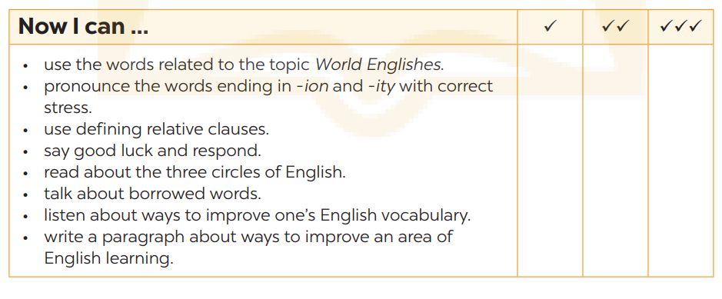
NOW I CAN...
Complete the self-assessment table.

Slide 26
LESSON 7: LOOKING BACK & PROJECT
LESSON 1: GETTING STARTED
WARM-UP
Brainstorming
Task 1: Fill in the blank with word from the box.
Task 2: Choose the correct answer A, B, C, or D to complete each sentence.
VOCABULARY
Task 3: Read each sentence and circle the relative pronoun which can be omitted.
Task 4: Combine the two sentences, using a relative pronoun. Start the new sentence with the given phrase.
GRAMMAR
PROJECT
Poster presentation
CONSOLIDATION
Wrap-up
Homework

Slide 27

CONSOLIDATION
1
Wrap-up
What have we learnt in this lesson?
Review the vocabulary and grammar of Unit 9
Apply what they have learnt (vocabulary and grammar) into practice through a project.

Slide 28

CONSOLIDATION
2
Homework
- Prepare for the next lesson

Slide 29
Website: hoclieu.vn
Fanpage: facebook.com/www.tienganhglobalsuccess.vn/

