Slide 2




Unit
6
OUR TET HOLIDAY
LESSON 1: GETTING STARTED
Happy New Year

Slide 3
Unit
6
OUR TET HOLIDAY
LESSON 1: GETTING STARTED
Happy New Year

Slide 4
LESSON 1: GETTING STARTED
LESSON 1: GETTING STARTED
WARM-UP
Quick draw
PRESENTATION
Vocabulary
Task 1: Listen and read.
Task 2: What are Linda and Phong talking about? Task 3: Complete the sentences.
Task 4: Match the words/phrases with the pictures.
PRACTICE
PRODUCTION
Task 5: Game – Is it about Tet?
CONSOLIDATION
Wrap-up
Homework

Slide 5

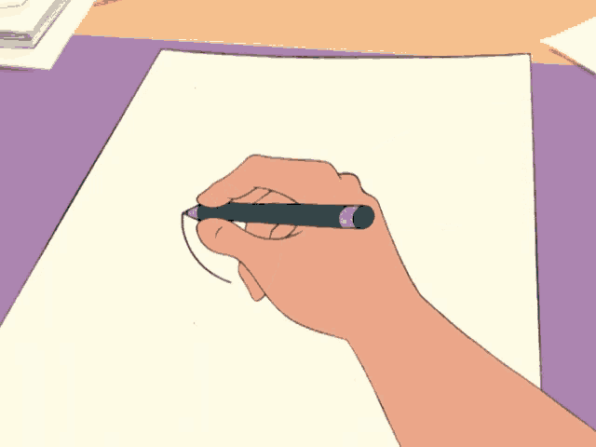
WARM-UP
Quick draw

Slide 6
WARM-UP
HOW TO PLAY

Slide 7
WARM-UP
- Work in groups
- Each round, one student from each team stands up and faces away from the screen.
- There are the words/sentences on the screen. Members in each group will describe the words/sentences so that the students can draw the picture.
- If you draw right picture, your team will have points.

Slide 8
WARM-UP
LET’S PLAY

Slide 9
WARM-UP
flowers

Slide 10
WARM-UP
fireworks

Slide 11
WARM-UP
sticky rice cake

Slide 12
WARM-UP
visit grandparents

Slide 13
WARM-UP
exchange gifts

Slide 14


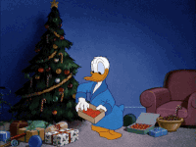
PRESENTATION
celebrate (v)
/ˈselɪbreɪt/
to show that a day or an event is important by doing something special on it

Slide 15
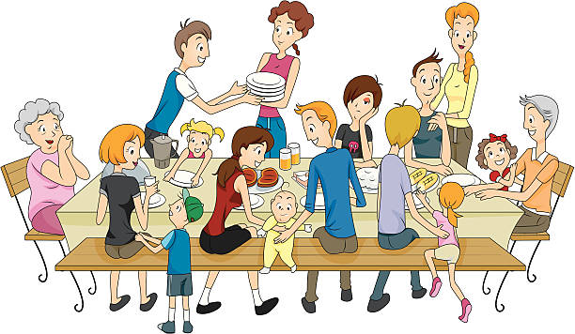
PRESENTATION
decorate (v)
/ˈdekəreɪt/
to make something look more attractive by putting things on it

Slide 16

PRESENTATION
family gathering (n. phr.)
/ˈfæməli ˈɡæðərɪŋ/
all members of a family meeting together for a social event

Slide 17
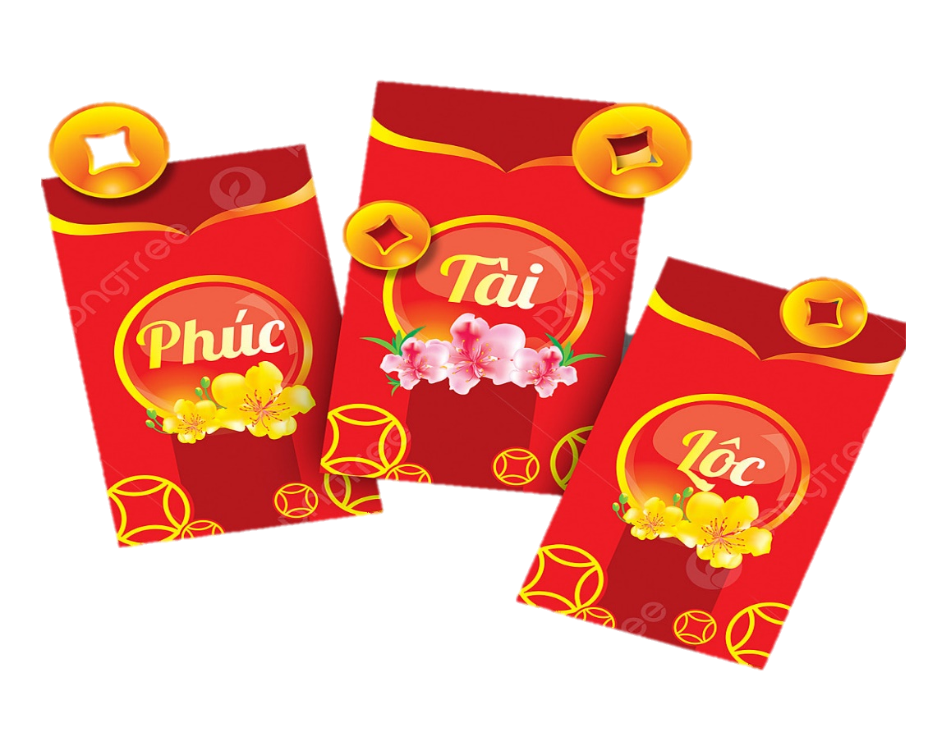
PRESENTATION
lucky money (n. phr.)
/ˈlʌki ˈmʌni/
money placed in a red envelope and given as a gift, usually for Lunar New Year

Slide 18
PRESENTATION
New words | Pronunciation | Meaning
1. celebrate (v) | /ˈselɪbreɪt/ | ăn mừng, tán dương
2. decorate (v) | /ˈdekəreɪt/ | trang trí
3. family gathering | /ˈfæməli ˈɡæðərɪŋ/ | sum họp gia đình
4. lucky money | /ˈlʌki ˈmʌni/ | tiền lì xì

Slide 19

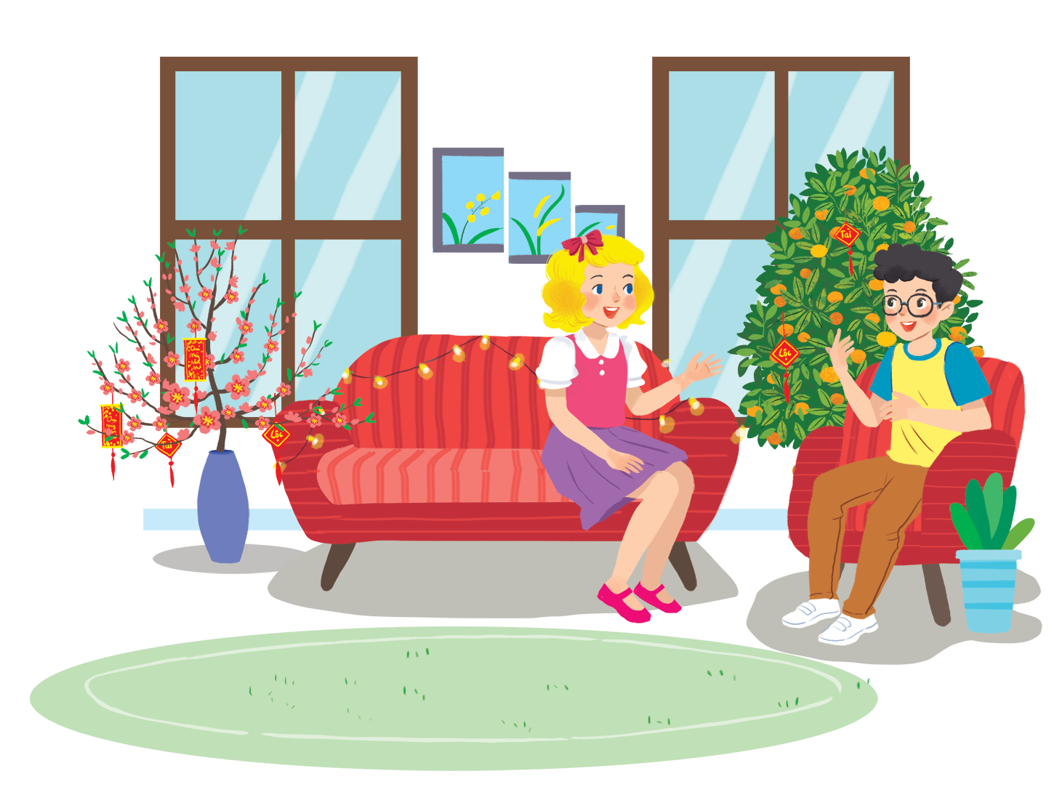
PRACTICE
1
Listen and read.
Questions:
1. What do you think they are talking about?
2. When is Tet?
3. Is it a holiday?
4. What do we do at Tet?

Slide 20




PRACTICE
2
What are Linda and Phong talking about?
A. New Years in the world
B. Tet in Viet Nam
C. What to eat and wear during Tet

Slide 21


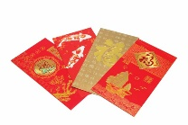



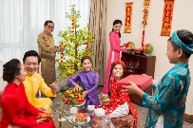
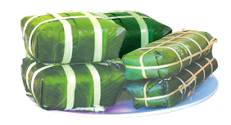

PRACTICE
3
Complete the sentences about Tet.
1.
January
This year Tet is in
.
2.
We decorate our
homes
.
3.
Tet is a time for family
gatherings
.
4.
Children get
lucky money
.
5.
People shouldn’t
break
anything.

Slide 22
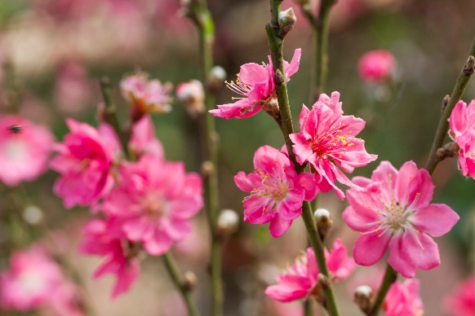
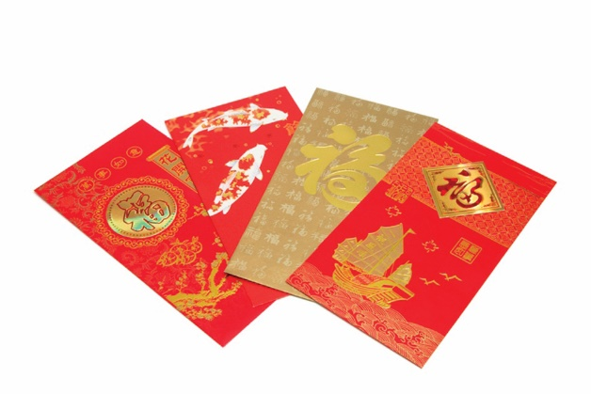
PRACTICE
4
Match the words / phrases in the box with the pictures.
a. lucky money
c. banh chung and banh tet
b. peach flowers
d. family gathering
1
2
b. peach flowers
a. lucky money

Slide 23
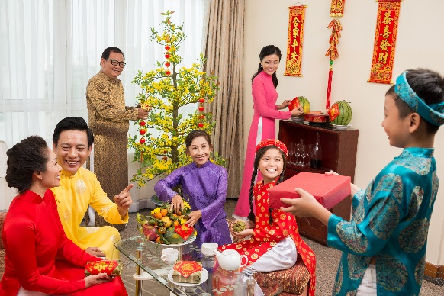
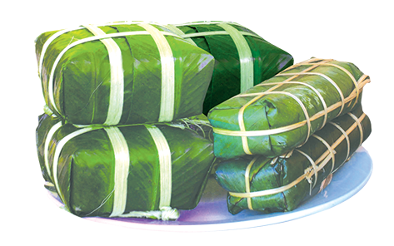
PRACTICE
4
Match the words / phrases in the box with the pictures.
a. lucky money
a. lucky money
c. banh chung and banh tet
c. banh chung and banh tet
b. peach flowers
b. peach flowers
d. family gathering
d. family gathering
3
4
c. banh chung and banh tet
d. family gathering

Slide 24

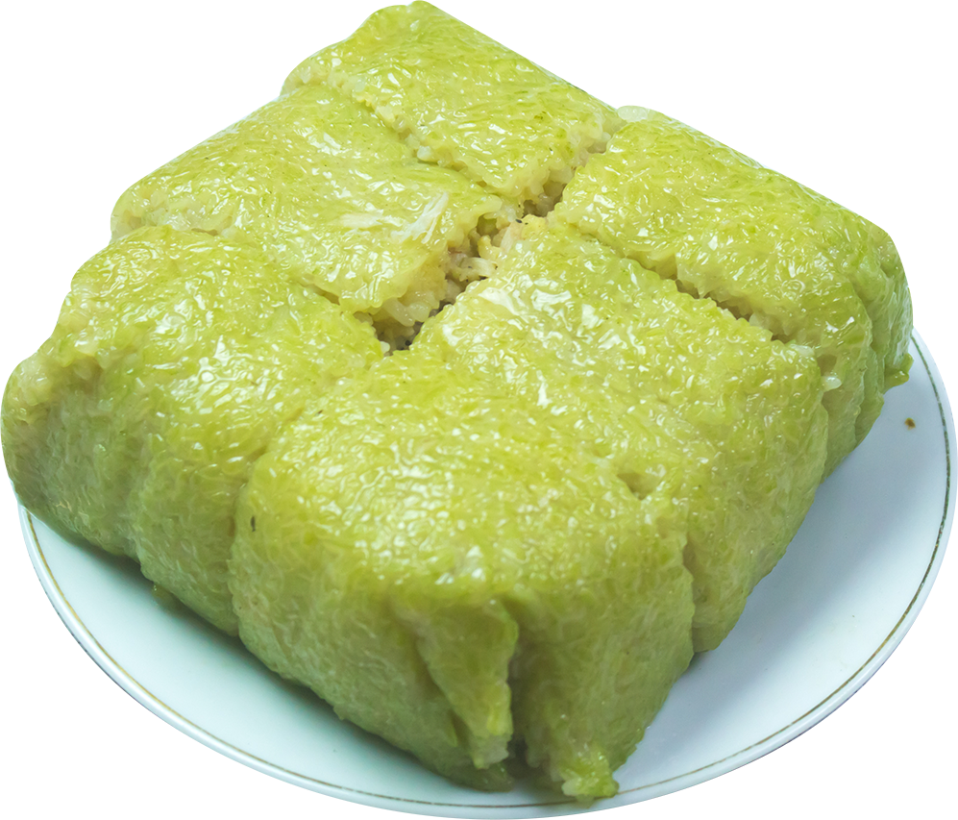
PRODUCTION
5
Is it about Tet?
Write two things or activities and share them with the class. The class listen and decide whether they are about or not about Tet.
Example:
Student: banh chung
Class: It’s about Tet.
Student: flying a kite.
Class: It’s not about Tet.

Slide 25
CONSOLIDATION
1
Wrap-up
- Tell me some words you remember from the lesson.
- Make some sentences with vocabulary which you’ve learnt from the lesson.

Slide 26

CONSOLIDATION
1
Wrap-up
What have we learnt in this lesson?
Identify the topic of the unit
Use lexical items related to “Tet”
Use the vocabulary and structures to describe things and activities at Tet

Slide 27

CONSOLIDATION
2
Homework
- Learn new words by heart.
- Practice using phrases you have learnt.

Slide 28






Website: hoclieu.vn
Fanpage: facebook.com/www.tienganhglobalsuccess.vn/

