Slide 1


Slide 2

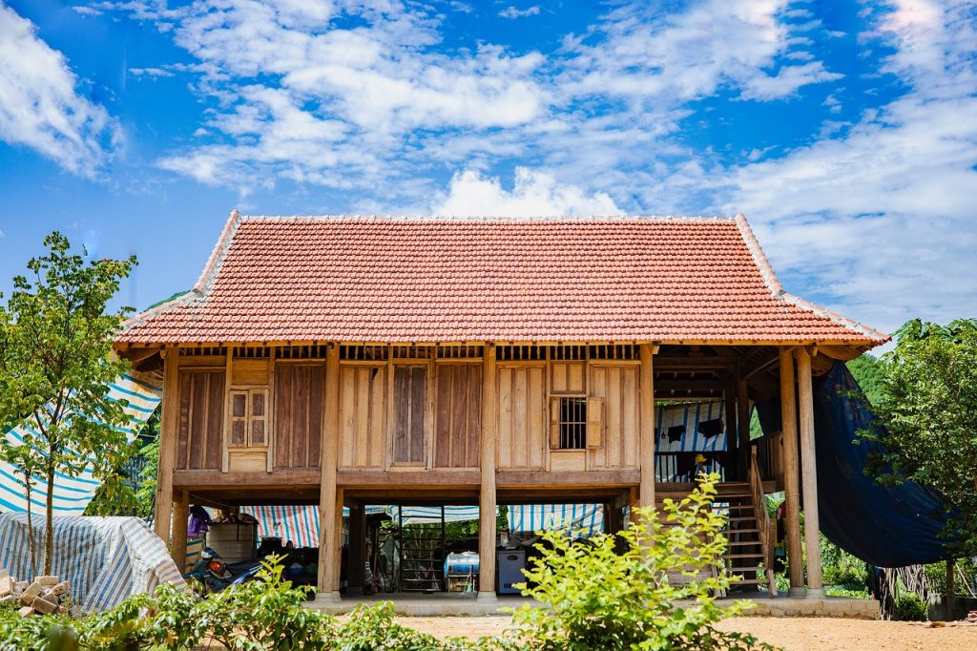
Unit
4
ETHNIC GROUPS OF VIET NAM
Unit
ETHNIC GROUPS OF VIET NAM
LESSON 5: SKILLS 1
LESSON 3: A CLOSER LOOK 2
Unit
HOBBIES

Slide 3
LESSON 5: SKILLS 1
WARM-UP
Who’s faster?
READING
Vocabulary
Task 1: Write the words and phrase from the box under the correct pictures.
Task 2: Read the passage and tick T (true) or F (false)
Task 3: Read the passage again and fill in each blank with one word
SPEAKING
Task 4: Work in pairs. Discuss and tick the features of a stilt house from the list below. Share your opinions with the class.
Task 5: Work in pairs. Ask and answer about the type of home each of you lives in. Take notes of your partner’s answer and report what you find to the class
CONSOLIDATION
Wrap-up
Homework

Slide 4
WARM-UP
Villa
Types of house

Slide 5
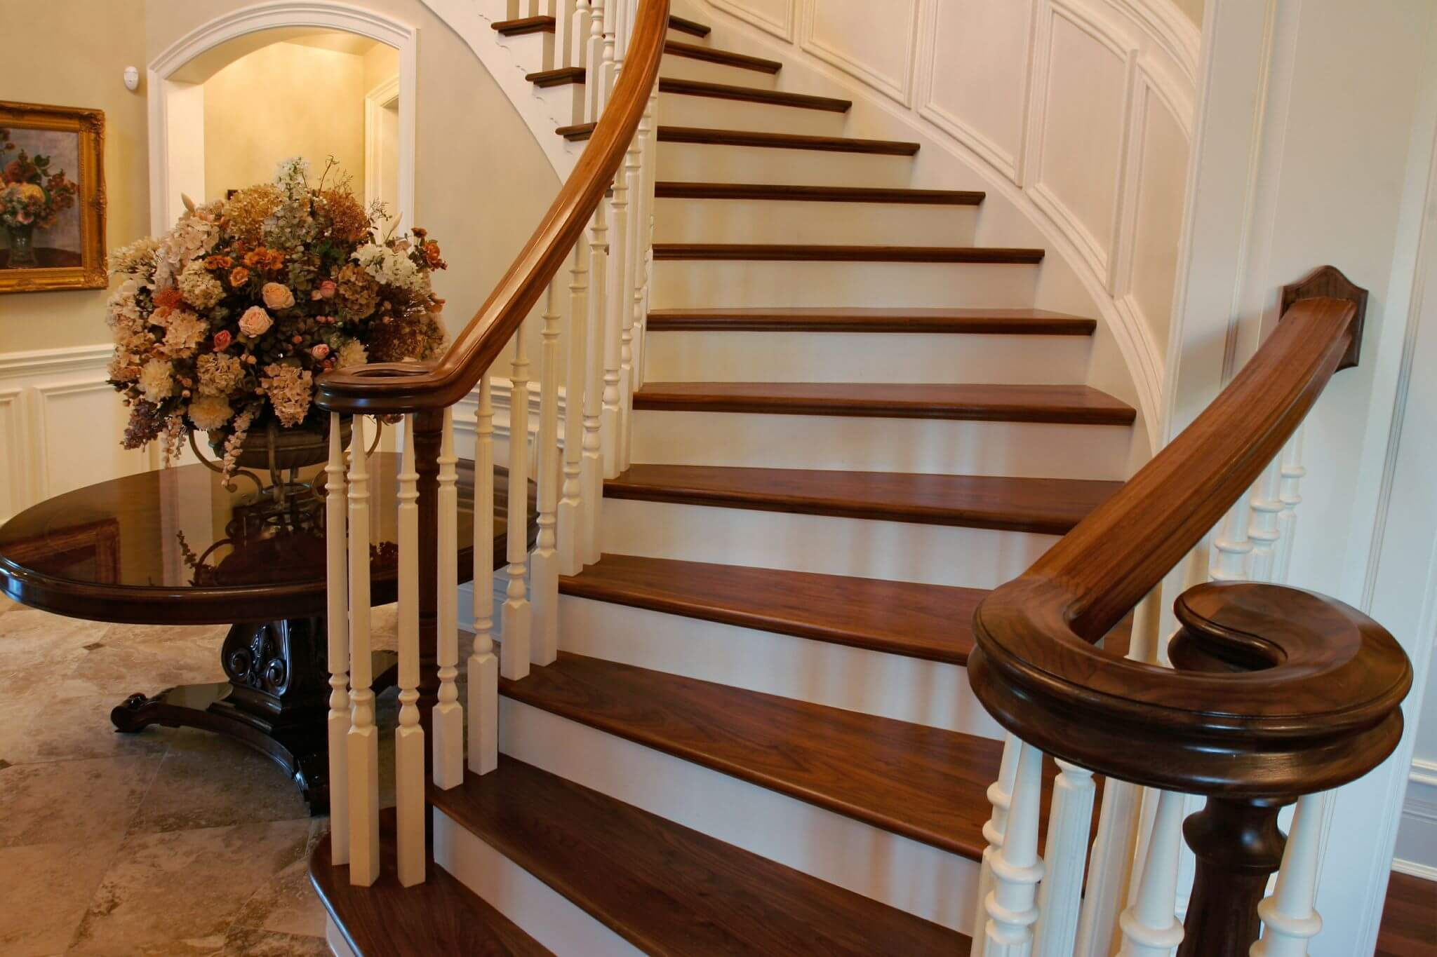

VOCABULARY
staircase (n)
/ˈsteəkeɪs/
cầu thang bộ

Slide 6

VOCABULARY
material (n)
/məˈtɪəriəl/
vật liệu

Slide 7
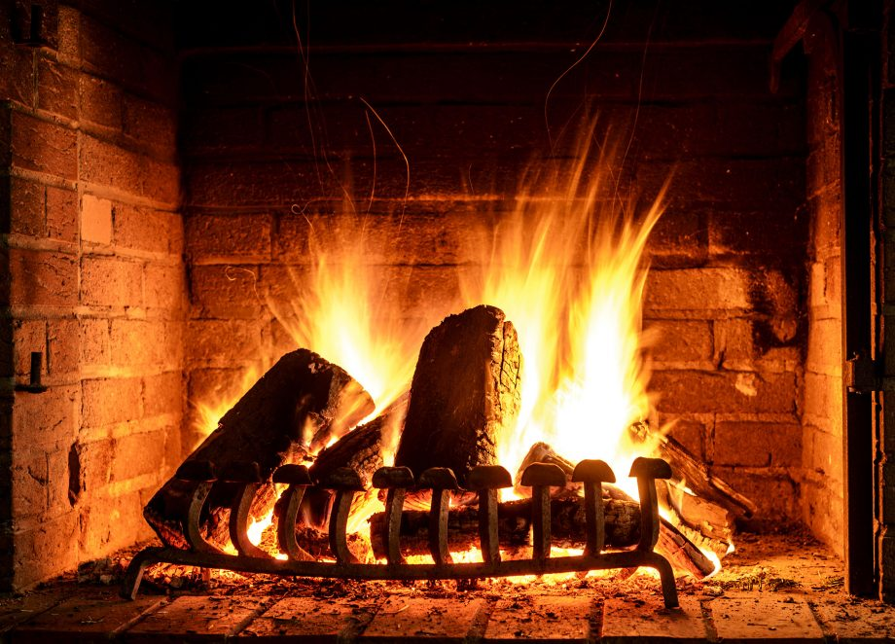
VOCABULARY
open fire (n)
/ˌəʊpən ˈfaɪə/
lò sưởi, bếp lửa

Slide 8

VOCABULARY
owner (n)
/ˈoʊnə/
người sở hữu, chủ

Slide 9
VOCABULARY
New words | Pronunciation | Meaning
1. staircase (n) | /ˈsteəkeɪs/ | cầu thang bộ
2. material (n) | /məˈtɪəriəl/ | vật liệu
3. open fire (n) | /ˌəʊpən ˈfaɪə/ | lò sưởi, bếp lửa
4. owner (n) | /ˈoʊnə/ | người sở hữu, chủ

Slide 10
VOCABULARY
New words |  | Meaning
1. staircase (n)
2. material (n)
3. open fire (n)
4. owner (n)
vật liệu
người sở hữu, chủ
cầu thang bộ
lò sưởi, bếp lửa

Slide 11
READING
1
Write the words and phrase from the box under the correct pictures.
open fire
posts
staircase
1. _______________
2. _______________
3. _______________

Slide 12

READING
2
Read the passage and tick T (True) or F (False)
Statements | True | False
1. Only a few minority groups live in stilt houses.
2. All stilt houses look alike.
3. Family gatherings take place by the open fire in the middle of the house.
4. The Rong house serves as the centre of an Ede village

Slide 13
READING
3
Read the passage again and fill in each blank with one word.
1. A stilt house shows the _________ culture of the owner.
traditional
2. The Tay’s and Nung’s stilt houses overlook a _________.
field
3. The Thai’s stilt houses overlook a _________ or __________.
forest
mountains
4. The largest and tallest house in an Ede village is the _________ house.
Rong

Slide 14


SPEAKING
4
Work in pairs. Discuss and tick ( )the features of a stilt house from the list below. Share your opinions with the class.
A stilt house ____________.
- has a flat cement roof
- stands on big posts
- is made from natural materials
- has a modern toilet
- is a flat in a big block
- is close to nature

Slide 15
SPEAKING
5
Work in pairs. Ask and answer about the type of home each of you lives in. Take notes of your partner’s answer and report what you find to the class.
1. What type of home do you live in?
2. What materials is it made from?
3. What is the most important part of your home? What do you do there?

Slide 16

CONSOLIDATION
1
Wrap-up
In this lesson, you have:
learnt new words related to the topic of stilt house.
read a passage about stilt houses.
described the house you live in.

Slide 17

CONSOLIDATION
2
Homework
Learn by heart all the new words.
Do exercises in the workbook.
Prepare for Lesson 6 – Skills 2.

Slide 18

Website: hoclieu.vn
Fanpage: facebook.com/www.tienganhglobalsuccess.vn/

