Slide 1


Slide 2


REVIEW
1
UNIT 1-2-3
LESSON 2: SKILLS

Slide 3
LESSON 1: LANGUAGE
WARM-UP
Miming game
READING
Task 1: Read the passage and choose the correct answer A, B, or C.
Task 2: Work in pairs. interview each other, using the questions below. Take notes of the answers and then report the results to the class.
SPEAKING
LISTENING
Task 3: Listen to Tom and Mai talking about their lives in the city and the countryside. Fill in each blank with one word.
WRITING
Task 4: Write a paragraph (80 - 100 words) about the leisure activities one of your family members does.
CONSOLIDATION
Wrap-up
Homework

Slide 4



WARM-UP
MIMING
GAME
GARDENING
TAKING PHOTOS
HORSE RIDING

Slide 5
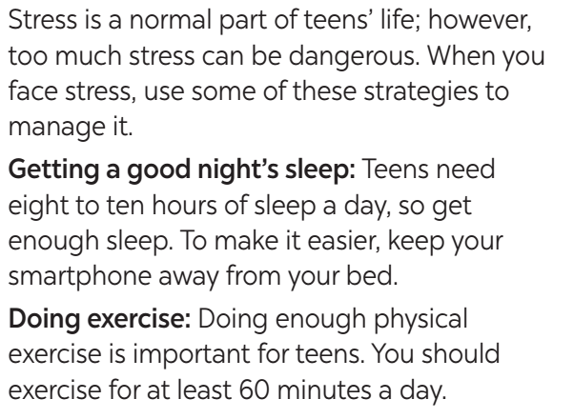
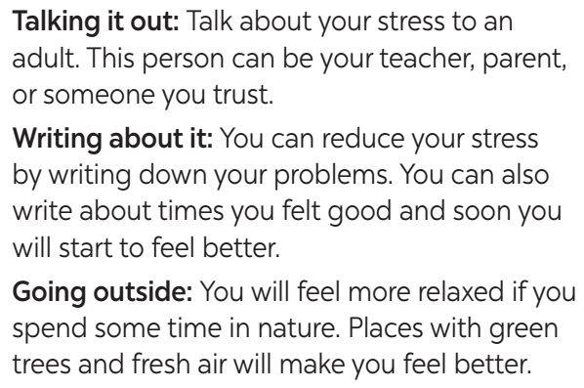
READING
1
Read the passage and choose the correct answer A, B, or C.

Slide 6

READING
1
Read the passage and choose the correct answer A, B, or C.
1. The passage is about ______.
A. the causes of stress
B. strategies to deal with stress
C. the dangers of stress
2. how many hours of sleep a day do teens need?
A. 6 to 8. B. 7 to 9. C. 8 to 10.

Slide 7
READING
1
3. How much time should teens spend on daily exercise?
A. At least an hour.
B. Exactly 60 minutes.
C. No more than 60 minutes.
4. Teens may talk about their problems to ______.
A. a friend in their class
B. a young person they like
C. someone they trust
5. Teens can feel better when they ______.
A. are at home with their parents
B. get closer to nature
C. write to a friend

Slide 8
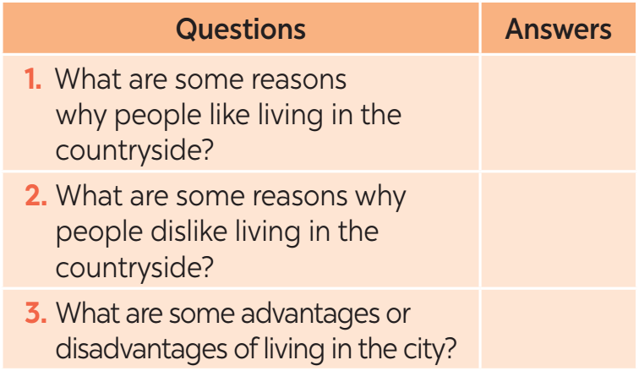
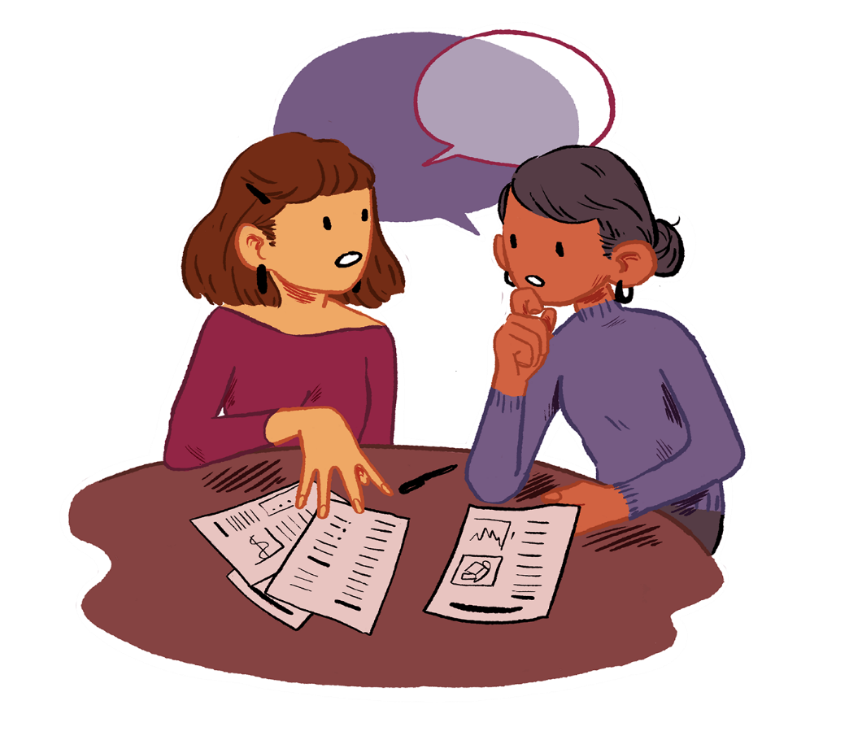
SPEAKING
2
Work in pairs. Interview each other, using the questions below. Take notes of the answers and then report the results to the class.

Slide 9

LISTENING
3
Listen to Tom and Mai talking about their lives in the city and the countryside. Fill in each blank with one word.
In the city | In the countryside
– There are many (1) ______ for entertainment. – It is more (2) _________ to get around. – There are many means of (3) ______ transport. | – It is peaceful and (4) _________. – Things are simple and lovely. – People are kind and (5) _________.
places
spacious
convenient
hospitable
public

Slide 10


WRITING
4
Write a paragraph (80 – 100 words) about the leisure activities one of your family members does.
1. What does he / she like doing in his / her free time?
2. Who does he / she like doing these with?
3. Why does he / she like doing these?

Slide 11
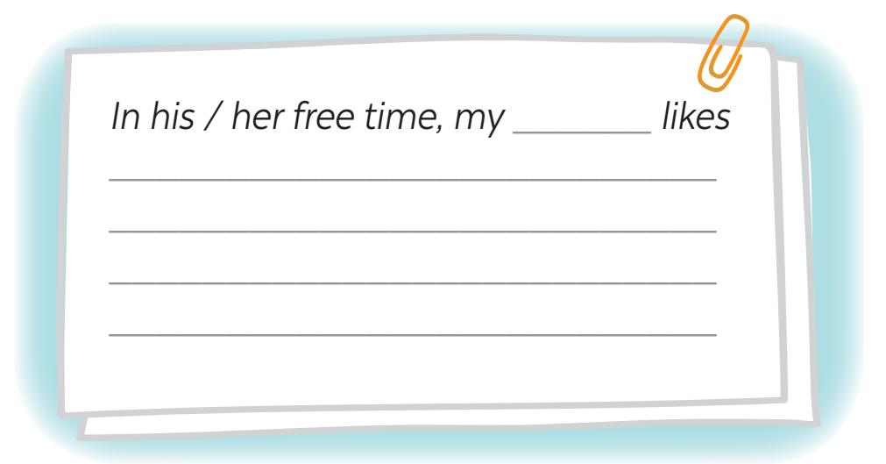

WRITING
4
Write a paragraph (80 – 100 words) about the leisure activities one of your family members does.
10 mins
1. What does he / she like doing in his / her free time?
2. Who does he / she like doing these with?
3. Why does he / she like doing these?

Slide 12

CONSOLIDATION
1
Wrap-up
What have we learnt in this lesson?
Practice 4 skills using lexical items learnt in Units 1-2-3

Slide 13

CONSOLIDATION
2
Homework
Students’ workbook.

Slide 14

Website: hoclieu.vn
Fanpage: facebook.com/www.tienganhglobalsuccess.vn/

