Slide 1
KET SPEAKING
Time allowed - 8-10 minutes
Normally you will do the speaking test with another candidate. The two of you will meet two examiners. One of the examiners will talk to you, the other does not participate in the conversations.
There are two parts to the speaking test:
Speaking part 1: short questions and answers between you and the examiner.
Speaking part 2: the examiner gives you some information or a card with some ideas for questions. You have to talk with the other candidate and ask or answer questions.
Scoring
The Speaking section is worth 25% of the total score for the exam.
How to prepare for KET Speaking:
Speak as much as you can, with your friends
Practise asking and answering questions about daily life
Practise giving information about yourself

Slide 2
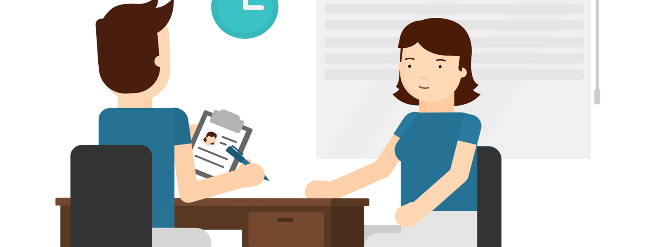
KEY ENGLISH TEST 4
Test 1 - Speaking

Slide 3

Part 1:
Student – examiner interaction
Section 1:
The examiner will ask you:
Your name
Where you come from?
Provide full-sentence answers

Slide 4

Part 1:
Student – examiner interaction
Section 2: You will be asked some questions that require longer answers. For example:
Why you like something
Details about a hobby…

Slide 5
Popular topic
family
best friend
hometown
your house
sport
computer
collecting
music

Slide 6
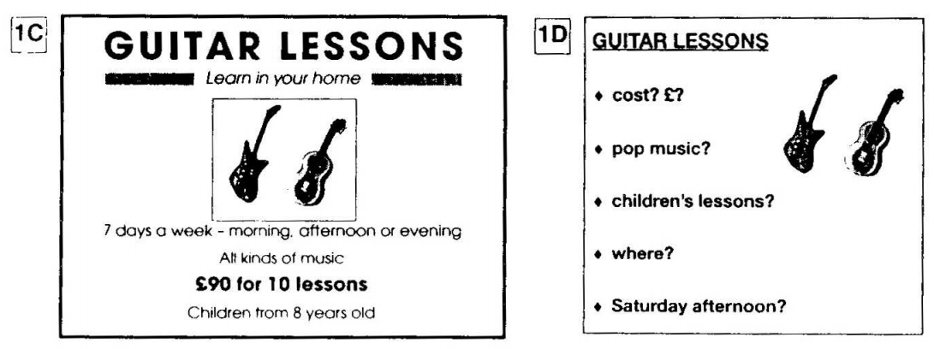
PART 2:
Student – student interaction
Ask and answer questions based on the cue cards
For example:
Do not just read from the cards. Answer in full sentences.
Pay attention to the grammar.

Slide 7

SPEAKING
PART 1

Slide 8
Part 1
What is/was your favourite subject?
Why do/did you like it? What classes don't/didn't you like? Why not?
What subjects are/were you good at?
What subjects are/were difficult for you?

Slide 9
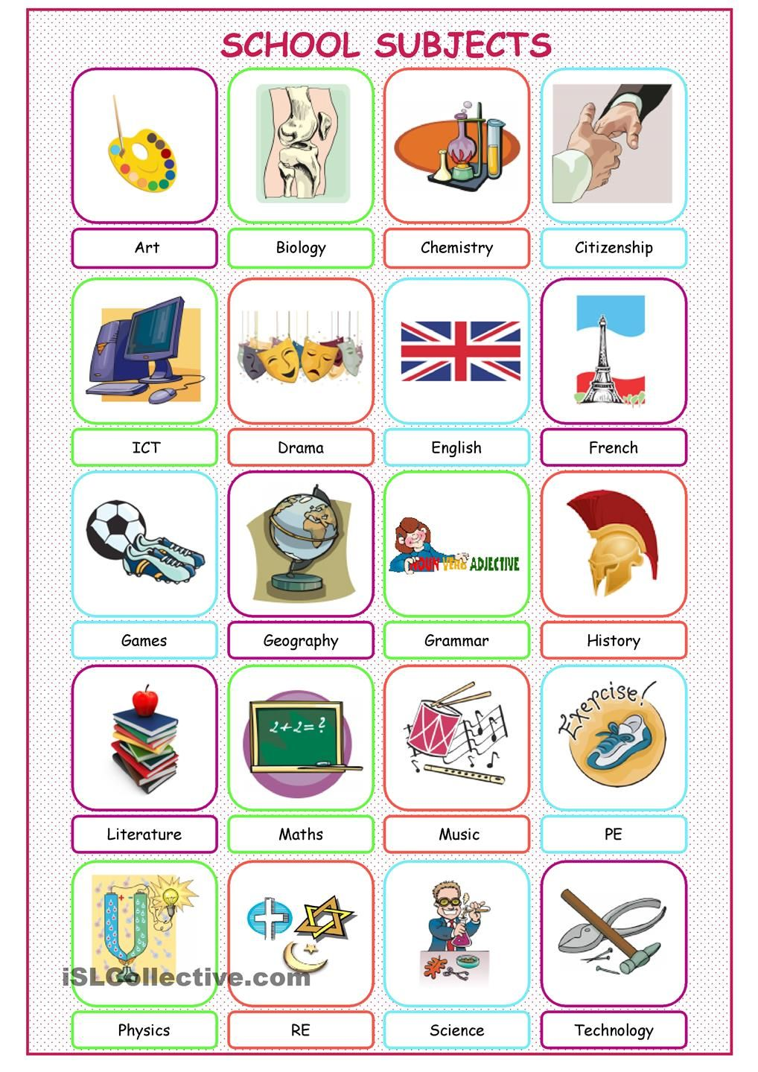


Slide 10

Name some compulsory subjects in your school.

Slide 11

to be good at/ bad at + n/ v-ing: giỏi về.../ kém về...
I am good at Math.
NamJoon is good at producing music.
What subjects are/were you good at?

Slide 12


Talk about your favourite subject
For example: My favourite subject is English. I feel that, this is one subject that I can learn effortlessly. In fact, to me studying English does not feel like studying at all, it seems like pursuing a hobby. I also love geography and computer science and look forward to studying them. However, English has always been on the top of my list. I can study the English chapters anytime and anywhere.

Slide 13
SPEAKING PART 2
Asking and answering questions using these prompt cards

Slide 14

Ask and answer
Ask and answer questions using the words given.

Slide 15
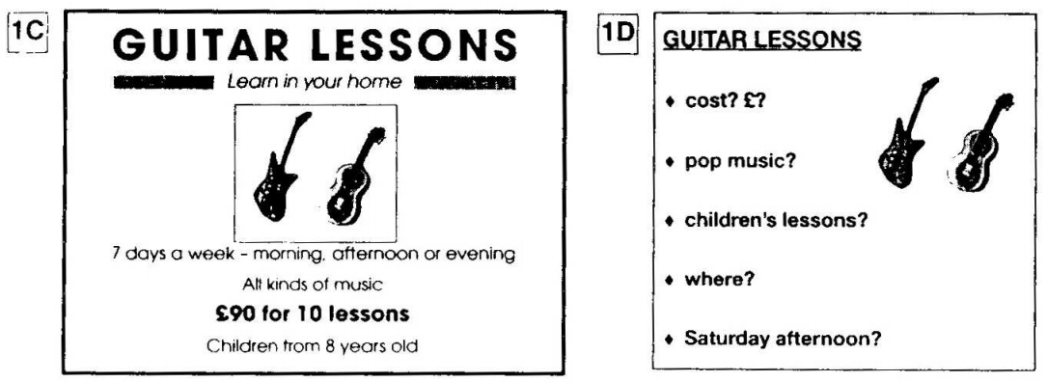
Ask and answer
Ask and answer questions using the words given.
What are other questions and answers you can think of?

Slide 16



Based on the given information, talk about the New World Music shop.

