Slide 1

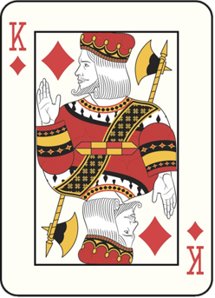
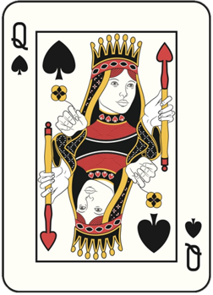
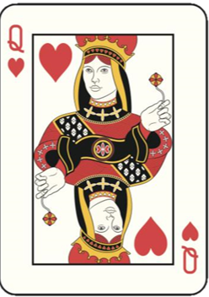

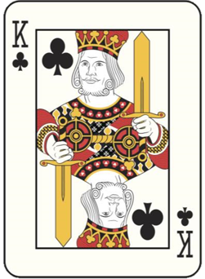
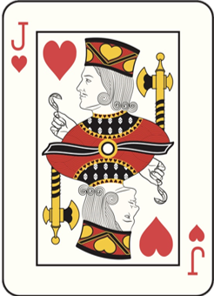
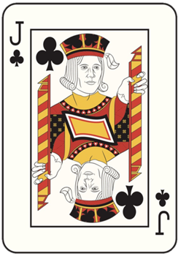
PICK A CARD AND
SAY ITS NAME
IN YOUR MIND
MIND READER II

Slide 2



PICK A CARD AND
SAY ITS NAME
IN YOUR MIND
MIND READER II
KEEP THINKING OF YOUR CARD
SAY IT OVER AND OVER IN YOUR MIND
AND LOOK INTO MY EYE

Slide 3

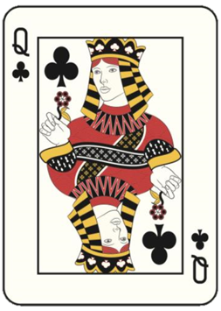
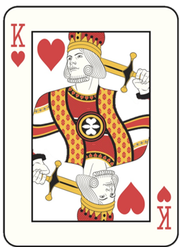

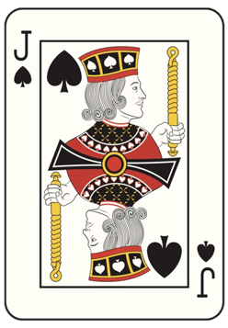
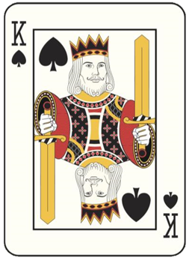
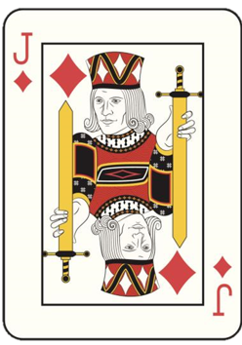

Slide 4

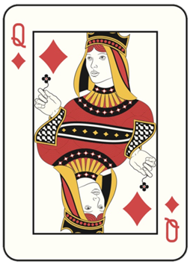
PICK A CARD AND
CONCENTRATE
ON IT
KEEP THINKING OF YOUR CARD
SAY IT OVER AND OVER IN YOUR MIND
AND LOOK INTO MY EYE

Slide 6
PICK A CARD AND
CONCENTRATE
ON IT
KEEP THINKING OF YOUR CARD
SAY IT OVER AND OVER IN YOUR MIND
AND LOOK INTO MY EYE

Slide 8
PICK A CARD AND
CONCENTRATE
ON IT
KEEP THINKING OF YOUR CARD
SAY IT OVER AND OVER IN YOUR MIND
AND LOOK INTO MY EYE

Slide 10
KEEP THINKING OF YOUR CARD
SAY IT OVER AND OVER IN YOUR MIND
AND LOOK INTO MY EYE

