Slide 1
Hi!
MARCOM iGV

Slide 2
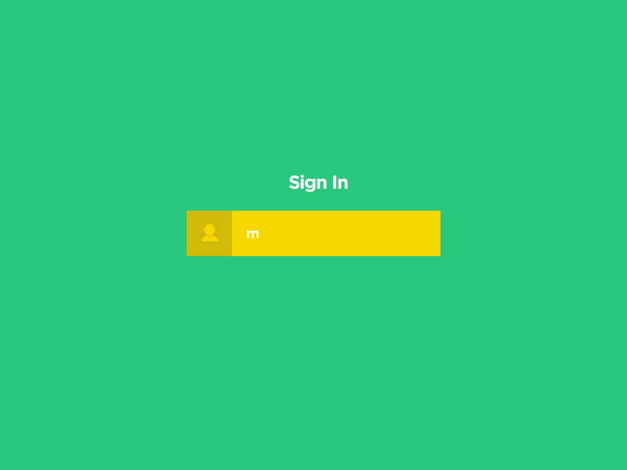
Training
Day 2

Slide 3
Agenda
Practice building content for email and posts on facebook.
Mailchimp.
Posts on facebook.
Communicate via online channel.
Basic design (canva, powerpoint, photoshop, illustrator).

Slide 4
Setting expectation
Notes:
5 mins

Slide 5
Review Content
INBOUND
OUTBOUND

Slide 6
Mail Content >
< Posts Content
Opening
1 sentence
(~10 words)
GIF
1-2 sentences
(~20 words)
Body
Separate into 4-5 sentences
Deliver by pictures
Outsource from internet (blog) or pinterest
1 -2 paragraphs (200 -250 words)
Outsource from internet (blog) or pinterest
Quote
1 sentence
Motivate/ make customers curious.
1 sentence
Motivate/ make customers curious.
Call actions
1 sentence
Customer click link to apply/ more information
(button, GIF)
1 sentence
Customer click link to apply/ more information
(link)
Contact
Hotline
Email
Fanpage
Hotline
Email

Slide 7
#Words to Avoid
Free
Visit our website
Opportunity
50% Off
Subscribe
Bonus
Discount
Save up to
Notes:
Thay vào đó, wording kiếm những từ lạ, đọc vô gây sự tò mò, dùng từ đao to búa lớn nhiều vô, dùng những tính từ mạnh

Slide 8
Practice
Inbound
Recruit local supporter
Keys:
Touchpoint with @
Target: 2nd year students.
Inbound
about Unlock Project.
Keys:
Project of skills.
Theme: introvert.
Notes:
20 mins

Slide 9
Notes:
Why we should use mailchimp
Create new account (copy password)
List send
Campaign
Template
→ Check link

Slide 10
Notes:
GIF
Reach ??? Post???
1 post xuất hiện trên page…

Slide 11
Communication

Slide 12
AIESEC mail >
“
AIESEC.NET email with OE signature.
Send to the whole LC → must be approved by your VP & Marcom Manager.
Rejection/Approval/Enhancement: 72 hours Rush: 24 hours (with phone call/text message to Marcom Manager)
Send to MC & other LCs → must be approved by OEP/OEVP
In rush & cannot contact OEP/OEVP & it affects members’ benefit
→ no need to seek for OEP/OEVP
”
Notes:
1. Copy signature of VP.

Slide 13
Email title >
From EB : [OEP/OEVP Function] issue
From LC members: [Function][Sender’s position (if any)] Issue
Ex: [MARCOM][MARCOM Coordinator] Training Communication Guideline and Visual Brand Toolkit
From OC: [OC name][Sub function (if needed)] Issue
Ex: [OC Award Night] Confirmation Letter
Urgent or important email: [URGENT / IMPORTANT][Sender’s position/ Function] Issue
Notes:
1. Copy signature of VP.

Slide 14
Email Penalty >
Members who fail to follow these guidelines shall be:
• 1st time: individually warned, via email
• 2nd time: whole-OE warned, via email
• 3rd time: whole-OE warned, via email and put into alert member

Slide 15
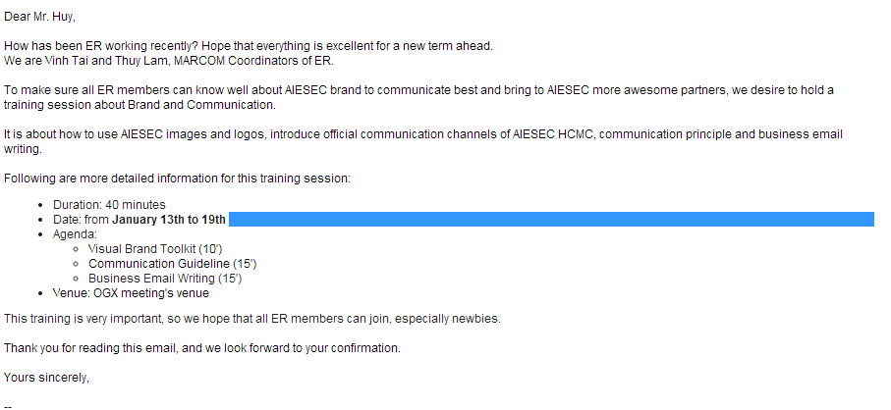
Example >

Slide 16
Facebook

Slide 17
Basic Design

