Slide 1
KEY ENGLISH TEST 2 SPEAKING TEST 1

Slide 2
KET SPEAKING
Time allowed - 8-10 minutes
Normally you will do the speaking test with another candidate. The two of you will meet two examiners. One of the examiners will talk to you, the other does not particpate in the conversations.
There are two parts to the speaking test:
Speaking part 1: short questions and answers between you and the examiner
Speaking part 2: the examiner gives you some information or a card with some ideas for questions. You have to talk with the other candidate and ask or answer questions. How to prepare for KET Speaking
Speak as much as you can, with your friends
Practise asking and asnwering questions about daily life
Practise giving information about yourself

Slide 3
Part 1:
Remember to add more details to your answer to make it longer
Do you like music?
What sort of music do you like?
Do you often listen to music in your free time?
Where do you often listen to music?
Do you often buy CDs? Why? Why not?
Talk about your favorite band/singer

Slide 4
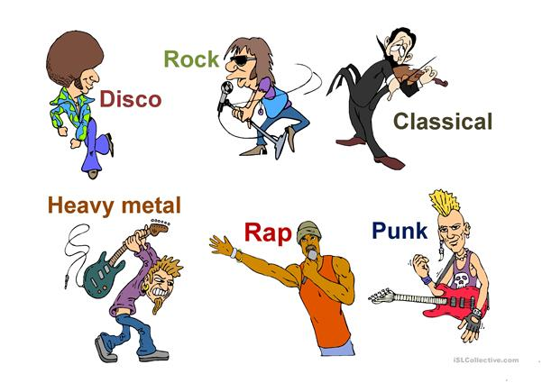
MUSIC GENRES

Slide 5
MUSIC GENRES
c

Slide 6
Sample answers:
Do you like music?
What sort of music do you like?
Do you often listen to music in your free time?
Where do you often listen to music?
Do you often buy CDs? Why? Why not?
Yes, I am a big fan of music.
I like pop music and electronic dance music (EDM) because they are very catchy.
Yes. I spend most of my freetime listening to music as a way to relax.
I often do that in my own room where I can feel and dance to the music I like
No, I have never bought a CD. Because I can listen to music online through the Internet.

Slide 7
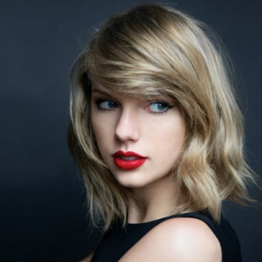
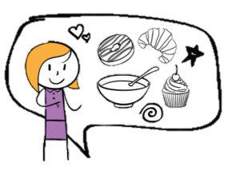
Favorite singer/band
The answer should be at least 3 sentences
Helpful outline and vocabulary
singer/band
Who is he/she
Why do you listen to their music
What is his/her genre of music
For example: My favorite singer is Taylor Swift, an American. She used to be famous for her country music and now she changes to pop music. I love listening to her songs because they are very arousing and catchy.

Slide 8
SPEAKING PART 2
Asking and answering questions using these prompt cards

Slide 9
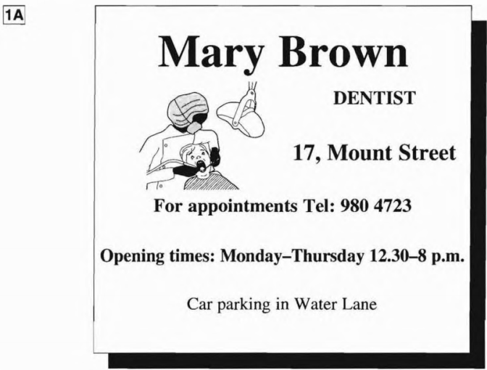
What is the name of the dentist?
What is his telephone number?
Can I make an appointment in the evening?
What is the address?
Is there a car park?
Can you think of other questions or other ways to ask and answer?

Slide 10
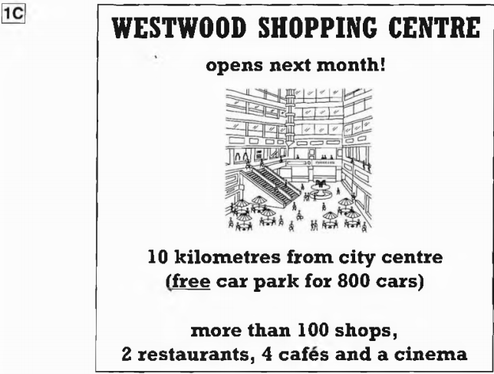
What is the shopping centre’s name?
Where is it?
How many shops are there in the centre?
Is there a car park?
Does it open today?

Slide 11
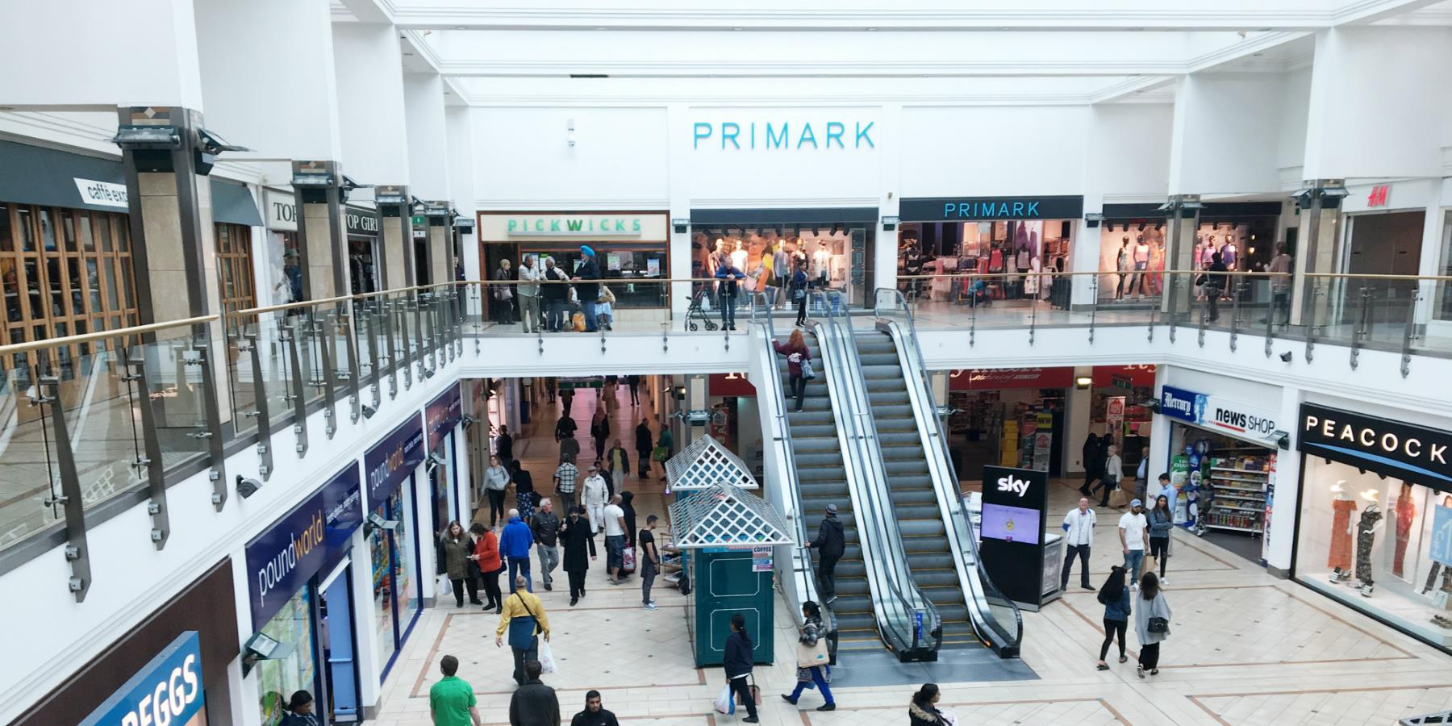
Now, imagine you are advertising the shopping centre. Talk about it based on the given information

