Slide 1

Unit 4: Community Services
Review
Pages 92 & 93

Slide 2






LESSON OUTLINE
Consolidation

Slide 3

By the end of this lesson, students will be able to…
- review vocabulary and grammar points in Unit 4.
- talk about
• charity events.
• what we can do to help our community.
- practice listening, reading, and speaking skills.

Slide 4
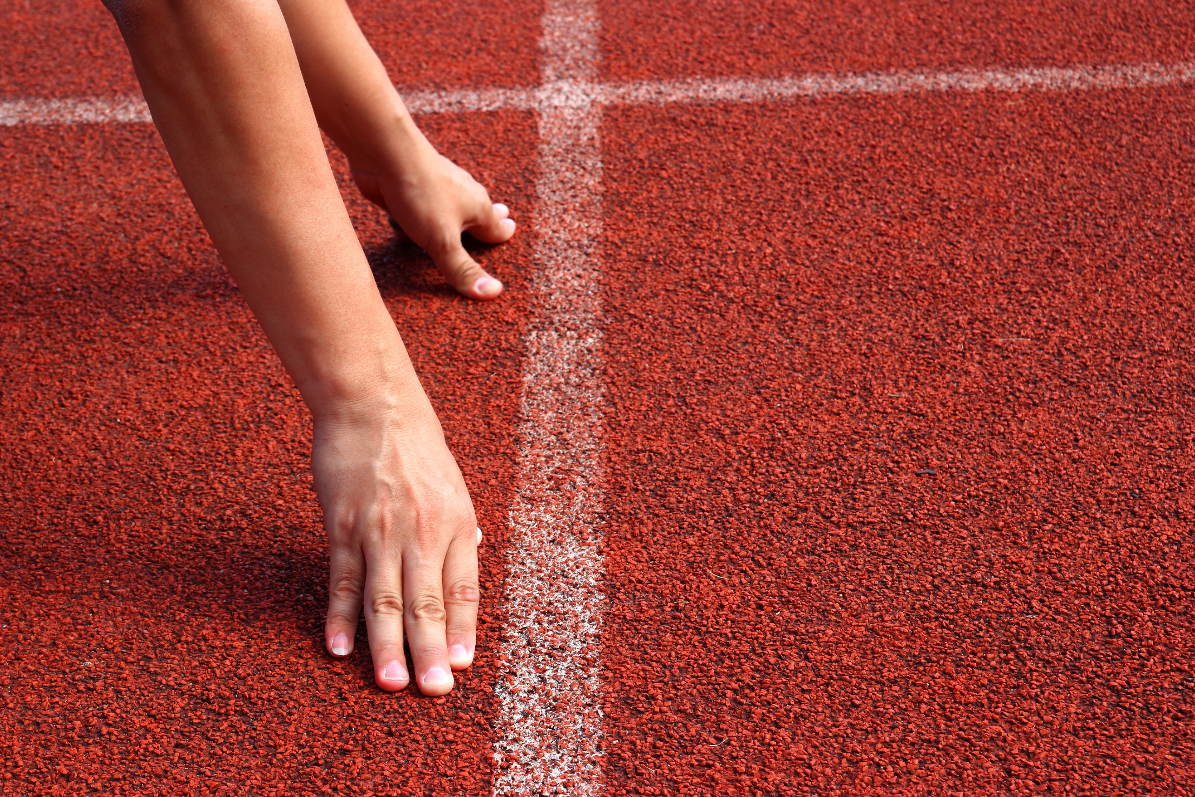
WARM-UP

Slide 5
Work in groups: Complete the diagram.
A fun run
A car wash
A craft fair
Charity events
A bake sale
An art show
A talent show
A food fair

Slide 6

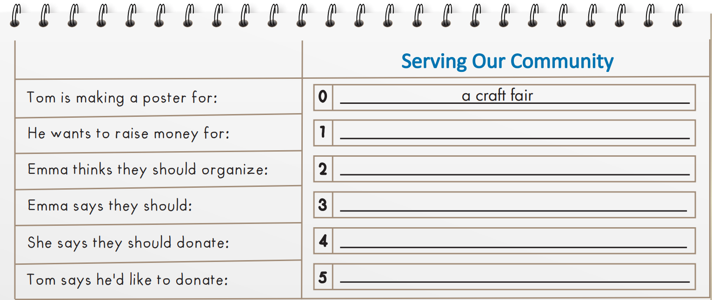
You will hear a boy talking to his friend about different kinds of community service. Listen and complete questions 1-5. You will hear the conversation twice.

Slide 7
Pre-listening
Work in pairs and guess the answers.
Poor children / homeless people / the elderly / …
A talent show / a bake sale / a fun run / …
Clean up streets / plant trees / serve food / …
Old books / old clothes / money /…
Old books / old clothes / money /…

Slide 8

While - listening
Listen and complete the chart.
poor children
a fun run
plant trees
clothes
(his) school books

Slide 9
Audio scripts
Emma: What are you doing, Tom?
Tom: I'm making a poster. I think we need a charity event in our town. I think we should organize a craft fair so that we can raise some money and help the local poor children.
Emma: Why?
Tom: Because we can raise some money for poor children in our community.
Emma: I agree. You know what else? I think we should organize a fun run. I think an event like that will be very popular.
Tom: Yes, I agree. What else should we do to help our community?
Emma: Hmmm. How about we plant trees?
Tom: Good idea. What else should we do?
Emma: We should donate clothes. I've got plenty of old clothes that I don't wear anymore. What would you like to donate, Tom?
Tom: I'd like to donate my school books so children can learn at school.

Slide 10
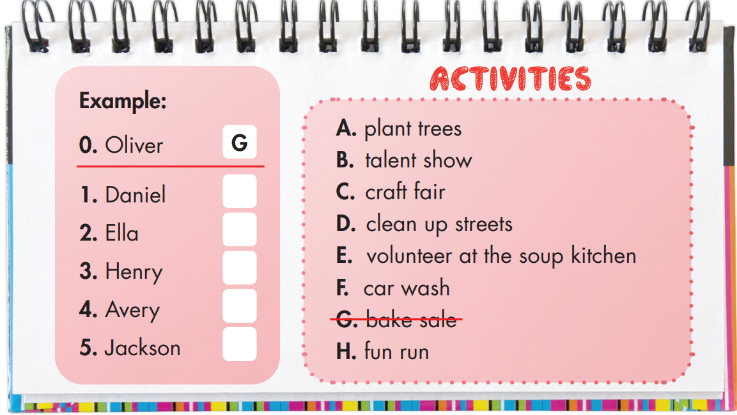
Extra Practice
WB, page 65
You will hear Oliver talking to his mother about helping a charity. What will each person's group do? For each question, write a letter (A-H) next to each person. You will hear the conversation twice.
F
B
H
C
D

Slide 11
Audio Scripts
Mrs. Green: Hi Oliver. How was school?
Oliver: It was interesting. We're going to help a local charity. Each group is doing a different activity.
Mrs. Green: What will you do?
Oliver: My group will organize a bake sale.
Mrs. Green: Great. Let's make cookies. I'll help you.
Oliver: Thanks, Mom. And Daniel's group is washing cars. They wanted to plant trees, but that won't make much money.
Mrs. Green: Yeah. What about Ella?
Oliver: Her group will have a talent show.
Mrs. Green: Fantastic. They should practice a lot to have a great show. How about Henry's group?
Oliver: Henry's group is going to join the fun run in the park.
Mrs. Green: Good idea.
Oliver: Avery's group is making jewelry for the craft fair.
Mrs. Green: You all have such good ideas!
Oliver: Jackson has the best idea. His group will clean up the streets near the school.
Mrs. Green: That's nice.

Slide 12

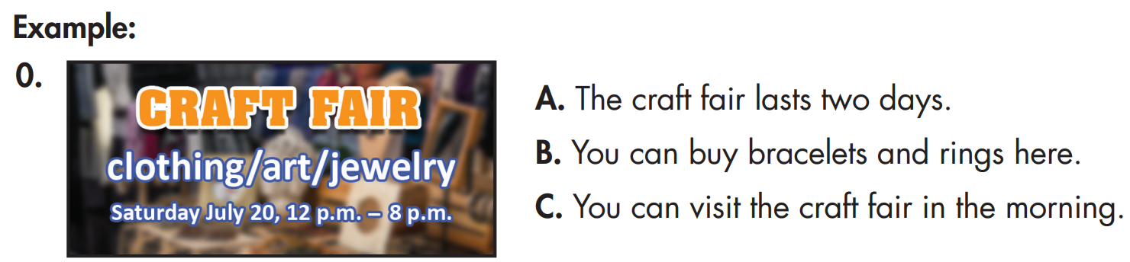
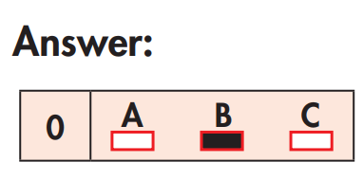
Look and read. Choose the correct answer (A, B, or C) and explain for your choice.

Slide 13
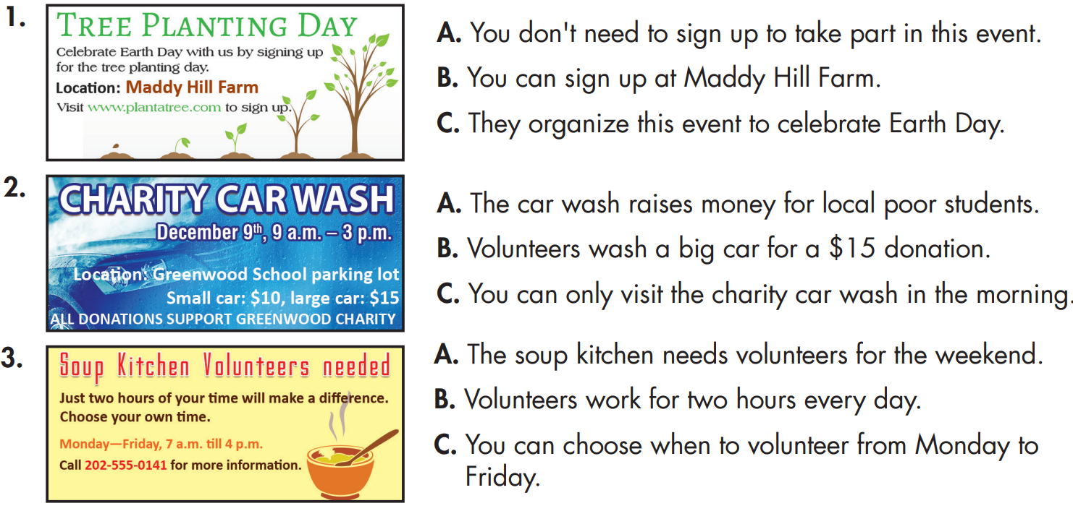

Slide 14
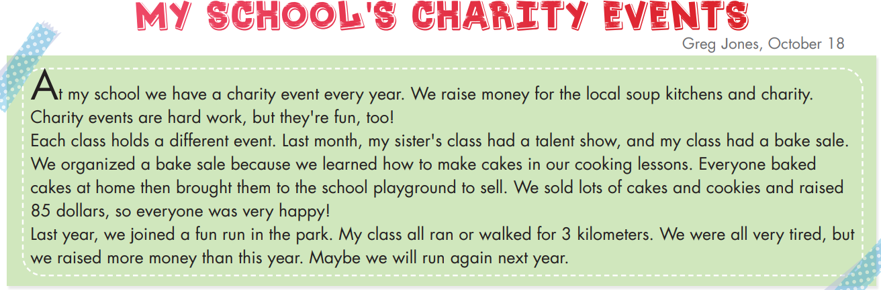
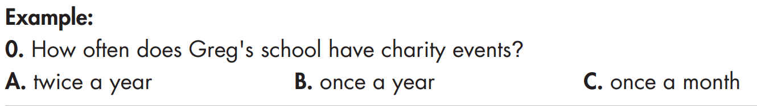
Extra Practice
WB, page 65
Read the text about charity events. Choose the correct answer (A, B, or C).

Slide 15
Read the questions and underline the key words:
1. Who organizes the school's charity events?
A. Greg's teachers B. all classes C. only Greg's class
2. What charity event did Greg's sister and her school friends organize this year?
A. bake sale B. fun run C. talent show
3. Before the charity event, Greg and his friends made cakes...
A. during cooking lessons. B. on the school playground. C. at home.
4. Greg thinks his class should have a fun run next year because they...
really like running. B. want to raise more money.
C. want to run for 3 kilometers.

Slide 16
Scan the text, choose the correct answers and explain for your choices.
1. Who organizes the school's charity events?
A. Greg's teachers B. all classes C. only Greg's class
At my school we have a charity event every year. We raise money for the local soup kitchens and charity. Charity events are hard work, but they're fun, too!
Each class holds a different event. Last month, my sister's class had a talent show, and my class had a bake sale. We organized a bake sale because we learned how to make cakes in our cooking lessons. Everyone baked cakes at home then brought them to the school playground to sell. We sold lots of cakes and cookies and raised
85 dollars, so everyone was very happy!
Last year, we joined a fun run in the park. My class all ran or walked for 3 kilometers. We were all very tired, but we raised more money than this year. Maybe we will run again next year.

Slide 17
2. What charity event did Greg's sister and her school friends organize this year? A. bake sale B. fun run C. talent show
At my school we have a charity event every year. We raise money for the local soup kitchens and charity. Charity events are hard work, but they're fun, too!
Each class holds a different event. Last month, my sister's class had a talent show, and my class had a bake sale. We organized a bake sale because we learned how to make cakes in our cooking lessons. Everyone baked cakes at home then brought them to the school playground to sell. We sold lots of cakes and cookies and raised
85 dollars, so everyone was very happy!
Last year, we joined a fun run in the park. My class all ran or walked for 3 kilometers. We were all very tired, but we raised more money than this year. Maybe we will run again next year.

Slide 18
3. Before the charity event, Greg and his friends made cakes...
A. during cooking lessons. B. on the school playground. C. at home.
At my school we have a charity event every year. We raise money for the local soup kitchens and charity. Charity events are hard work, but they're fun, too!
Each class holds a different event. Last month, my sister's class had a talent show, and my class had a bake sale. We organized a bake sale because we learned how to make cakes in our cooking lessons. Everyone baked cakes at home then brought them to the school playground to sell. We sold lots of cakes and cookies and raised
85 dollars, so everyone was very happy!
Last year, we joined a fun run in the park. My class all ran or walked for 3 kilometers. We were all very tired, but we raised more money than this year. Maybe we will run again next year.

Slide 19
4. Greg thinks his class should have a fun run next year because they...
A. really like running. B. want to raise more money.
C. want to run for 3 kilometers.
At my school we have a charity event every year. We raise money for the local soup kitchens and charity. Charity events are hard work, but they're fun, too!
Each class holds a different event. Last month, my sister's class had a talent show, and my class had a bake sale. We organized a bake sale because we learned how to make cakes in our cooking lessons. Everyone baked cakes at home then brought them to the school playground to sell. We sold lots of cakes and cookies and raised
85 dollars, so everyone was very happy!
Last year, we joined a fun run in the park. My class all ran or walked for 3 kilometers. We were all very tired, but we raised more money than this year. Maybe we will run again next year.

Slide 20
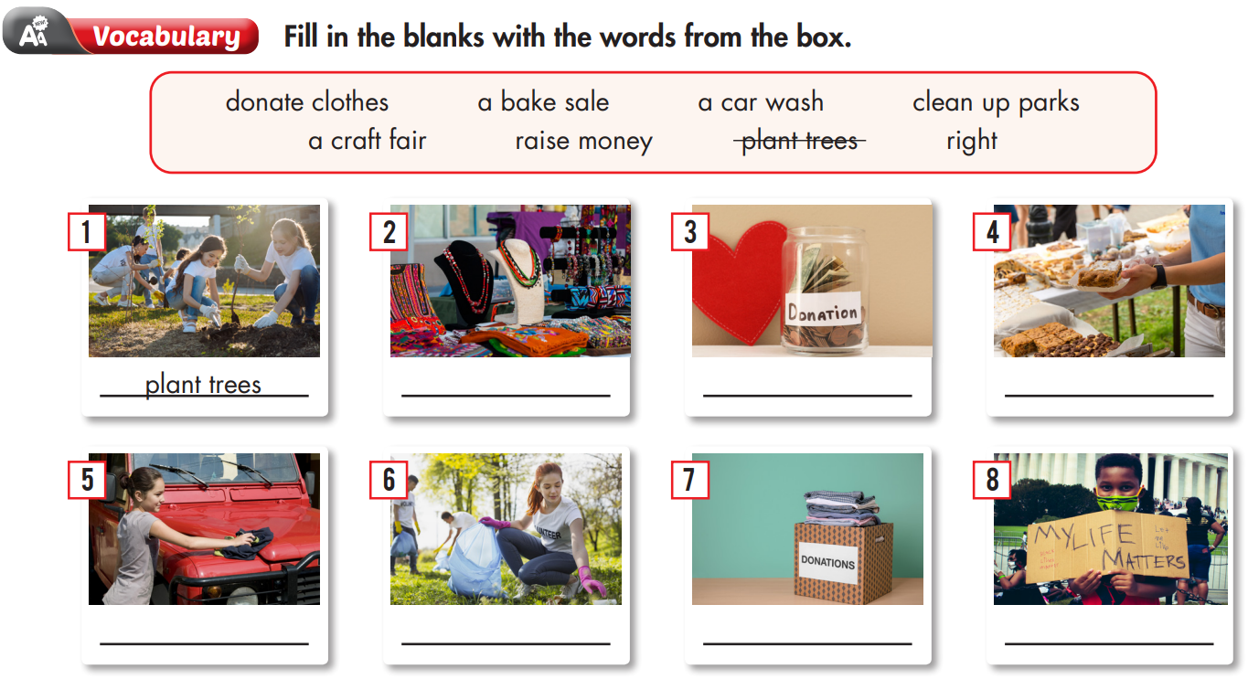

Slide 21
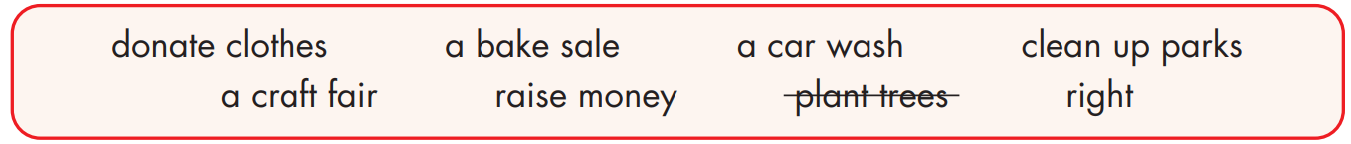
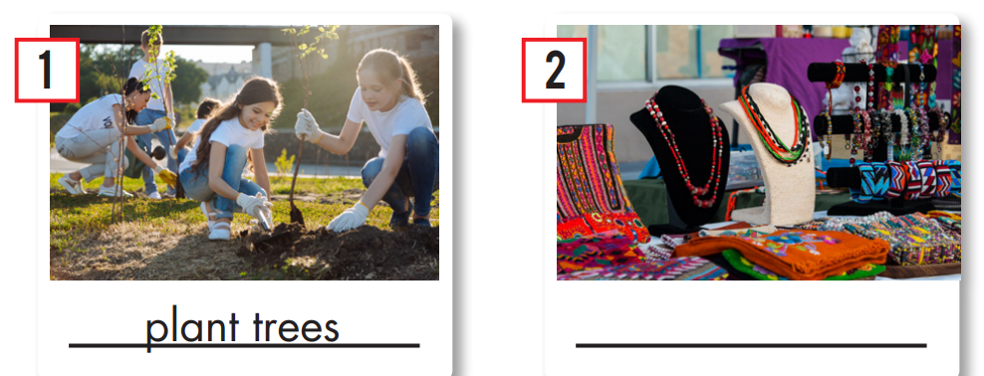
a craft fair

Slide 22
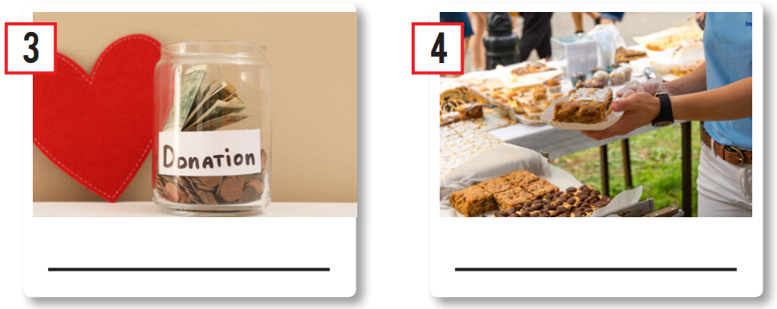
raise money
a bake sale

Slide 23
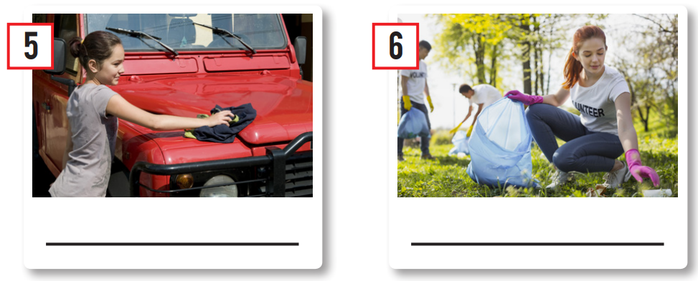
a car wash
clean up parks

Slide 24
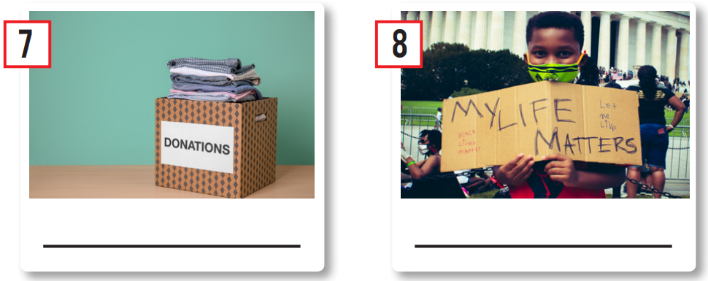
donate clothes
right

Slide 25

Past Simple Tense
Affirmative: S + V-ed
Negative: S + didn’t + V (bare infinitive)
Interrogative: Did + S + V (bare infinitive)?

Slide 26

a. Fill in the blanks with the Past Simple form of the verbs in brackets.
raised
1. The school _______________ (raise) nearly five thousand dollars after the charity day.
2. My friends and I _______________ (not clean up) the local park last weekend.
3. Last summer, my brother _______________ (volunteer) at the local food kitchen. He _______________ (help) prepare food and do the dishes.
4. We _______________ (donate) sweaters, scarves, and socks to poor children last winter.
5. _______________ they _______________ (organize) a fun run last month?
didn’t clean up
volunteered
helped
donated
Did
organize

Slide 27
Making suggestions
We should + V (bare infinitive)
Let’s + V (bare infinitive)
Let’s not + V (bare infinitive)
How about + V-ing ?
How about + S + V (bare infinitive) ?

Slide 28
b. Underline the mistake in each sentence. Write the correct word on the line.
1. Let's having a charity car wash. _____________
2. I think we should helping homeless animals in our town. _____________
3. How about we organized a craft fair? _____________
4. How about put "Run for Fun" on the poster? _____________
5. Let's not having a bake sale. _____________
have
help
organize
putting
have

Slide 29

a. Circle the word that has the underlined part pronounced differently from the others.
1. A. fun B. but C. put D. run
/fʌn/ /bʌt/ /pʊt/ /rʌn/
2. A. walk B. bake C. play D. sale
/wɑːk/ /beɪk/ /pleɪ/ /seɪl/
3. A. lived B. raised C. picked D. organized
/lɪvd/ /reɪzd/ /pɪkt/ /ˈɔːrɡənaɪzd/

Slide 30
b. Circle the word that differs from the other three in the position of primary stress in each of the following questions.
4. A. organize B. volunteer C. decorate D. charity
/ˈɔːrɡənaɪz/ /ˌvɑːlənˈtɪr/ /ˈdekəreɪt/ /ˈtʃerəti/
5. A. event B. talent C. flower D. money
/ɪˈvent/ /ˈtælənt/ /ˈflaʊər/ /ˈmʌni/
6. A. children B. poster C. kitchen D. donate
/ˈtʃɪldrən/ /ˈpoʊstər/ /ˈkɪtʃən/ /doʊˈneɪt/

Slide 31

CONSOLIDATION

Slide 32
Work in groups, discuss what we can do to help the community. Complete the diagram below
Raise money
Plant trees
Donate clothes
Activities
Clean up the beach
Clean up streets
Volunteer at the soup kitchen
Donate books
Plant flowers

Slide 33

WRAP-UP

Slide 34
Today’s lesson
Reading & Listening:
- Understand instructions.
- Practice reading and listening for general and specific information.
Speaking:
- Talk about charity events and activities to help the community.

Slide 35
Homework
Review all vocabulary and grammar points in Unit 4.
Practice presenting about charity events based on the diagram.
Play the consolidation games in Tiếng Anh 7 i-Learn Smart World DHA App on www.eduhome.com.vn.
Prepare the next lesson (page 36 SB).

Slide 36

Lesson 3
Stay positive and have a nice day!

