Slide 1
English 8
UNIT 2 . LIFE IN THE COUNTRYSISE
PERIOD 16: REVISION FOR UNITS 1,2
Welcome to our class

Slide 2
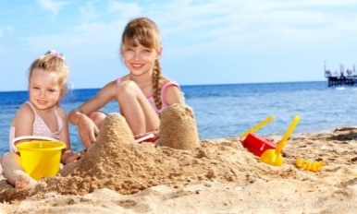
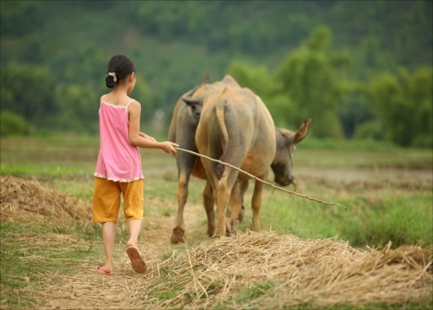
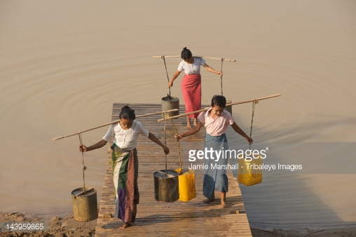
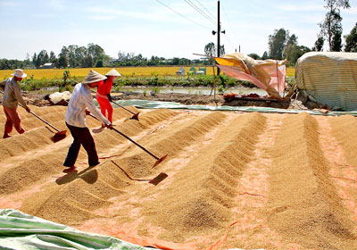
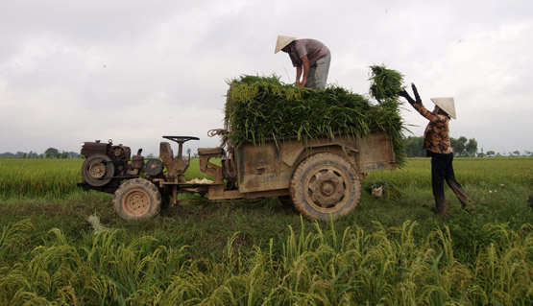
* Warm up
LABEL THE NAMES OF THE PICTURES
playing beach games
Making crafts
texting
doing Diy
Herding buffaloes
collecting water
drying the rice
loading the rice

Slide 3
A. LISTENING
Listen to the passage and choose the correct answer.
What percentage of Britain’s population dream of living in the country?
A. 18 % B. 80% C. 20%
2. English village communities are often small and ….
A. close B. poor C. unknown
3. Which is village life good for, according to Maggie?
A. Childen
B. People who have money
C. People who don’t have money
.

Slide 4
A. LISTENING
Listen to the passage and choose the correct answer.
4. People in English villages use private transport………
A. a little B. less C. more
5. The environment of English villages is…………
A. spoil B. not spoilt much C. not safe
.

Slide 5
Audio script:
Life in the English countryside
According to a recent survey by Country Life magazine, about 80 percent of Britain’s population dream of living in the countryside. In fact the countryside of England today shows the wealth of landowners and those who can afford to escape the busy and noisy city life.
English village communities are often small and close. They are warm and usually welcoming. Maggie, who lives in North Yorkshire, says: “ Village life is wonderful and safe for the kids. There is a great sense of community here. It is more relaxing and you can’t tell who has money and who doesn’t”. People in the English countryside use private transport more, and the environment hasn’t been spoilt much.

Slide 6
B. LANGUAGE FOCUS
I. Choose the best answer.
1. Nam fancies …………… his homework in the morning.
A. doing B. to do C. am doing
2. My father doesn’t mind…………… my me from school every day.
A. pick up B. picked up C. picking up
3. The boys help load the rice ………… buffalo – drawn carts.
A. into B. onto C. to
4. I’ve been kind of addicted ………….. the net.
A. to B. on C. from
5. If you have to do home improvements, …………. is the good way to save money.
A. eating out B. walking C. doing DIY

Slide 7
B. LANGUAGE FOCUS
I. Choose the best answer.
6. A busy time when people collect their crops is called ..…..
paddy fields B. harvest time C. pasture
7. She speaks English……....... now than last year.
A. better than B. good C. better
8. Which one is the odd one out?
A. love B. fancy C. detest
9. Choose the word that has a different stressed syllablefrom that of the others.
A. addicted B. leisure C. pasture
10. My father ……………… this wall for 2 hours.
A. paint B. has painted C. painted

Slide 8
B. LANGUAGE FOCUS
II. Use the correct form of the words to complete the sentences.
running
The children enjoy ………………………….…… around the fields. (run)
2. The …………………… have a very hard life. They can’t live permanently in one place. (nomadic)
3. The hills are …………………. in spring when the wild flowers bloom. (colour)
4. Everybody has to work hard for world ……………. (peaceful).
5. If you want to stay slim, you have to eat more ……………….… (healthy)
nomads
colourful
peace
heathily

Slide 9
C. READING
I.Fill in the gaps with the words provided.
problem
computer
join
watching
world
In today's world, teenagers rely on technology more than in the past .This can be a (1) ………………. because using computers too much may have harmful effect on both their minds and bodies. They prefer (2)……………. TV and playing computer games to reading books, perhaps because they don't have to think and imagine as much. They don’t (3)……………… clubs or have hobbies and they don't play sports. They sit in front of the (4)………………… all the time. They don't get out of the house, even for a walk.
They are in a world that doesn't exist

Slide 10
D. WRITING
* Rewrite these sentences with the cues given or directed in the brackets.
faster than Mr Minh
Mr Hung can drive 50km/hr while Mr Minh can only drive 20km/hr. (fast) (rewrite sentences)
→ Mr Hung can run ____________________.
2. to / I / 5 pm / going / at / hang / with / am / my / out / cousins / .
(reorder sentence)
3. We are both bad at swimming but I’m better than
my sister. (badly) (rewrite sentences)
→ My sister swims ____________________.
→I am going to hang out with my cousins at 5 pm .
worse than I do

Slide 11
D. WRITING
4. enjoys / Lan / read / news / surfing / Internet / to / the / . (reorder sentence)
5. We / fancy / relax / with / relatives / downtown / . (complete sentence)
→Lan enjoys surfing Internet to read news .
→ We fancy relaxing with our relatives downtown.

Slide 12
D. WRITING
* Rewrite these sentences with the cues given or directed in the brackets.
PLAY GAME

Slide 13
To pick up flowers

Slide 14
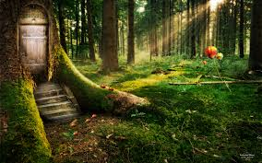
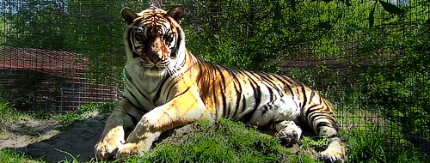
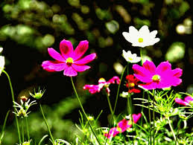
5
2
6
7
8
3
1
4

Slide 15
To pick up flowers
1. Mr Hung can drive 50km/hr while Mr Minh can only drive 20km/hr. (fast)
___ Mr Hung can drive ____________
faster than Mr Minh

Slide 16
To pick up flowers
2. to / I / 5 pm / going / at / hang / with / am / my / out / cousins / .
(reorder sentence)
I am going to hang out with my cousins at 5 pm .

Slide 17
To pick up flowers
3. We / fancy / relax / with / relatives / downtown / . (complete sentences)
→ We fancy relaxing with our relatives downtown .

Slide 18
To pick up flowers
4. enjoys / Lan / read / news / surfing / Internet / to / the / .
(reorder sentence)
_______________
→Lan enjoys surfing Internet to read news .

Slide 19
To pick up flowers
5. We are both bad at swimming but I’m better than my sister. (badly)
→ My sister swims _______________
worse than I do.

Slide 20
D. WRITING
* Write a short paragraph about the changes in the countryside. Using the cues:
How does the life in the countryside change?
-Houses. (in brick houses , earthen ones or cottages. )
- Equipment ( electric fans and TVs, electric lights .)
- Means of transport (motorcycles for transport instead of riding a horse or walking.)
- school , hospital
- the place for children to play. ( a park in the village)

Slide 21
D. WRITING
* Write a short paragraph about the changes in the countryside.
*Life in the countryside changes so much.
Firstly, Some villagers now live in brick houses instead of earthen ones or cottages.
Secondly, Their houses are better equipped with electric fans and TVs, electric lights .
Thirdly, More villagers are using motorcycles for transport instead of riding a horse or walking.
Besides, there’s a school , a hospital nearby the village.
The last change is the place for children to play.
There is a park in the village

Slide 22
E. AT HOME
Review all the vocabularies and structures.
Do exercises 3, 4, 5, 6 /p.36 in textbook.
Write a short paragraph about the changes in the countryside.
Be ready for TEST 1.

Slide 23
Notes:
23

