Slide 2
Unit 2
A multicultural world
LESSON 5
LISTENING
Celebrating Halloween in Viet Nam

Slide 3
LESSON 5
LISTENING
WARM-UP
Lucky number
PRE-LISTENING
- Task 1: Work pairs and label the pictures.
- Vocabulary
- Task 2: Listen and circle.
- Task 3: Listen and complete the sentence.
WHILE-LISTENING
POST-LISTENING
- Task 4: ﻿Work in groups and discuss.
CONSOLIDATION
- Wrap-up
- Homework

Slide 4
WARM-UP
Lucky number
- Work as 2 groups.
- Choose a number. There are 6 numbers, 5 of which include pictures of different festivals.
- If you open a picture ➔ look and guess the name of the festival.
- One point for a correct answer.
- If you open a lucky number ➔ get one point without answering the question.
- The group with more points is the winner.

Slide 5
WARM-UP
Lucky letter
1
2
3
4
5
6

Slide 6
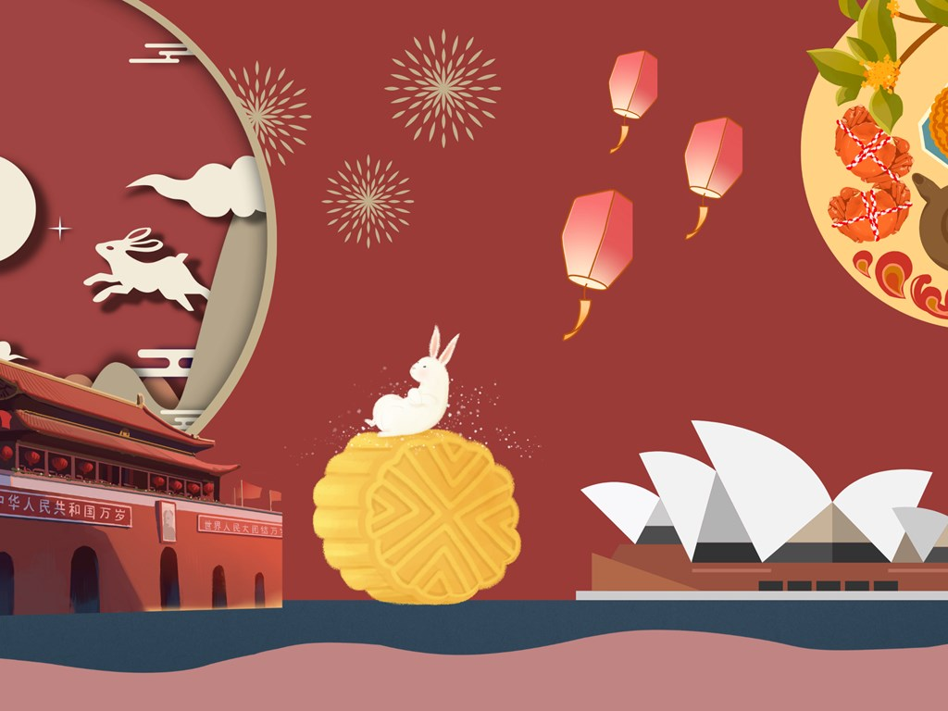
WARM-UP
Question 1:
Mid-autumn festival

Slide 7
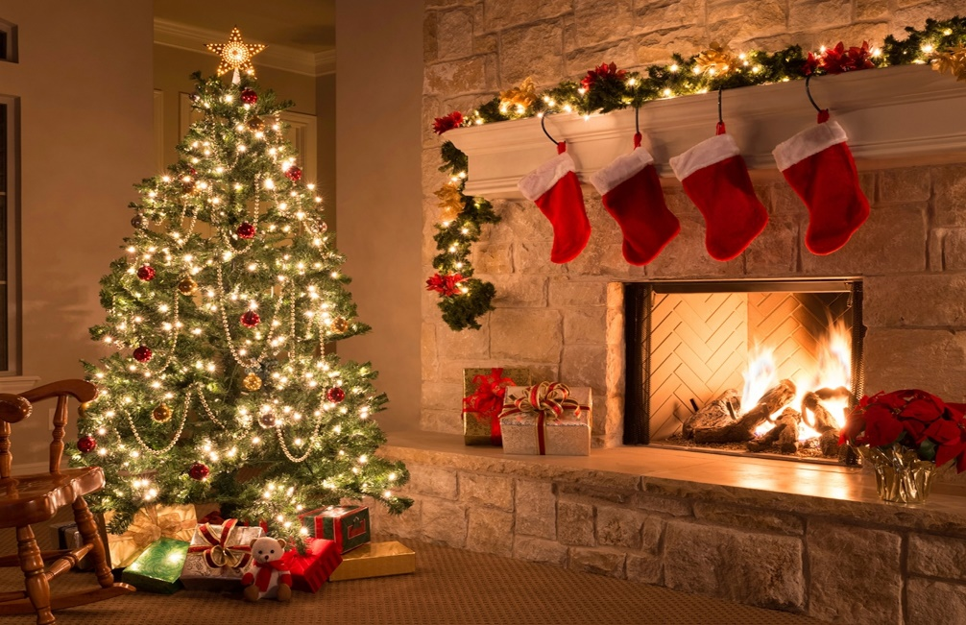
WARM-UP
Question 2:
Christmas

Slide 8
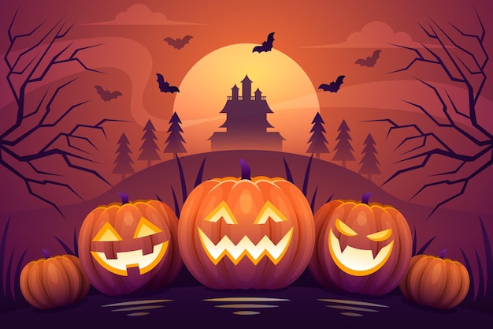
WARM-UP
Question 3:
Halloween

Slide 9
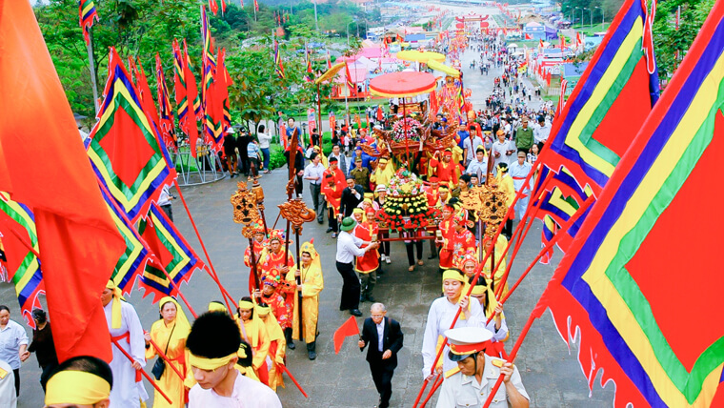
WARM-UP
Question 4:
Hung Kings’ festival

Slide 10
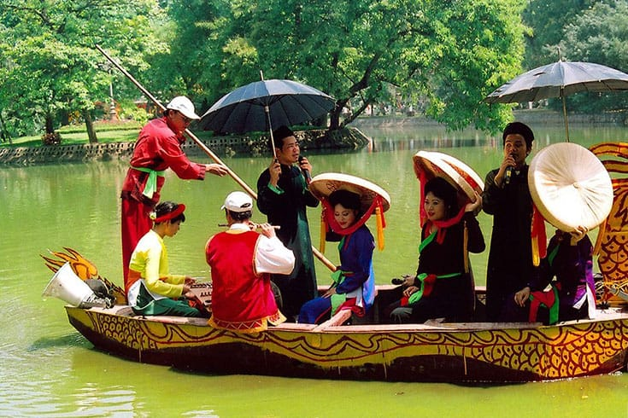
WARM-UP
Question 5:
Lim festival

Slide 11

WARM-UP

Slide 12
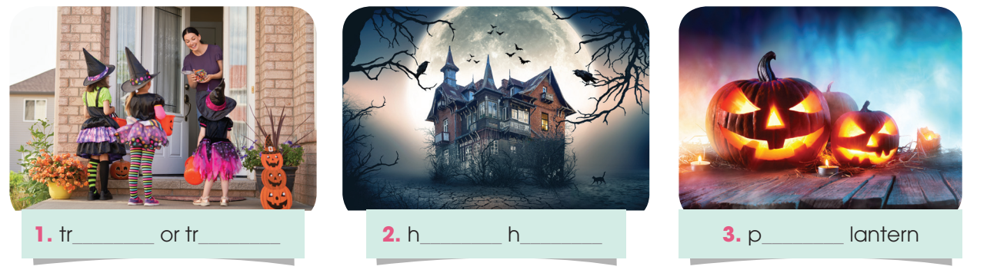
PRE-LISTENING
1
Work in pairs. Label the following pictures. do you often see them in Viet Nam?
ick
eating
aunted
ouse
umpkin

Slide 13
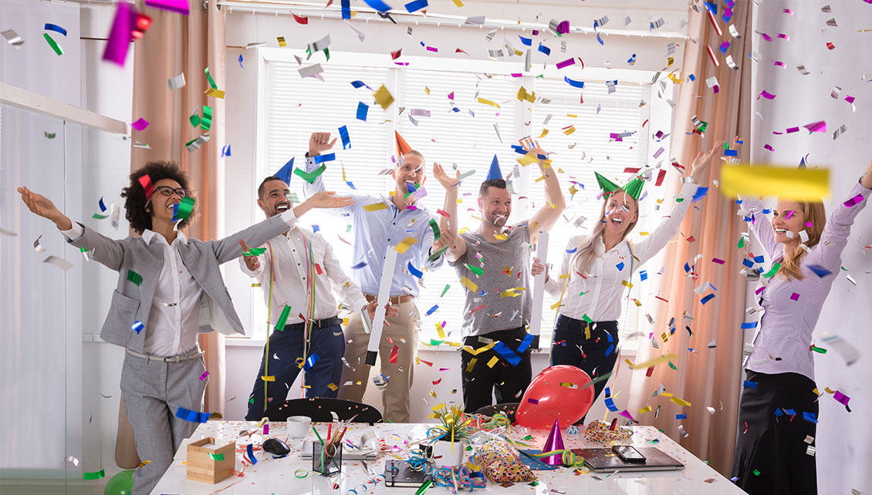

PRE-LISTENING
celebrate (v)
/ˈselɪbreɪt/
to show that a day or an event is important by doing something special on it

Slide 14
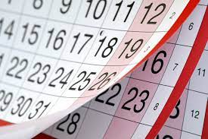
PRE-LISTENING
annually (adv)
/ˈænjuəli/
once a year

Slide 15
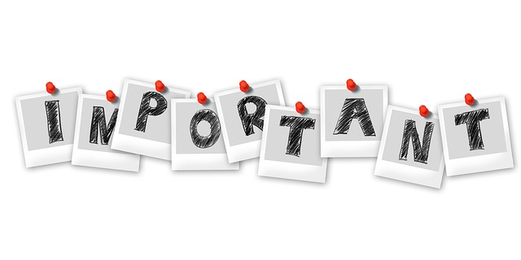
PRE-LISTENING
be of importance
/biː əv ɪmˈpɔːtns/
be important

Slide 16
PRE-READING
Form | Pronunciation | Meaning | Vietnamese equivalent
1. celebrate (v) | /ˈselɪbreɪt/ | to show that a day or an event is important by doing something special on it | làm lễ kỉ niệm
2. annually (adv) | /ˈænjuəli/ | once a year | hàng năm
3. be of importance | /biː əv ɪmˈpɔːtns/ | be important | quan trọng

Slide 17

WHILE-LISTENING
2
Listen to an interview. What do Minh and Mai think about Halloween? Circle the correct words or phrase.
1. Minh likes / dislikes celebrating Halloween.
2. Minh thinks the history of Halloween is boring / interesting.
3. Mai thinks that people should / shouldn’t celebrate Halloween in Viet Nam.
4. Mai believes that the popularity of international festivals in Viet Nam is cause for alarm / no cause for alarm.

Slide 18
WHILE-LISTENING
3
Listen to the interview again and complete each sentence with no more than TWO words.
1. The students at the New Era Secondary School are preparing for a(n) ____________.
2. Halloween is celebrated annually and it is quite ________ in Minh’s school.
3. Halloween has its roots in a(n) _______ Celtic festival celebrated in Ireland.
4. Nowadays, Halloween is quite popular _______.
5. In Viet Nam, ________________ are still of great importance.
special event
popular
ancient
in Asia
traditional festivals

Slide 19
POST-LISTENING
4
Work in groups. Discuss the questions.
What are some other festivals in the world celebrated in Viet Nam? Why are they popular?
Suggested answer:
Some Western festivals are celebrated in Viet Nam such as Valentine, Christmas, New Year Eve. The reasons why they are beocoming popular are they are organised based on the solar calendar and they are organised all over the world. Moreover, many young Vietnamese people learn English as their second language so they want to celebrate these festivals to learn language and explore western cultures.

Slide 20
CONSOLIDATION
1
Wrap-up
What have you learnt today?
An overview about celebrating Halloween in Viet Nam;
Listening skills for general and for specific information

Slide 21
CONSOLIDATION
2
Homework
Do exercises in the workbook.
Prepare for Lesson 6 - Writing.

Slide 22
Website: hoclieu.vn
Fanpage: facebook.com/www.tienganhglobalsuccess.vn

