Slide 1
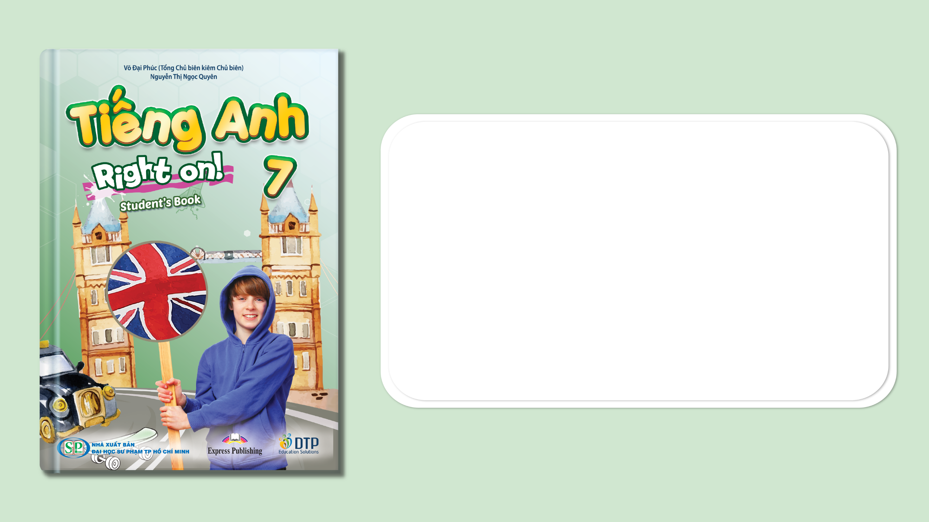
Unit 1: My World
Progress Check (Cont.)
Page 27

Slide 2
Lesson Outline
Warm-up
Reading
Everyday Eng.
Writing
Consolidation
Wrap-up

Slide 3
Objectives
By the end of this lesson, students will be able to…
- practise test-taking skills (Reading, Writing).

Slide 4

WARM-UP

Slide 5
Fill in the blanks with the correct tense of the verb.
go
1. Every night, we (go) _____________ to bed at 10 p.m.
2. Giang (like) ____________ Music but I (like) ____________ Maths.
3. Now, they (stay) _______________ in Hue.
4. My father (read) ______________ a newspaper in the morning.
5. Every day, Mr. Hung (not/go) ______________ to work by car.
6. On Friday, I (have) ____________ English.
likes
like
are staying
.
reads
doesn’t go
have

Slide 6
Choose the word whose underlined part is pronounced differently from that of the others.
A. long B. blonde C. old D. job
2. A. cooks B. reads C. plays D. finds
3. A. top B. blog C. clock D. love
/lɒŋ/
/blɒnd
/əʊld/
/dʒɒb/
/kʊks/
/riːdz/
/pleɪz/
/faɪndz/
/tɒp/
/blɒɡ/
/klɒk/
/lʌv/

Slide 7
Choose the word whose main stress is placed differently from that of the others.
A. video B. computer C. opinion D. amusement
2. A. issue B. respect C. member D. table
3. A. argue B. prepare C. divide D. advise
/ˈvɪdiəʊ/
/kəmˈpjuːtər/
/əˈpɪnjən/
/əˈmjuːzmənt/
/ˈɪʃuː/
/rɪˈspekt/
/ˈmembər/
/ˈteɪbl/
/ˈɑːɡjuː/
/prɪˈpeər/
/dɪˈvaɪd/
/ədˈvaɪz/

Slide 8

It’s time to learn …

Slide 9
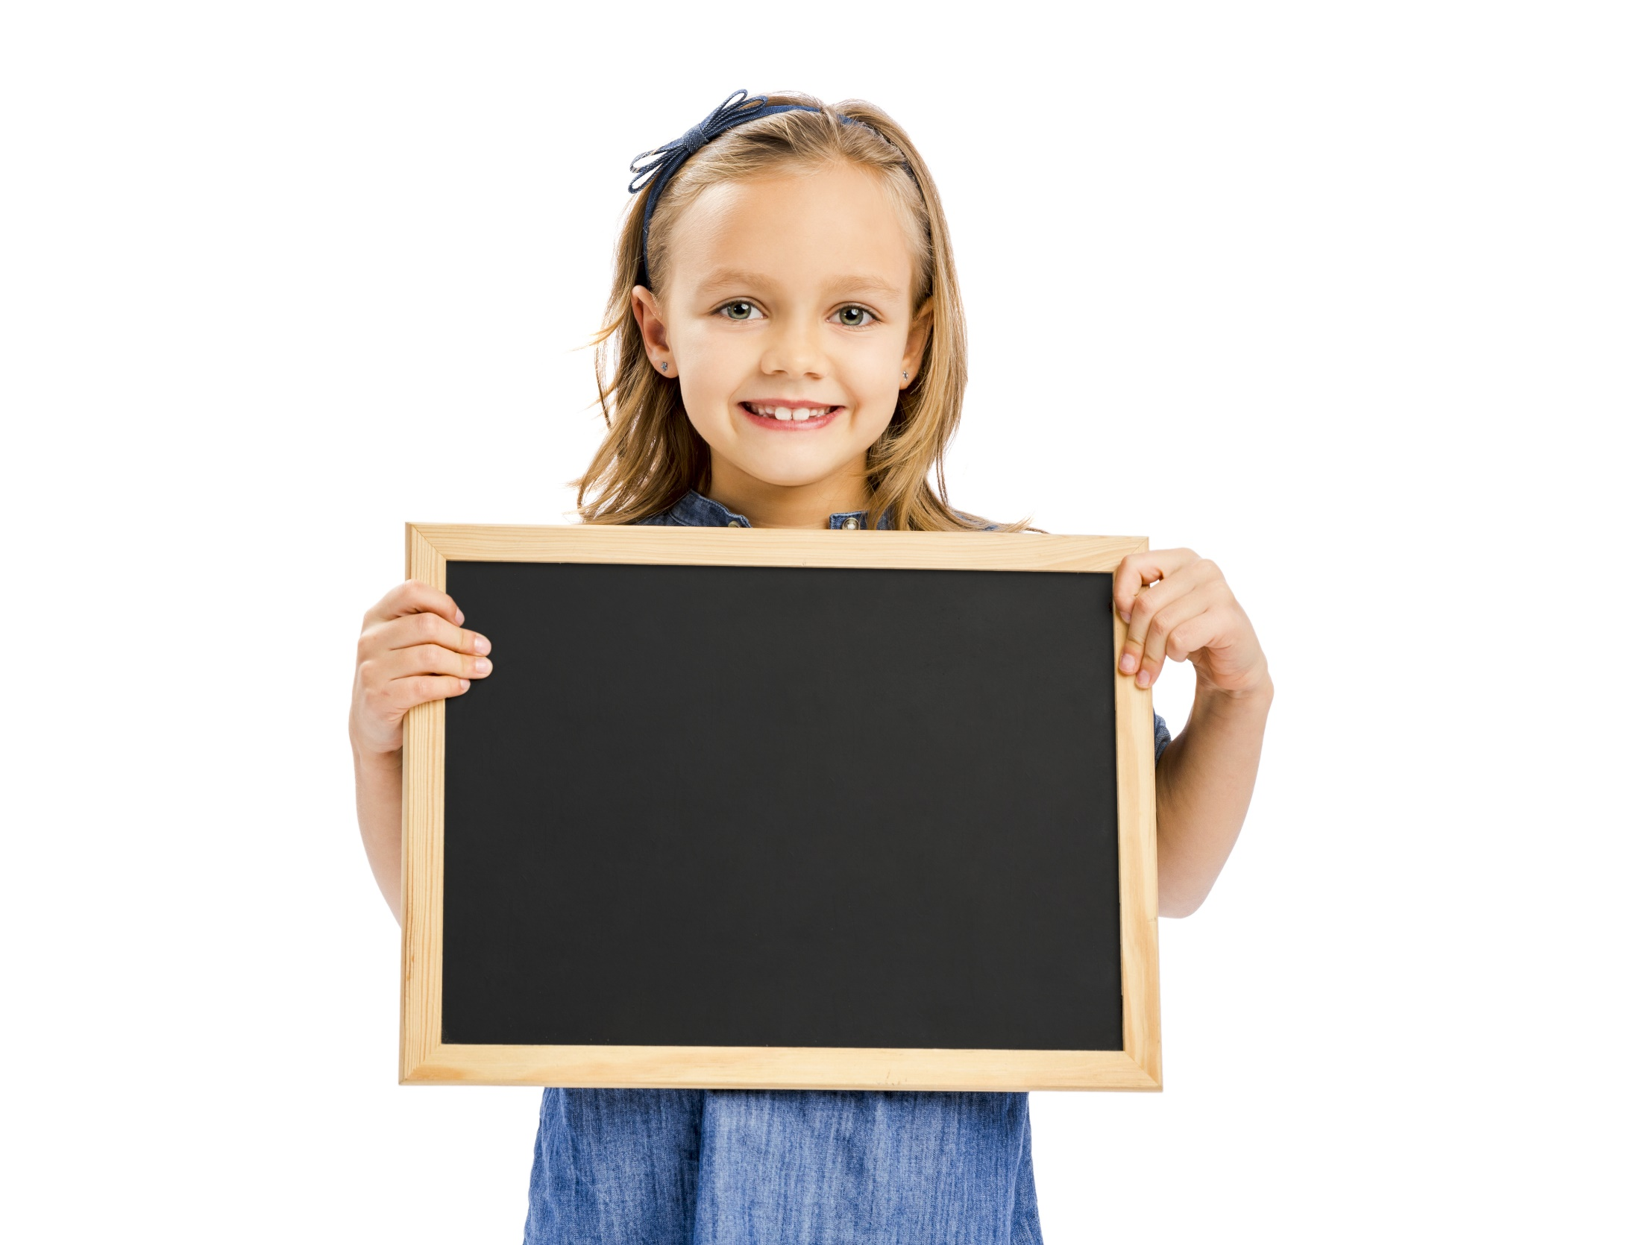
Reading

Slide 10
Pre-reading
Read the instruction, underline the key words.
7 Read the blog post and replace the words in red with the words from the text.
What are you going to do?
Read the blog post.
Replace the words in red with the words from the text.

Slide 11
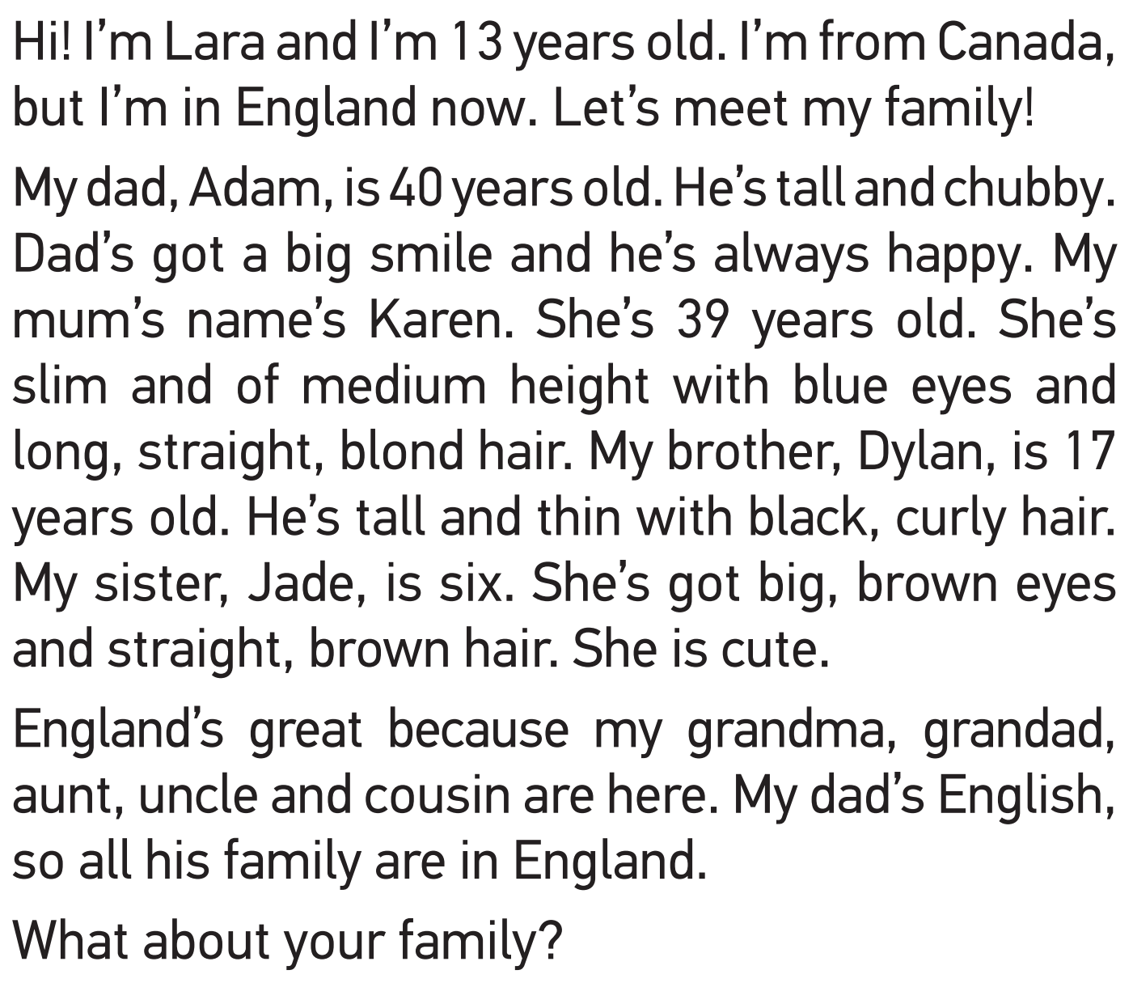
While-reading
Now, read and do the task.
1 Lara is from there. __________
2 Her hair is blond. __________
3 She’s six years old. __________
4 His hair is black and curly. __________
5 He is chubby. _________
6 They live in England. __________
What are your answers?

Slide 12
While-reading
Now, read again and check.
1 Lara is from there. __________
2 Her hair is blond. __________
3 She’s six years old. __________
4 His hair is black and curly. __________
5 He is chubby. _________
6 They live in England. __________
Canada
Lara’s mum
Lara’s sister, Jade
Lara’s brother, Dylan
Lara’s dad
Lara’s dad’s
family (Lara’s grandma, grandpa,
aunt, uncle and cousin)

Slide 13
Post-reading
Work in pairs. Describe members in your family.

Slide 14
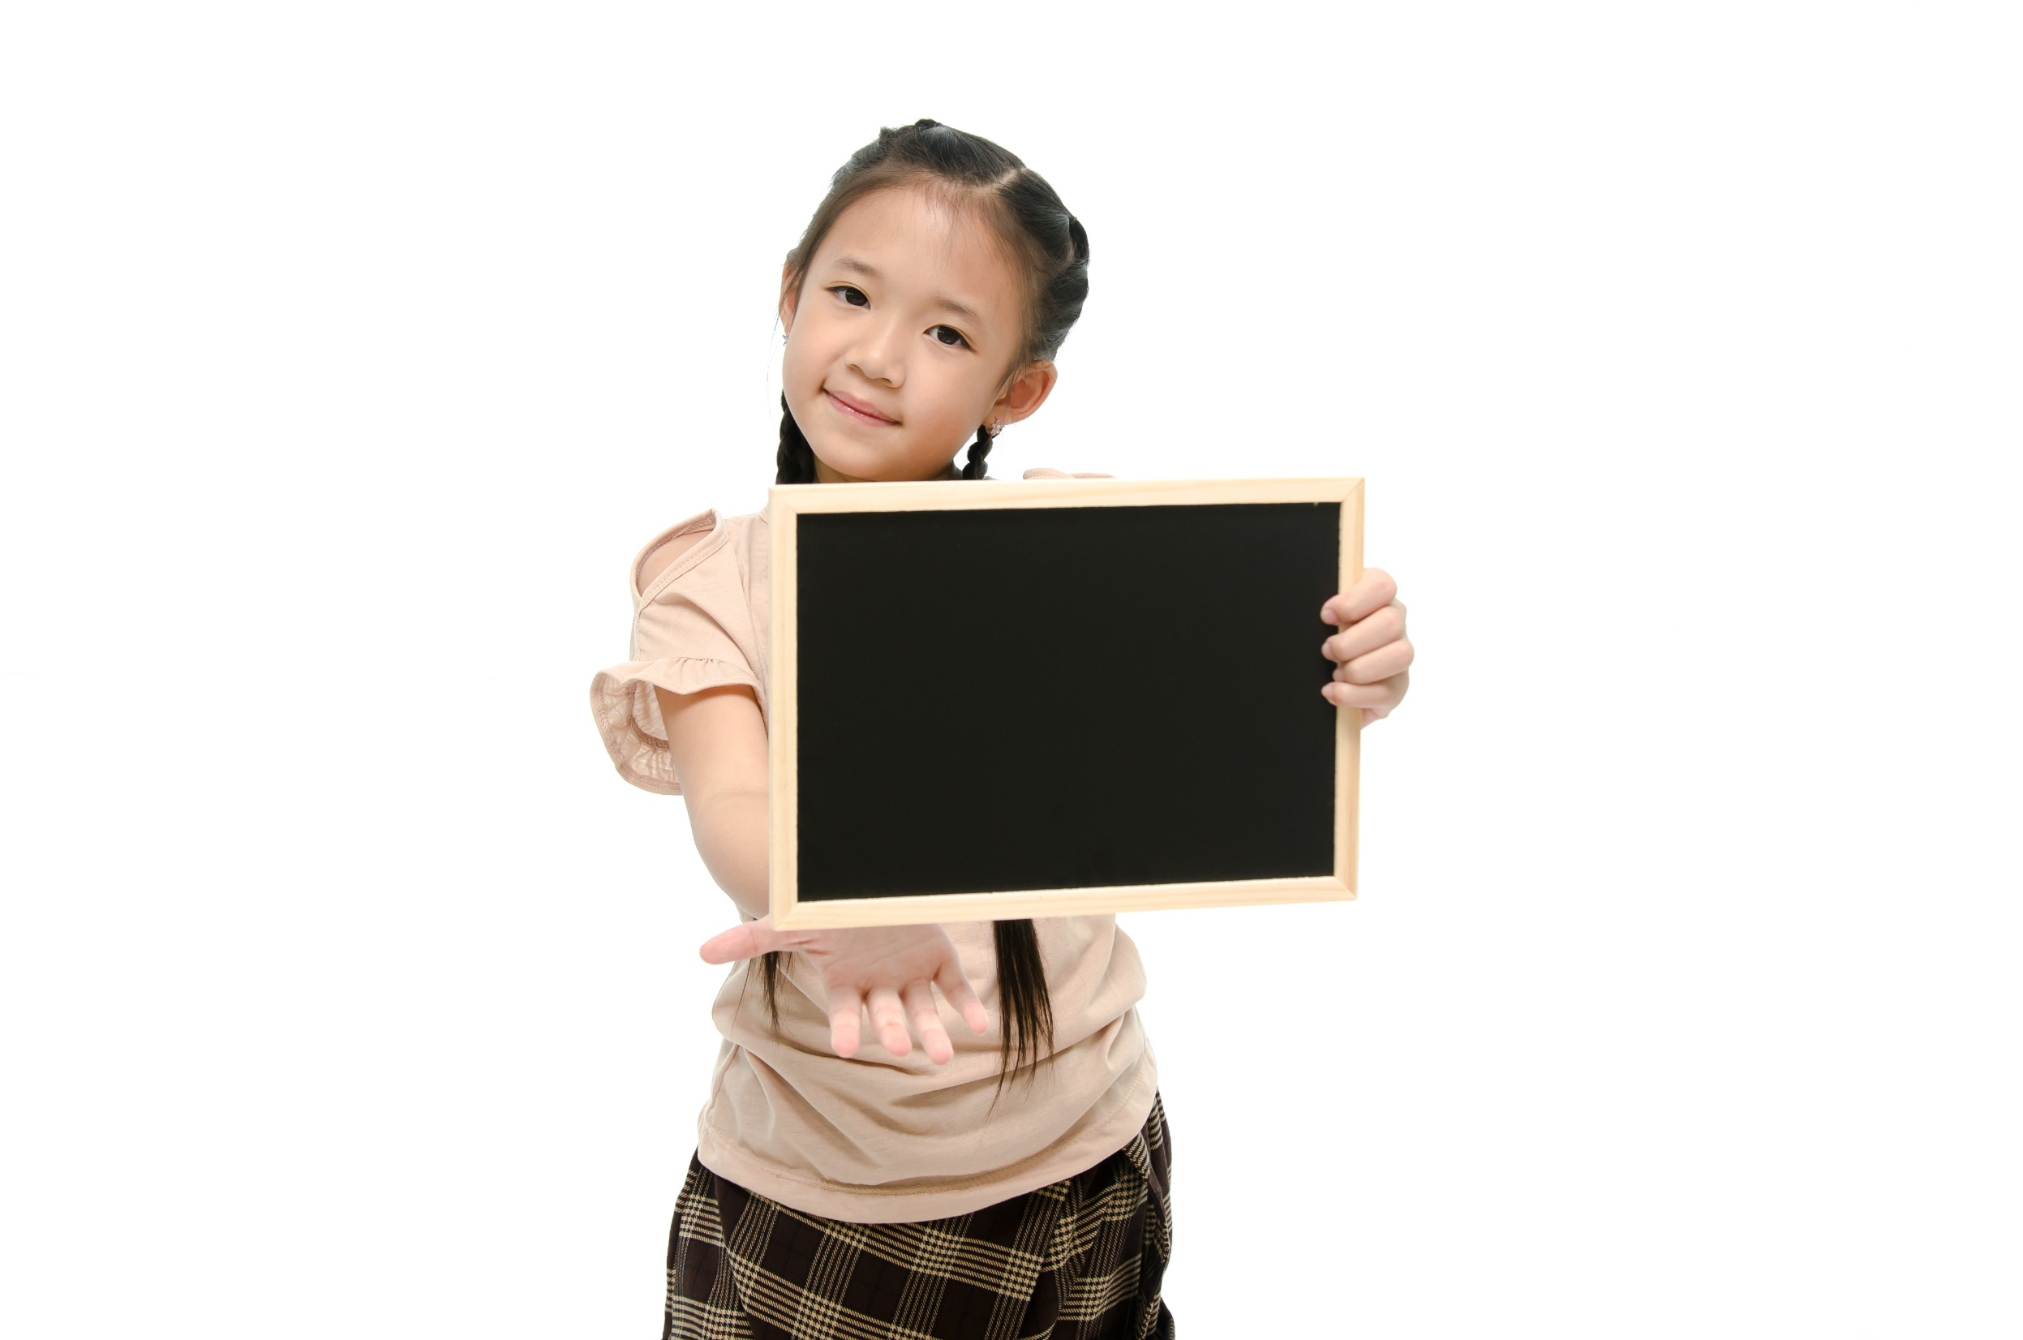
Speaking

Slide 15
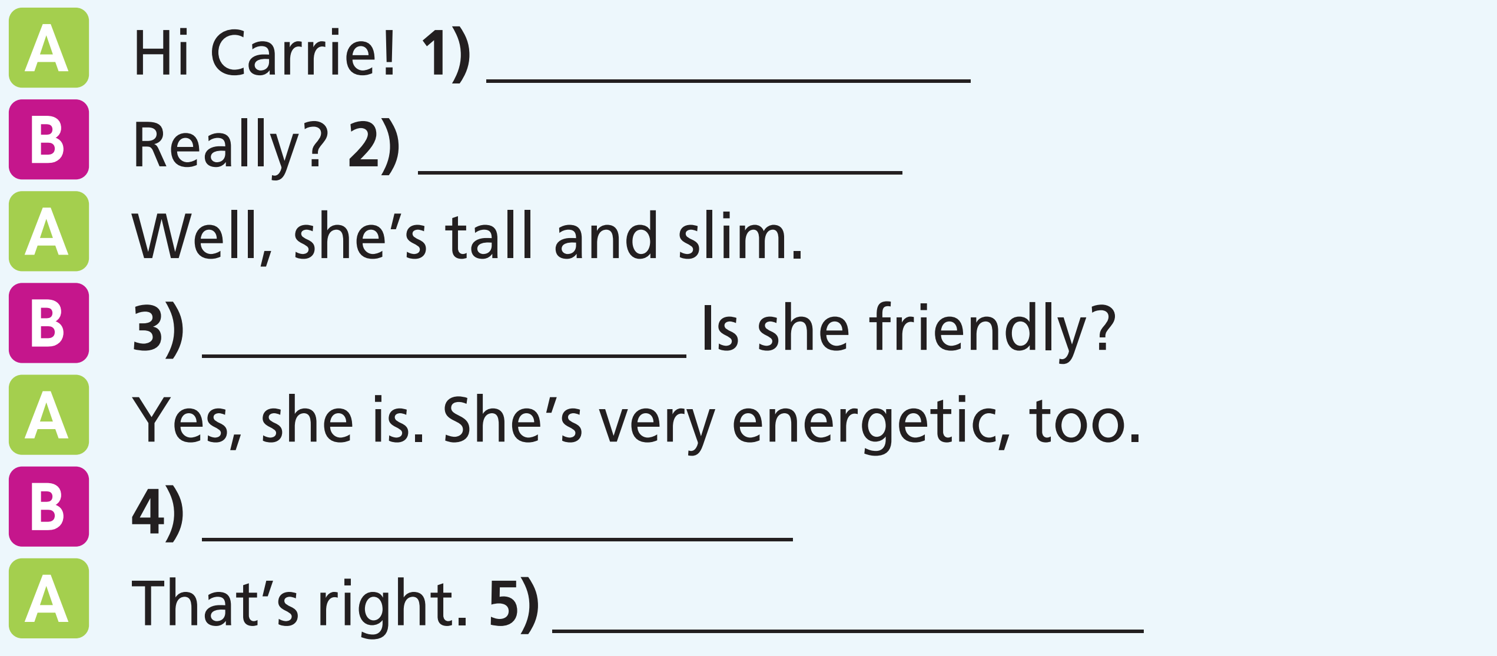
Pre-speaking
Read the task, underline the key words.
8 Complete the dialogue with sentences (a-e).
a What’s she like?
b Let’s go and meet her now!
c Is she the one in the red T-shirt and jeans?
d What does she look like?
e The new girl in our school is great!

Slide 16
While-speaking
Now, do the task.
8 Complete the dialogue with sentences (a-e).
a What’s she like?
b Let’s go and meet her now!
c Is she the one in the red T-shirt and jeans?
d What does she look like?
e The new girl in our school is great!

Slide 17
While-speaking
Now, let’s check.
8 Complete the dialogue with sentences (a-e).
a What’s she like?
b Let’s go and meet her now!
c Is she the one in the red T-shirt
and jeans?
d What does she look like?
e The new girl in our school is great!

Slide 18
Post-speaking
Work in pairs. Practise the dialogue.
A Hi Carrie! The new girl in our school is great!
B Really? What does she look like?
A Well, she’s tall and slim.
B What’s she like? Is she friendly?
A Yes, she is. She’s very energetic, too.
B Is she the one in the red T-shirt and jeans?
A That’s right. Let’s go and meet her now!

Slide 19
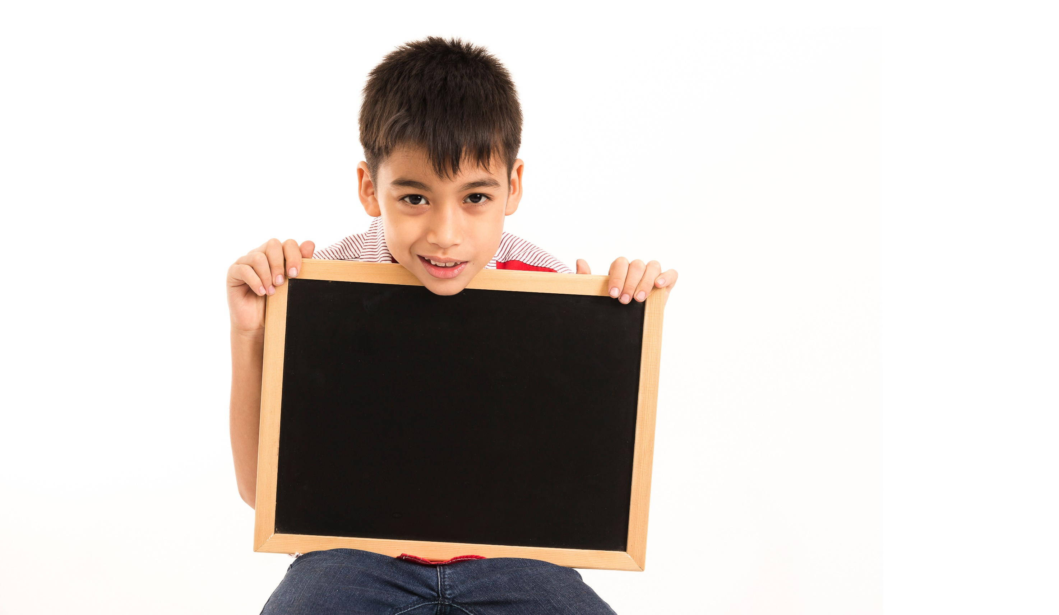
Writing

Slide 20
Pre-writing
Read the instruction, underline the key words.
9 Write a blog post about your favourite free-time activities and hobbies (about 60-80 words).
What are you going to write?
=> A blog post.
What are you going to write about?
=> favourite free-time activities and hobbies.

Slide 21
Look at the sample blog post. What is the structure of a blog?
Opening: Greeting.
Hi everyone! What do you do in your free
time? I listen to music every day after I finish
my homework. I also surf the Net sometimes
and watch TV series with my brother. At the
weekends, I play sports or go to the cinema
with my friends. I rarely play computer
games – I don't like them. What are your
favorite free-time activities?
Body: Tell what you do in your free time.
Ending: Ask a question.

Slide 22
While-writing
9 Write a blog post about your favourite free-time activities and hobbies (about 60-80 words).
Now, write a blog post like the sample writing.

Slide 23
Post-writing
Peer-correction
Criteria | Yes | No
Opening
Body
Ending
Grammar mistakes | Underline
Spelling mistakes | Circle

Slide 24

CONSOLIDATION

Slide 25
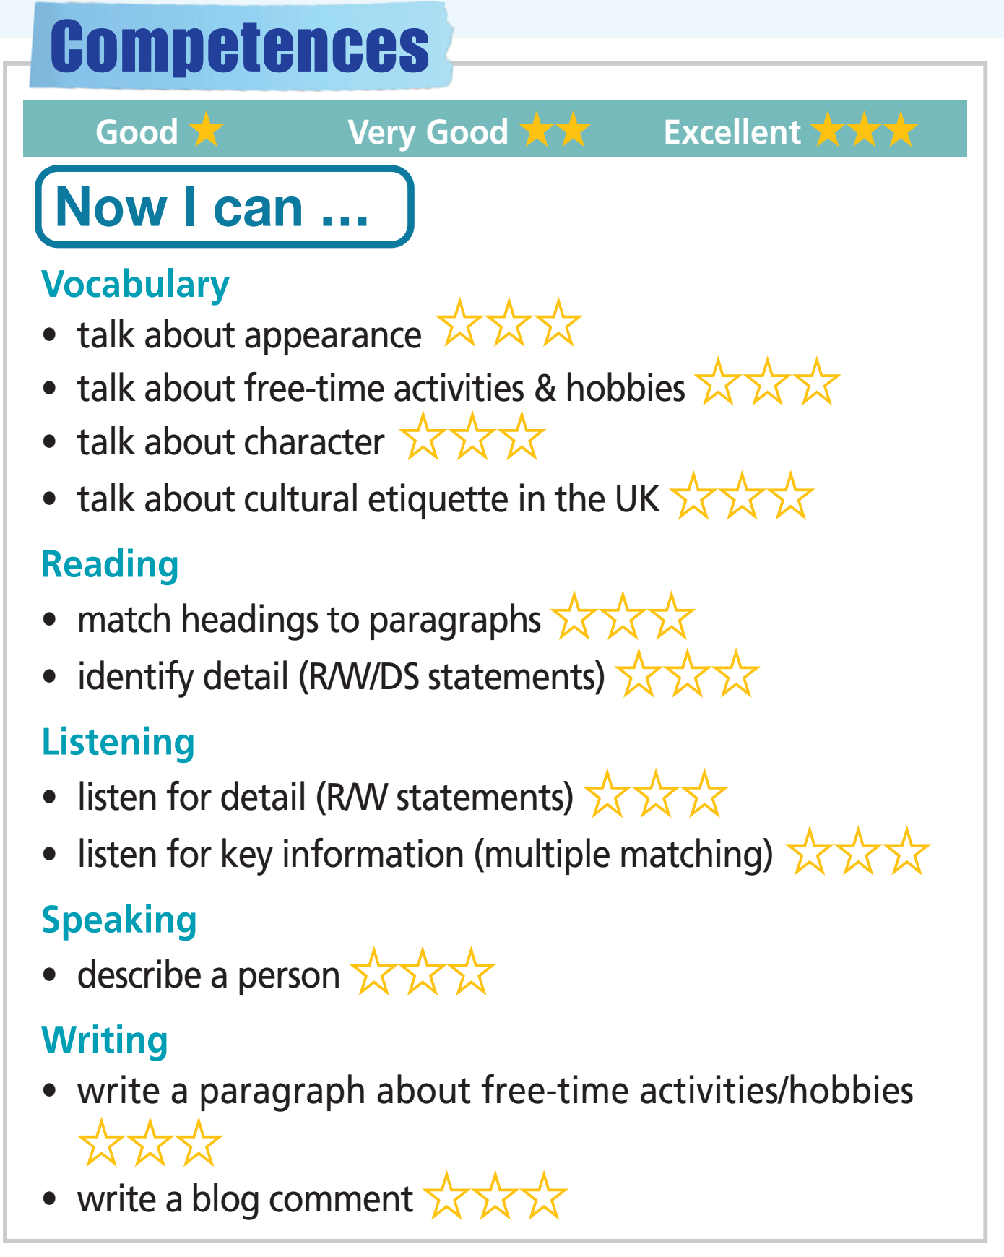
Colour the number of stars if you are good or very good or excellent at what you have learnt in Unit 1.

Slide 26

WRAP-UP

Slide 27
Today’s lesson
Vocabularies
Appearance
Hobbies
Free-time activities
Structures/ Sentence patterns
Present Simple
Present Continuous

Slide 28
Homework
Review the vocabularies and grammar; and make sentences using them.
Prepare the next lesson (page 28 SB)
Do Test 2 of Unit 1 in Bài Tập Bổ Trợ TA 7 Right on
(pages 14 – 17)
Do the Speaking Test – Test 2 of Unit 1 in Bài Tập Bổ Trợ TA 7 Right on (page 75)

Slide 29

Lesson 3
Stay positive and have a nice day!

