Slide 1


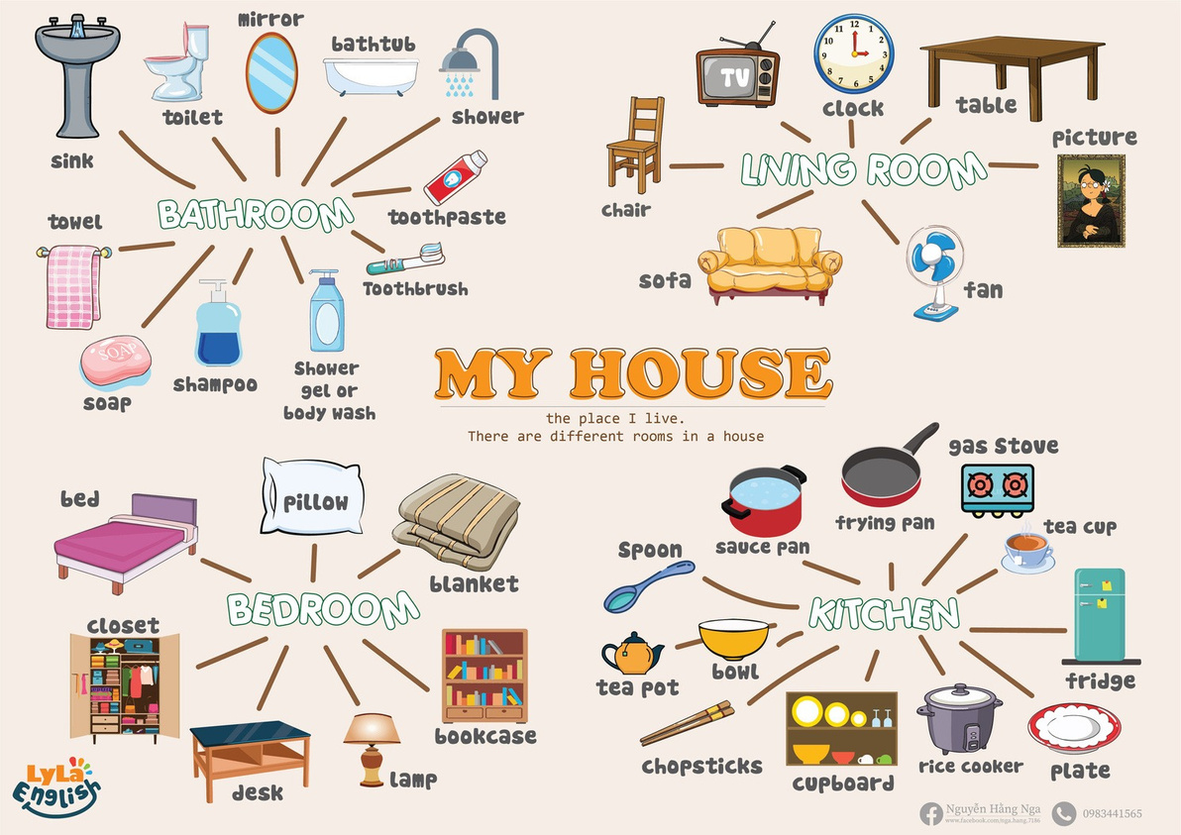

Slide 2
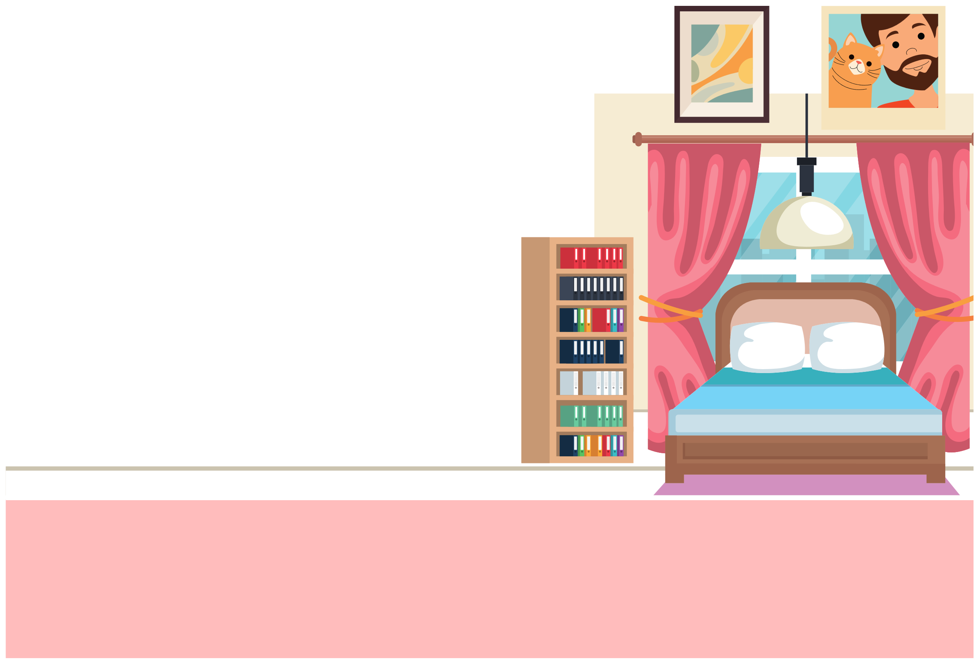
I. QUESTION
1.What room is it?
- It’s a ...
2. What things are there in the bedroom?
- There are ....
3. What shape is your bed?
- It’s ...
4. What color is it?
- It’s ...

Slide 3
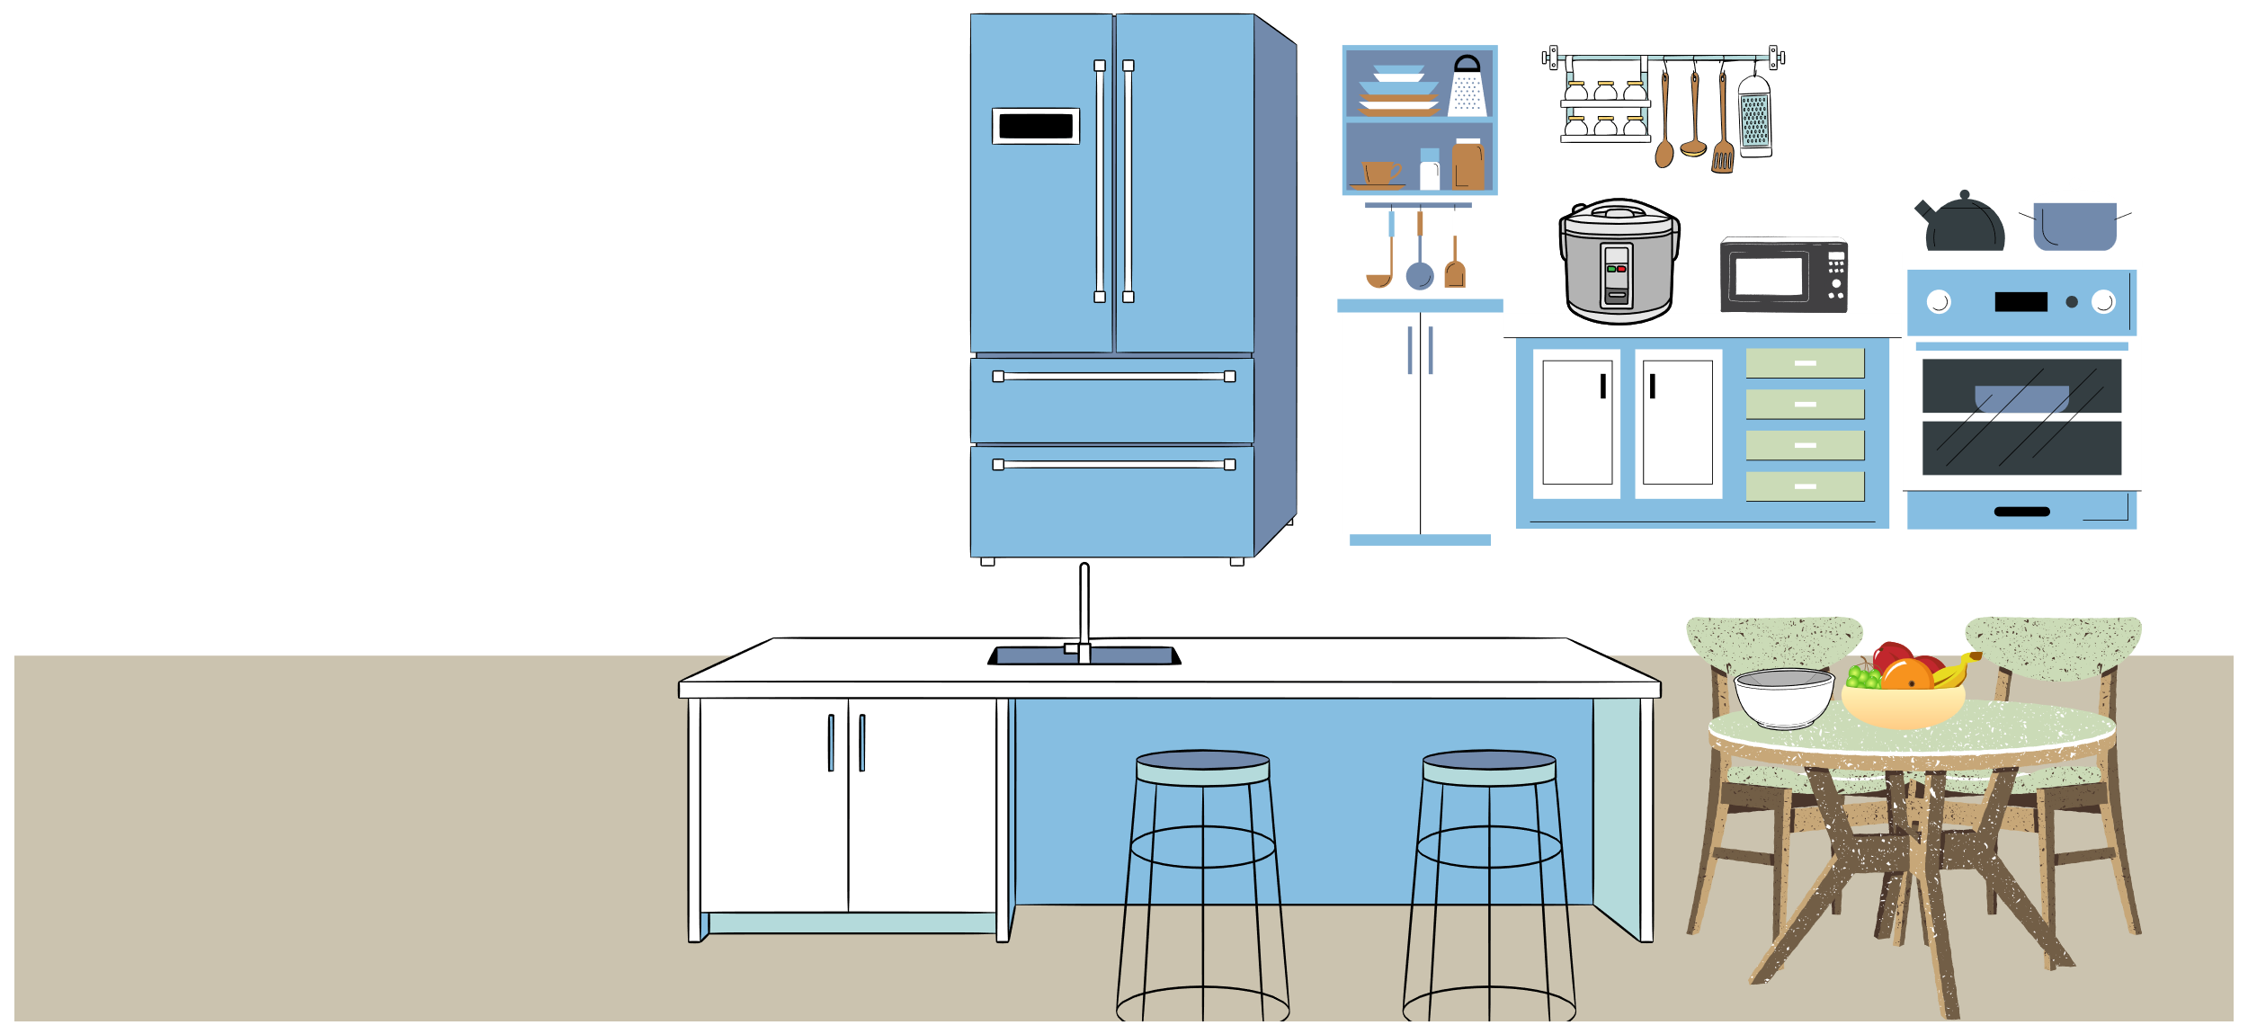
I. QUESTION
1. What things are there in the kitchen?
-There are ...
2. 1. What do you use to cook rice?
- I use...
3. What color is the bowl?
- It’s ...
4.What do you use keep the
food fresh?
-It’s a...
5. What shape is the fridge?
-It’s ....

Slide 4
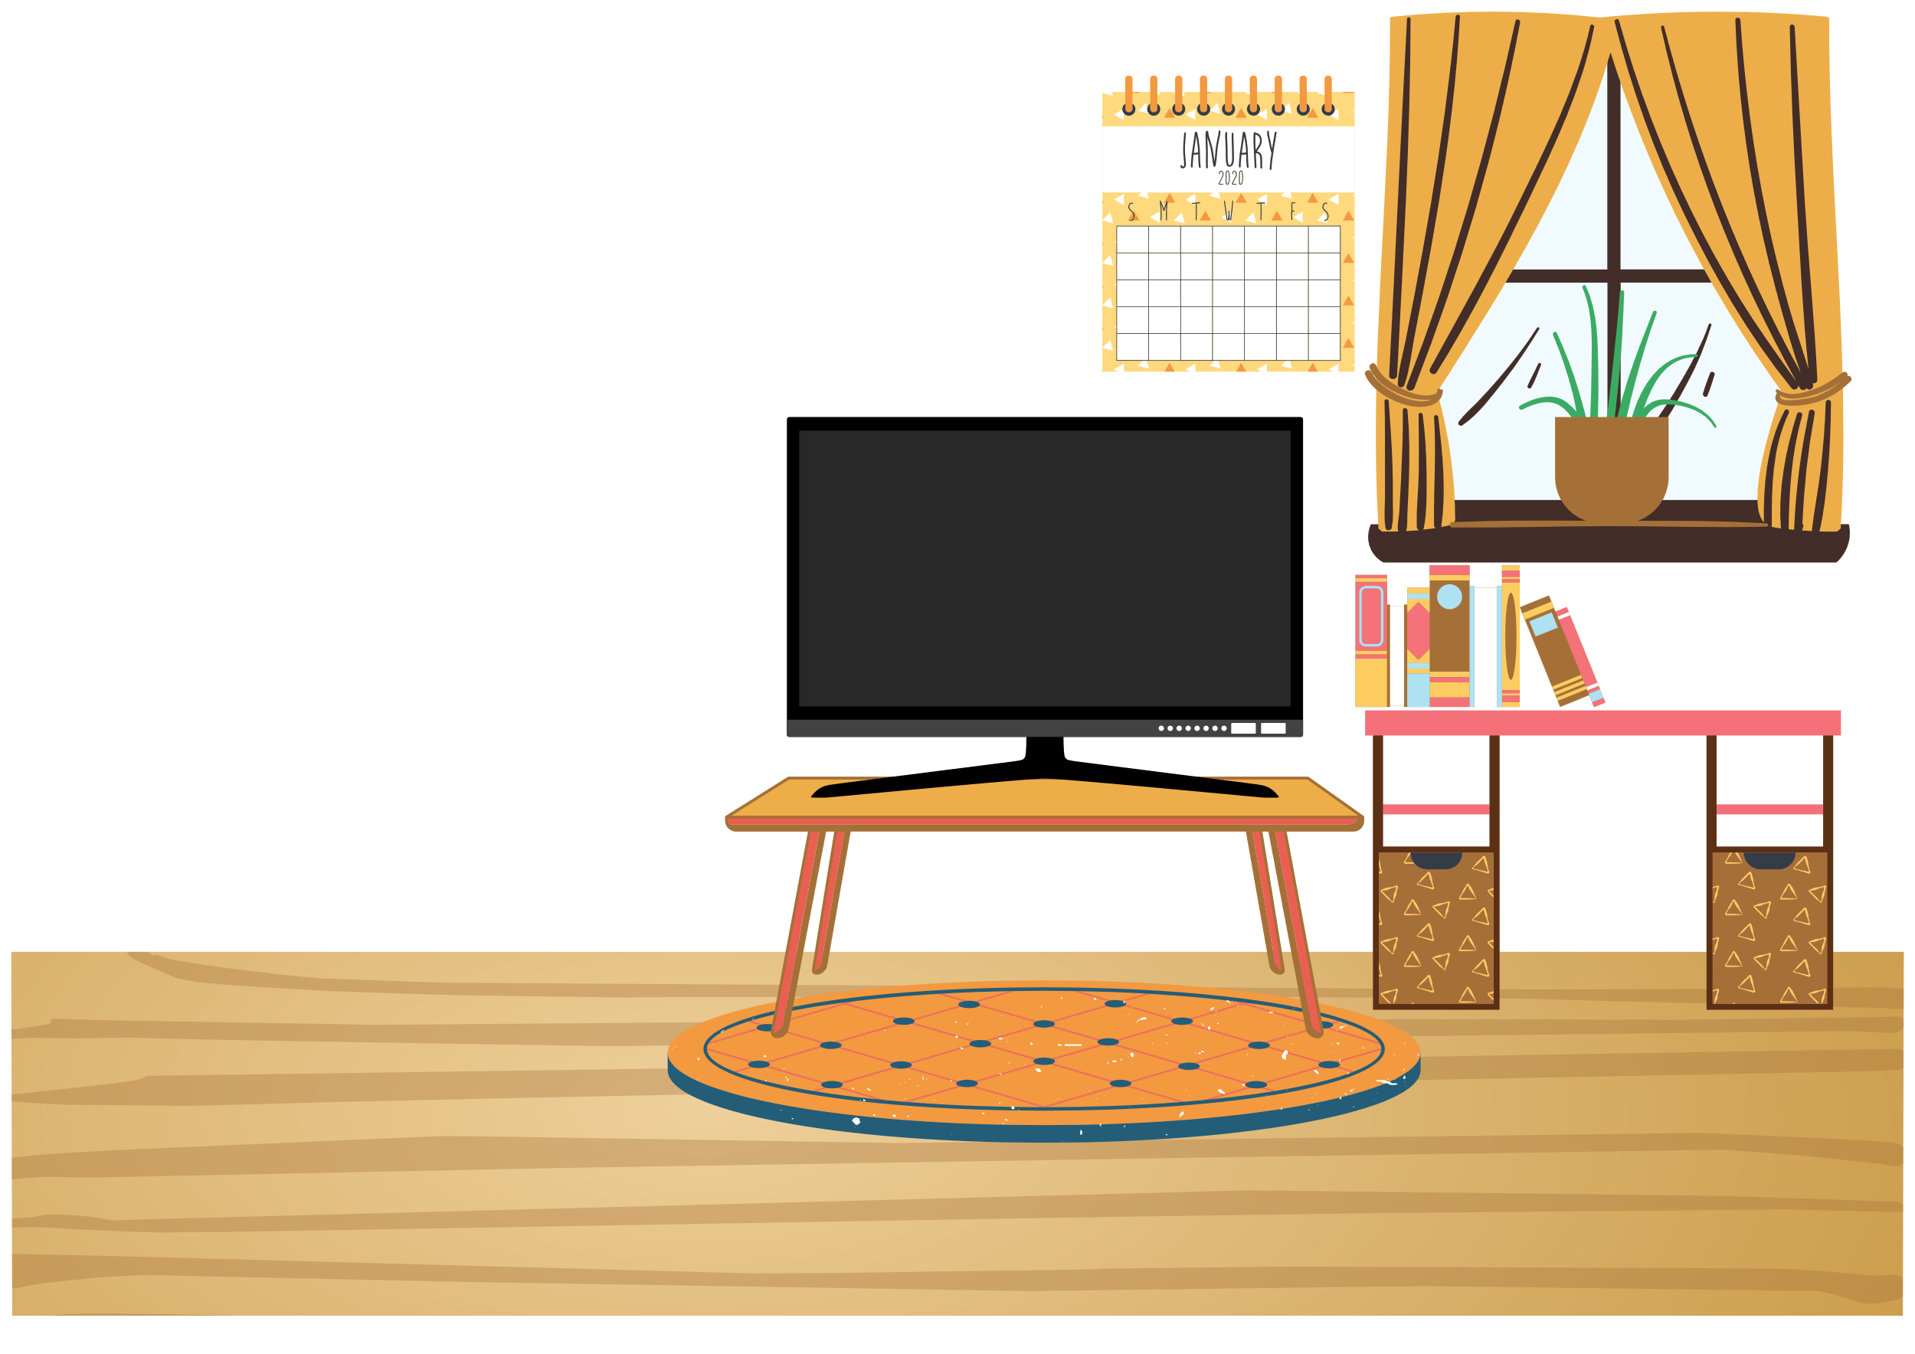

I. QUESTION
1.What is it? - It’s a ...
2. What shape is the table?
- It’s ...
3. What shape is this clock?
- It’s ...
4. What shape is the TV?
- It’s ...

Slide 5
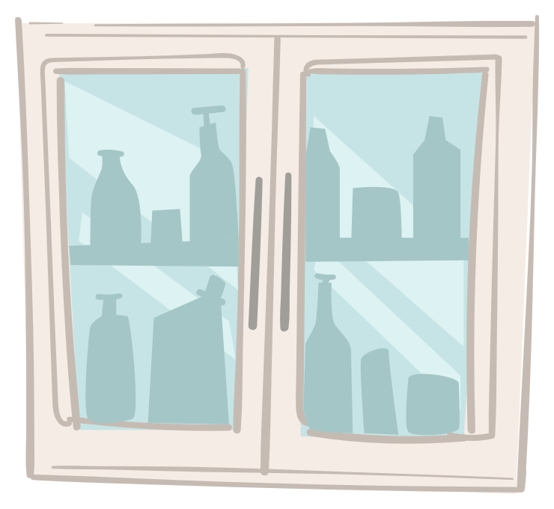
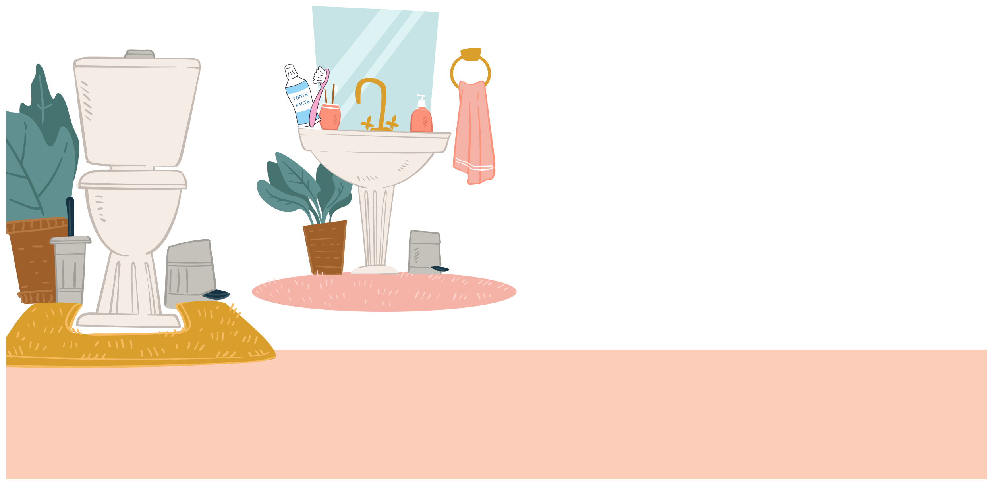
I. QUESTION
1. What do you use to brush teeth? - I use ....
2. How do you brush your teeth?
- ...
- ...
- ...

Slide 6
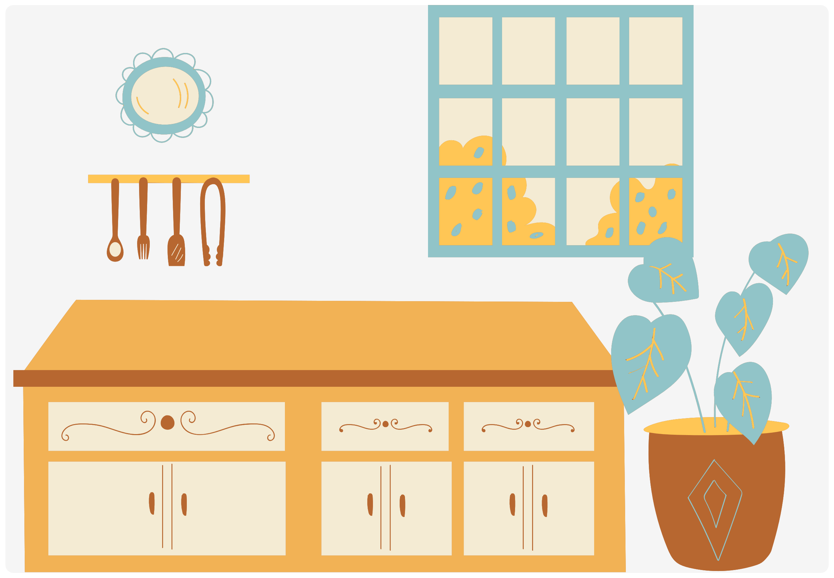
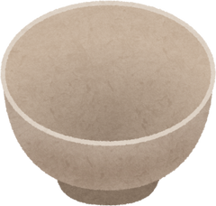

II. VOCABULARY
Bowl:.....................................................
Spoon:..................................................
Chopticks:.............................................
Pan:.....................................................

Slide 7
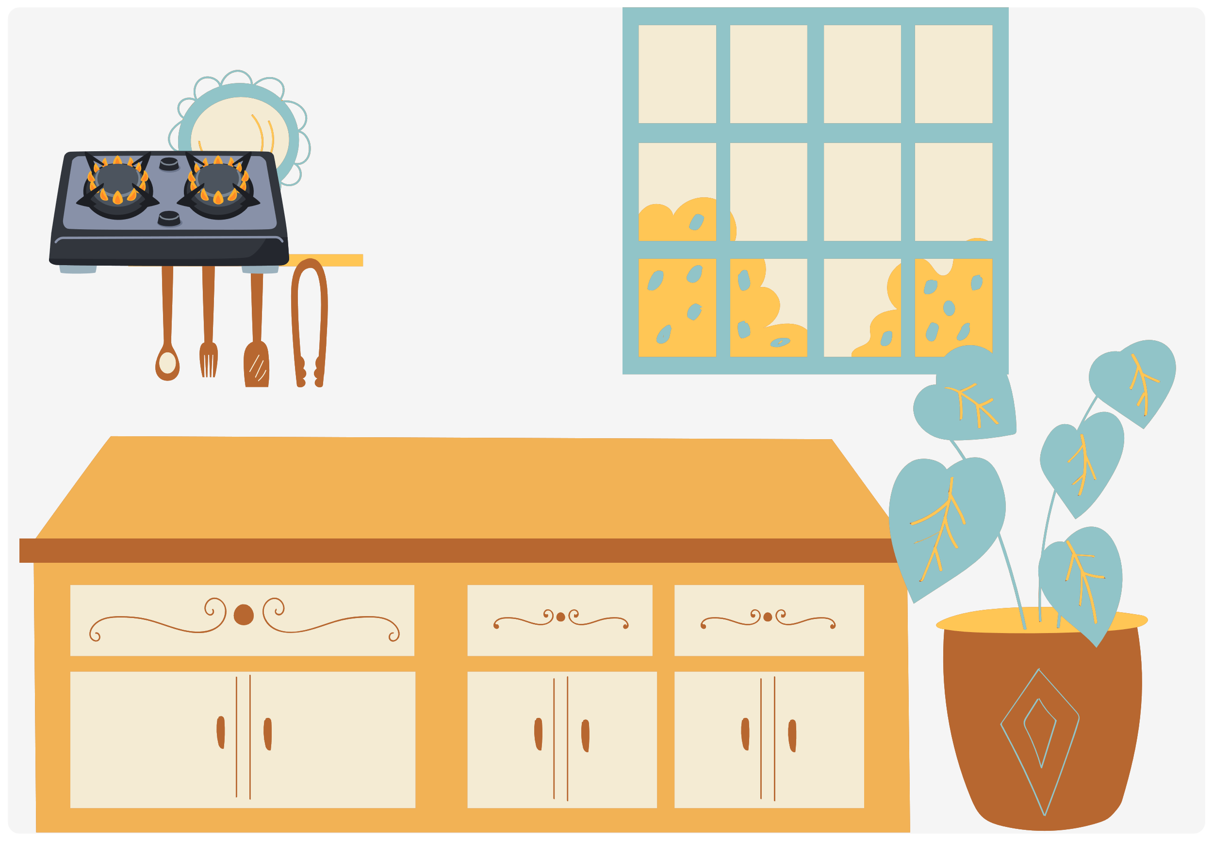

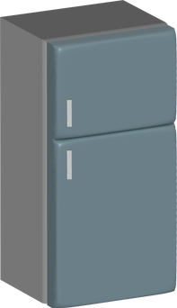
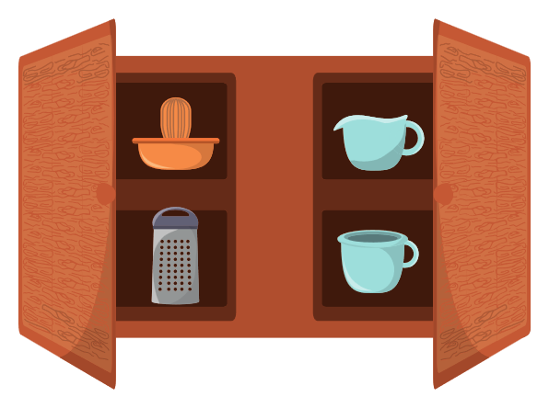






II. VOCABULARY
Gas stove:.................................................
Rice cooker:...............................................
Fridge:.....................................................
Cup board:..............................................

Slide 8

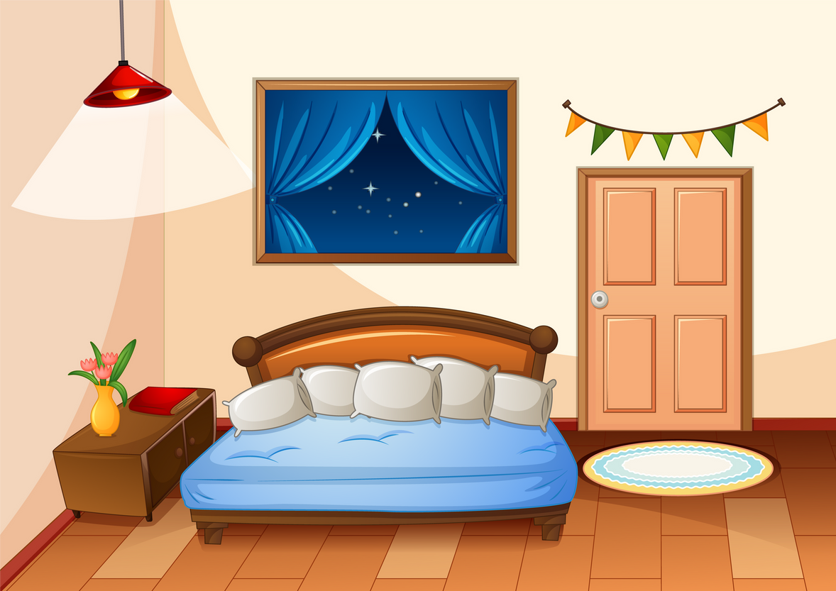
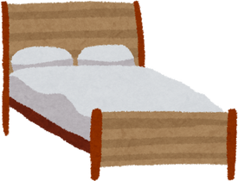
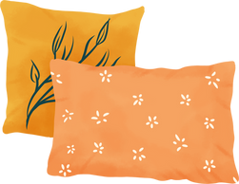
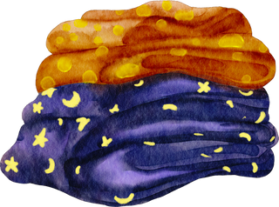
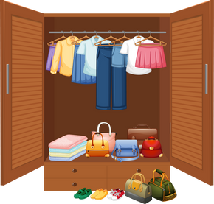
II. VOCABULARY
Bed:.....................................................
Pillow:...............................................
Blanket:.....................................................
Closet:............................................

Slide 9
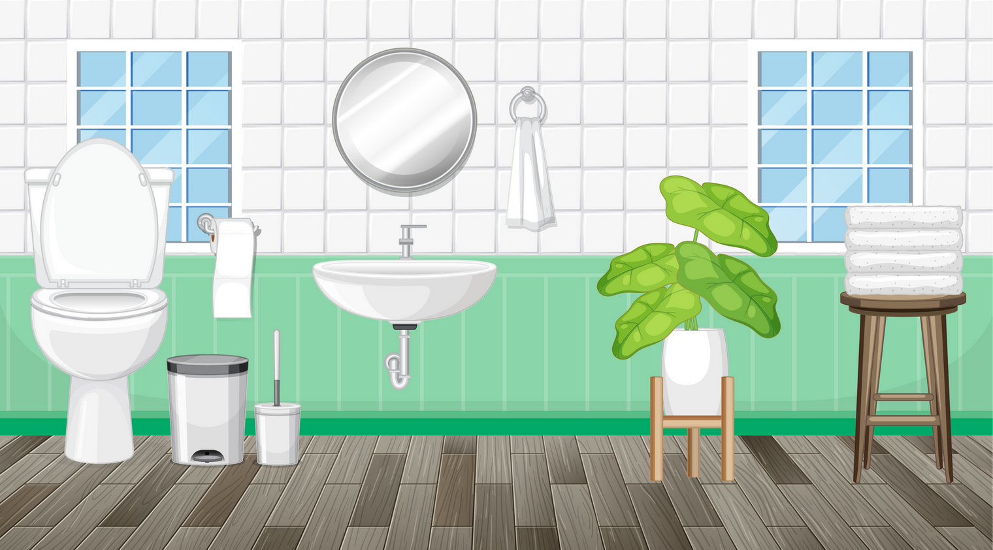
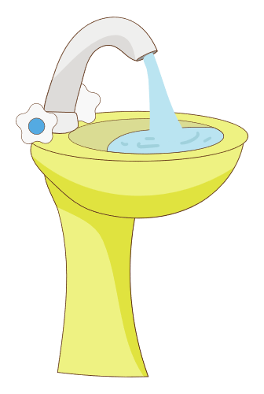



II. VOCABULARY
Sink:.....................................................
Toilet:...................................................
Toothpaste:..........................................
Toothbrush:.........................................

Slide 10
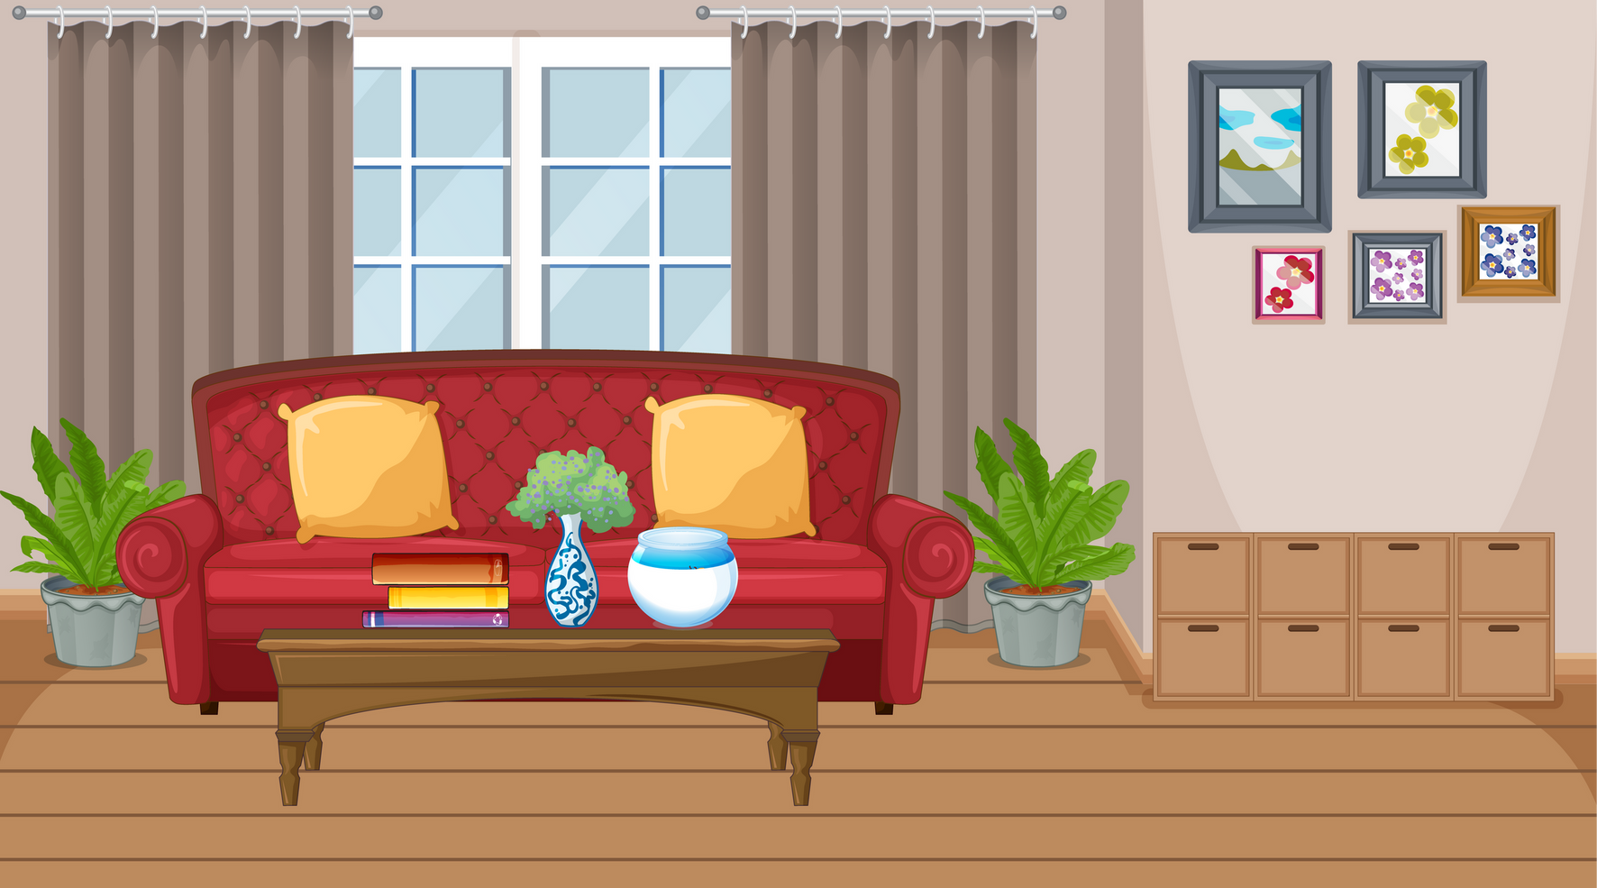
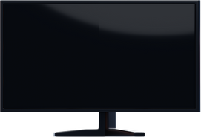
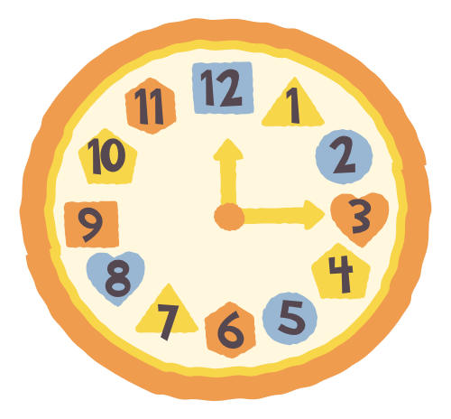
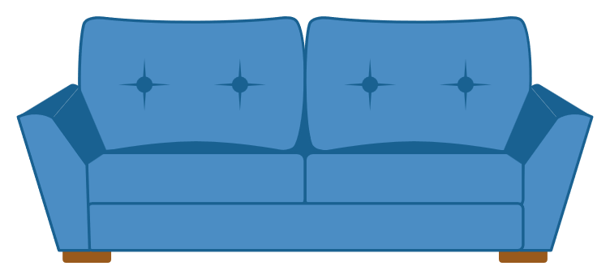
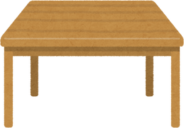
II. VOCABULARY
TV:....................................................
Clock:...............................................
Sofa:.................................................
Table:................................................

Slide 11
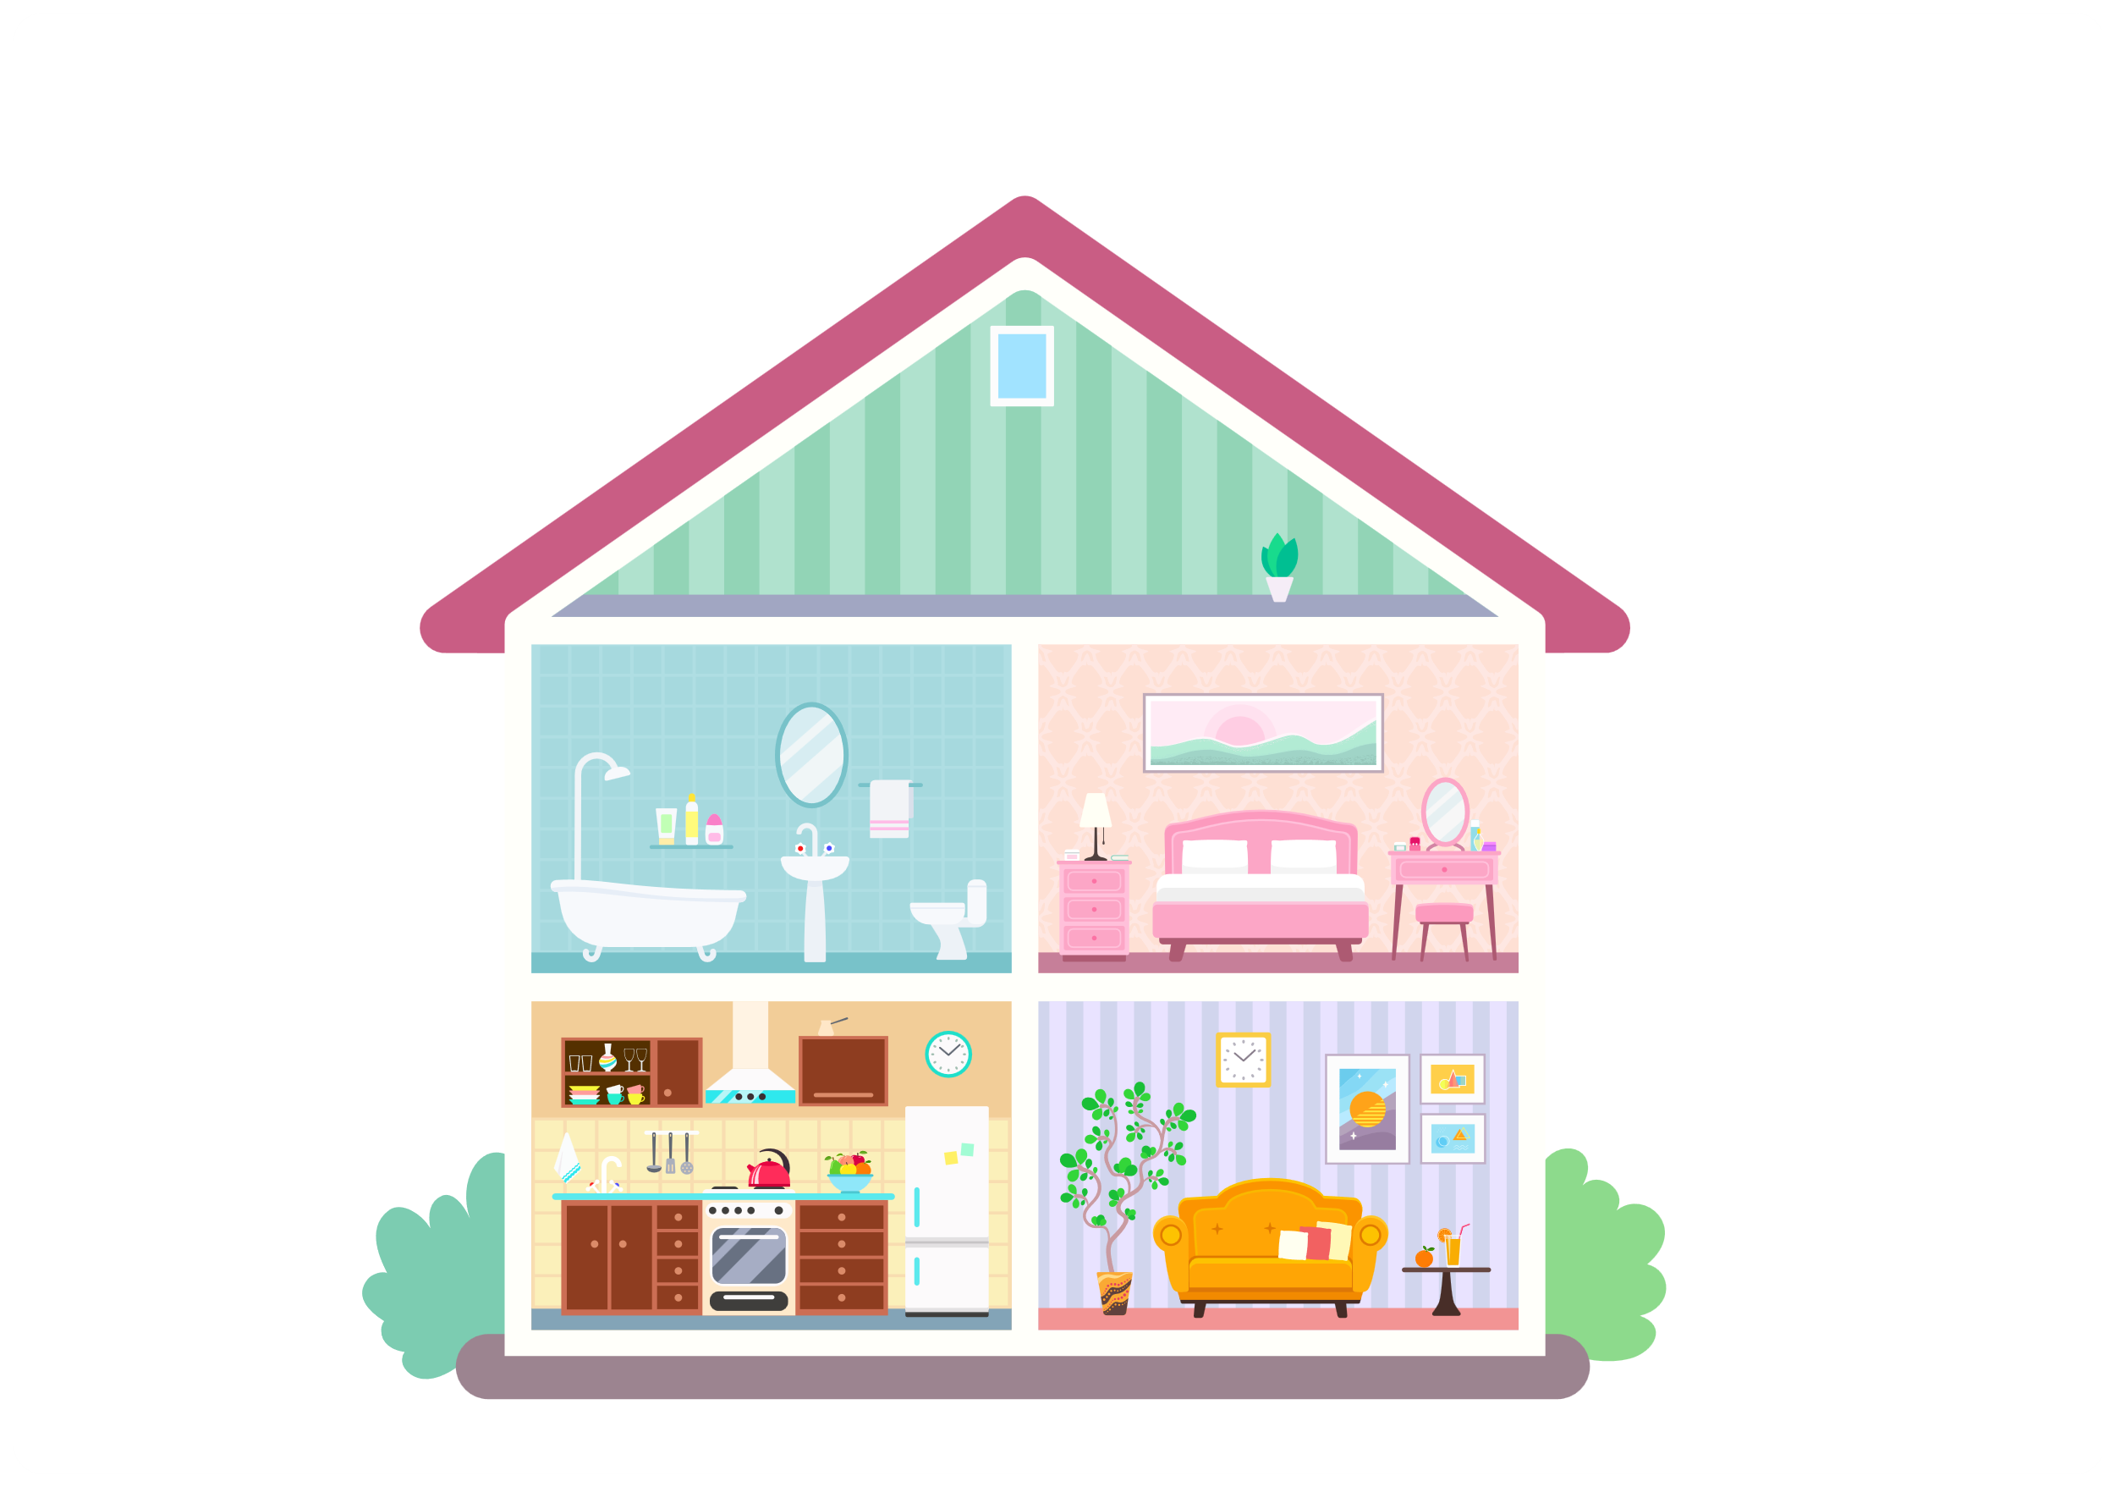
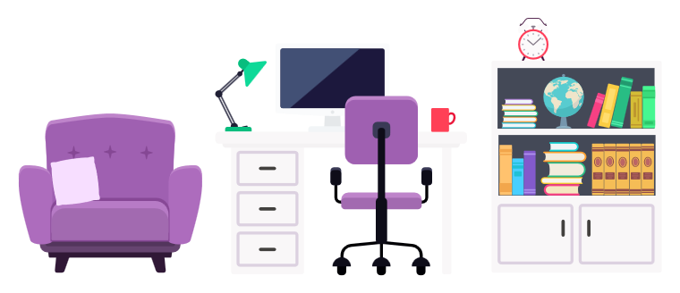




III. EXERCISES:
1.Write the rooms below:

Slide 12
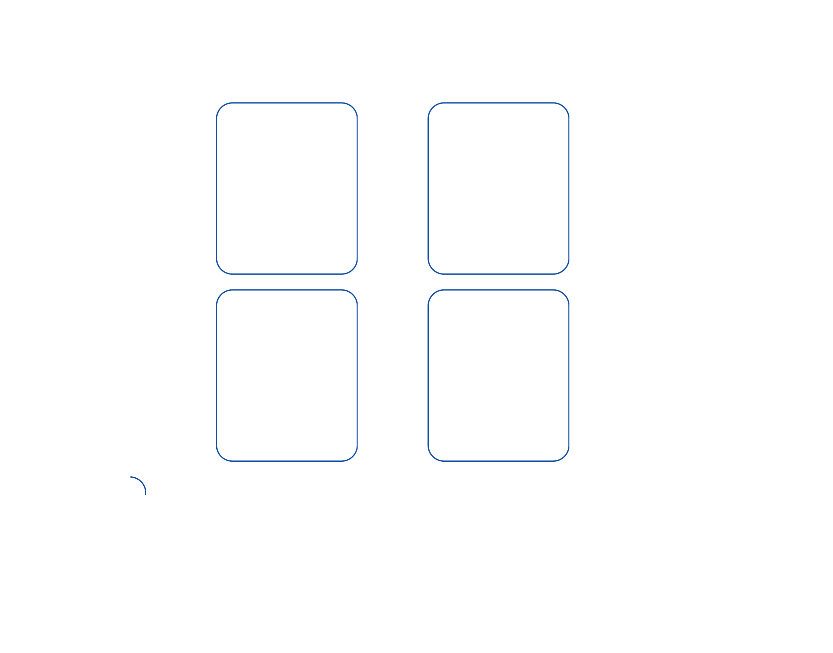






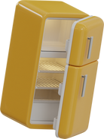
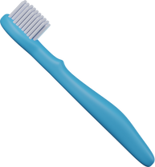

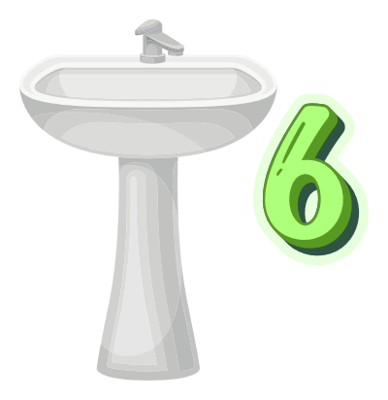
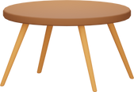

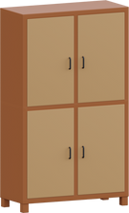

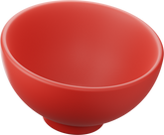
III. EXERCISES:
2. Classfify these things into correct rooms:
LIVING ROOM
BEDROOM
KITCHEN
BATHROOM

Slide 13

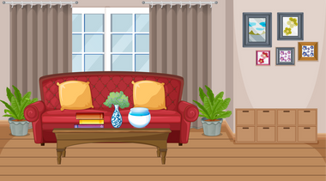

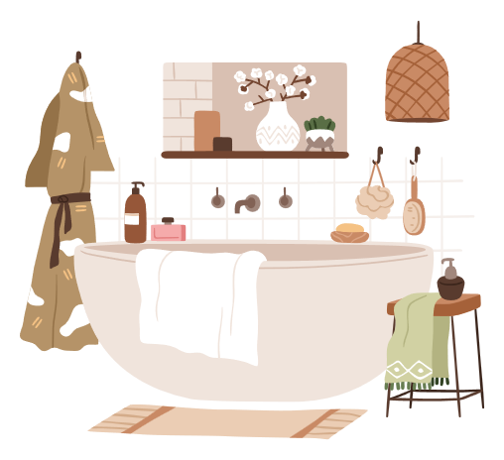
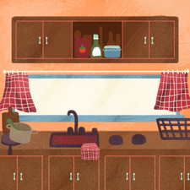
III. EXERCISES:
3. Trace the line:
living room bedroom bathroom
kitchen

Slide 14
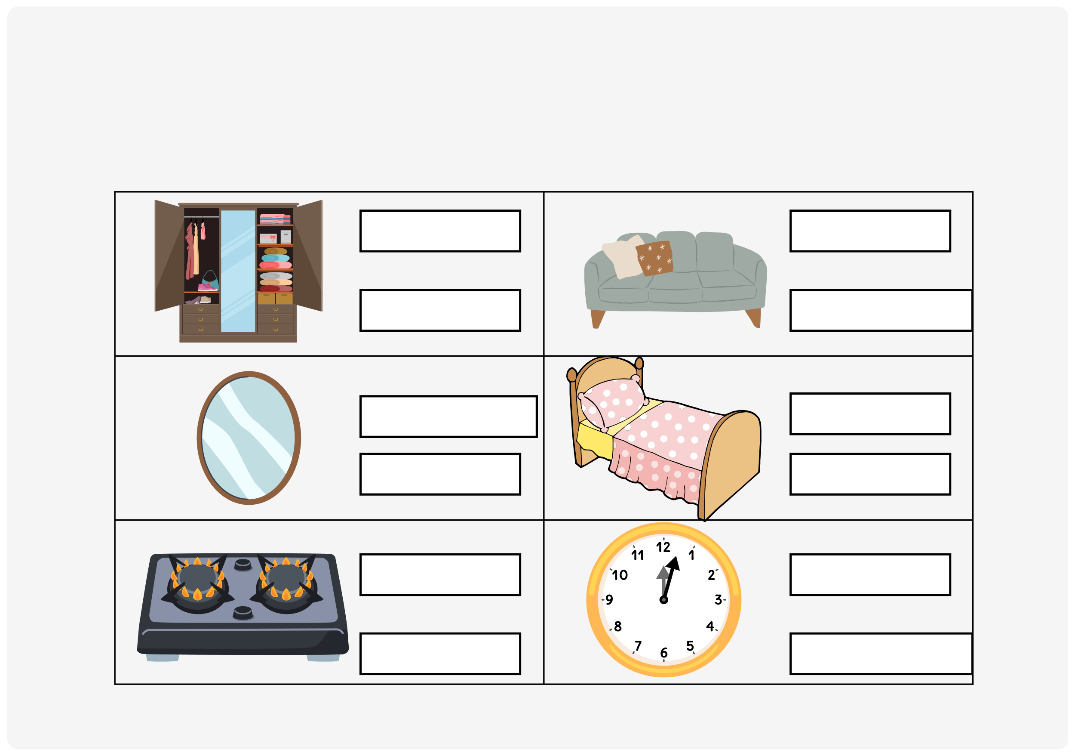
III. EXERCISES:
4. Which room is this item in? Circle the correct answer:
kitchen
kitchen
bedroom
living room
living room bathroom
bedroom bathroom
bathroom
bedroom
kitchen
living room

Slide 15
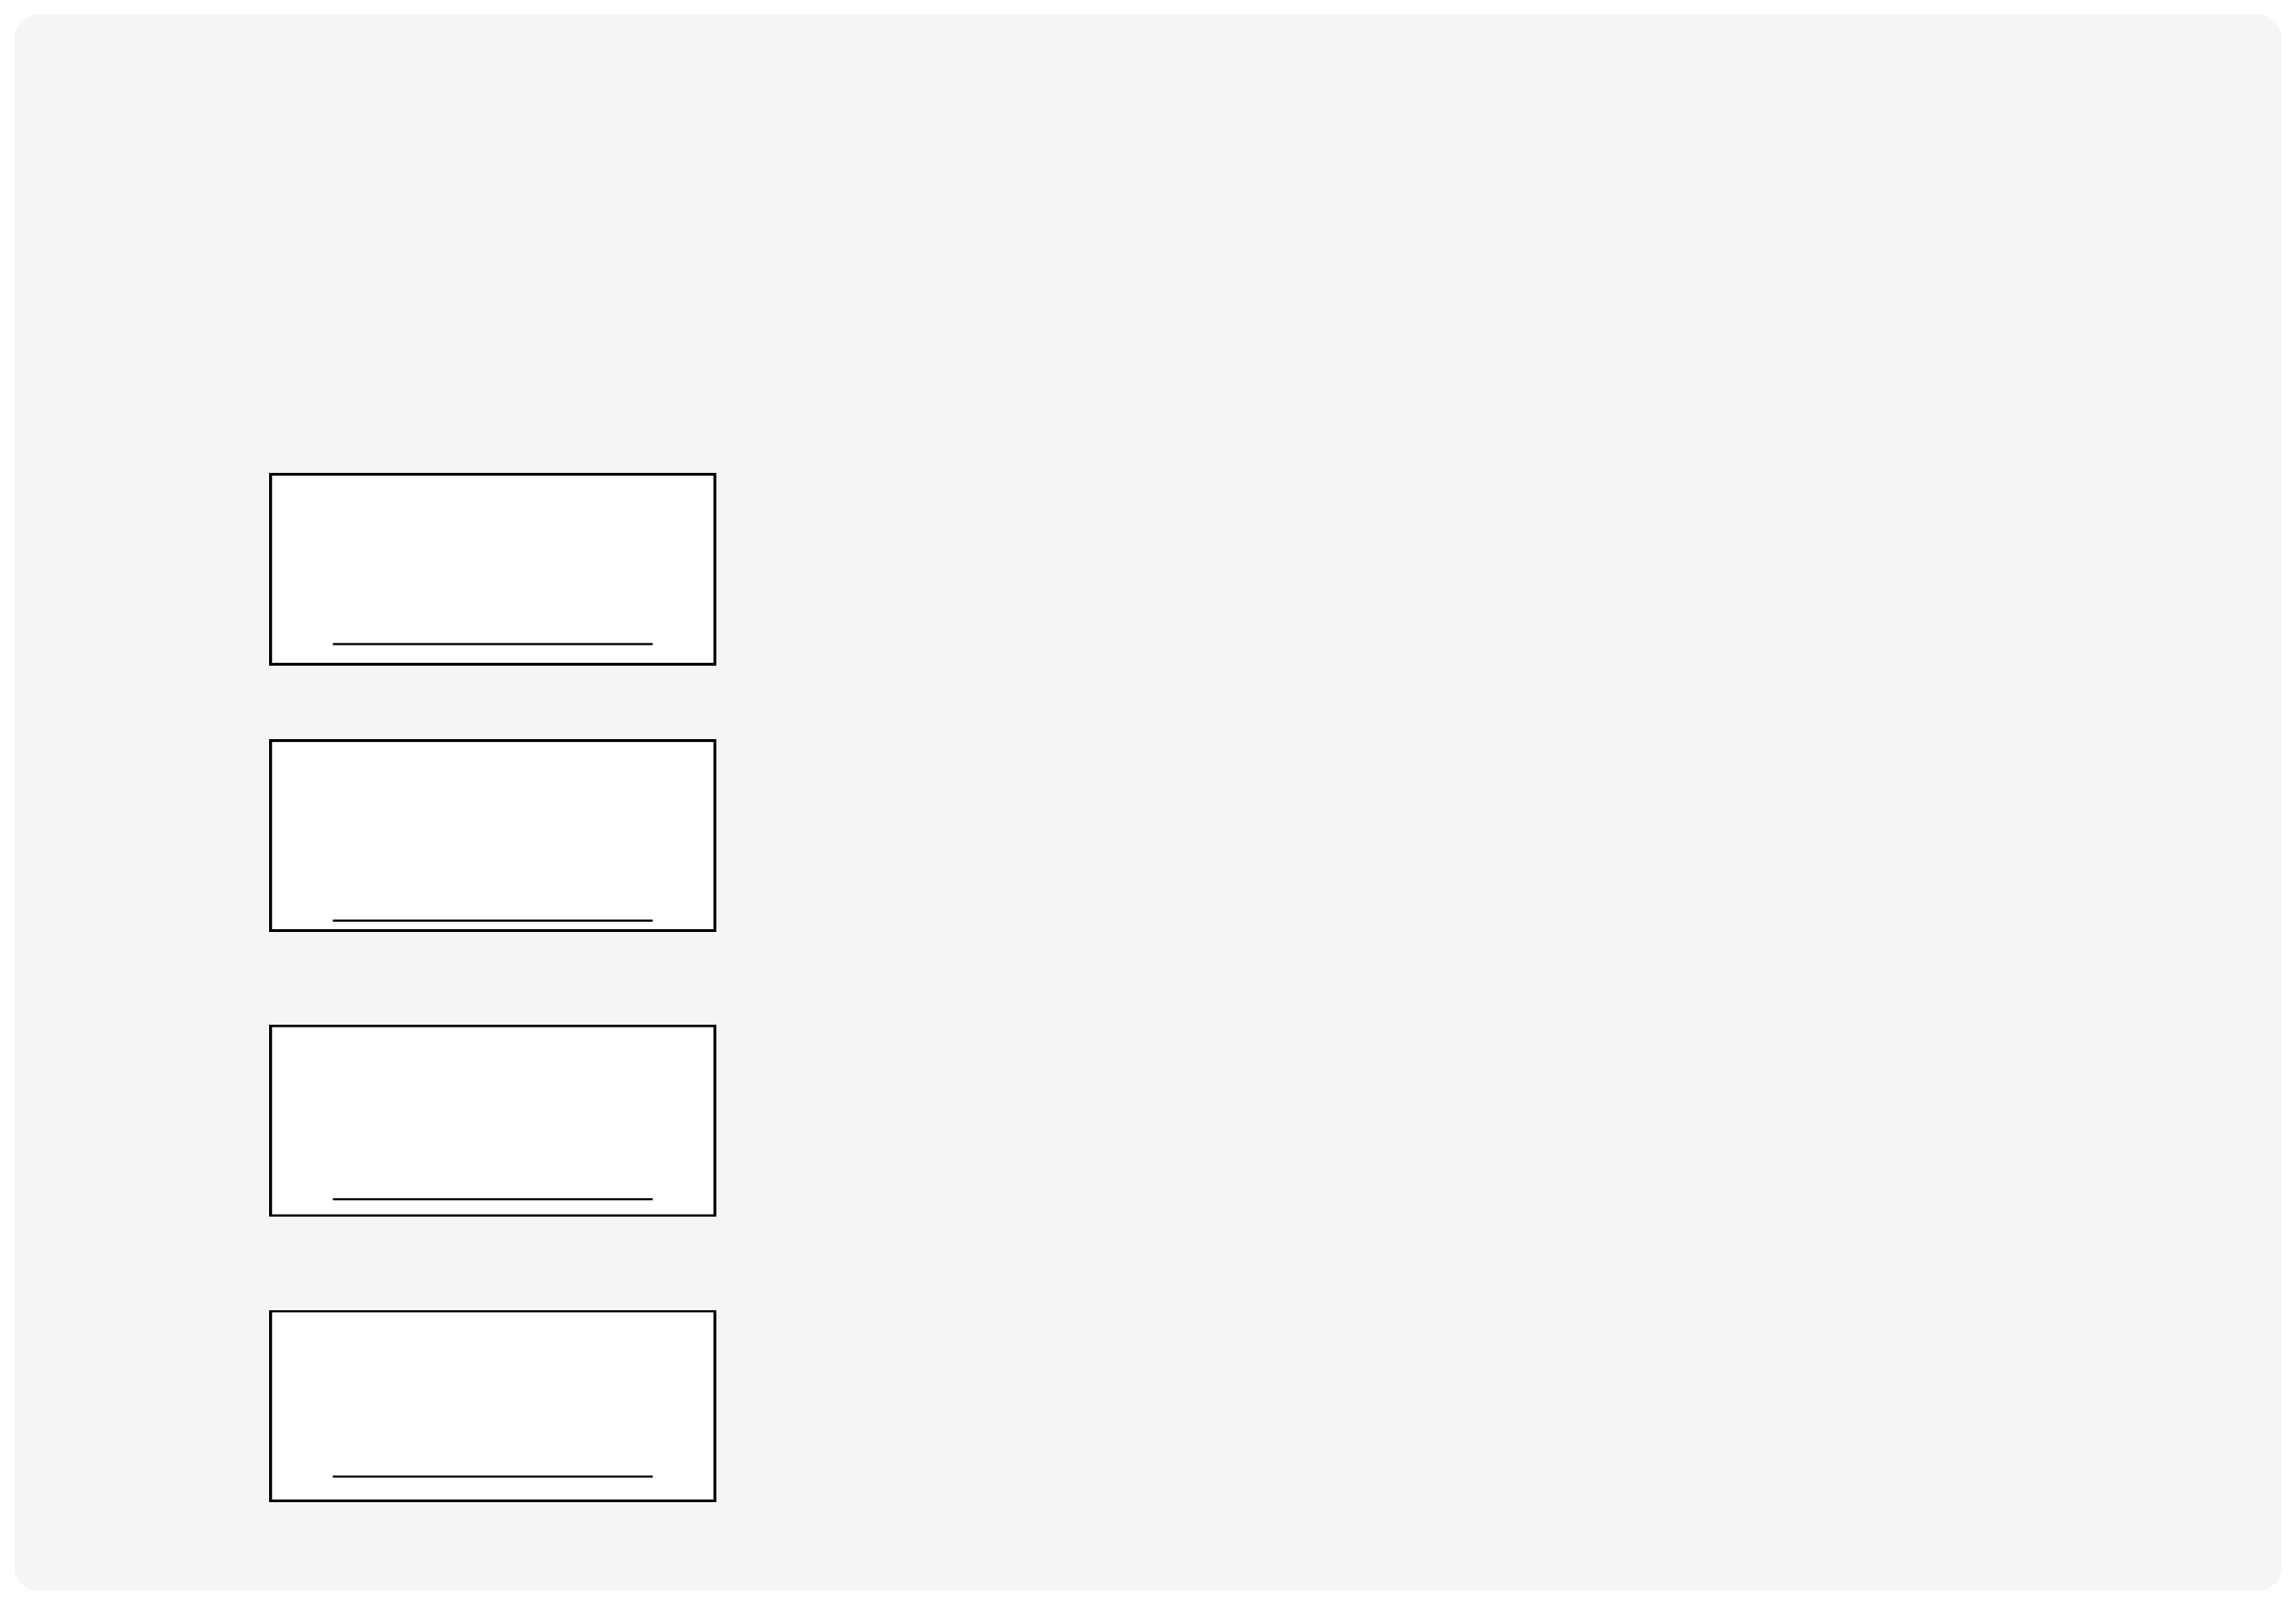
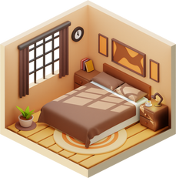
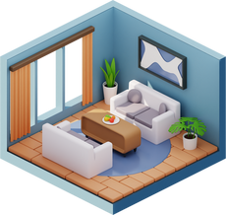
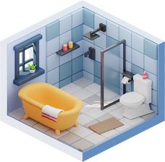
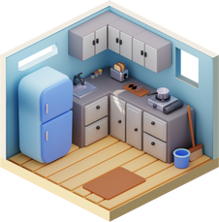
III. EXERCISES:
5. Rearrange the letters below and match the word to the correct picture:
ktihcen
ebdorom
lviign oomr
tbahormo

Slide 16
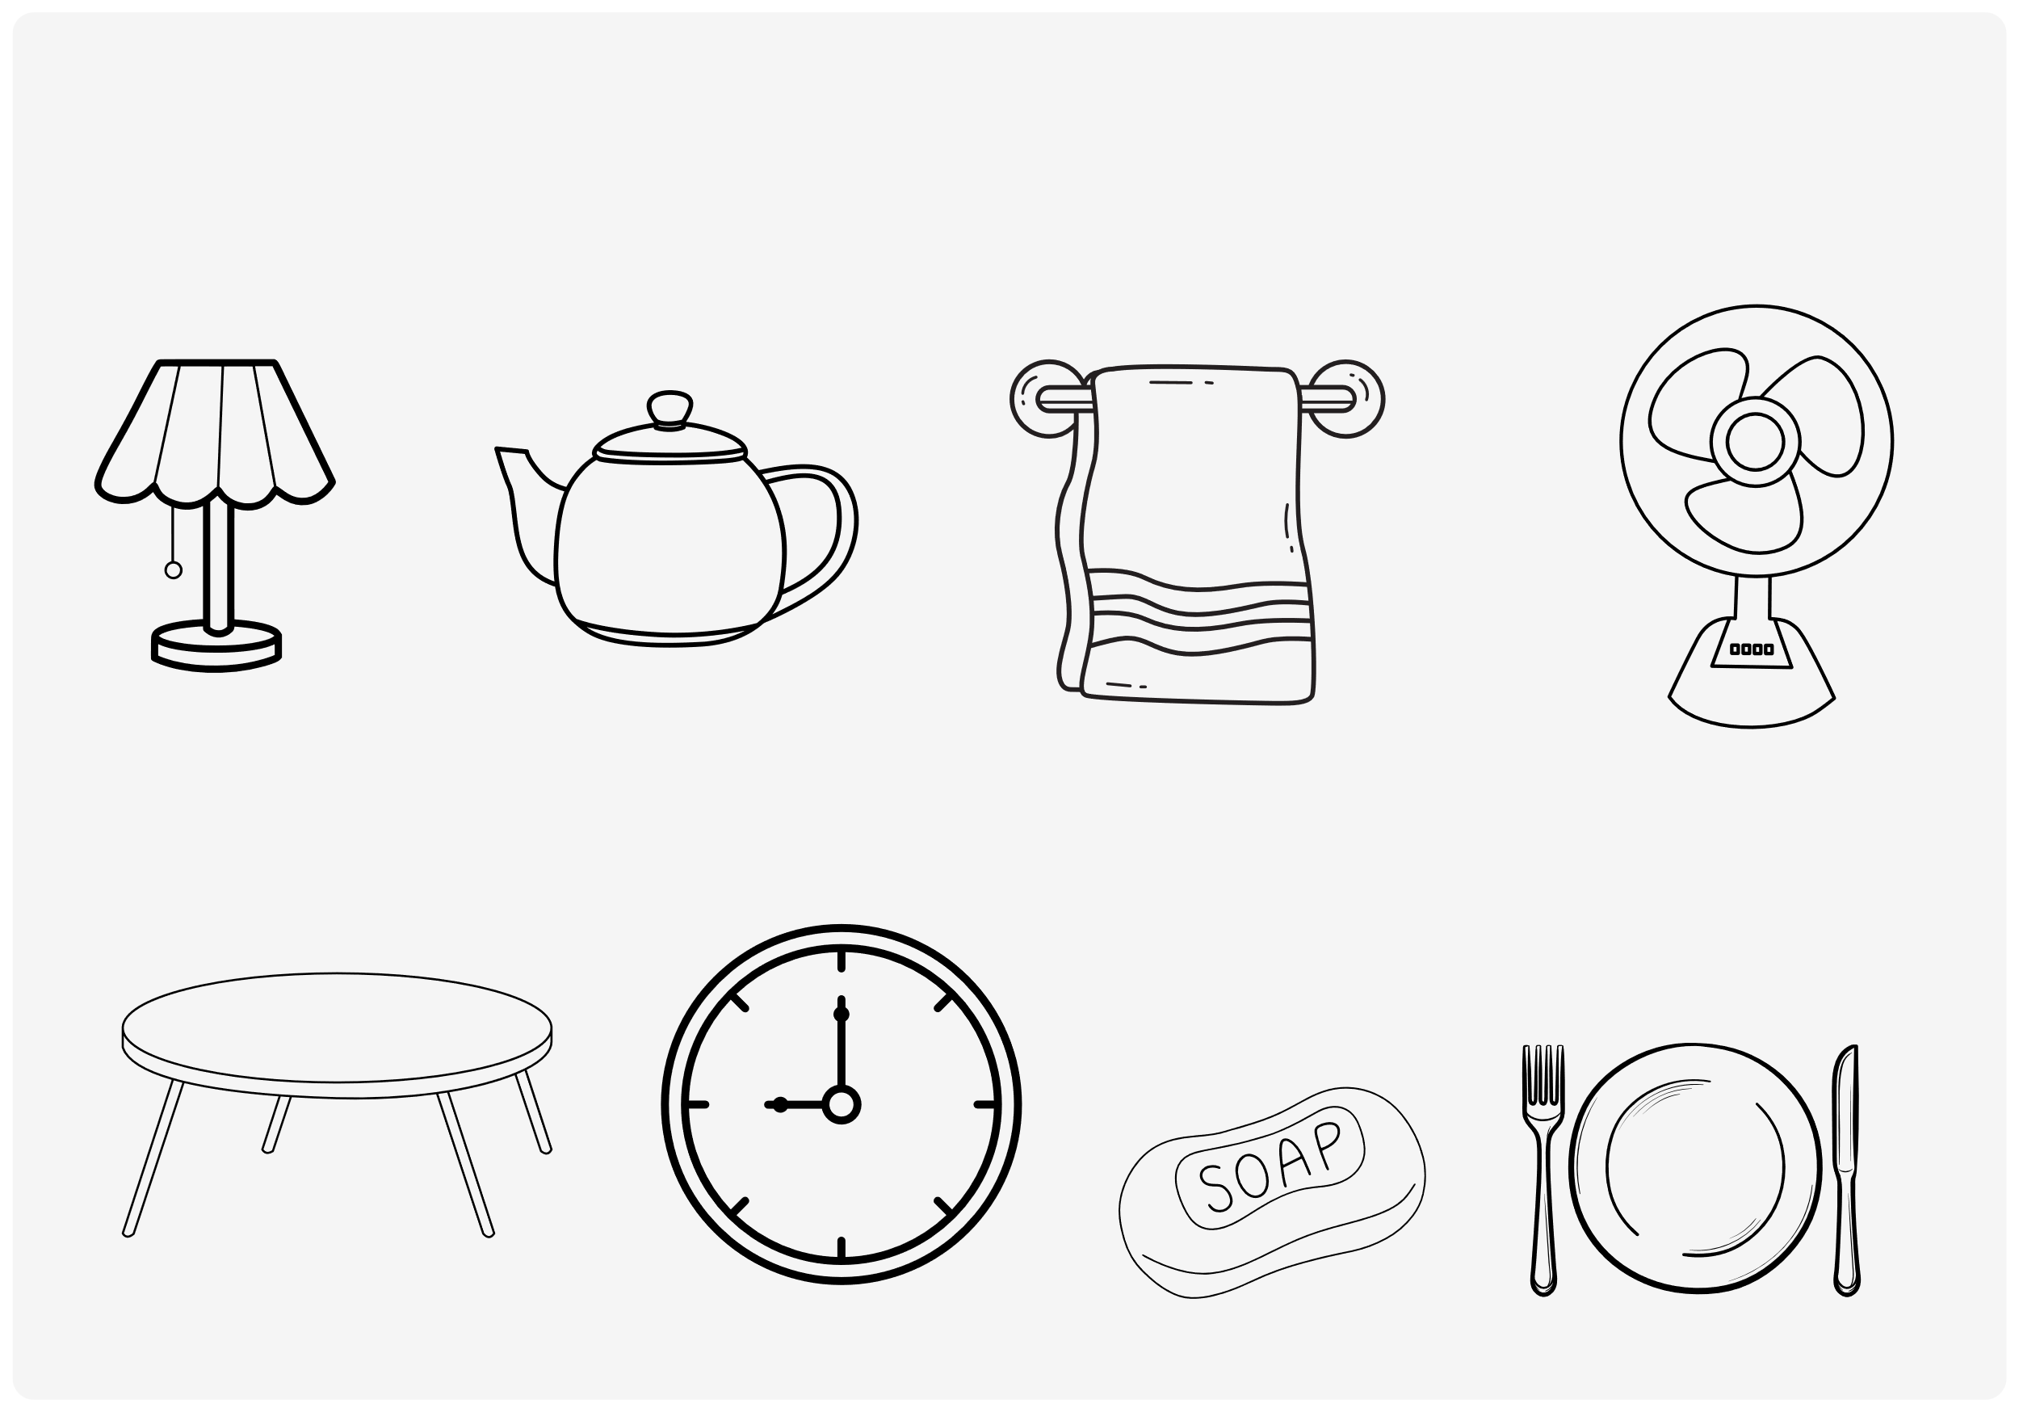
III. EXERCISES:
6. Color the things you have at your house:

Slide 17
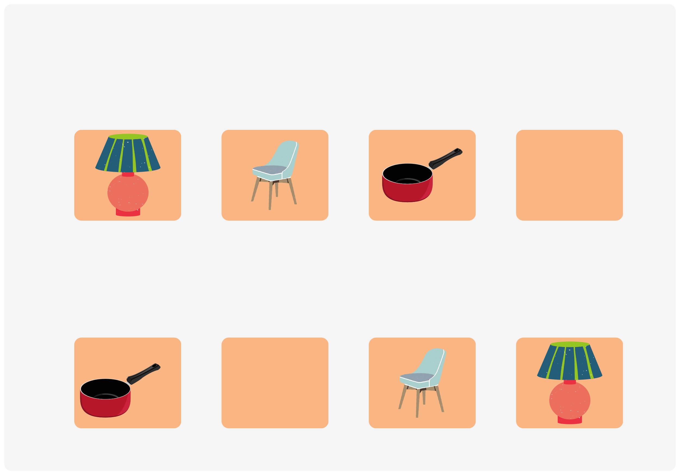

III. EXERCISES:
7. Find and line the similar picture:

Slide 18
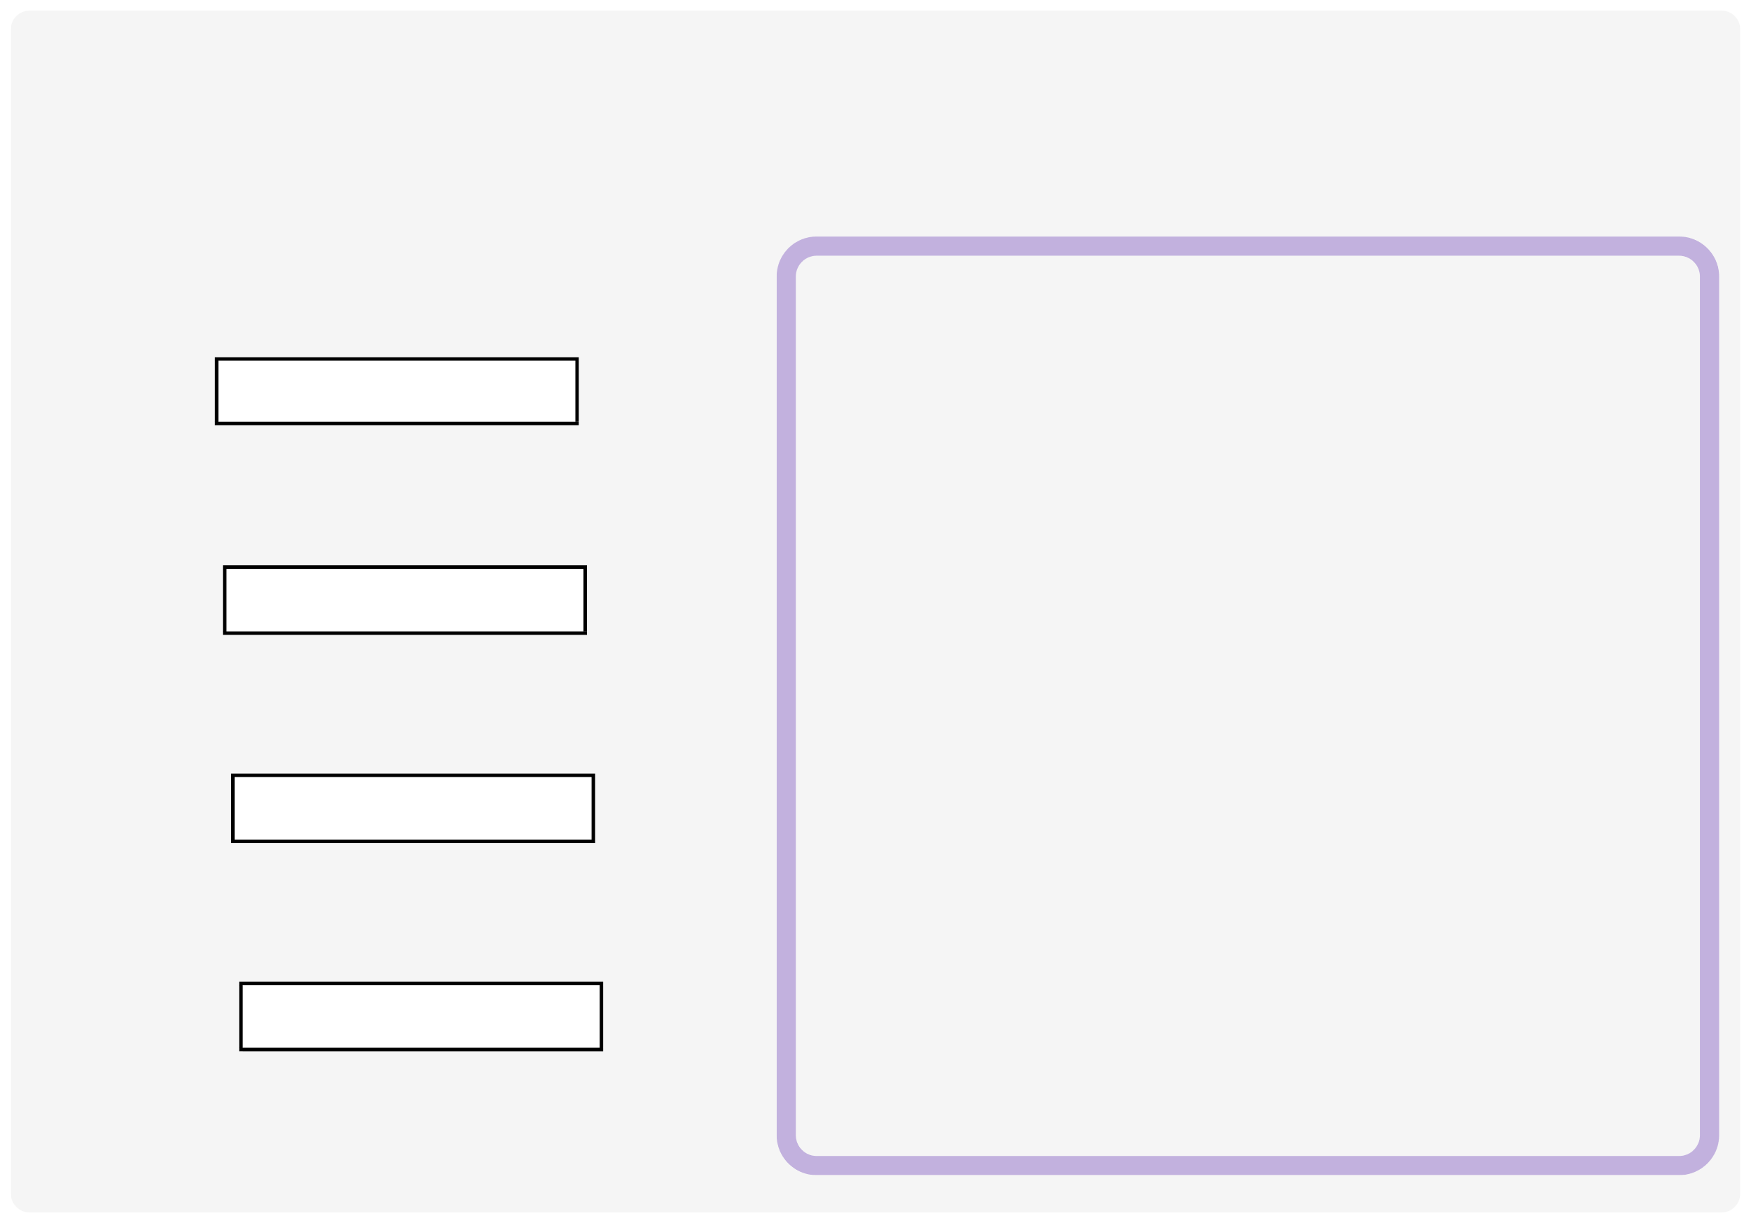
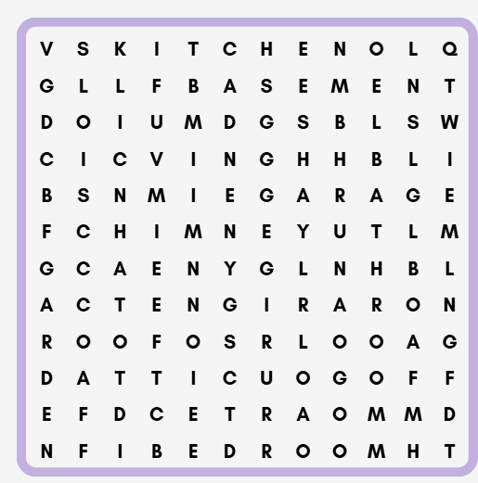
III. EXERCISES:
8. Find the words below:
Living room
Bedroom
Kitchen
Bathroom

