Slide 1
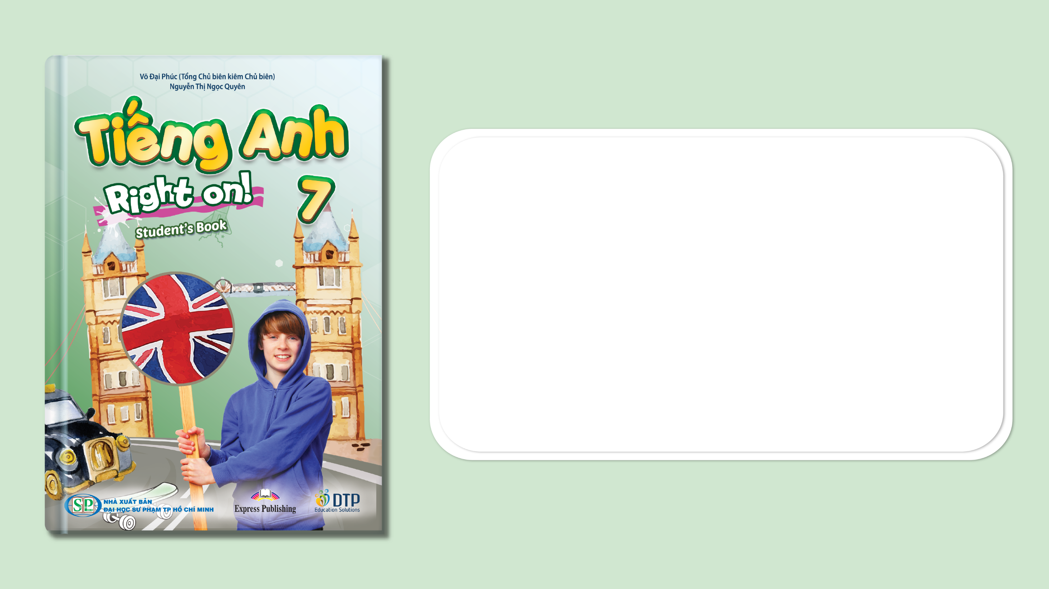
Unit 3: Arts and Music
Lesson 3e: Grammar
Page 53

Slide 2
Lesson Outline
Warm-up
Grammar
Consolidation
Wrap-up

Slide 3
Objectives
By the end of this lesson, students will be able to…
- use definite/indefinite articles - zero article correctly.

Slide 4

WARM-UP

Slide 5

Work in pairs.
MATCHING
Match the If- clause in column A and main- Clause in column B to make complete phrases.
A | B
1. If Mary goes to the film festival, | a. he will call us.
2. If we have free time, | b. she’ll see her favourite actor.
3. If Liam finishes early, | c. she won’t come.
4. If Jane doesn’t finish her homework. | d. we will go to the fashion show.
5. If Minh comes with us, | e. he will show us the way to the theatre.

Slide 6

It’s time to learn …

Slide 7

Presentation

Slide 8
Examples
1. I eat a banana. He eats an apple.
2. I booked a room in a hotel. The room costs £50 per night.
3. We live in Vietnam.

Slide 9
Lead in
1. What are a/an in sentence 1?
- Indefinite articles.
2. What do we use indefinite articles with?
- with singular countable nouns when we talk about something for the first time.
- before somebody’s job.

Slide 10
Lead in
3. How about the in sentence 2?
- Definite article.
4. What do we use definite articles with?
- singular or plural nouns when we talk about something again.
- with unique objects/things, unique landmarks.
- with some countries, hotels, museums, cinemas/theatres.

Slide 11
Lead in
5. Why aren’t there a/an or the before “Vietnam” in sentence 3?
We don’t use a/an and the:
- when we are making generalisations: I don’t like classical music.
- with streets, cities, most other countries, continents.

Slide 12
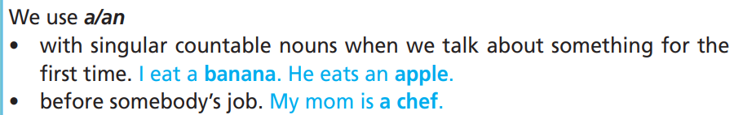
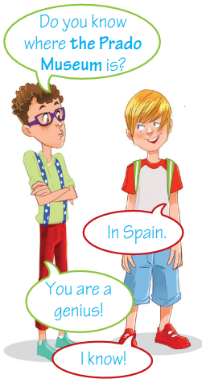
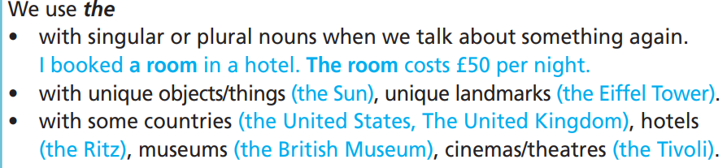
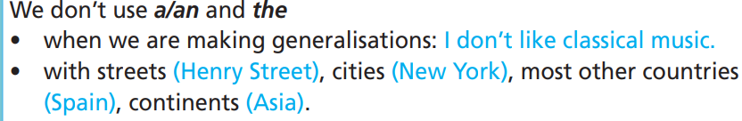

Slide 13

Practice

Slide 14
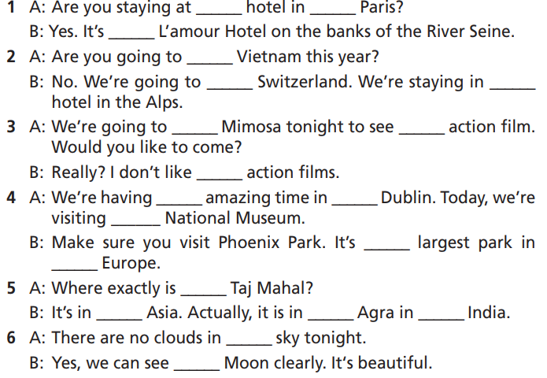
Practice
5 Fill in each gap with a/an, the or – (zero article).
How many sentences are there?
→ There are 6.
What are you going to do?
Fill in each gap with a/an, the
or – (zero article).

Slide 15
Practice
5 Fill in each gap with a/an, the or – (zero article).
-
1. A: Are you staying at ______ hotel in ____ Paris?
B: Yes. It’s ______ L’amour Hotel on the banks of the River Seine.
2. A: Are you going to ______ Vietnam this year?
B: No. We’re going to ______ Switzerland. We’re staying in ______ hotel in the Alps.
3. A: We’re going to ______ Mimosa tonight to see ______ action film. Would you like to come?
B: Really? I don’t like ______ action films.
a
the
-
-
a
the
an
-

Slide 16
Practice
5 Fill in each gap with a/an, the or – (zero article).
-
4. A: We’re having ______ amazing time in ______ Dublin. Today, we’re visiting ______ National Museum.
B: Make sure you visit Phoenix Park. It’s ______ largest park in ______ Europe.
5. A. Where exactly is ______ Taj Mahal?
B. It’s in ______ Asia. Actually, it is in ______ Agra in ______ India.
6. A. There are no clouds in ______ sky tonight.
B. Yes, we can see ______ Moon clearly. It’s beautiful.
an
the
-
the
-
-
-
-
the
the

Slide 17
Practice
Extra Practice
WB, page 30
Choose the correct option.
1. This is –/the museum we visited yesterday.
2. I’d love to visit –/the New York.
3. Did you buy your parents a/the souvenir?
4. They spent three weeks in Brazil, a/the country in South America.
5. He stayed in a/– hotel when he was in Brussels.

Slide 18
Practice
Extra Practice
WB, page 30
Choose the correct option.
6. There’s –/an Italian restaurant in the Old Town.
7. We saw some interesting things in –/the British Museum.
8. I’ll meet you outside –/the cinema at 10:00.
9. She moved to –/the UK last month.
10. The/– Eiffel Tower is in Paris.

Slide 19
Extra Practice
Grammar Bank, page 71
Fill in each gap with a/an, the or – (zero article).
1. They went skiing in _____ USA.
2. We’re staying at _____ Star Hotel.
3. My aunt bought _____ nice T-shirt in the department store last week.
4. They went to _____ Russia.
5. Ann wants to buy _____ hat.
the
the
a
–
a

Slide 20
Extra Practice
Grammar Bank, page 71
Fill in each gap with a/an, the or – (zero article).
6. Take _____ umbrella with you in case it rains.
7. We visited _____ Louvre Museum last Monday.
8. We spent our holidays in _____Hanoi.
9. He moved to _____ Vietnam last May.
10. Let’s eat _____ ice cream at this café.
an
the
–
–
an

Slide 21

Production

Slide 22

6 Play in two teams. Make sentences using the names below. Each correct sentence gets one point. The team with the most points is the winner.
• Sun • Vietnam • Parthenon, Athens • Europe • Hanoi
• Eiffel Tower • Ho Chi Minh City • Central Park
• Hạ Long Bay • Vietnam Tuồng Theatre
The Earth goes round the Sun.

Slide 23
Suggested Answer
S1: Vietnam is a southeast Asian country.
S2: The Parthenon is an ancient temple in Athens, Greece.
S3: Europe is a continent next to Asia.
S4: Hanoi is the capital city of Vietnam.
S5: The Eiffel Tower is a famous landmark in Paris, France.
S6: Ho Chi Minh City is the most crowded city in Vietnam.
S7: Central Park is a famous park in New York.
S8: Hạ Long Bay is a famous tourist attraction in Vietnam.
S9: The Vietnam Tuồng Theatre is in Hanoi.

Slide 24

CONSOLIDATION

Slide 25

Work in pairs.
Use definite/indefinite articles – zero article to write about a visit to a place of interest.
You can begin with:
In my last summer vacation / holiday, I went to…

Slide 26

WRAP-UP

Slide 27
Today’s lesson
Grammar: Practise and use definite/indefinite articles – zero article correctly.

Slide 28
Homework
Practise the grammar point and make sentences using them.
Do the exercises in TA 7 Right on WB (page 71).
Prepare the next lesson (page 54 SB).
Do the exercise in TA 7 Right on Notebook (pages 24).

Slide 29
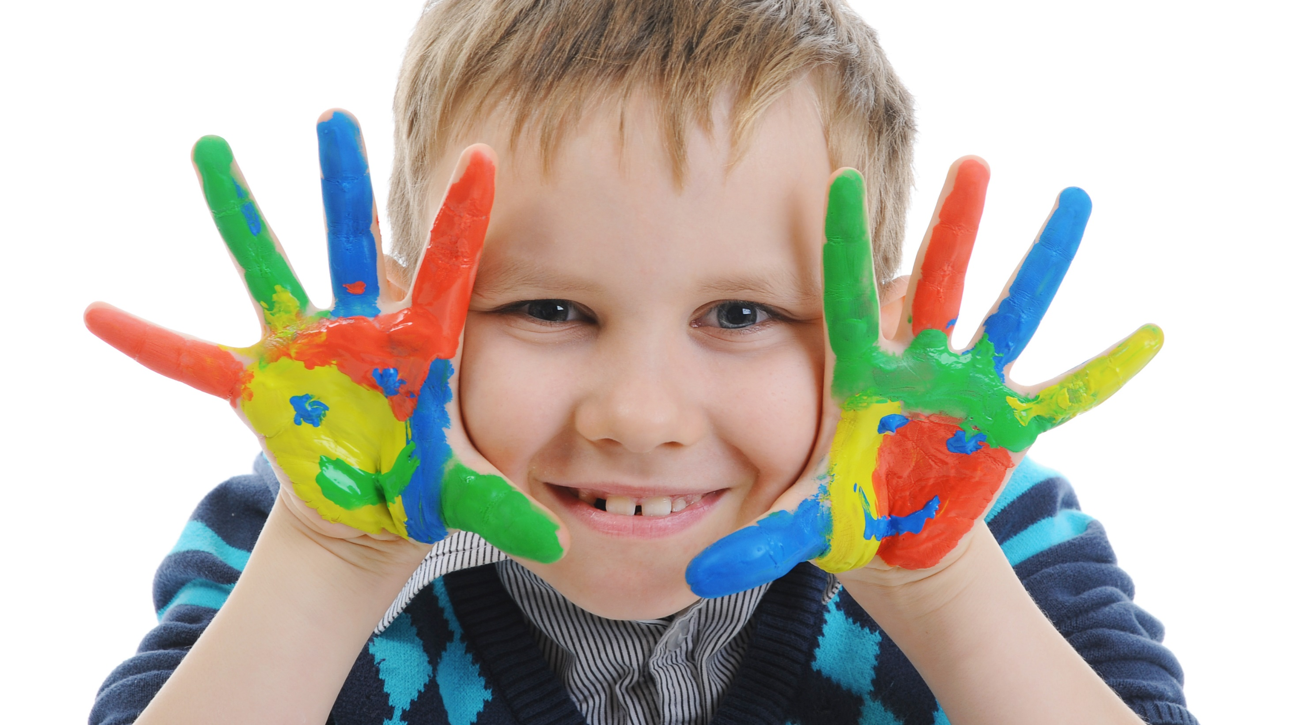
Enjoy your day!

