Slide 1


Slide 2



Unit
11
TRAVELLING IN THE FUTURE
LESSON 7: LOOKING BACK & PROJECT
Vocabulary review
Grammar review
Project: Our future means of transport
Unit

Slide 3

OBJECTIVES
By the end of the lesson, students will be able to:
review the vocabulary and grammar of Unit 11
apply what they have learnt (vocabulary and grammar) into practice through a project

Slide 4
LESSON 7: LOOKING BACK & PROJECT
WARM-UP
Mindmap
VOCABULARY REVIEW
Task 1: Write three adjectives or phrases to describe each picture.
Task 2: Complete the sentences with the words and phrases from the box.
Task 3: Find one mistake in each sentence and correct it.
Task 4: Read the passage and put the verbs in brackets in the correct future form.
GRAMMAR REVIEW
OUR FUTURE MEANS OF TRANSPORT
Task 5: Discussion
Task 6: Posters exhibition
PROJECT
CONSOLIDATION
Wrap-up
Home work

Slide 5
LESSON 7: LOOKING BACK & PROJECT
WARM-UP
Mindmap
MUSIC AND ARTS
PRONUNCIATION
VOCABULARY
GRAMMAR
Aims of the stage:
To help students revise the vocabulary items they have learnt in the unit.To enhance students’ skills of cooperating with team mates.
Notes:
Wordwall link to spin the wheel in real time: https://wordwall.net/resource/27022823

Slide 6

LESSON 7: LOOKING BACK & PROJECT
WARM-UP
Mindmap
VOCABULARY REVIEW
Task 1: Write three adjectives or phrases to describe each picture.
Task 2: Complete the sentences with the words and phrases from the box.

Slide 7
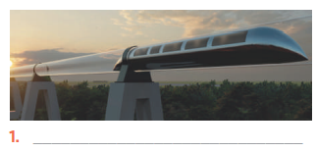
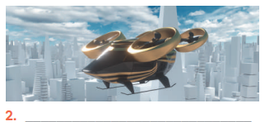
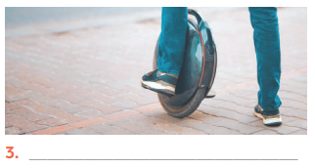
VOCABULARY REVIEW
1
Write three adjectives or phrases to describe each picture.
Suggested answers:
1. fast, green, carrying many passengers
2. fast, convenient, autopilot function
3. electric, green, convenient

Slide 8
VOCABULARY REVIEW
2
Complete the sentences with the words and phrases from the box.
eco-friendly runs on driverless bamboo-copter bullet trains
eco- friendly
1. A teleporter is _____________, so it does not cause pollution.
2. A solowheel ____________ electricity, so it is safe for the environment.
3. A convenient way to go to school is by __________________. Just put it on and fly away.
4. You can sleep when you travel by _____________ car.
5. _____________ are faster and greener than normal trains.
runs on
bamboo - copter
driverless
Bullet trains

Slide 9
LESSON 7: LOOKING BACK & PROJECT
WARM-UP
Mindmap
VOCABULARY REVIEW
Task 1: Write three adjectives or phrases to describe each picture.
Task 2: Complete the sentences with the words and phrases from the box.
Task 3: Find one mistake in each sentence and correct it.
Task 4: Read the passage and put the verbs in brackets in the correct future form.
GRAMMAR REVIEW

Slide 10

GRAMMAR REVIEW
3
Find one mistake in each sentence and correct it.
Aim of the task:
To help Ss revise the possessive pronouns.

Slide 11
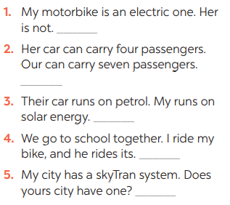
GRAMMAR REVIEW
3
Find one mistake in each sentence and correct it.
Her → Hers
Our → Ours
My → Mine
its → his
yours → your

Slide 12
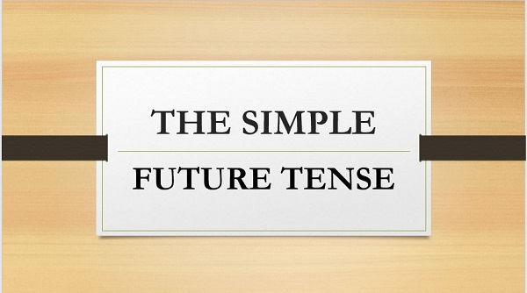
GRAMMAR REVIEW
4
Read the passage and put the verbs in brackets in the correct future form.
Aim of the task:
To help Ss revise the future simple.

Slide 13
GRAMMAR REVIEW
4
Read the passage and put the verbs in brackets in the correct future form.
In the future, we will travel much further than we do now. We will also visit new places for our holidays.
Some scientists think we (1. travel) ___________ to new planets. We (2. go) ____________ there by spaceship, but we (3. need) _____________new special means of transport. These new means of transport (4. carry) ______________ one or two passengers, but many. ______________ our dream (5. come) _____________true soon? Let’s wait and see.
will travel
won’t go
will need
won’t carry
Will
come

Slide 14
LESSON 7: LOOKING BACK & PROJECT
WARM-UP
Mindmap
VOCABULARY REVIEW
Task 1: Write three adjectives or phrases to describe each picture.
Task 2: Complete the sentences with the words and phrases from the box.
Task 3: Find one mistake in each sentence and correct it.
Task 4: Read the passage and put the verbs in brackets in the correct future form.
GRAMMAR REVIEW
OUR FUTURE MEANS OF TRANSPORT
Task 5: Discussion
Task 6: Posters exhibition
PROJECT

Slide 15
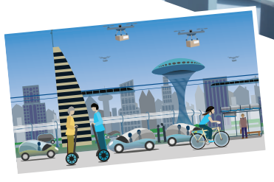
PROJECT
5
Work in groups.
Imagine a future means of transport you would like to see in the future. Use these
questions to think about it:
– What is the name of the means of
transport?
– What road system does it run on?
– What kind of energy does it use?
– How many passengers can it carry?
– What are some of its advantages?
Draw your means of transport.
5

Slide 16
PROJECT
5
Work in groups.
Posters exhibition
6

Slide 17
LESSON 7: LOOKING BACK & PROJECT
WARM-UP
Mindmap
VOCABULARY REVIEW
Task 1: Write three adjectives or phrases to describe each picture.
Task 2: Complete the sentences with the words and phrases from the box.
Task 3: Find one mistake in each sentence and correct it.
Task 4: Read the passage and put the verbs in brackets in the correct future form.
GRAMMAR REVIEW
OUR FUTURE MEANS OF TRANSPORT
Task 5: Discussion
Task 6: Posters exhibition
PROJECT
CONSOLIDATION
Wrap-up
Home work

Slide 18
CONSOLIDATION
1
WRAP-UP
Vocabulary review
Grammar review
Project: Our future means of transport

Slide 19
CONSOLIDATION
2
HOMEWORK
Prepare for the next lesson: Unit 12 – Getting started

Slide 20


